Slide 1
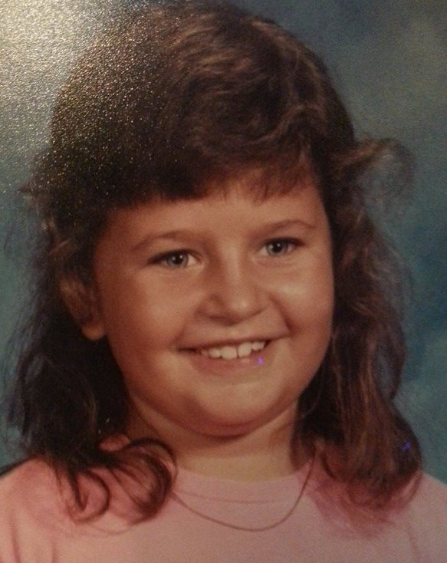
College & Career Readiness
Nyla Mowery
Pronouns: she/her
School Counselor, Studebaker Elementary
nyla.mowery@dmschools.org

Slide 2
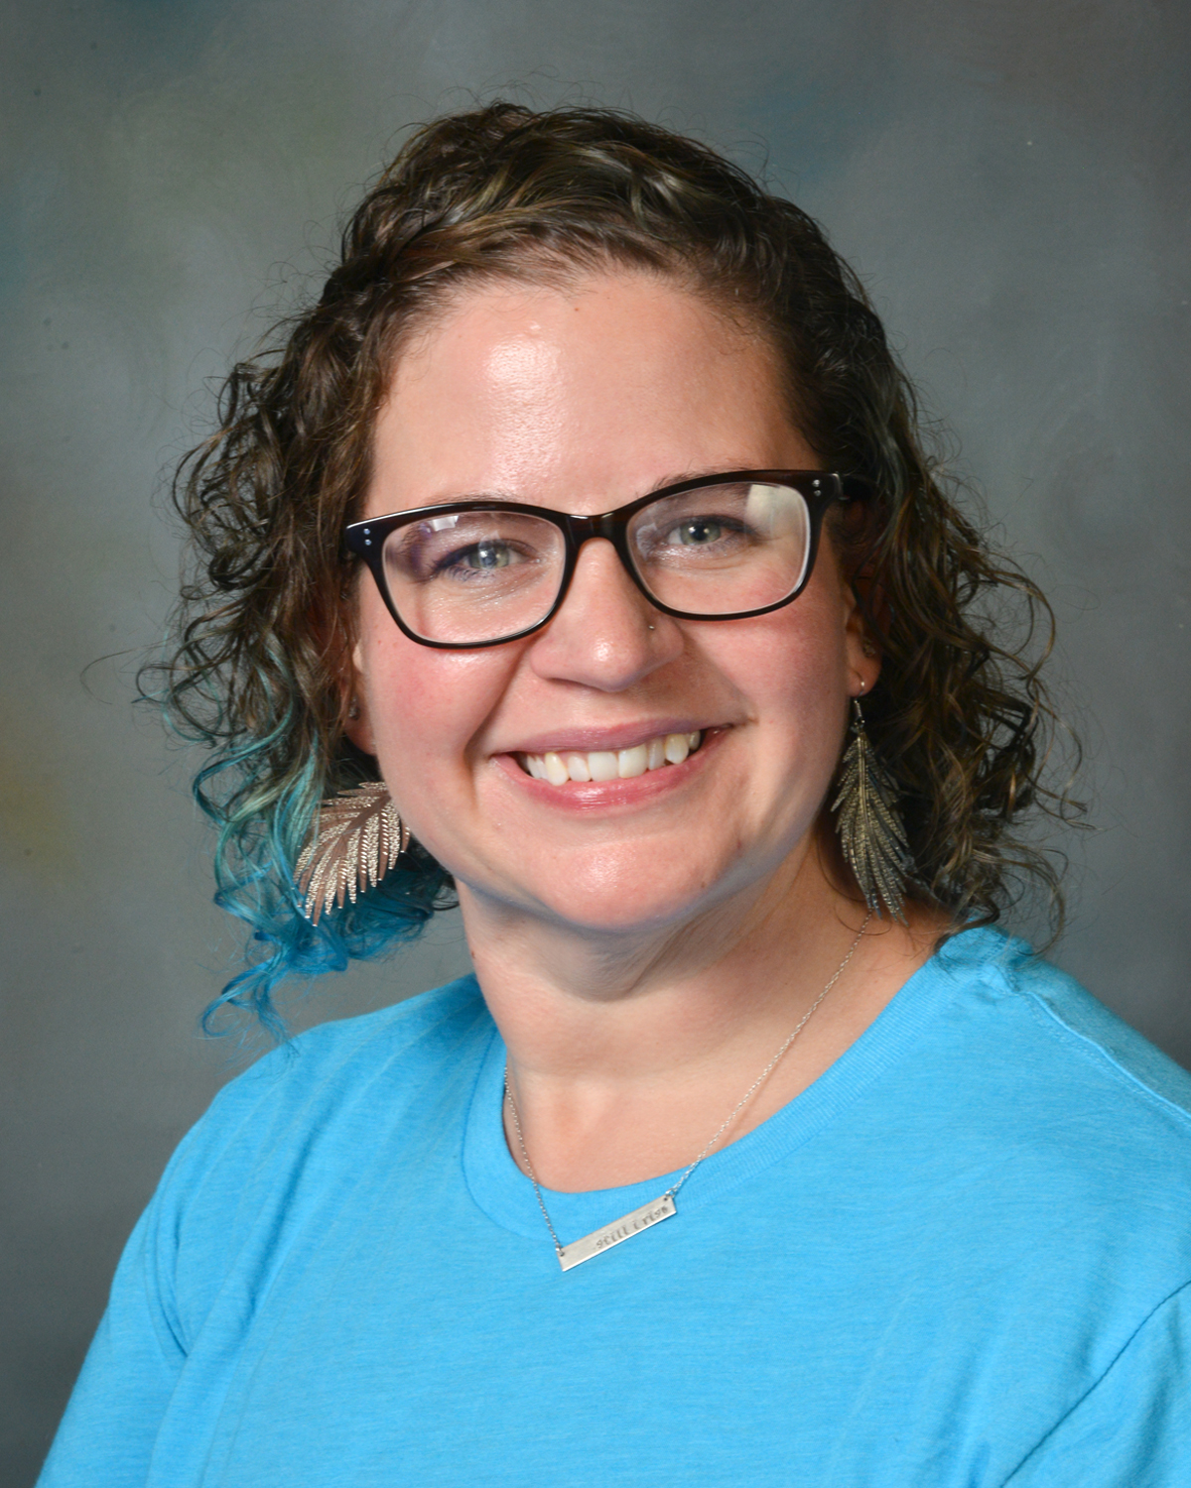
About Me
Eight years teaching experience prior to becoming a school counselor
Preschool, 4th Grade, 5th Grade
Graduated from Drake’s School Counseling program December 2013
Starting 10th year as a school counselor for Des Moines Public Schools
Active member for both the Iowa School Counseling Association (ISCA) and the American School Counseling Association (ASCA)
Vice-President of Elementary Schools for the ISCA board
Currently serving 3rd-5th grade students at Studebaker Elementary
Caseload is approximately 275:1

Slide 3
State of Des Moines Public Schools
No district-wide curriculum for elementary school counselors
Bank of resources for lessons
Mostly counselor created lessons
Outdated materials
Current plans to rework resource guides
Two current elementary based CCR programs
ISU 4U Promise– King and Moulton
By Degrees (formerly I Have A Dream Foundation) – Findley
New Postsecondary Success Standards introduced 2021-2022 school year

Slide 5
Previous Years at Studebaker
No lessons on CCR were taught for two years
COVID-19 shut down in 2020
Schedule limitations in 2021
Priority on SEL topics
Lessons on growth mindset and other “soft skills” needed for success later in life
Previous focus on identifying interests, skills and abilities and exploring career fields

Slide 6
Professional Development
Previous ISCA Conferences – David Ford’s Jamboard from 2018
Recognized the gap in CCR lessons and resources
AEA course “College & Career Readiness for K-5 School Counselors & Educators”
Focused on data informed decision making
Offered many resources for CCR lessons
Collaboration with co-counselor
Self-teaching

Slide 7
Take Aways from AEA Class
Elementary School Counselor’s Guide: Eight Components of College & Career Counseling
Iowa Department of Education - Education Statistics
Iowa’s FAFSA Filing Rates
Iowa Districts' FAFSA Filing Rates - Demographics
Iowa College Aid Guidebook
School Counselors Supporting the Career and College Preparedness of Students from Poverty: Using the CARE Model
Resource List

Slide 8
Plans for 2022
Create “Educational Pathways” posters for each staff member
Four week unit for CCR using lessons from Iowa College Aid Guidebook
Organize a Career Day
College Decision Day letters from fifth grade to seniors
Purposeful connection on SEL skills to CCR
College Going Map

Slide 9
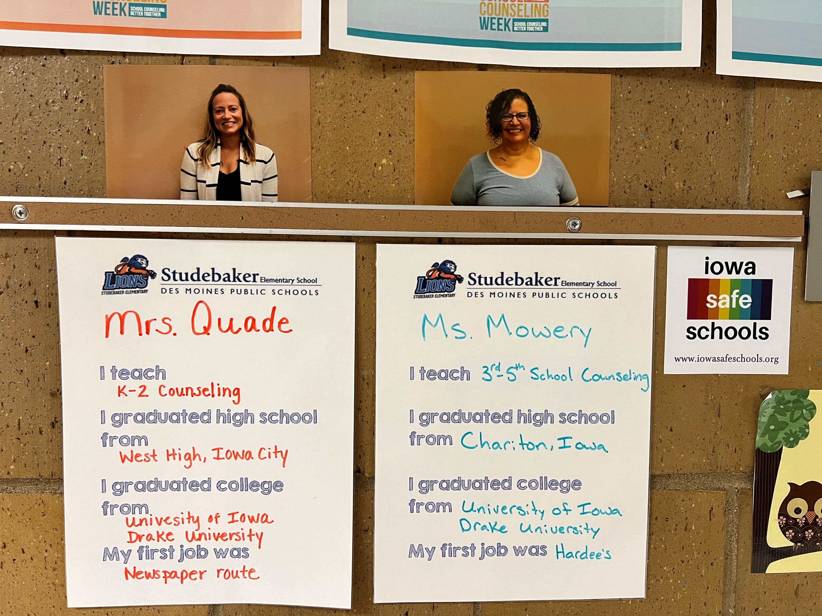

Slide 10
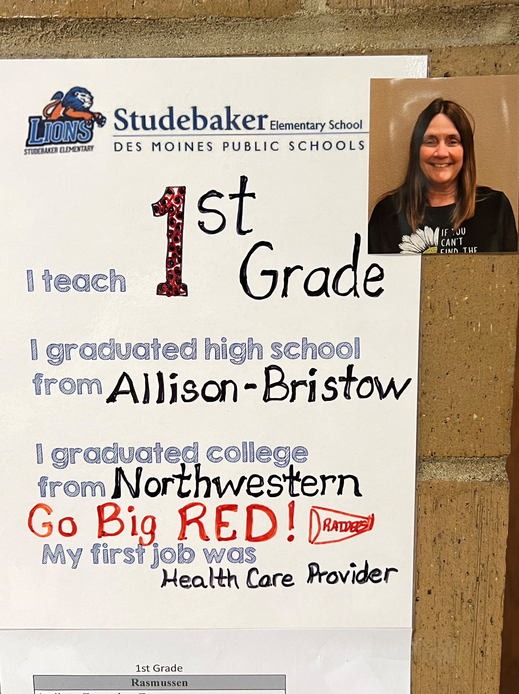
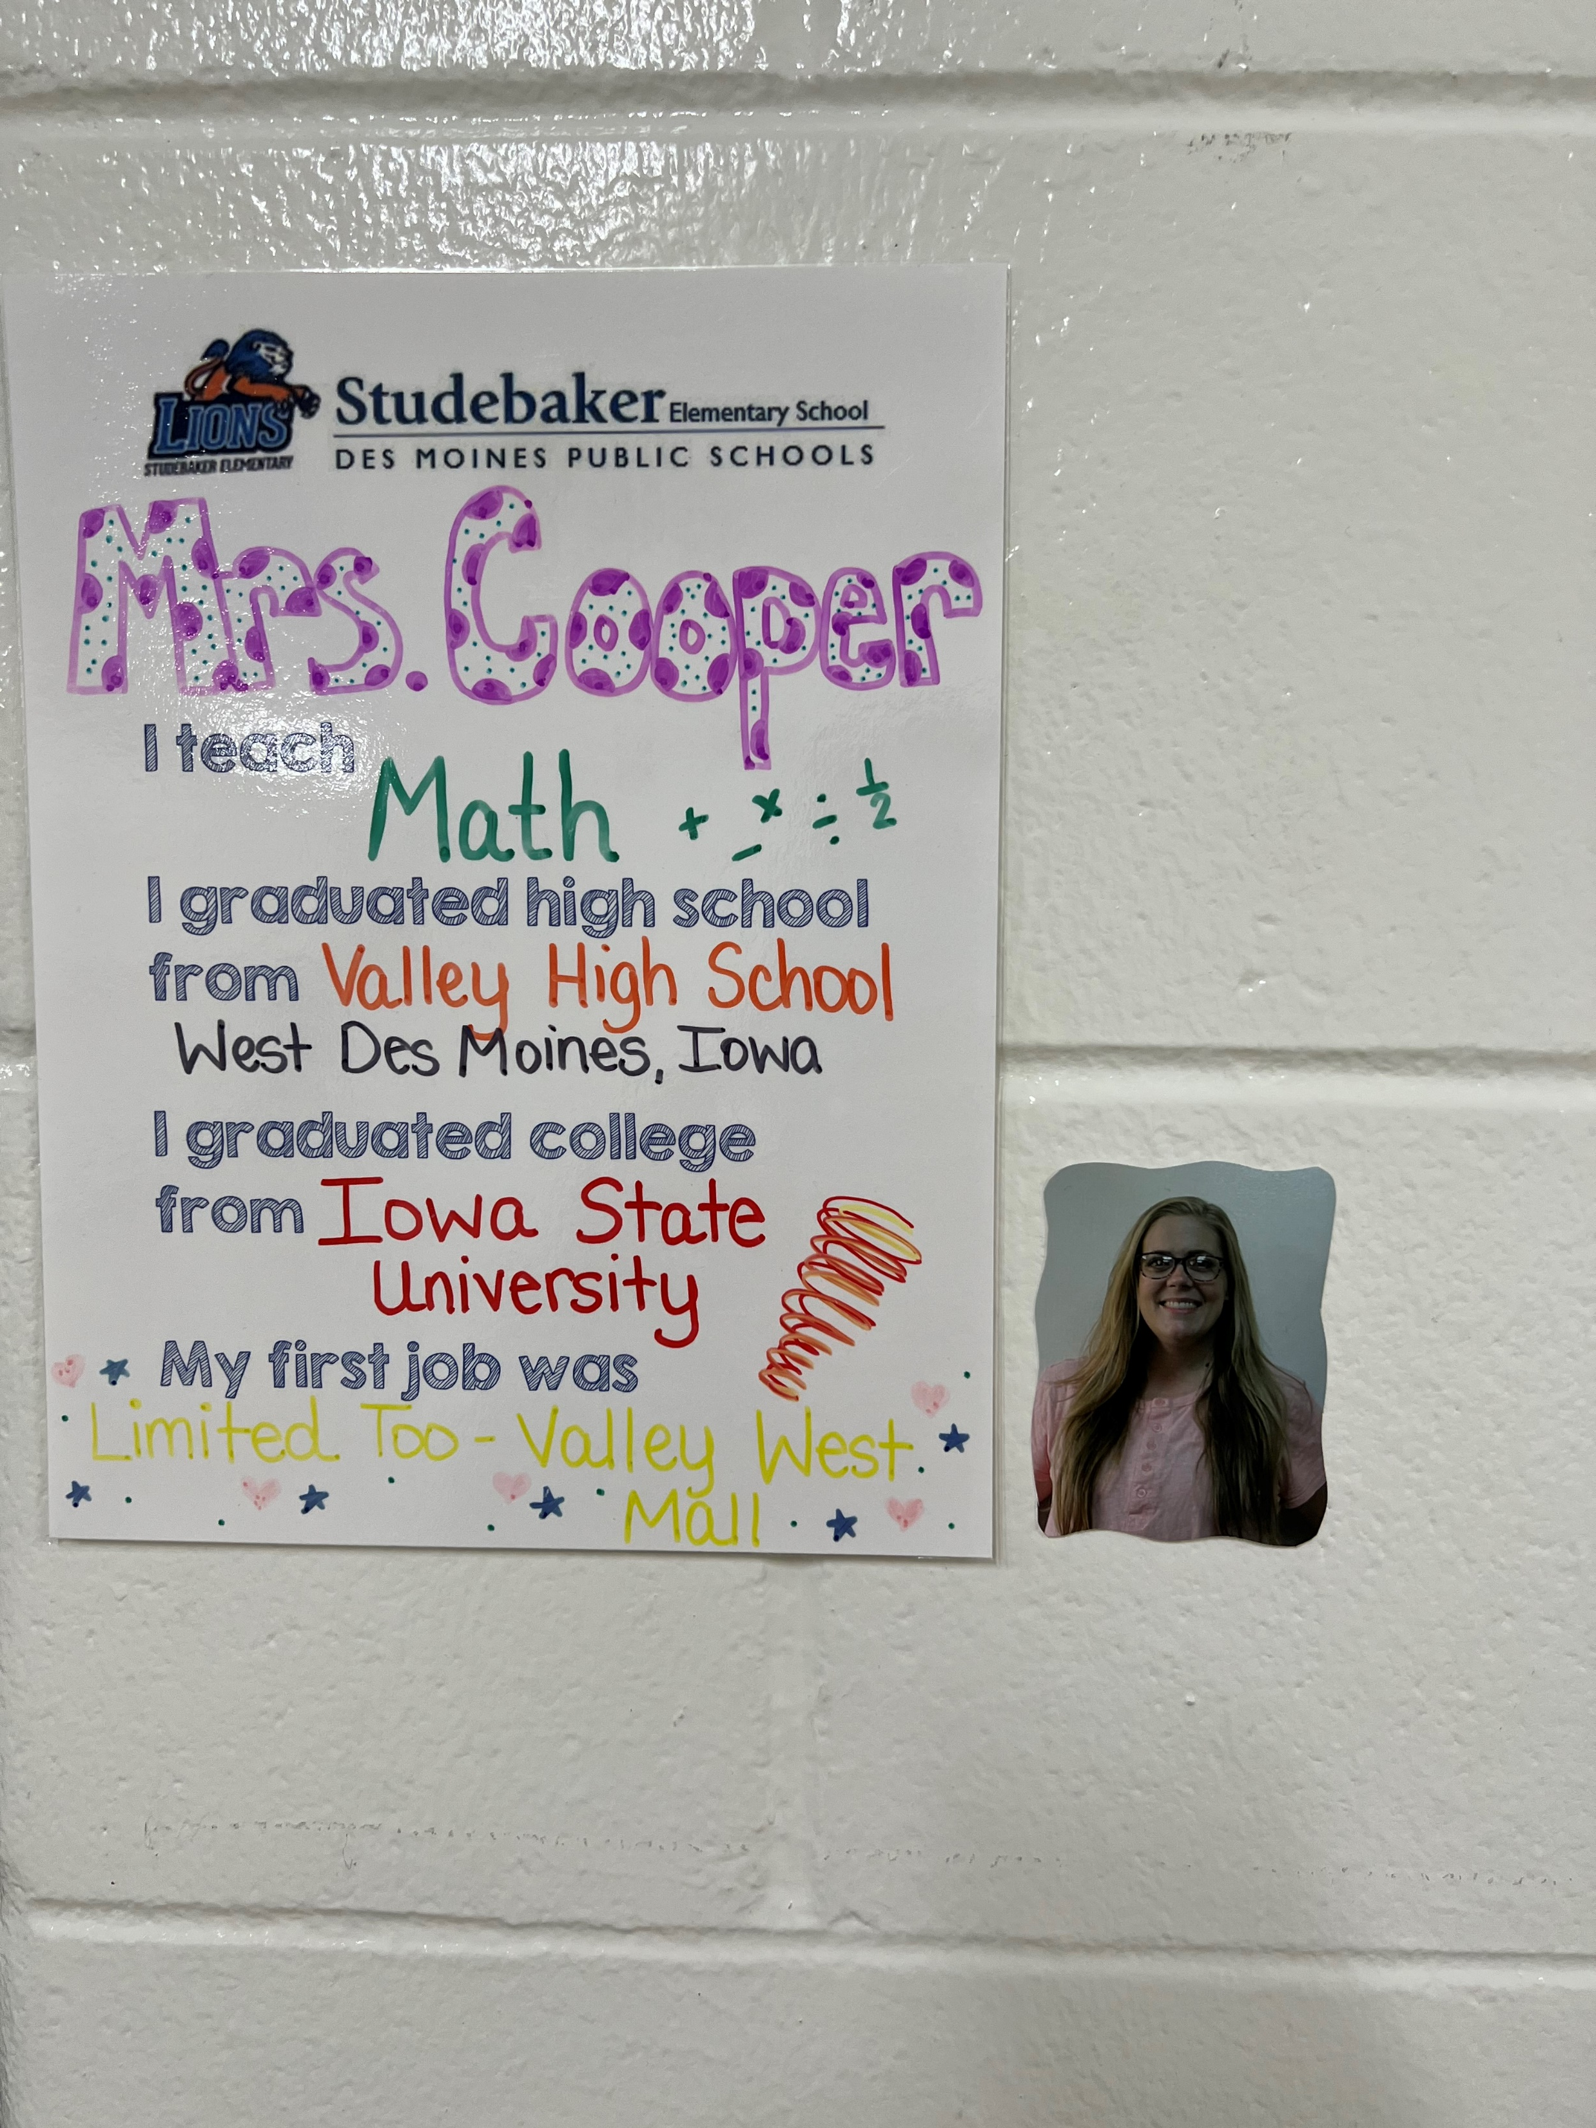

Slide 11
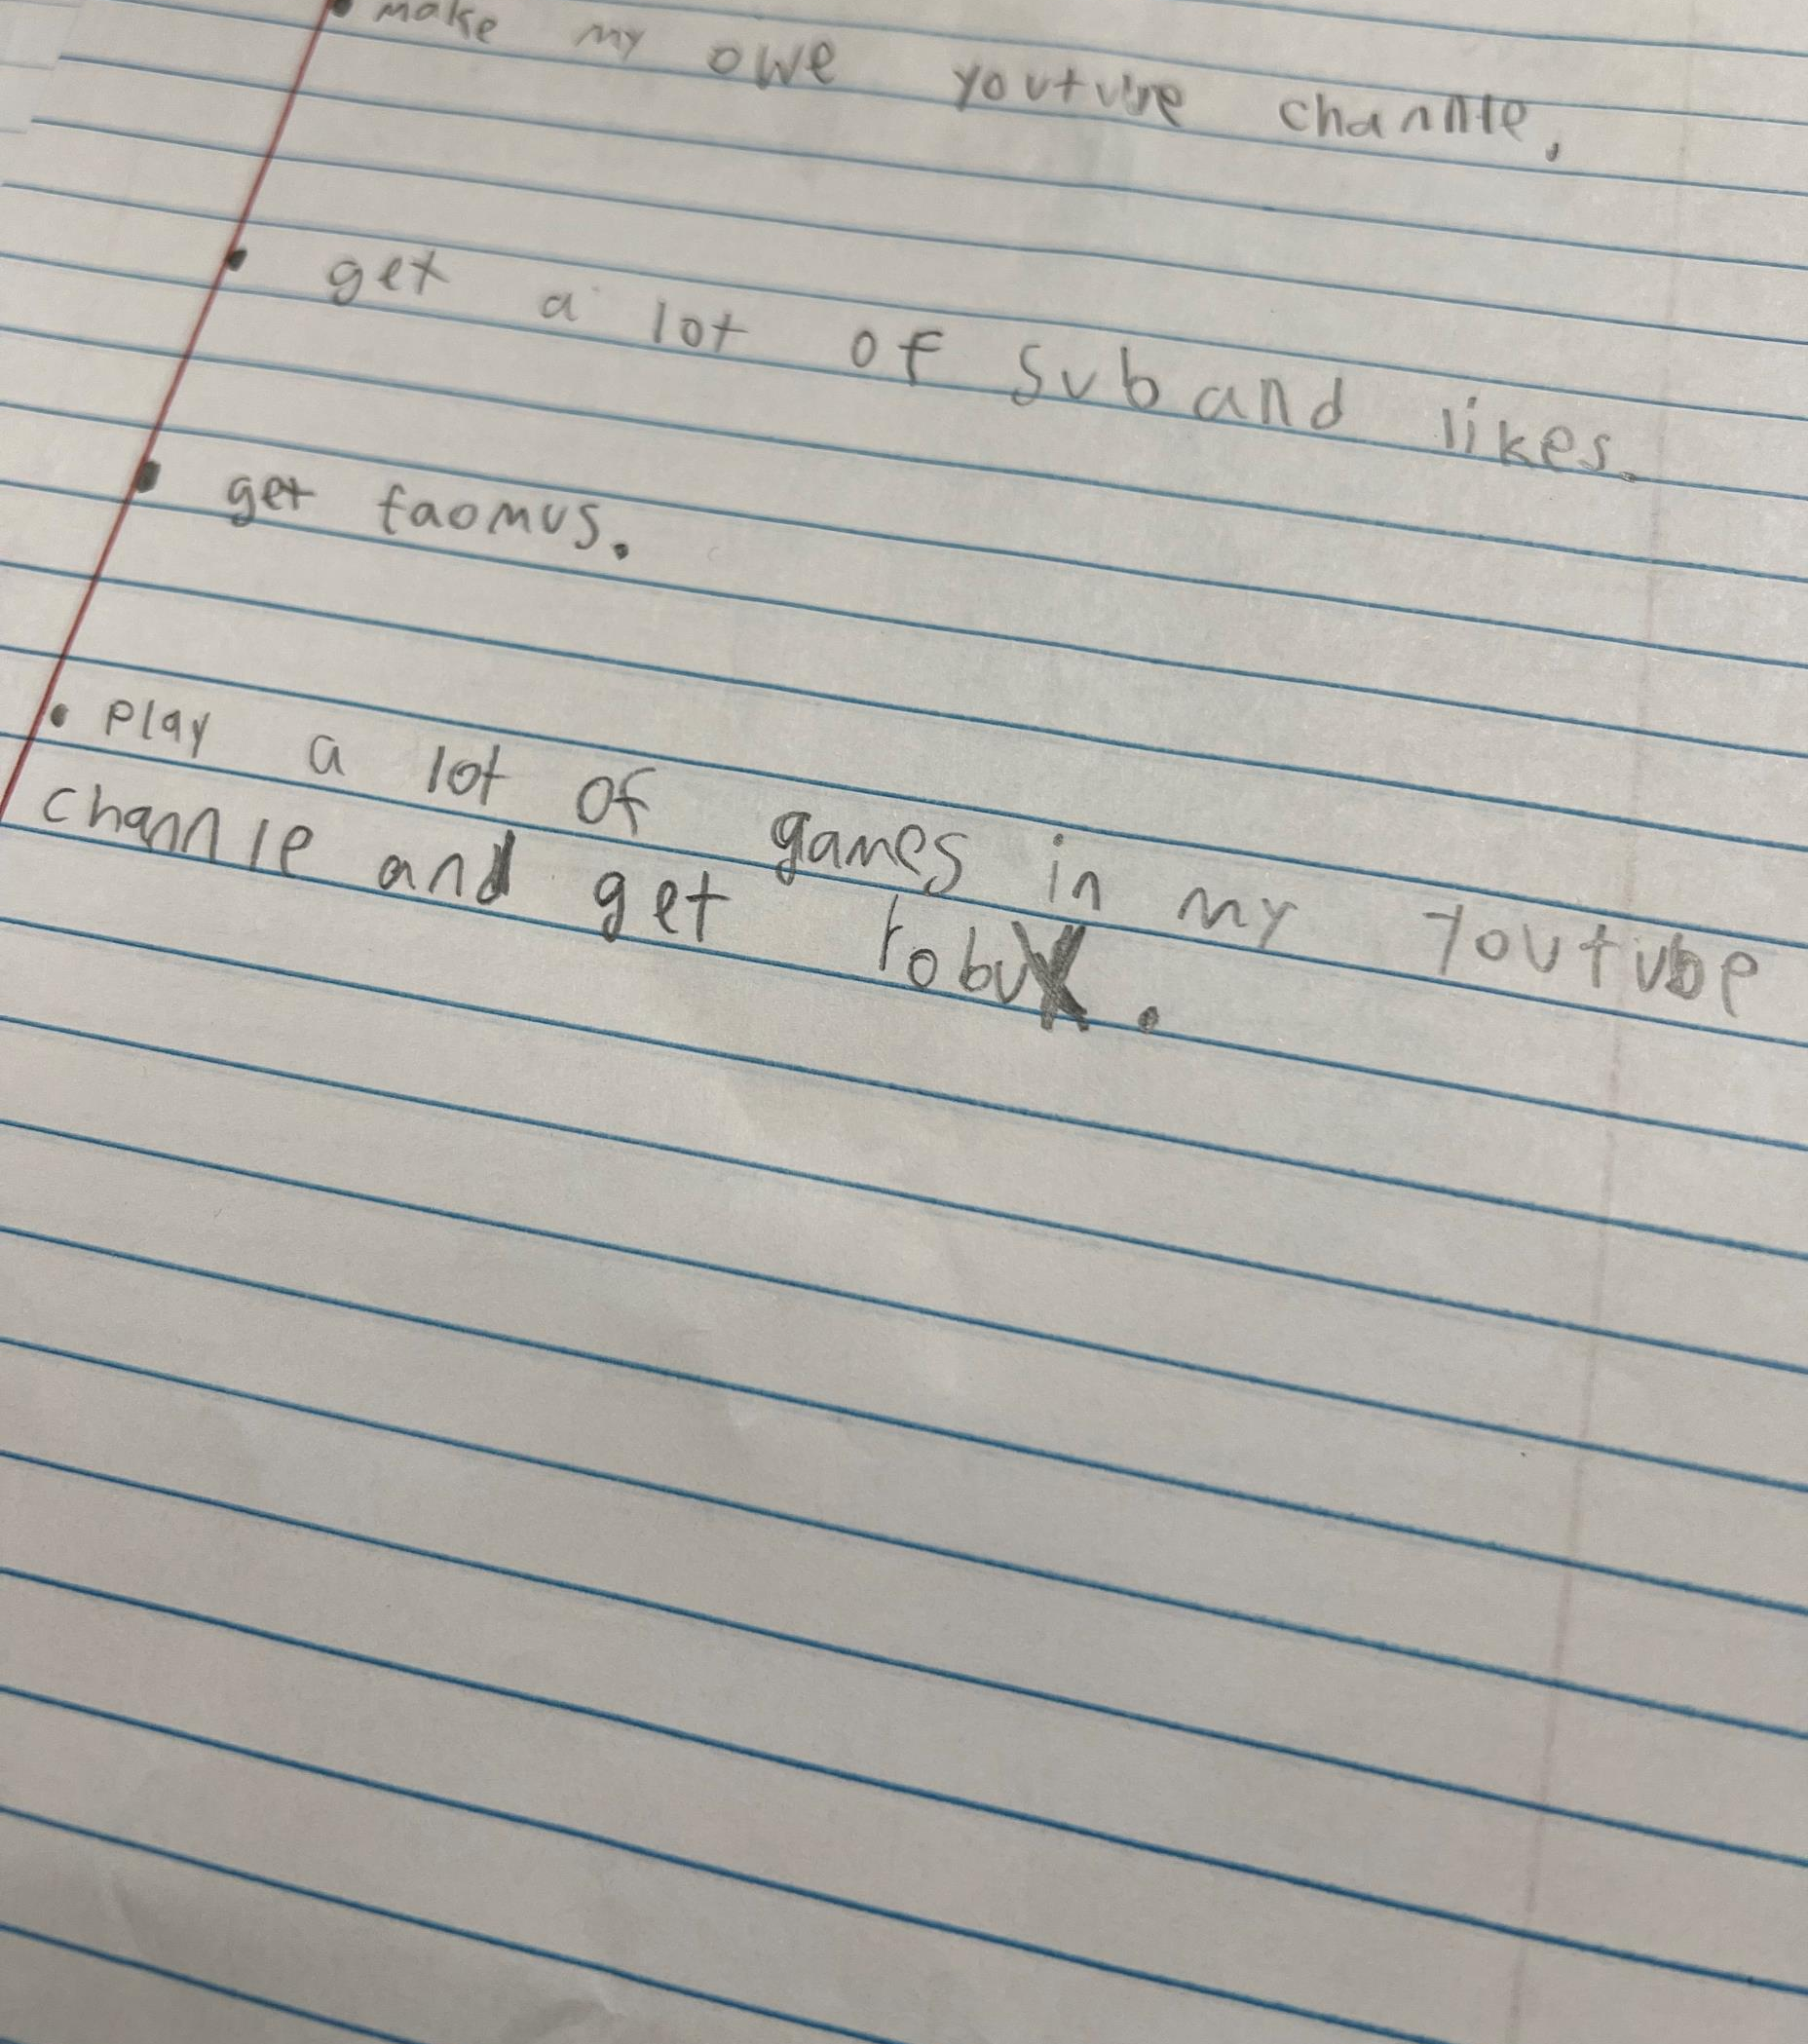
4th Grade Reflections
Read the book “Rosie Revere, Engineer”
Wrote their CCR plans

Slide 12
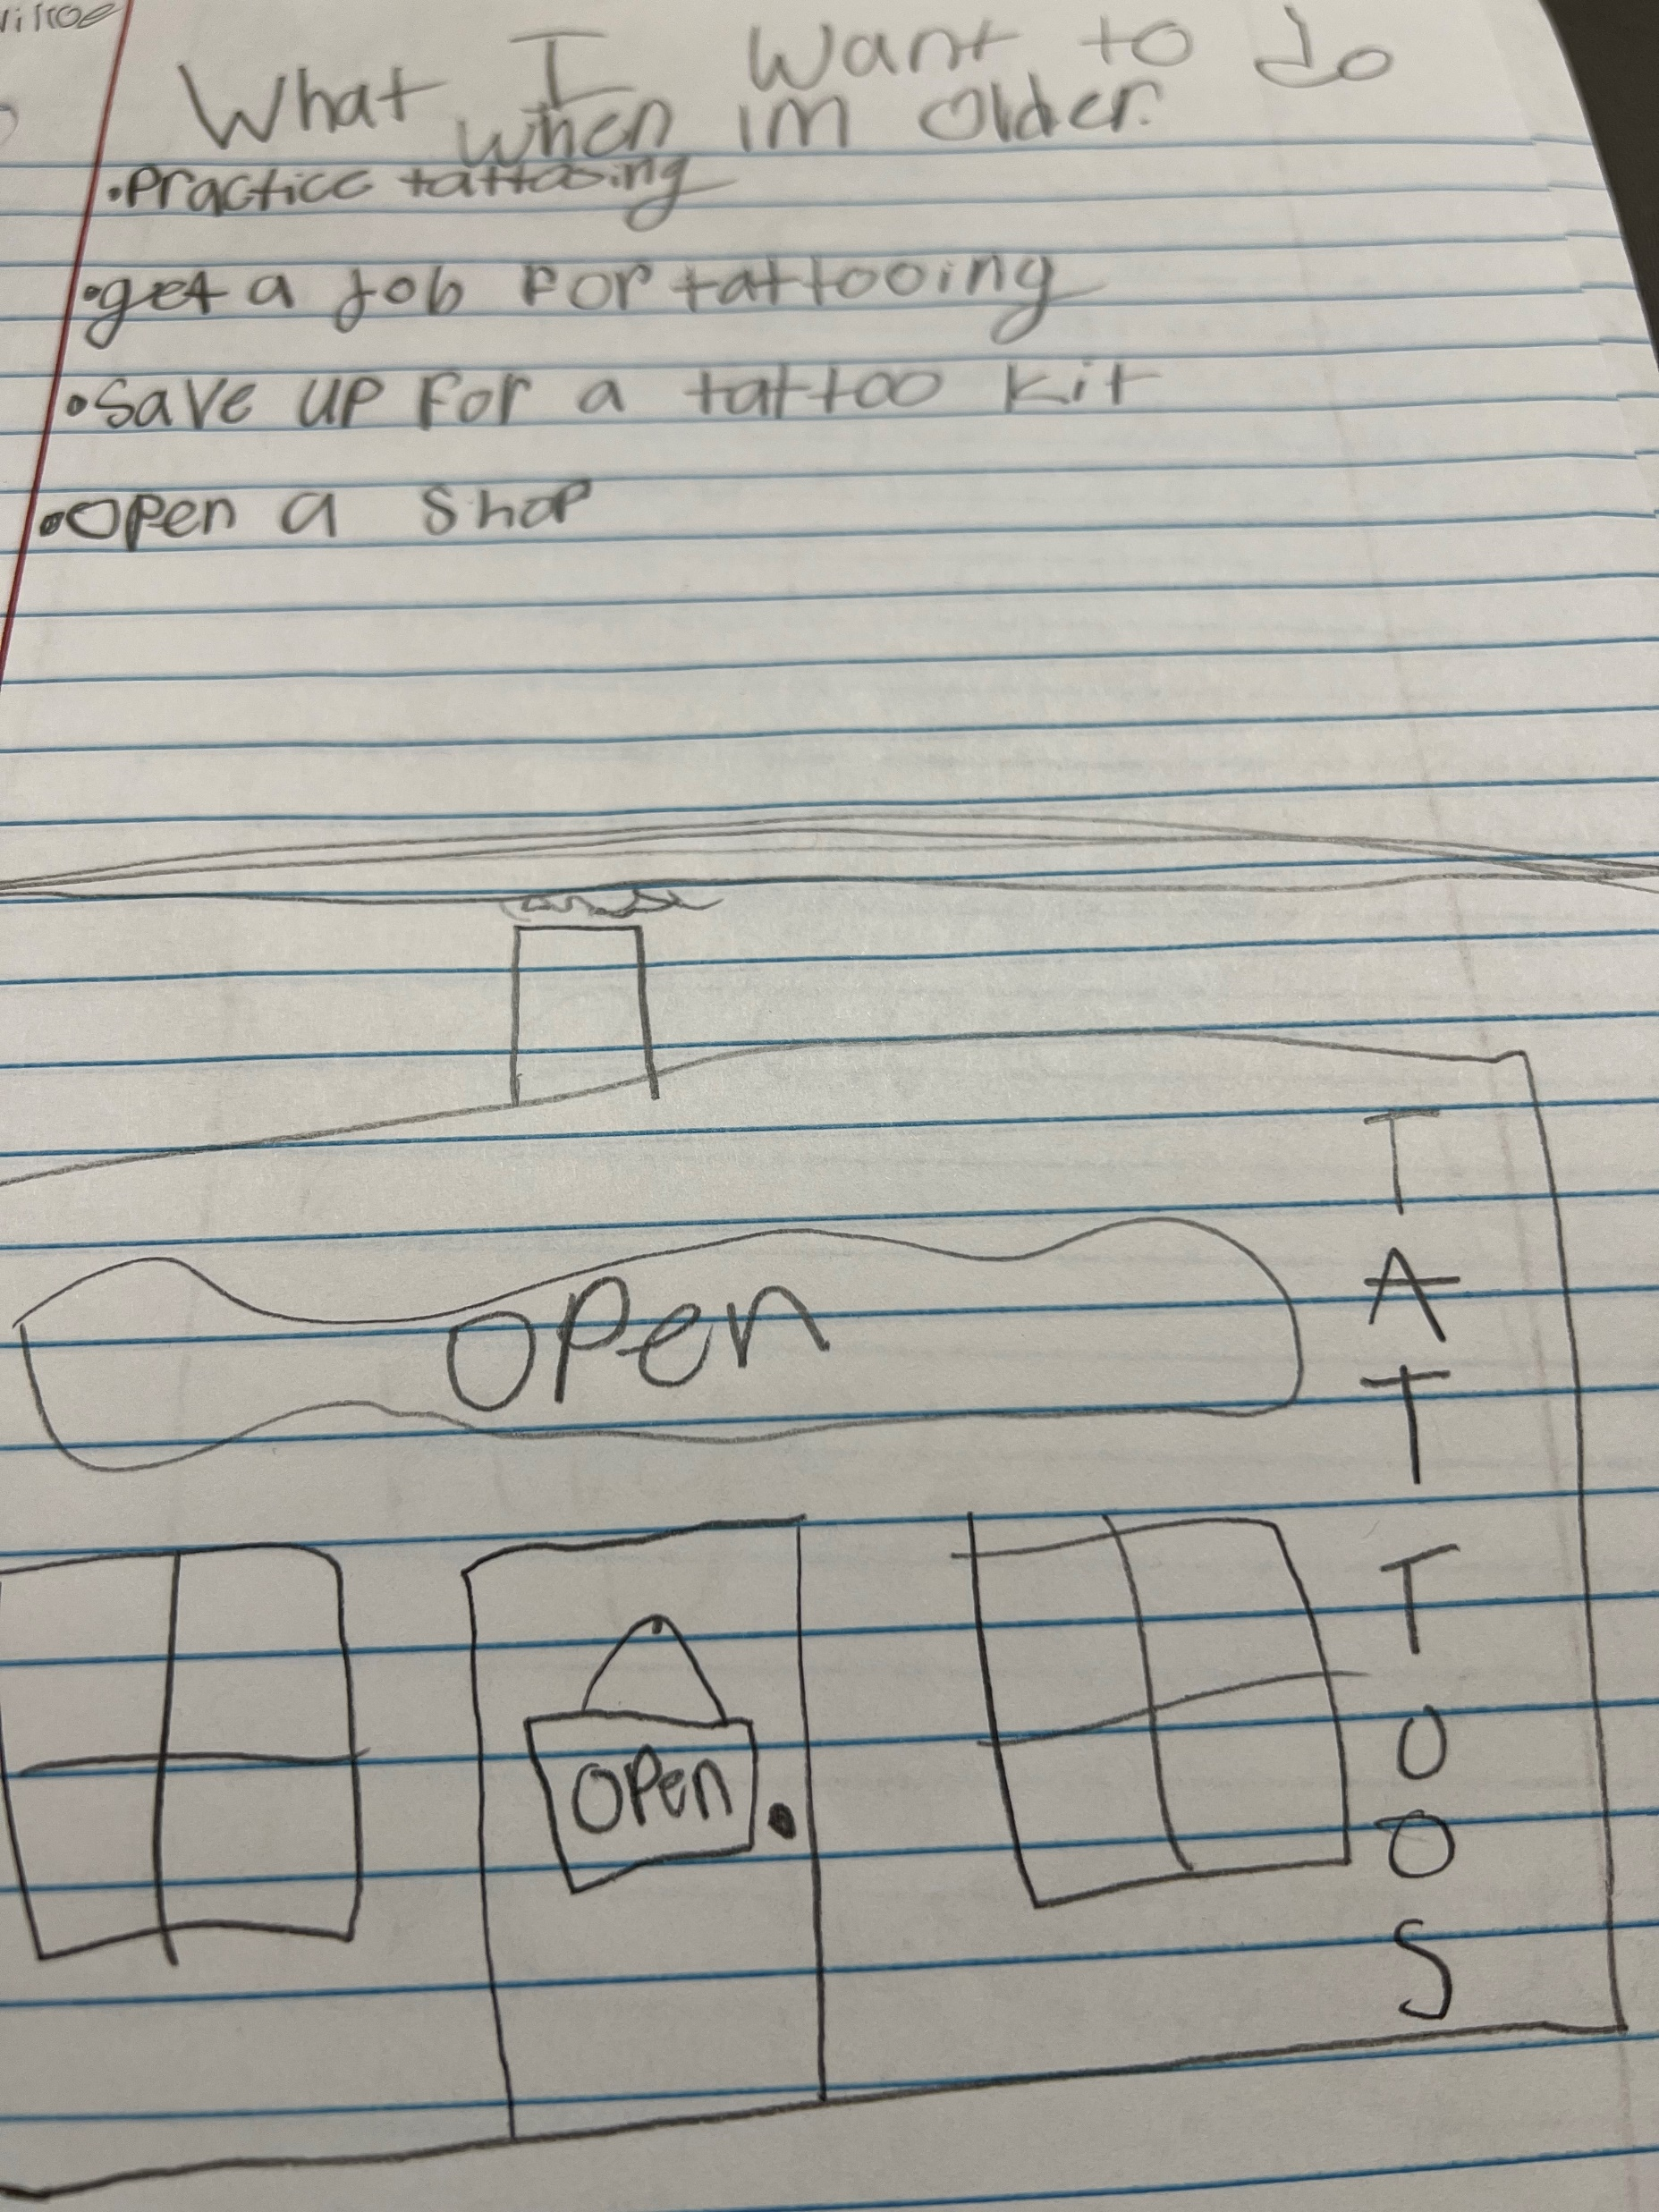

Slide 13
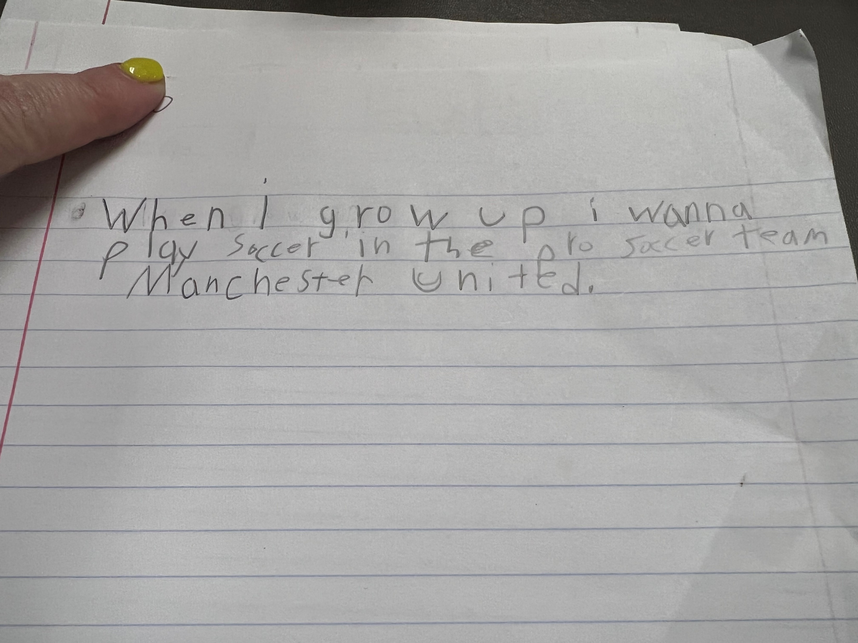

Slide 14
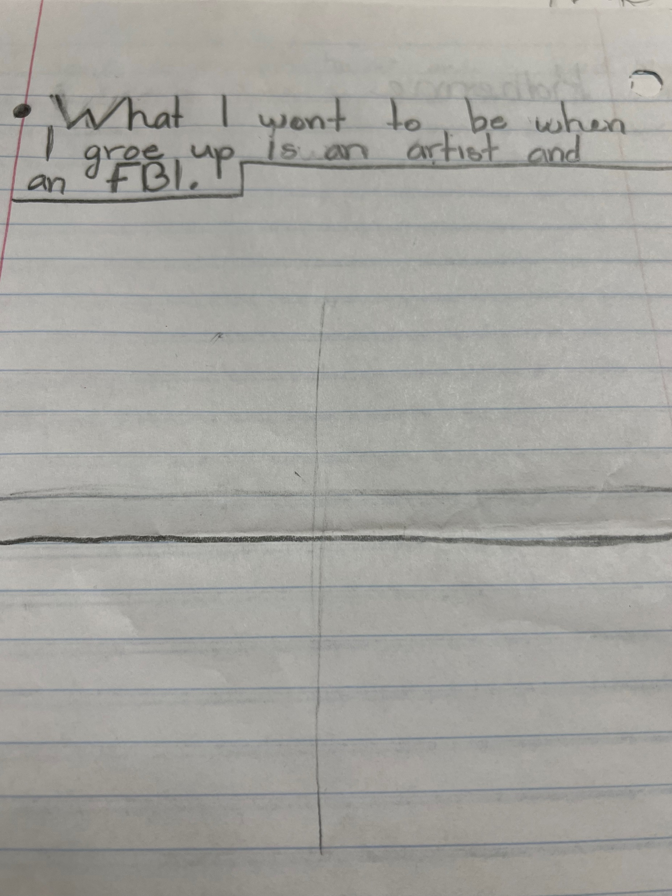

Slide 15
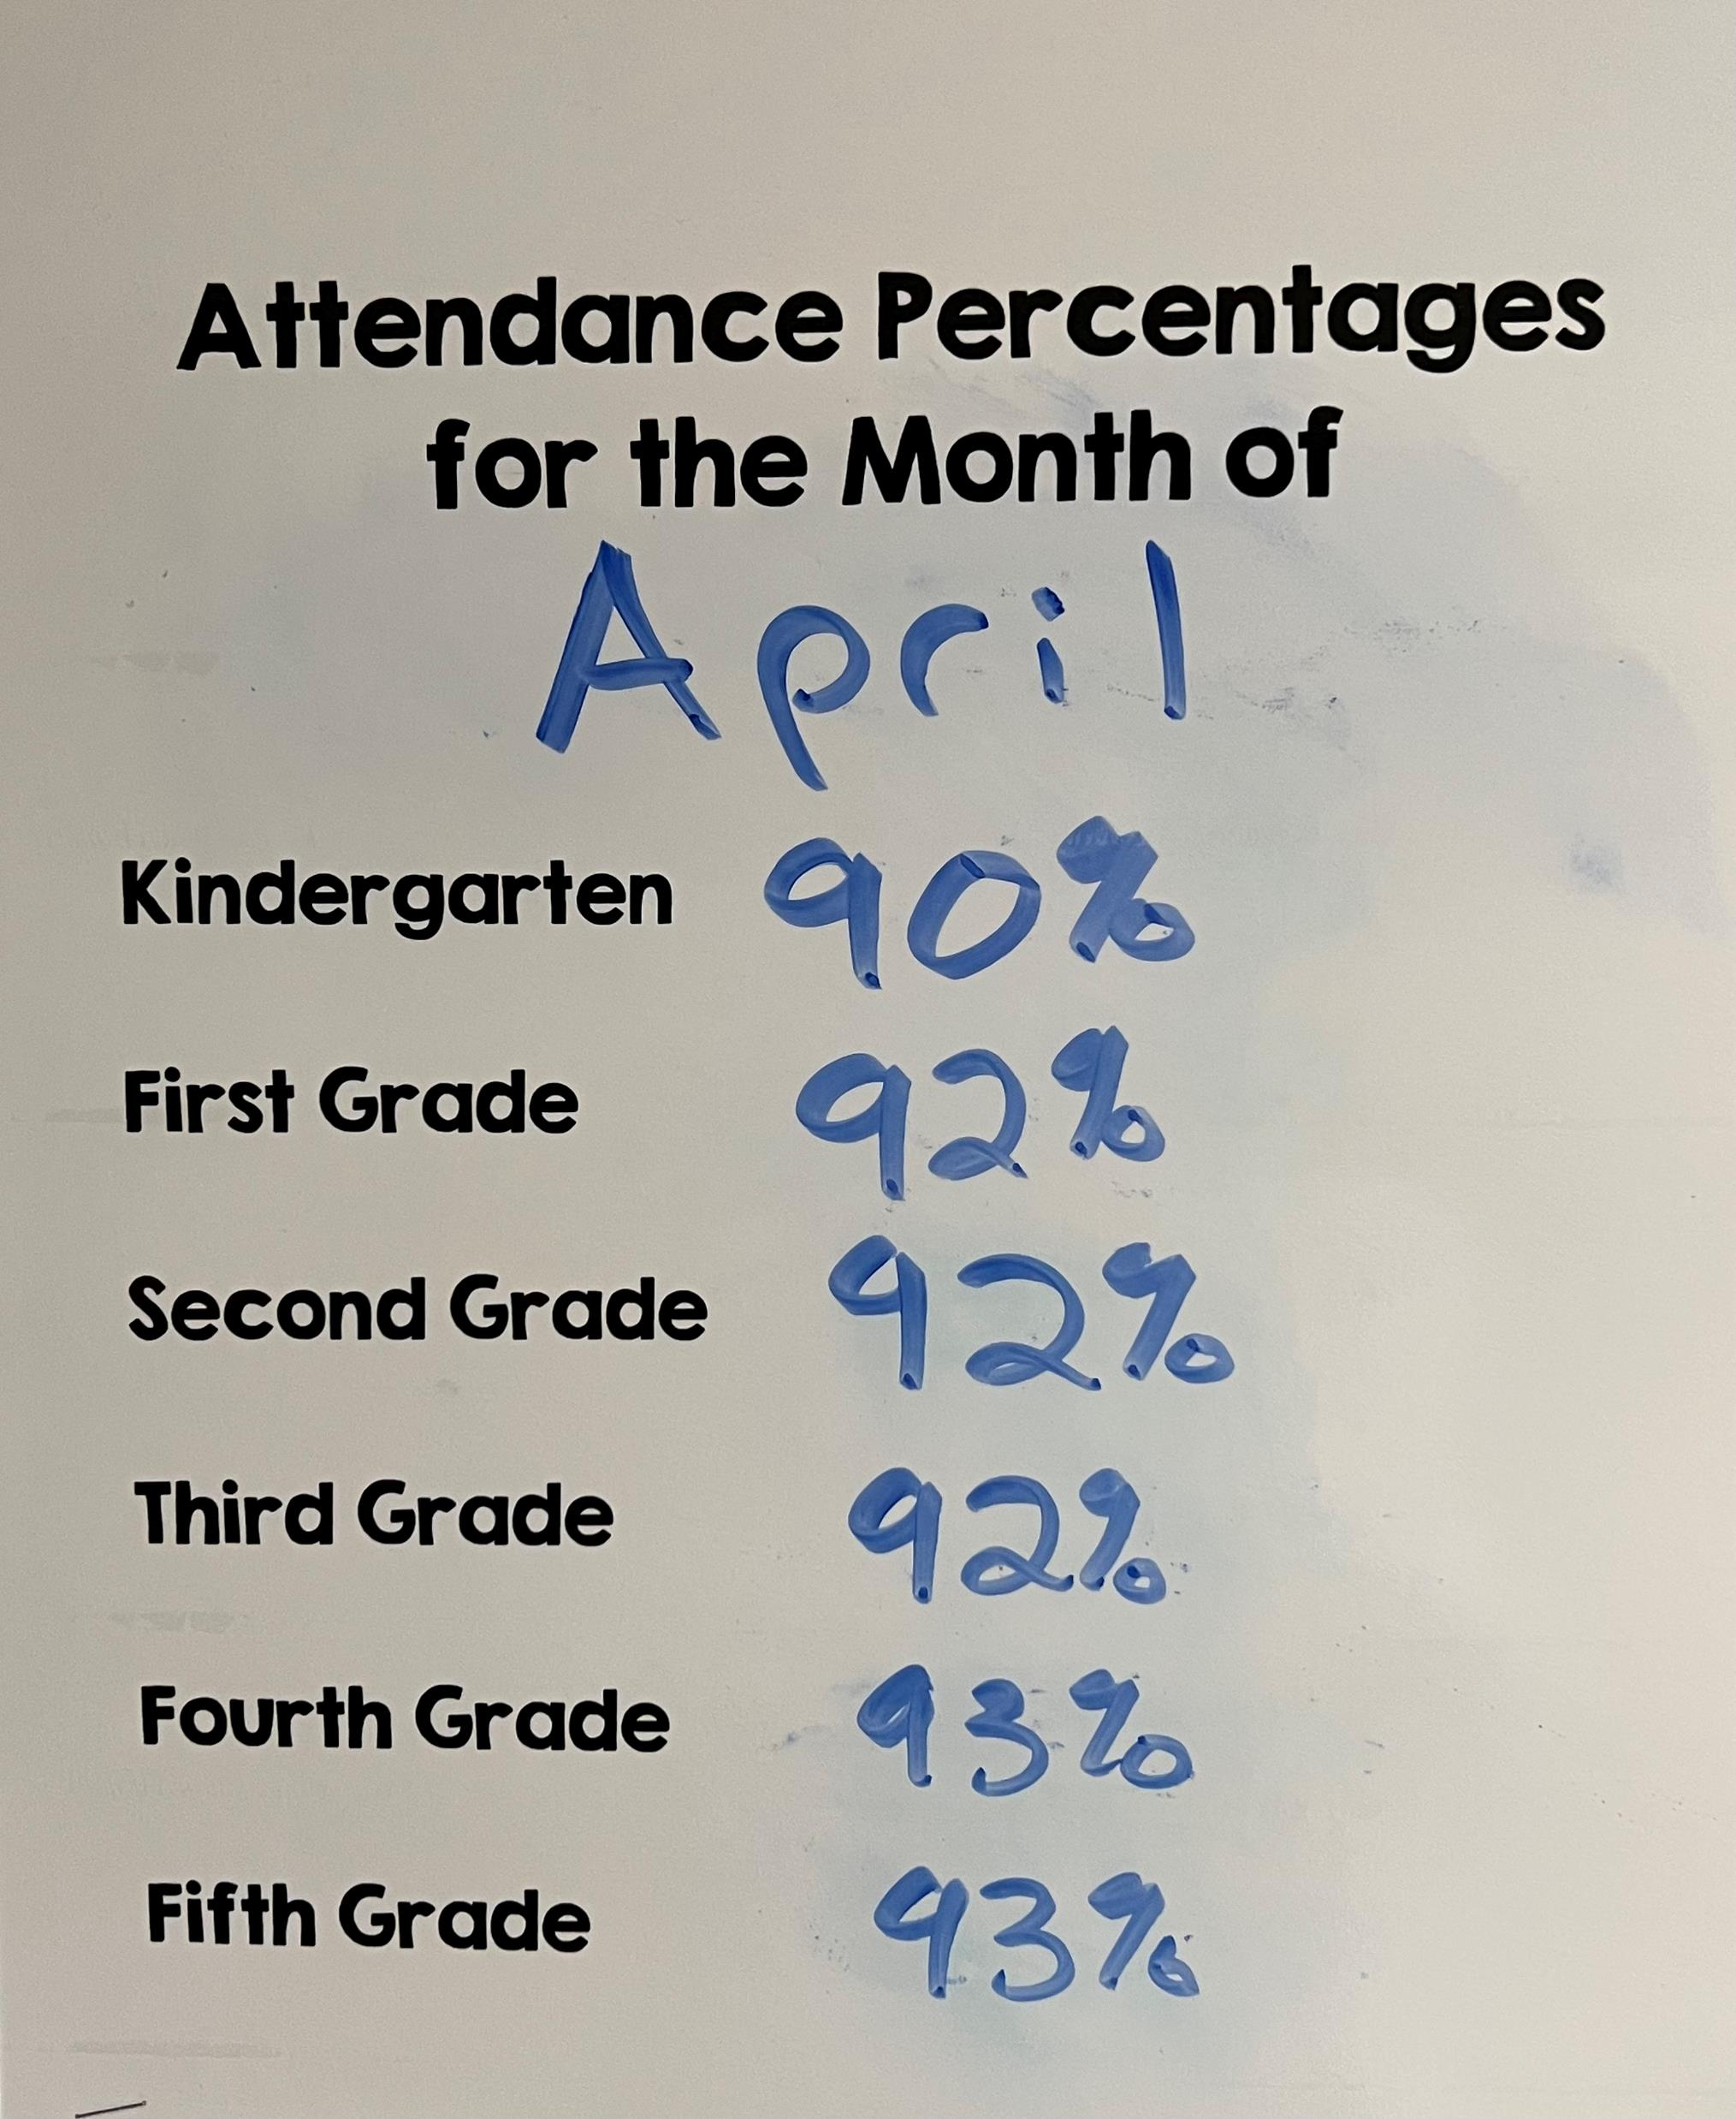
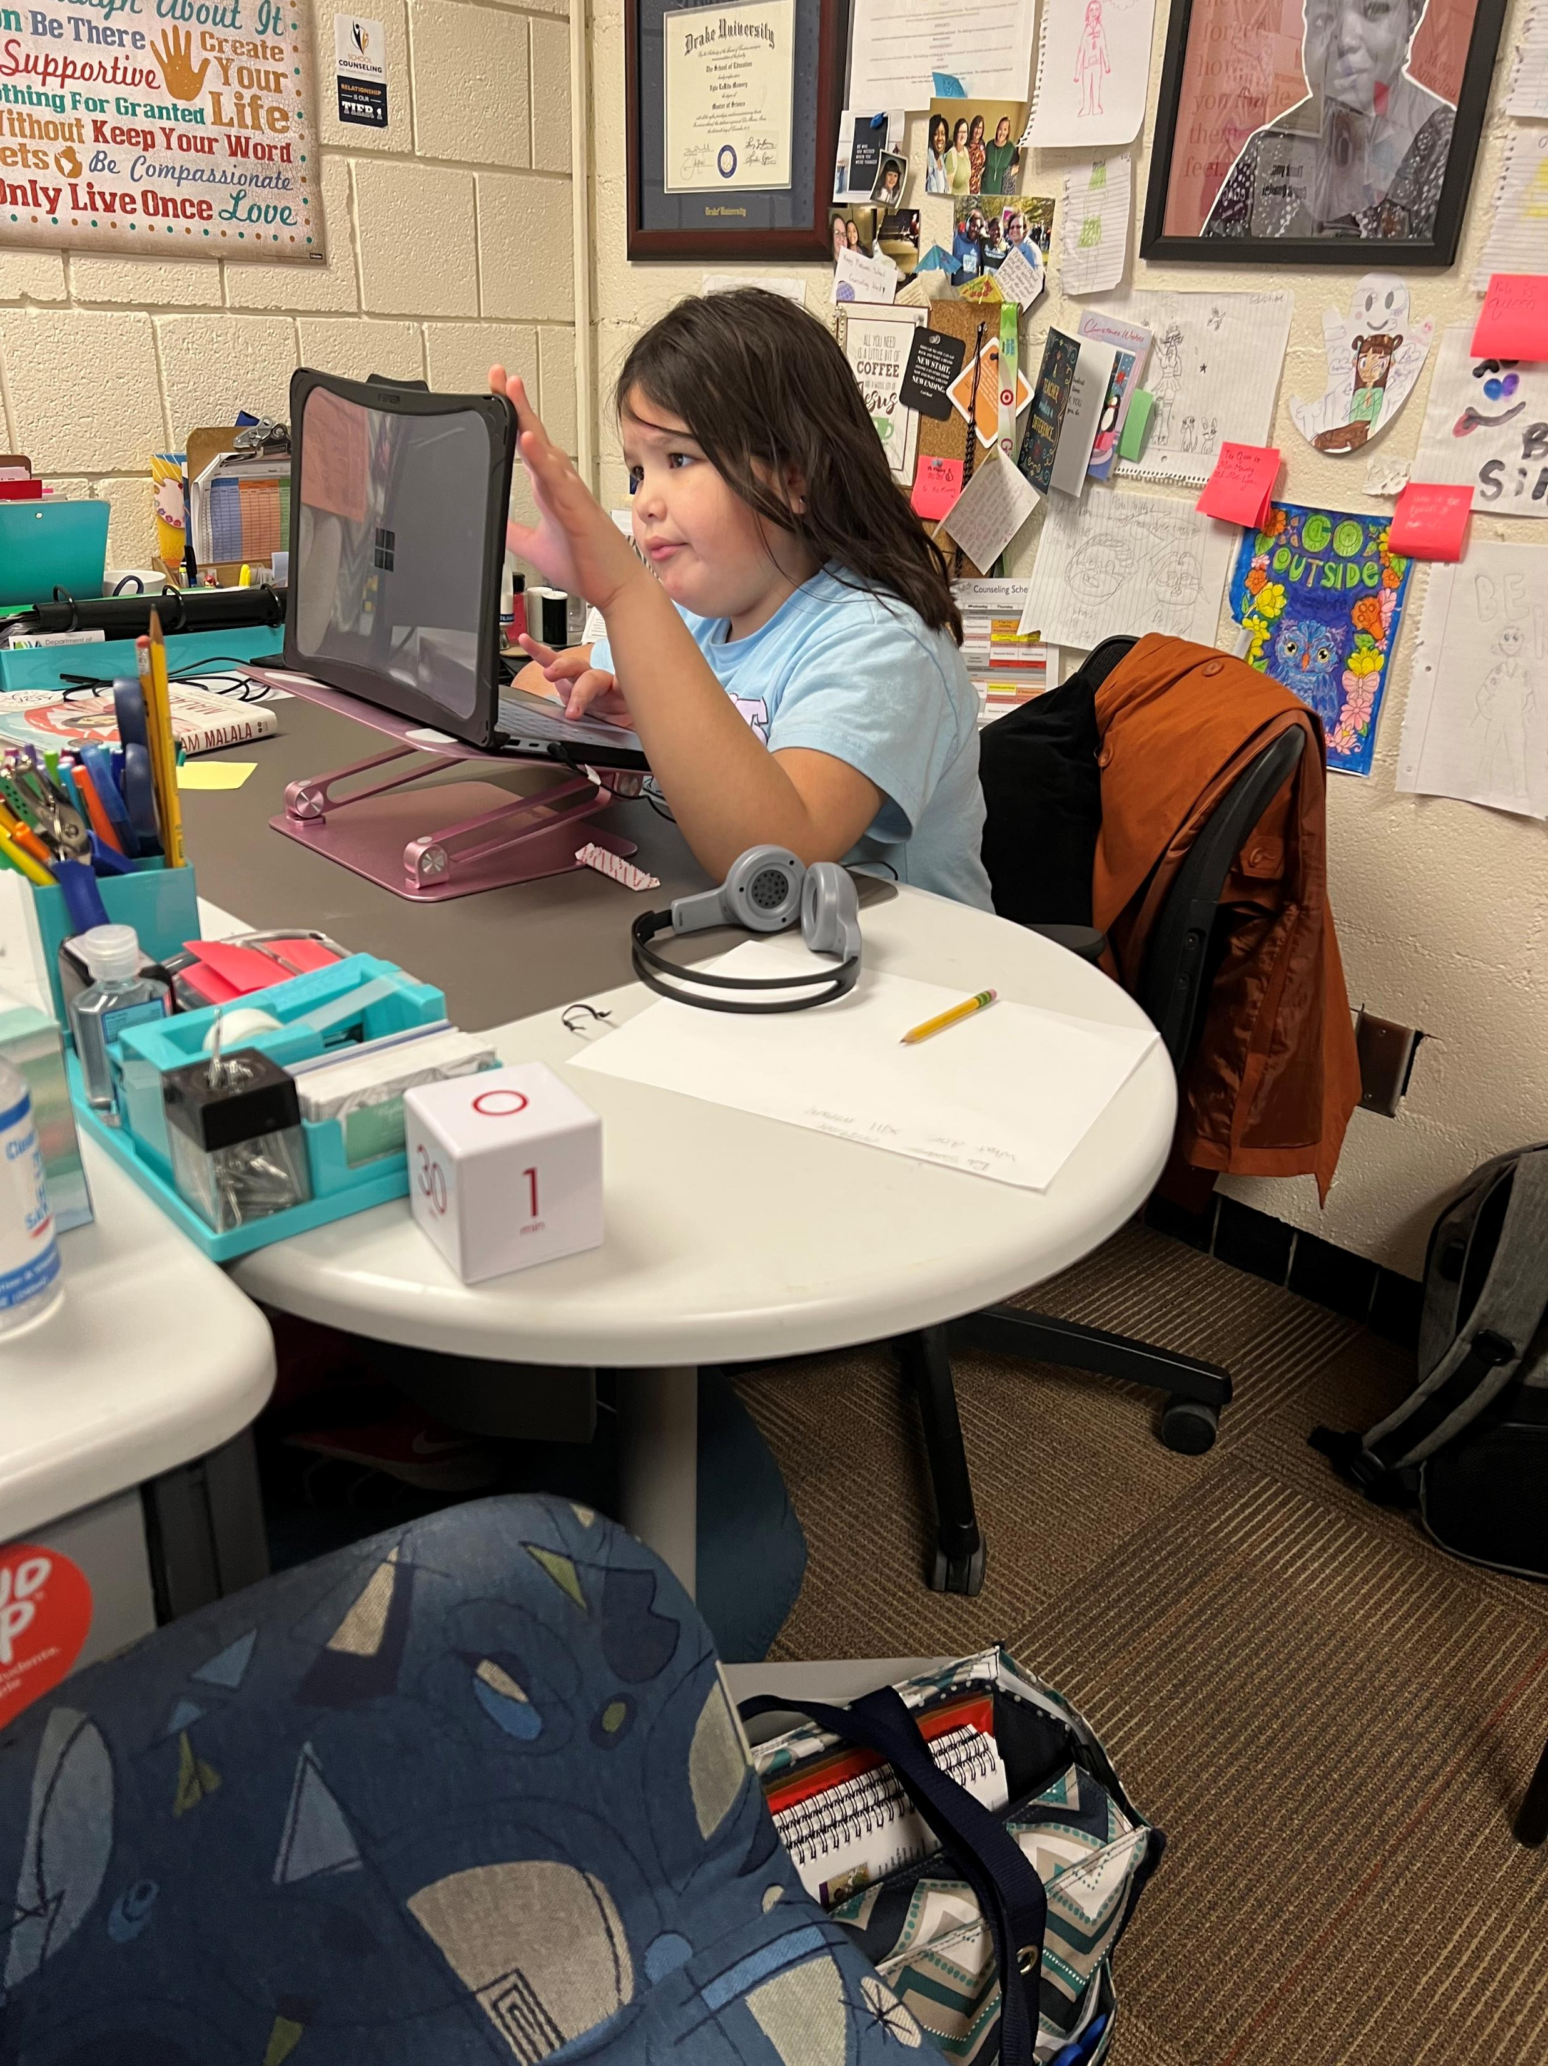
Use Data to Inform ALL Stakeholders
Staff
Students
Administration
Families
Community Members

Slide 16
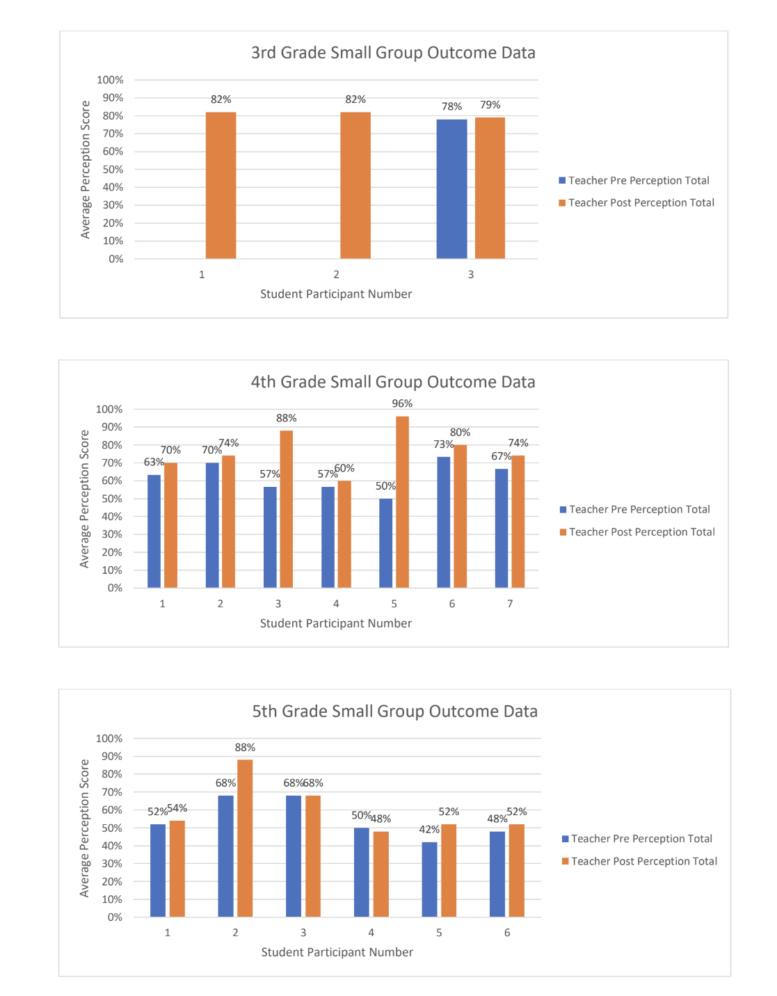
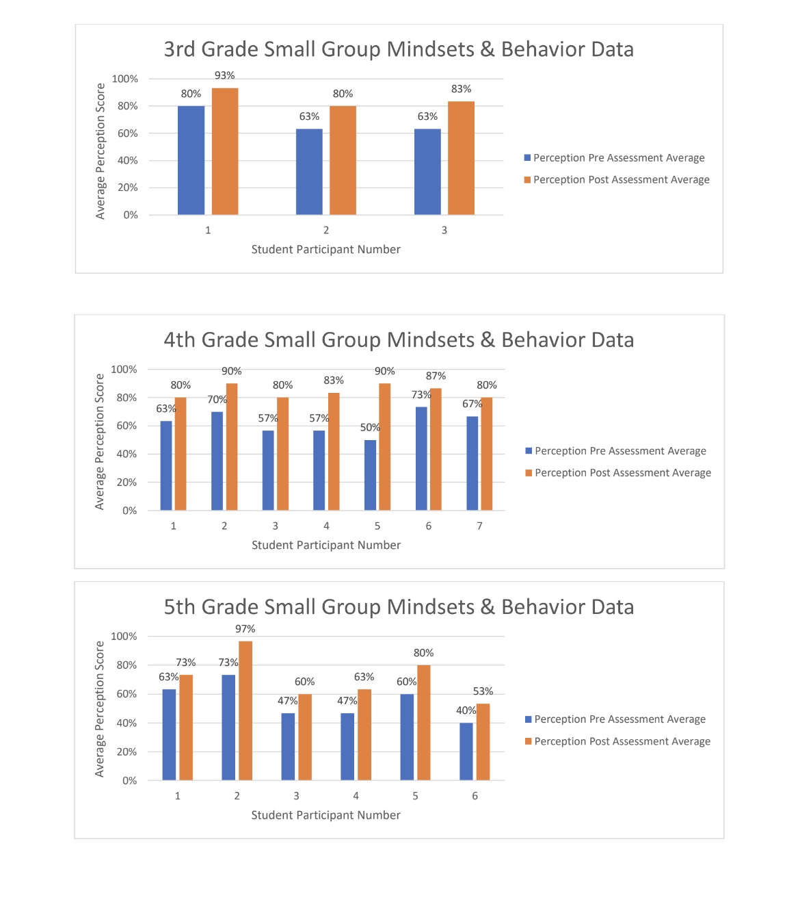

Slide 17
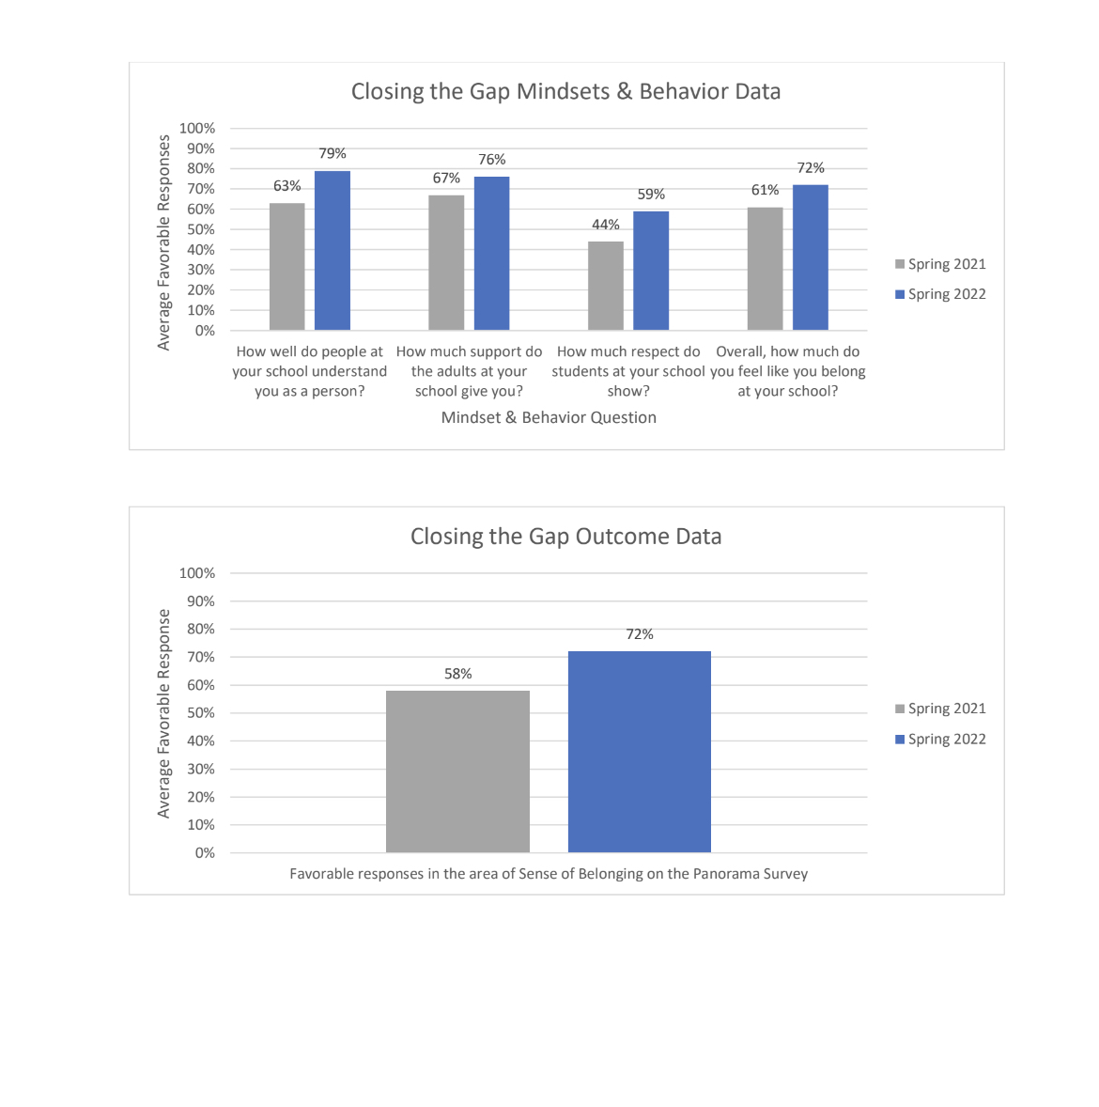

Slide 18
Plans for 2022
Create “Educational Pathways” posters for each staff member
Four(ish) week unit for CCR using lessons from Iowa College Aid Guidebook
Organize a Career Day
College Decision Day letters from fifth grade to seniors
Purposeful connection on SEL skills to CCR
College Going Map

Slide 20
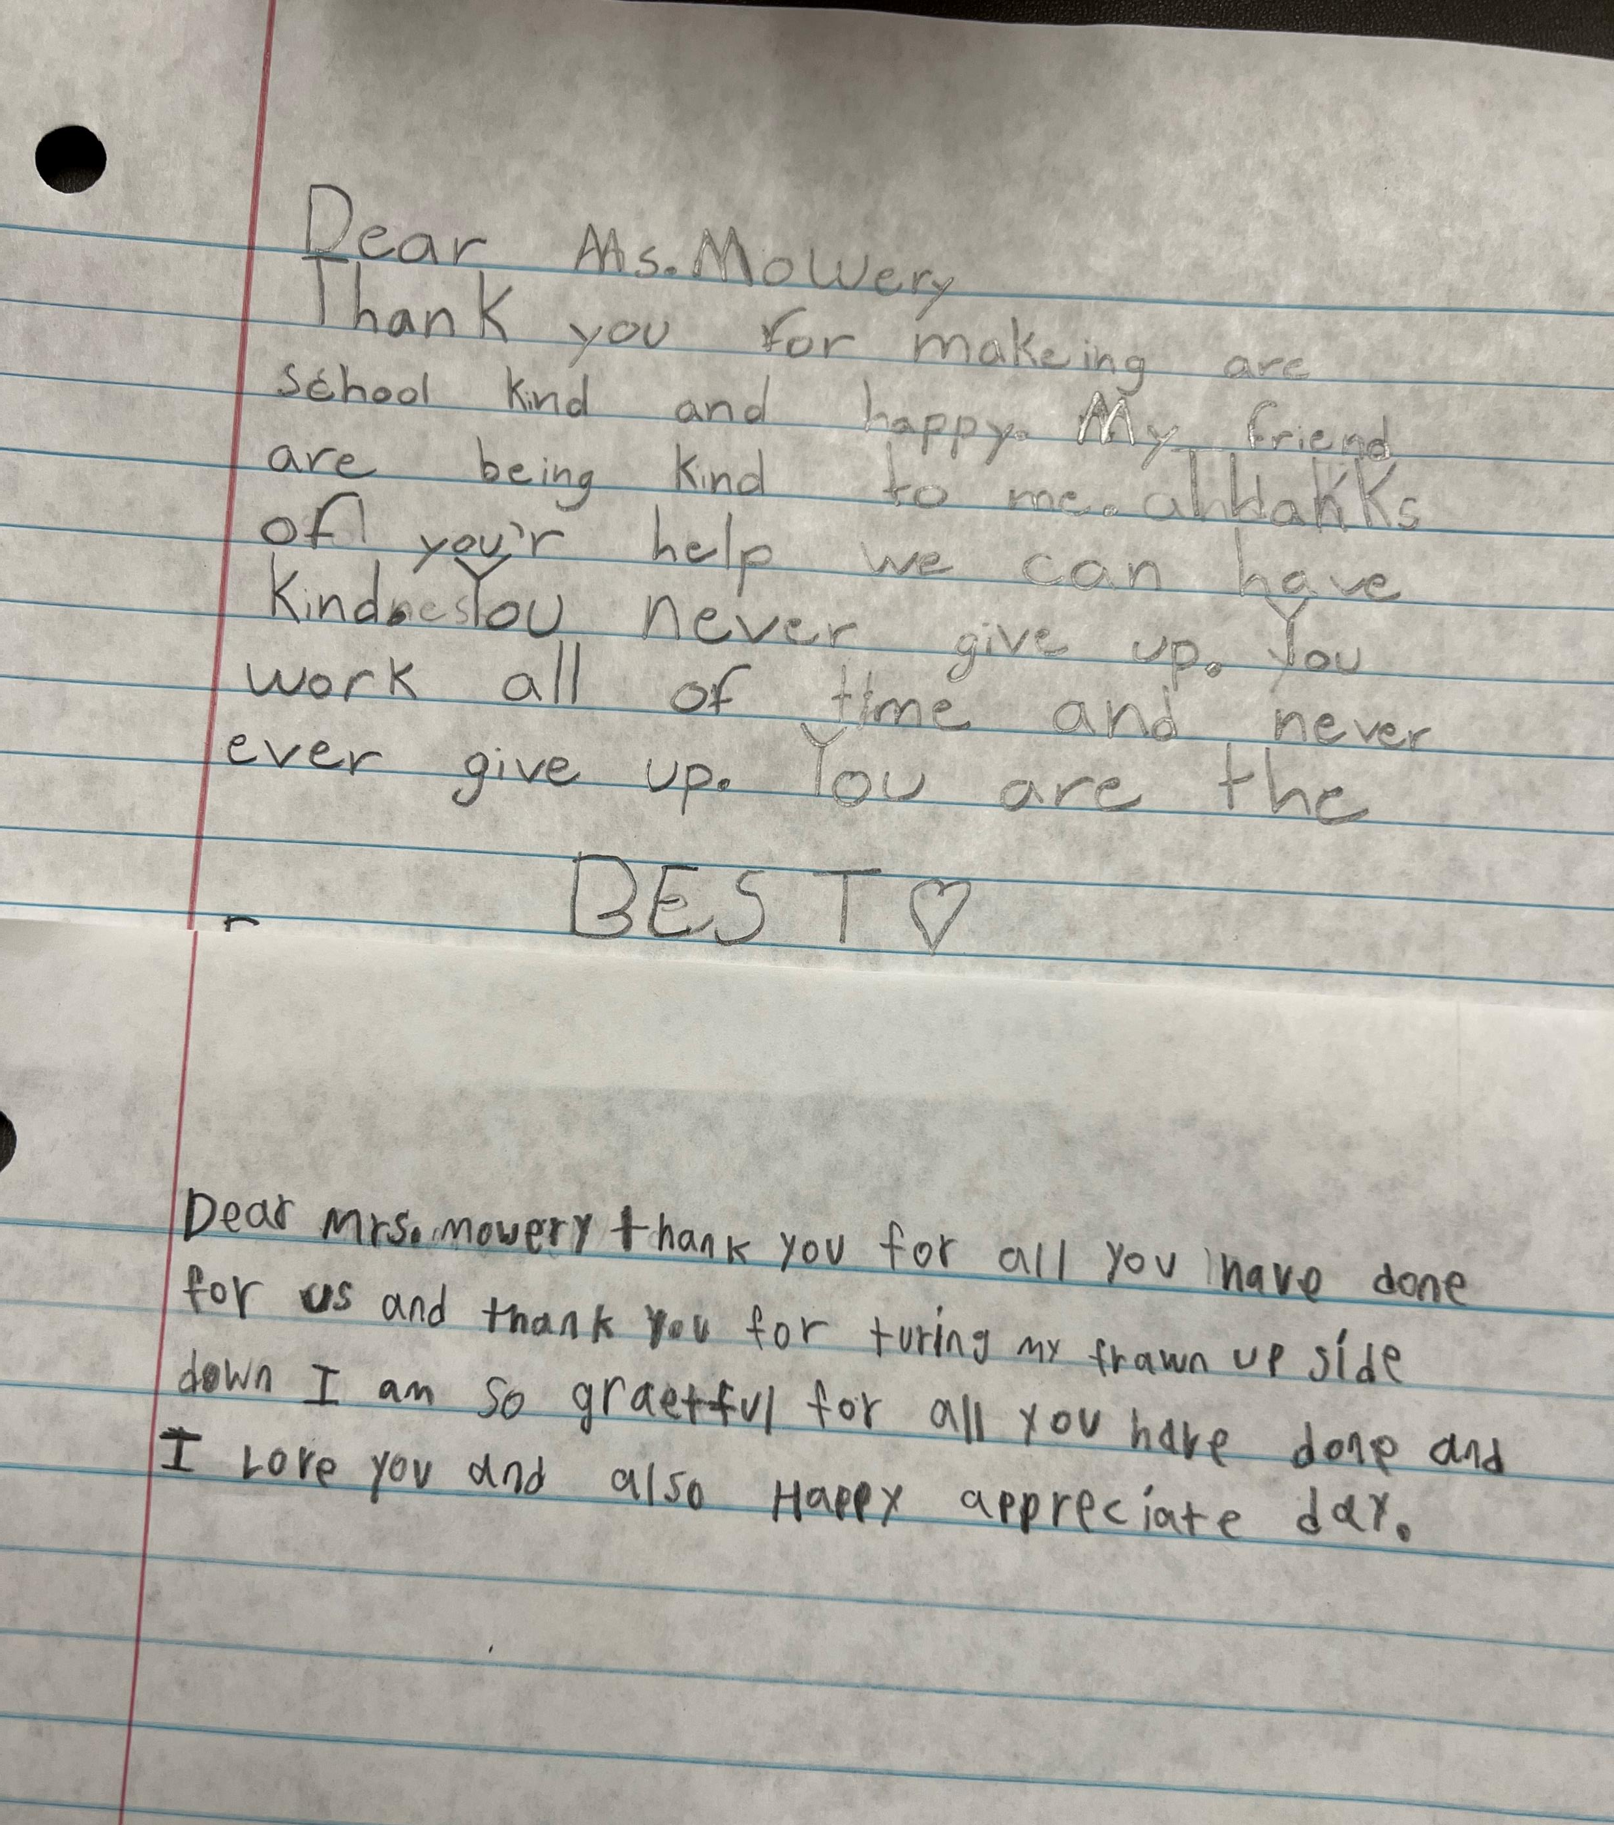
Questions and Discussion
nyla.mowery@dmschools.org
Attention!

