Slide 1
Books Make us Stronger
Using books in your School Counseling program
By: Allison Graham and Anita Townsley

Slide 2
Introduction
Allison Graham
Central College grad, Class of ‘05
Earned my Masters from BVU in 2021
2nd year School Counselor
Newton Community School District
Emerson Hough Elementary
I like dogs, reading, makeup, going to concerts, girls basketball

Slide 3
School Stats - Allison
K-4 grade level
233 students
12 classrooms
Part of a 6 day cycle specials rotation
Title 1 school
True neighborhood school (no bussing)

Slide 4
Introduction
Anita Townsley
North Mahaska Community Schools - New Sharon, Iowa
Central College/Pella, Iowa - BA in Elementary Education
Iowa State University - MS in Professional Studies - School Counseling
44 years in education - 32 years as a school counselor
41 years at South Tama County Schools
2nd year as an adjunct professor for Upper Iowa University - practicum students
I love my family, my dog Denver, traveling, sports - particularly girls basketball and obviously working with students and families.
I am a farm girl at heart and really enjoy working with cattle.

Slide 5
School Stats for Anita
Counselor for PS, Kindergarten and First Grade Students at South Tama County Elementary
350 students - 16 classrooms
I meet with each classroom every 5 days. PS meets weekly for classroom lessons
Small groups run for typically 6 to 8 sessions
Individual sessions are ongoing and as needed

Slide 6
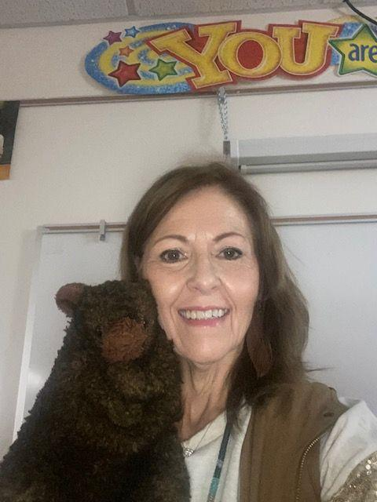
Harmony the Teddy Bear
I am known as the Teddy Bear Lady
This is Harmony the bear who has
been with me since 1990 when I
started my school counseling
career. He loves hugs and our song
is “You Are My Teddy Bear Lady”.

Slide 7
Learning Objectives:
*Identify ways to incorporate books into classroom instruction, small-group counseling sessions and individual sessions.
*Identify various books to use with a variety of topics

Slide 8
Session Takeaways
That books provide:
*discussion
*advocacy
*education
*awareness
A list of some of our favorite books

Slide 9
ASCA Mindsets & Behaviors
ASCA Mindsets and Behaviors
M1 Belief in development of whole self, including a healthy balance of mental, social/emotional and physical well-being
M2 Self-confidence in ability to succeed
B-SS 1. Use effective oral and written communication skills and listening skills
B-SS 2. Create positive and supportive relationships with other students.
B-SS 7. Use leadership and teamwork skills to work effectively in diverse teams

Slide 10
Considerations for Using Books
*Find a book matching the needs of the group or individual
*Look for discussion guides and resources
*Encourage students to read, write, draw, and participate
*Incorporate supplemental activities

Slide 11
Why Books?
Books benefit students by
*Identification - connecting to a character or situation
*Awareness/insight - problem/solution
*Release - recognition of emotion
Offers an opportunity for students to realize they are
not alone - sense of connection.
ASCA (2019). Bibliocounseling: Mental Health Literacy One Story at a Time Retrieved from https://www.schoolcounselor.org/newsletters/september-2019/bibliocounseling-mental-health-literacy-one-story?st=NJ

Slide 12
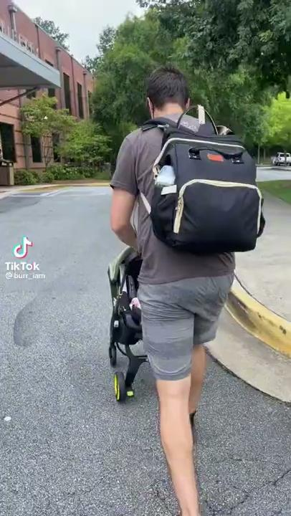
The Power of Books - Tik Tok

Slide 13
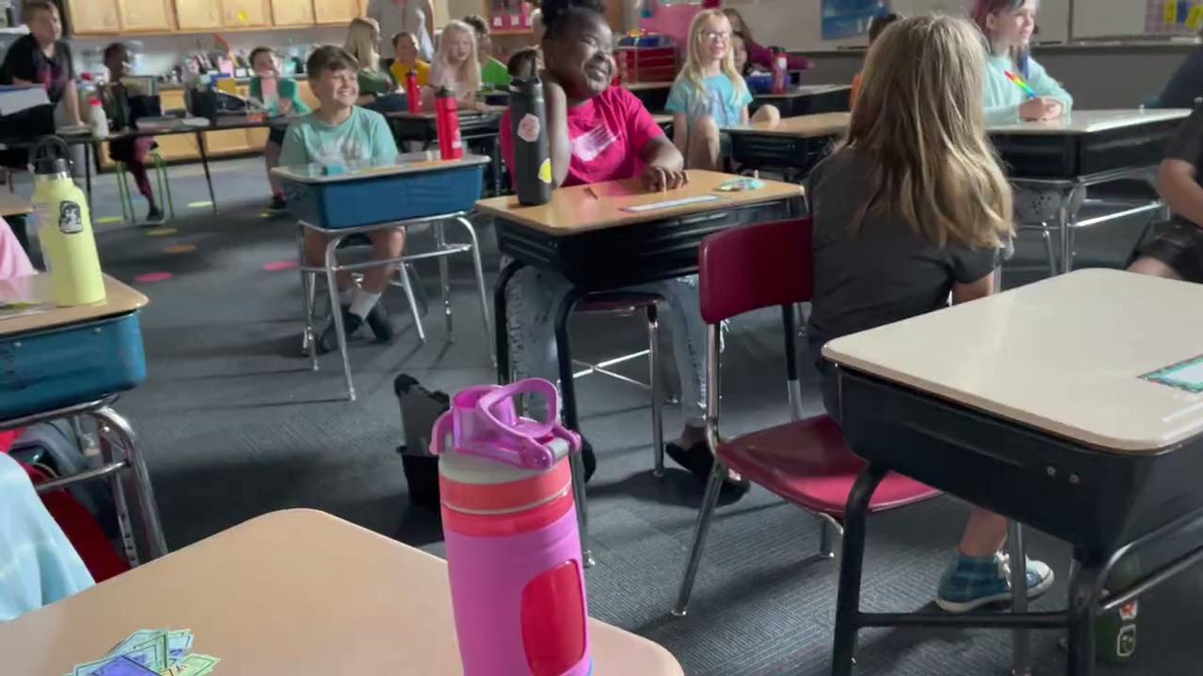
The Power of Books

Slide 14
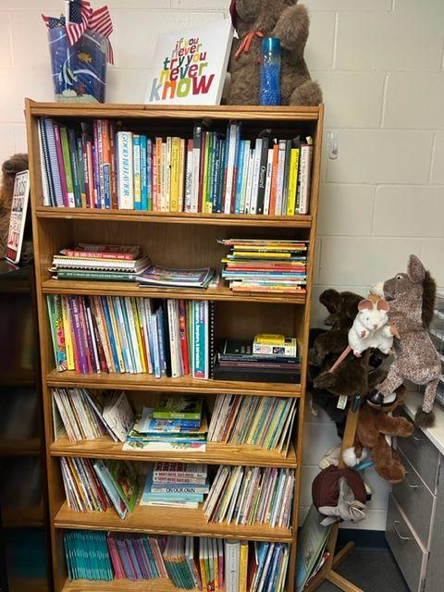
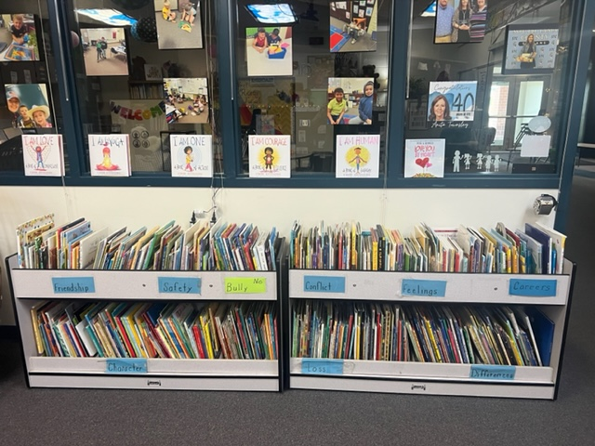
Books, Books, Books

Slide 15
When to use books?
ANYTIME!!!
Whole classroom lessons
Small groups
Individual counseling

Slide 16
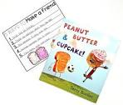
Book Time
Students need to interact with a book and I love to have students help me read the story. Here is an example of one of my favorite stories dealing with the topic of friendship and empathy.

Slide 17
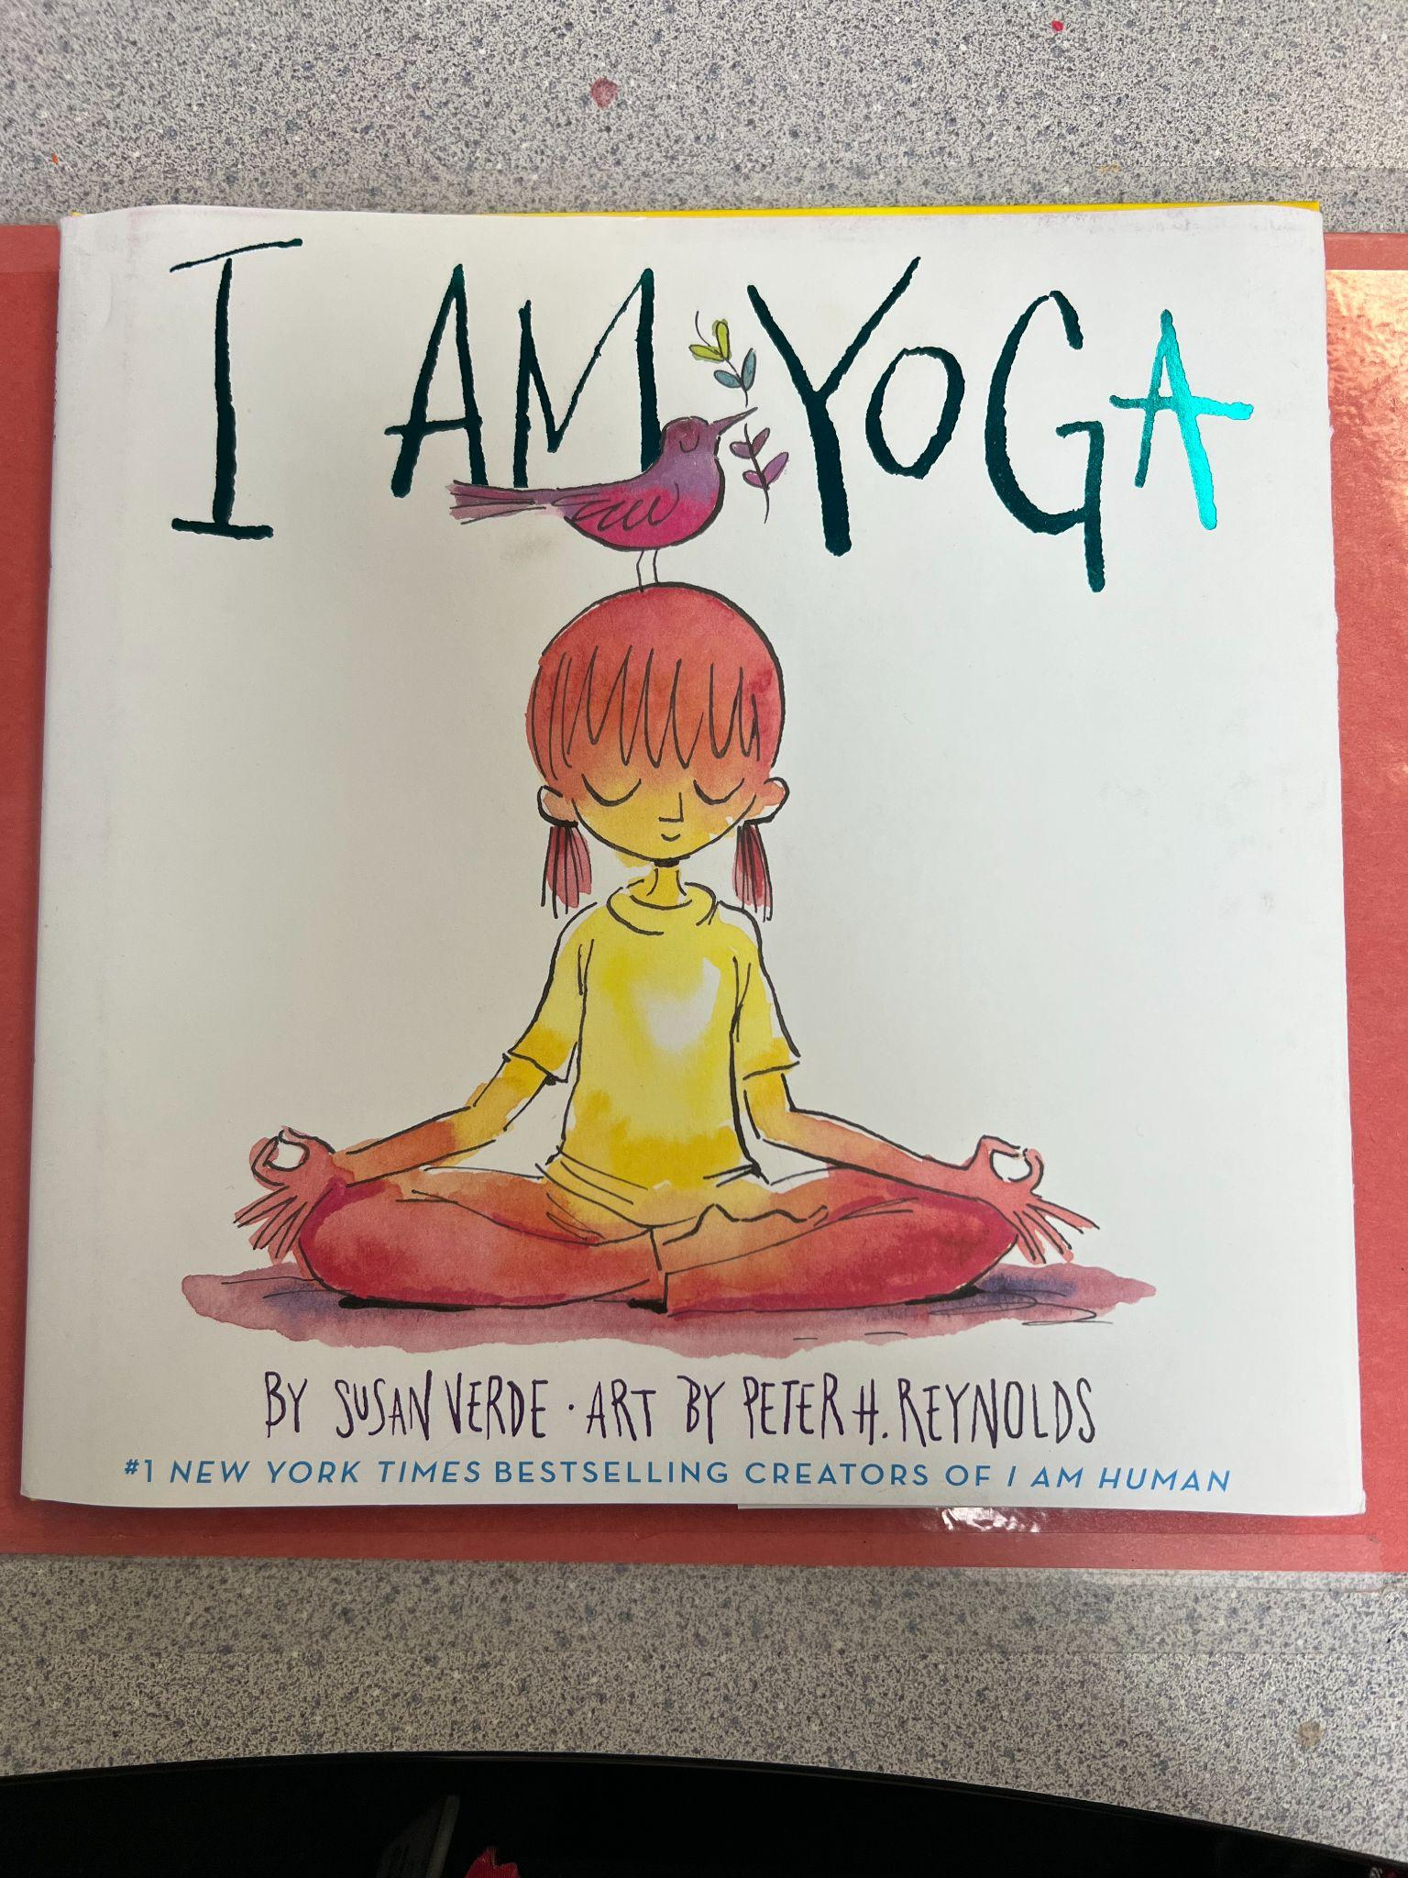
Read Aloud: I Am Yoga

Slide 18
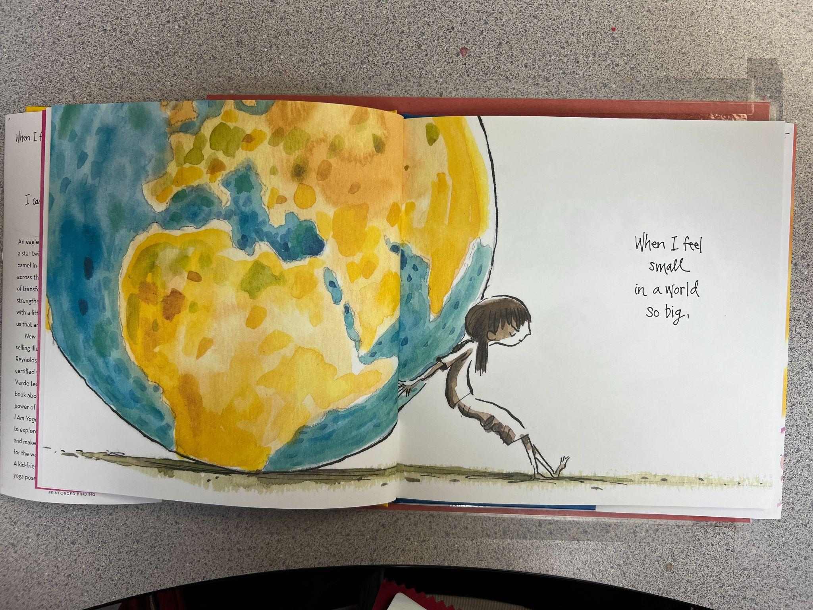

Slide 19
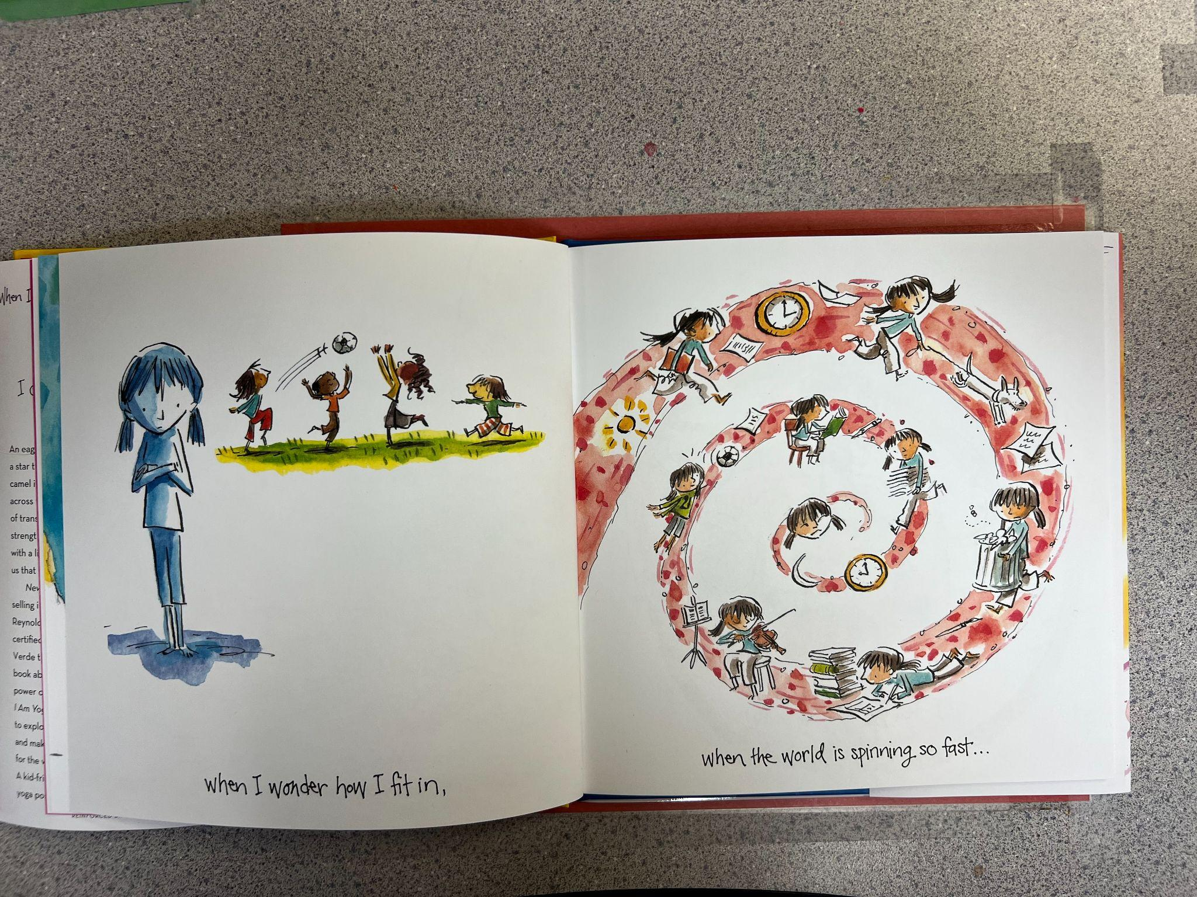

Slide 20
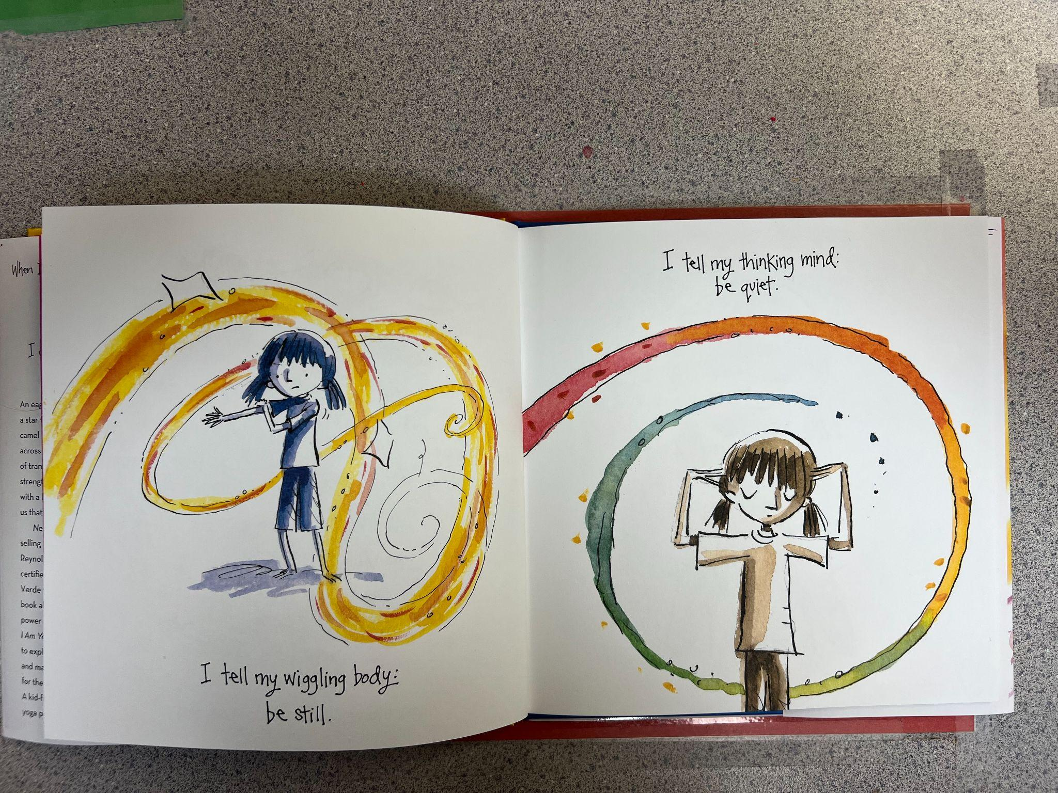

Slide 21
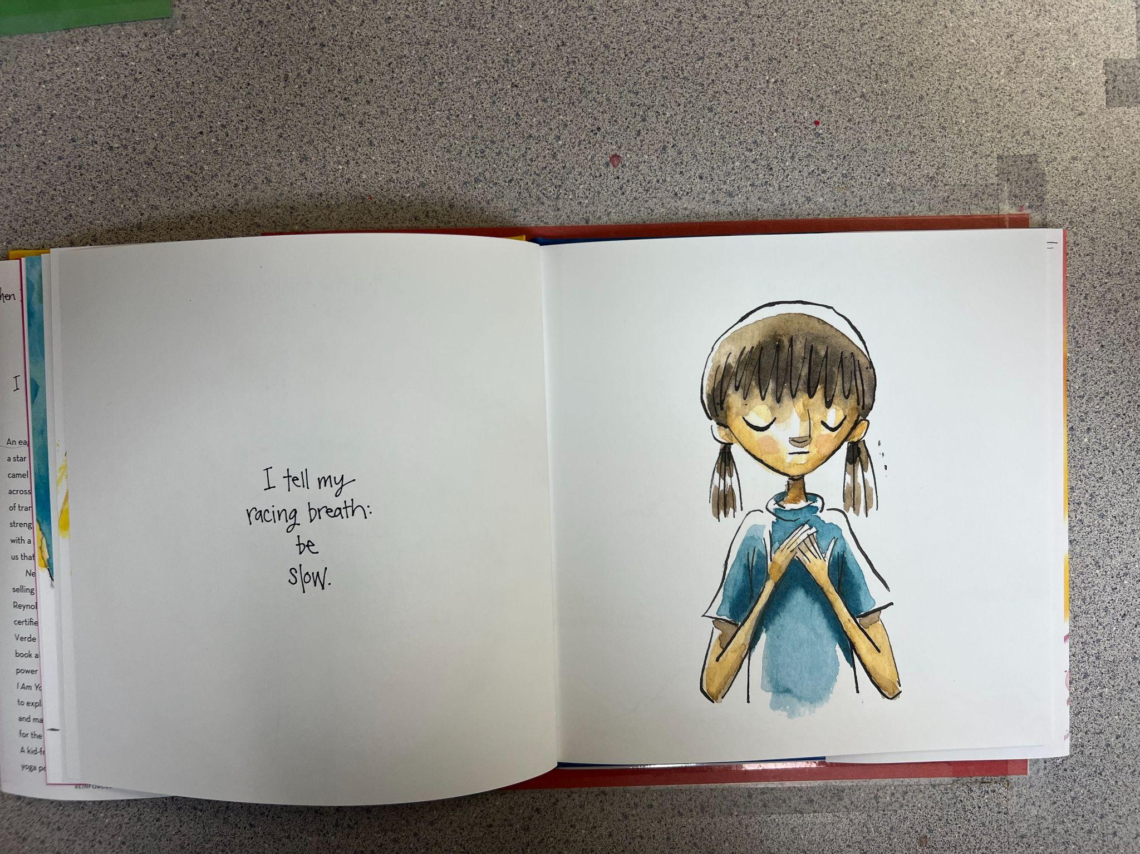

Slide 22
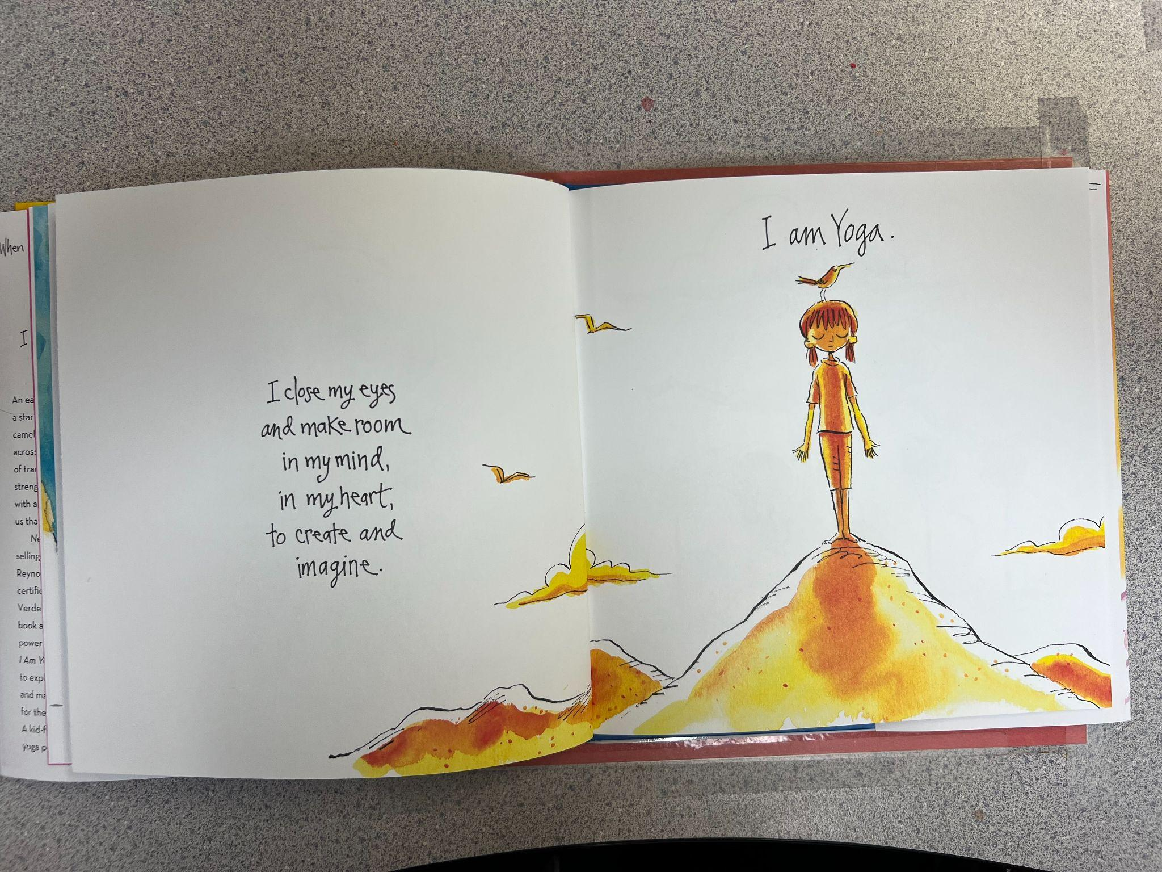

Slide 23
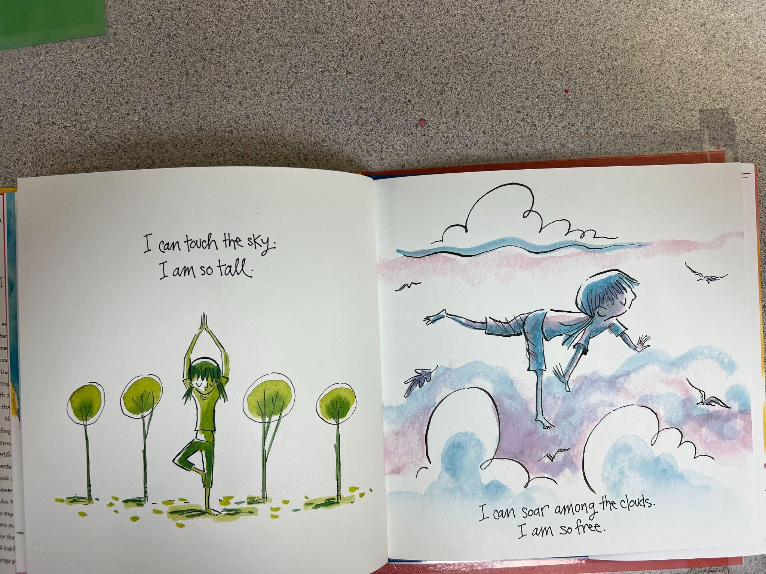

Slide 24
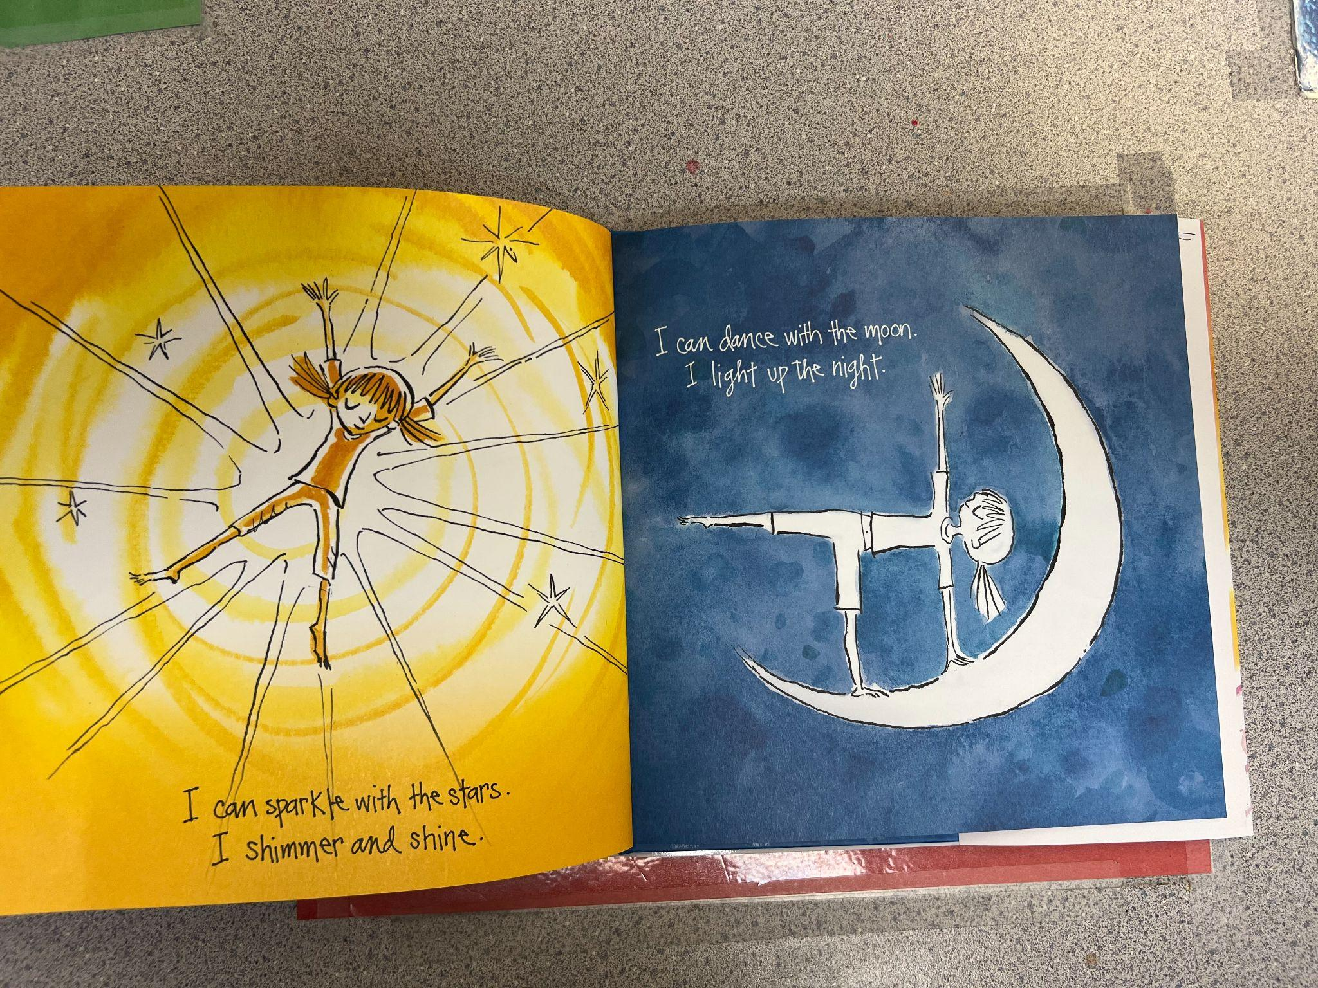

Slide 25
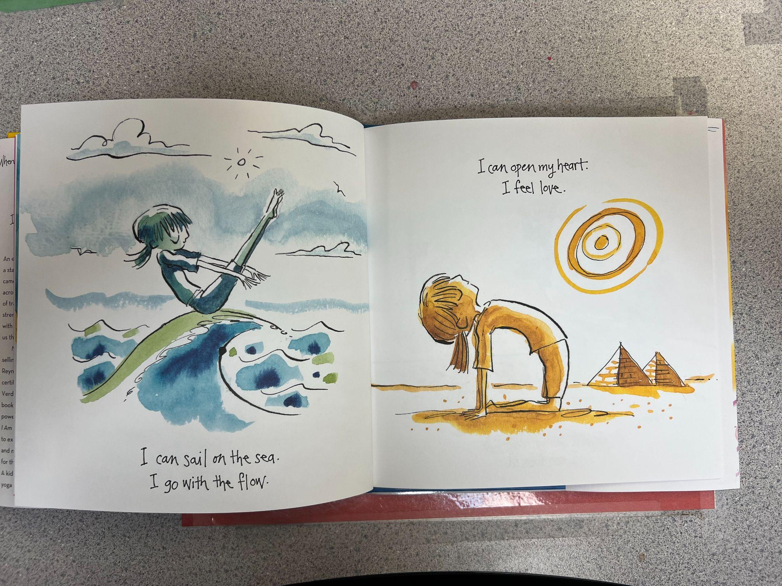

Slide 26
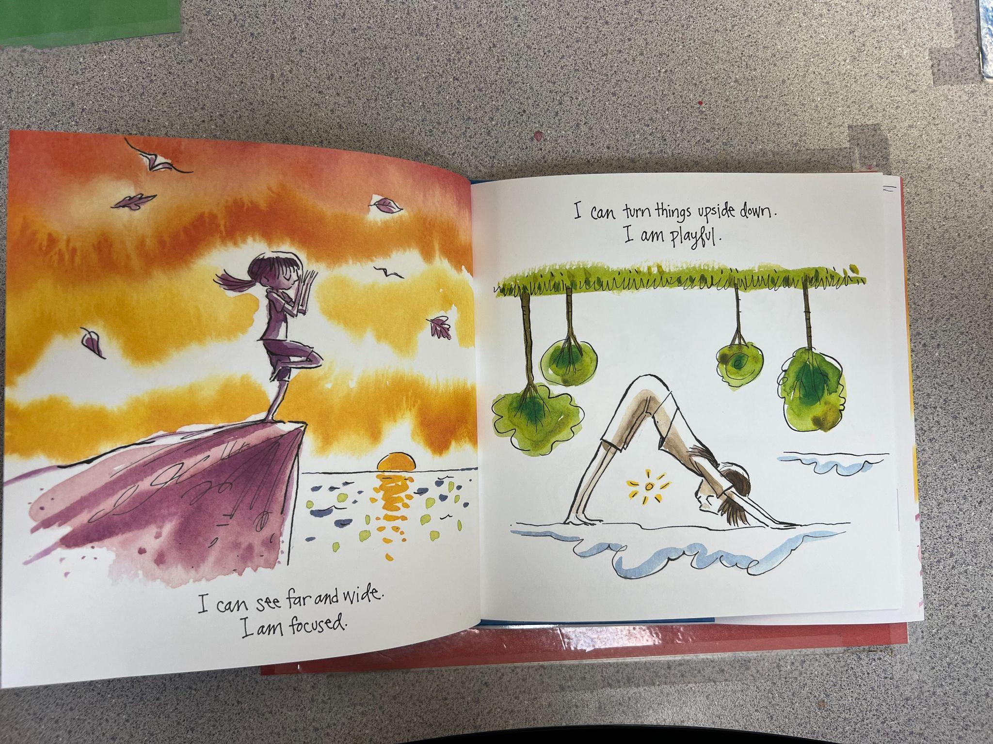

Slide 27
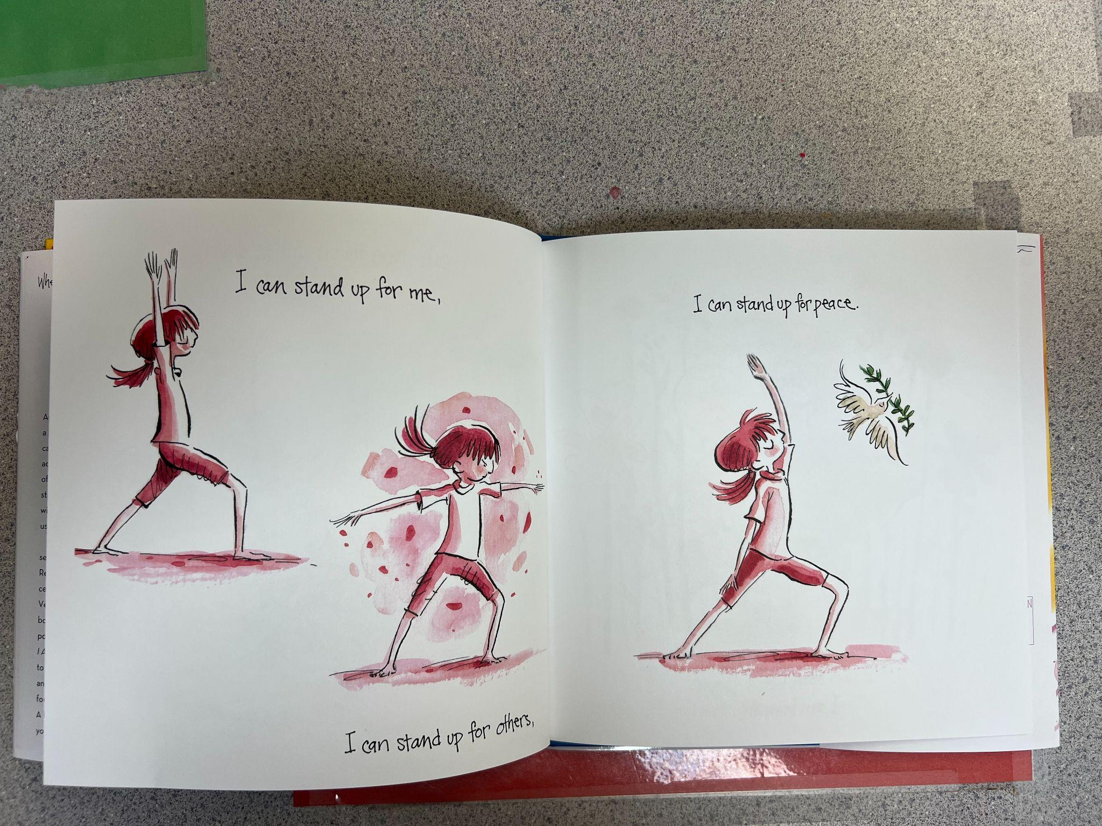

Slide 28
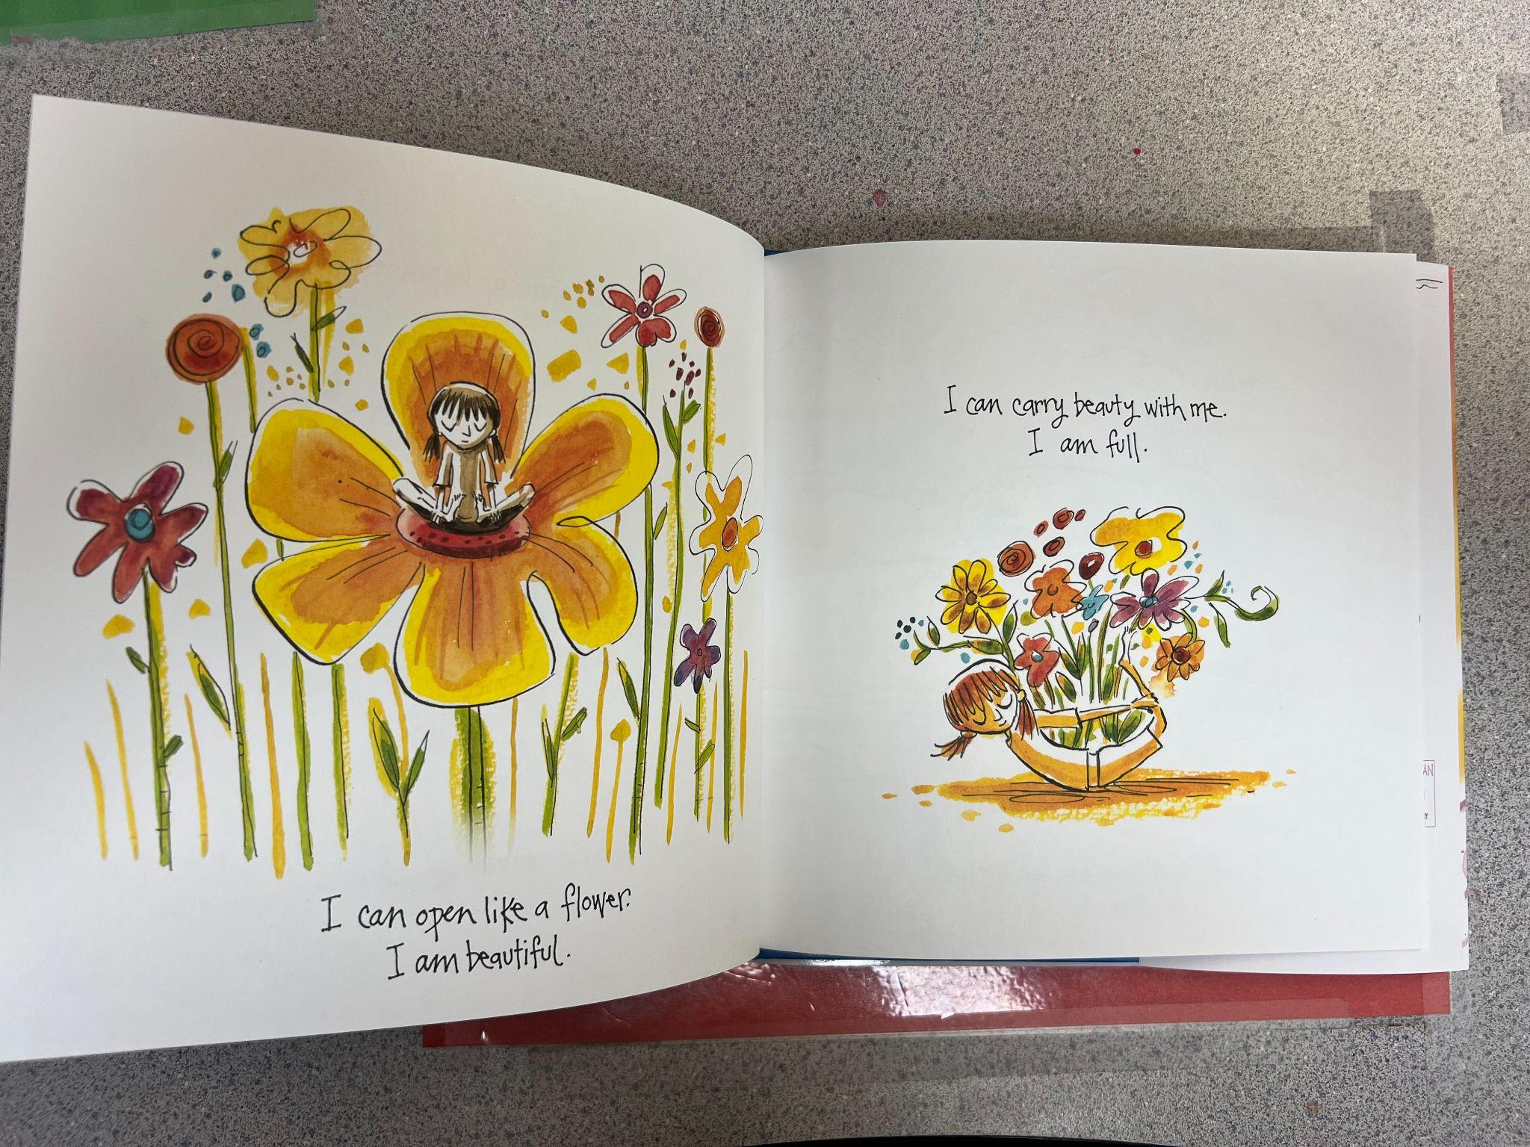

Slide 29
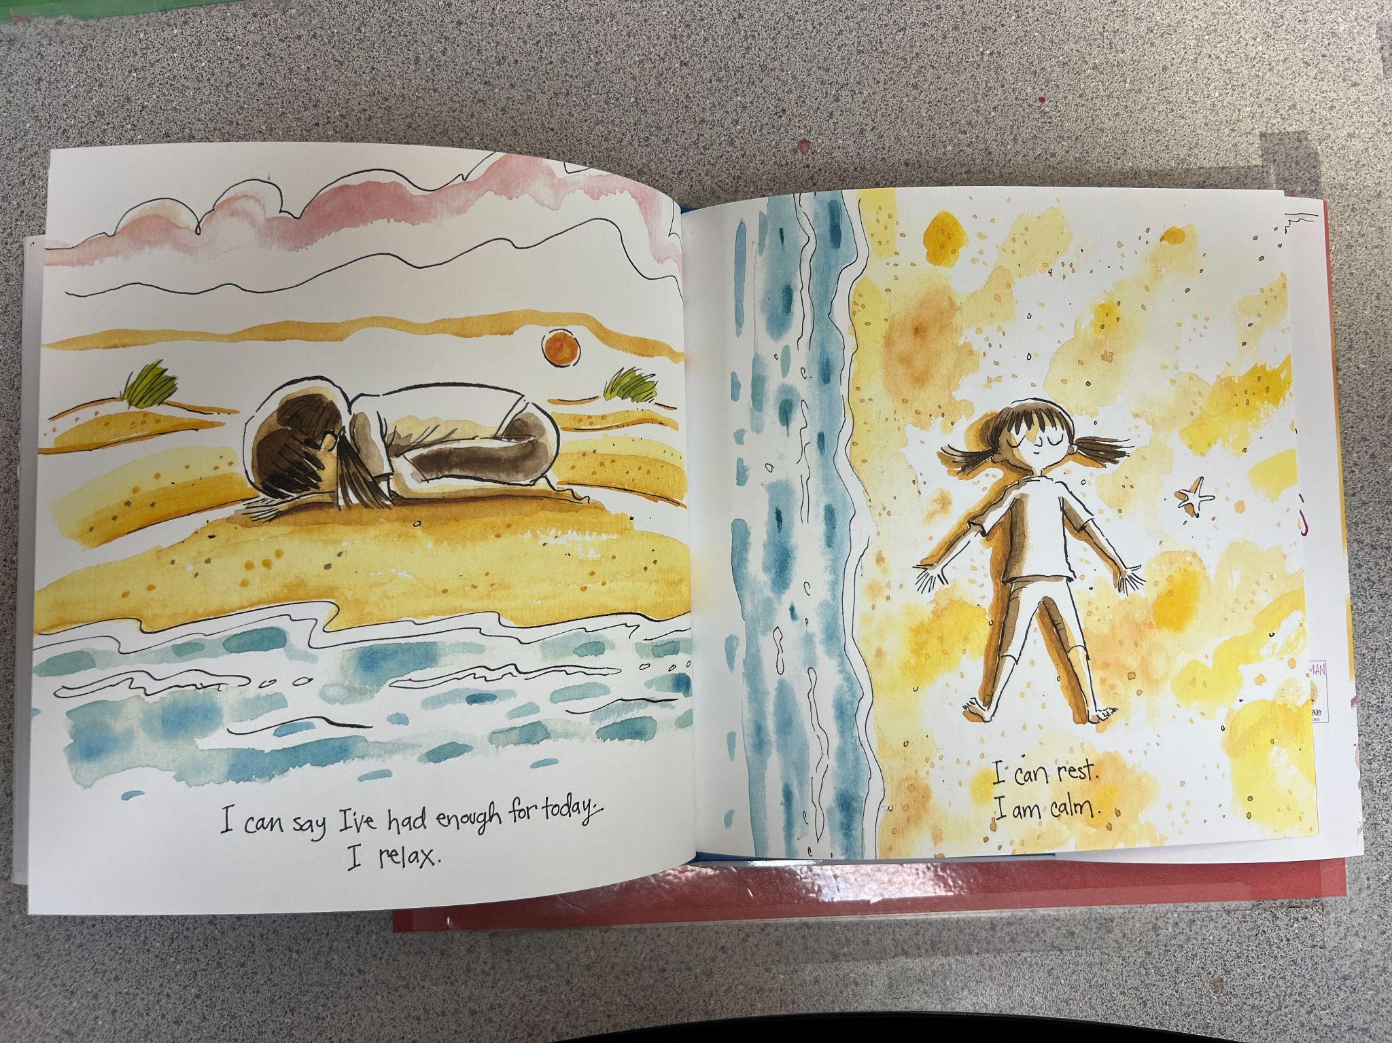

Slide 30
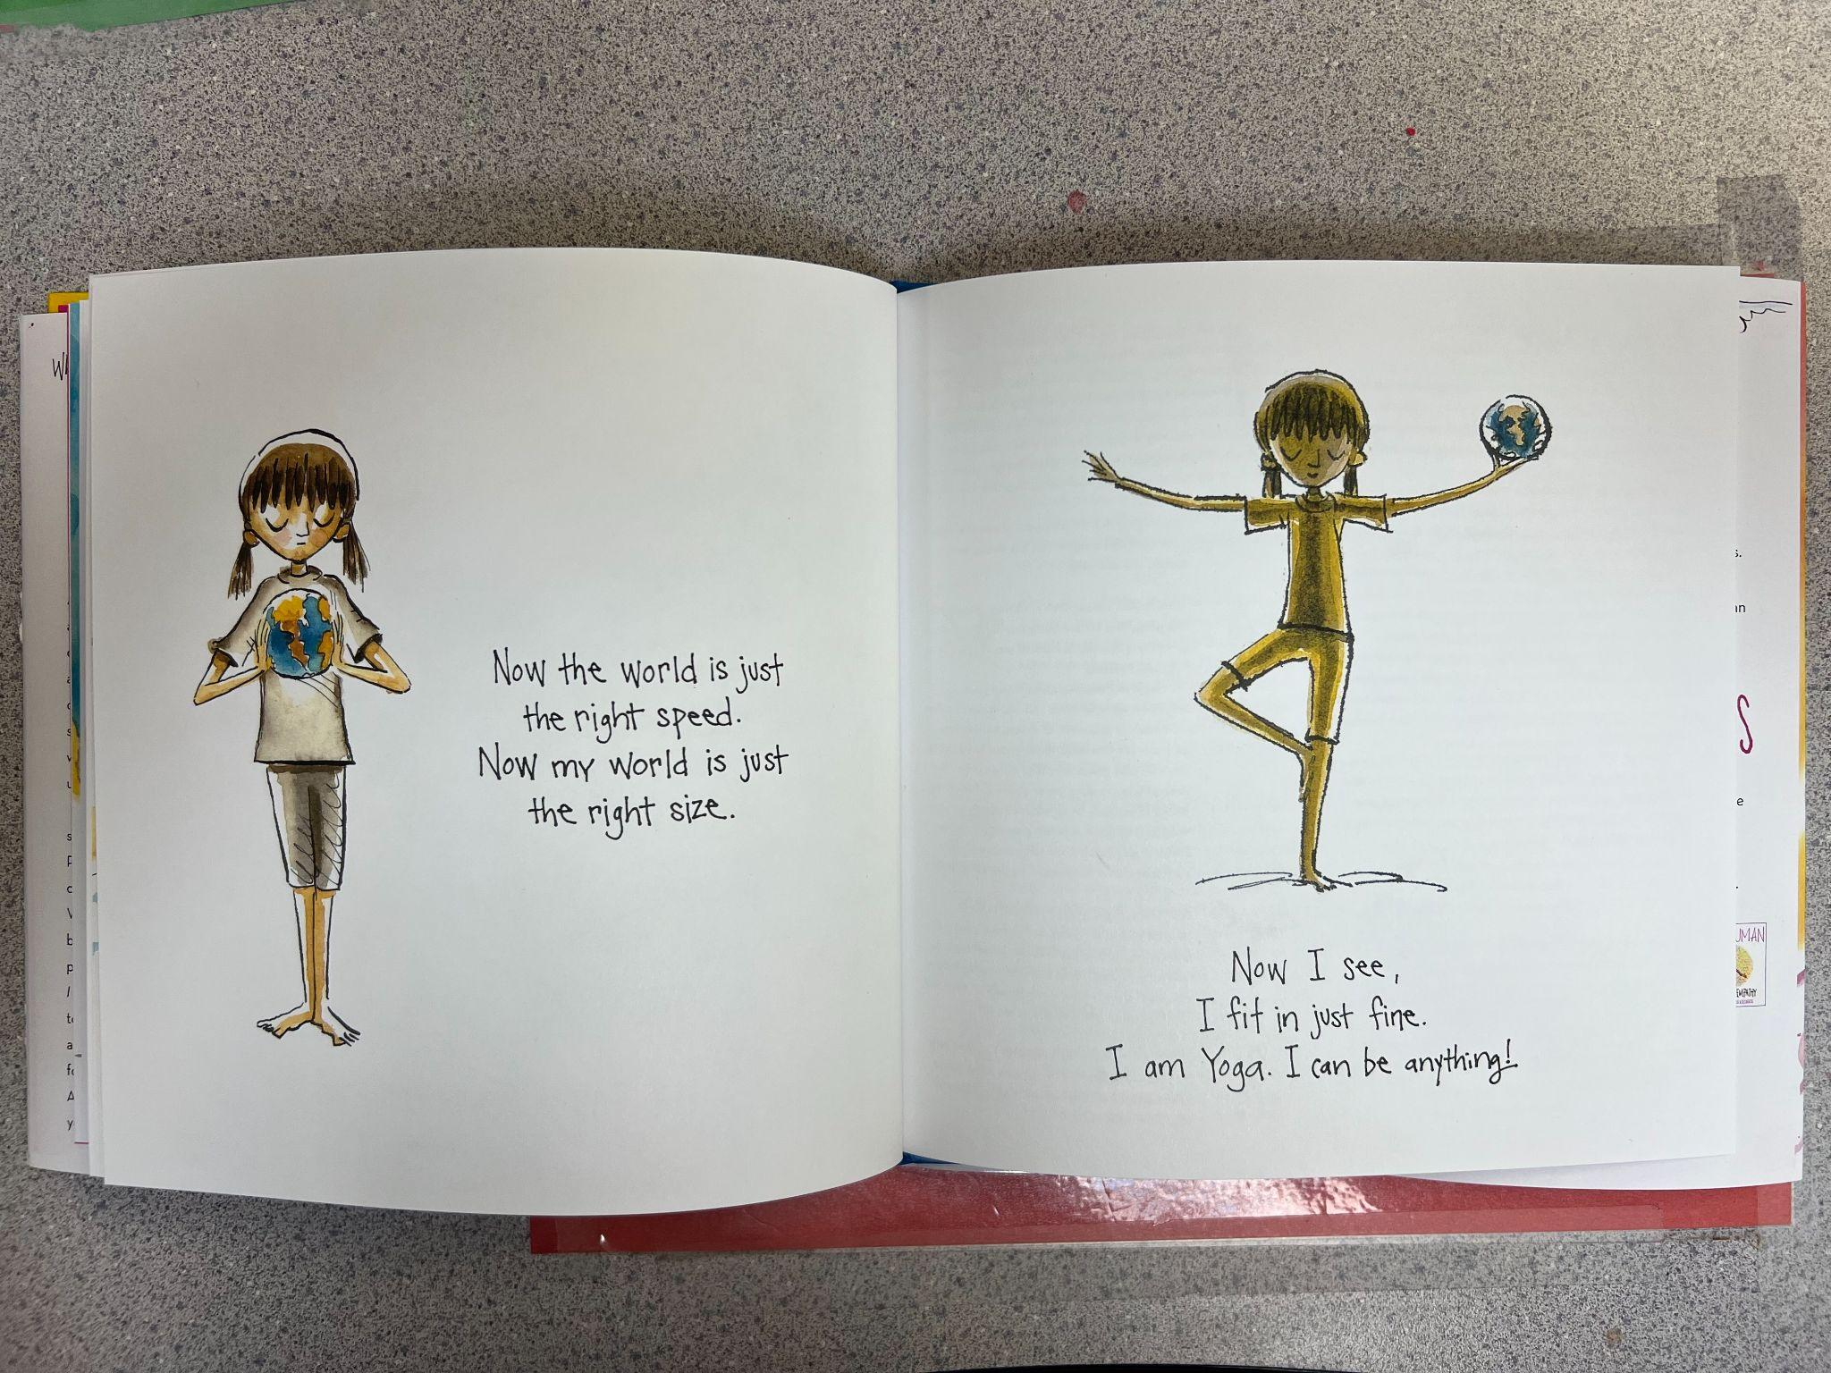

Slide 31
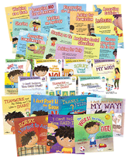
Julia Cook
A few of our favorites:
Wilma Jean the Worry Machine
Decibella
A Bad Case of Tattle Tale
My Mouth Is A Volcano
Baditude! What Do You Do When Your Life Stinks
Bubble Gum Brain: Ready, Get Mindset, Grow
Bully B.E.A.N.S
A Flicker of Hope

Slide 32
Books That Deal With Difficult Issues
Grief - Memory Tree (3-7)
The Invisible String (3-14)
Bullying - Strictly No Elephants (3-7)
Sticks and Stones (7-11)
Wonder - (12-14)
Divorce - Mom and Dad Blue (3-7)
Time Traveling With A Hamster (7-11)
The Thing About Jellyfish (12-14)
Trauma/Self Harm - A Terrible Thing Happened (3-7)
The Boy Who Built a Wall Around Himself (7-11)
The List of Real Things (12-14)
Anxiety/Worry - Wilma Jean and the Worry Machine (3-11)

Slide 33
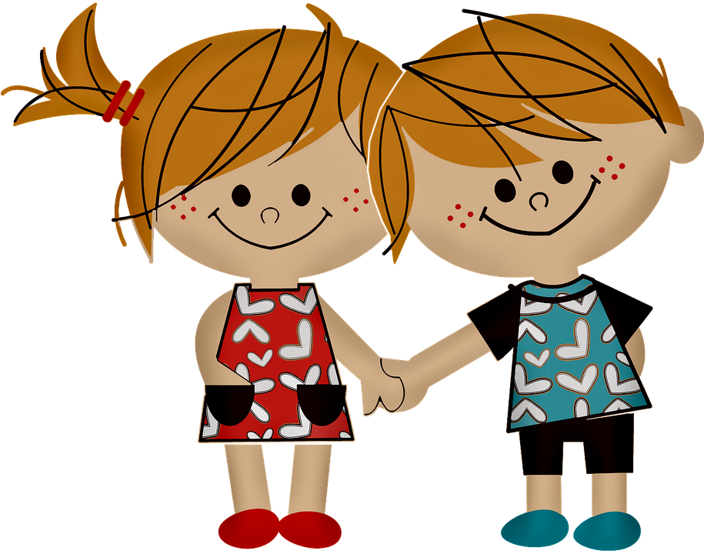
Respect
Chrysanthemum by Kevin Henkes
Personal Space Camp by Julia Cook
Do Unto Otters by Laura Keller
Lying Up a Storm by Julia Cook
Howard B. Wigglebottom and the Monkey on His Back
Ruthie and the (Not So) Teeny Tiny Lie by Laura Rankin
Lilly’s Purple Plastic Purse by Kevin Henkes

Slide 34
Responsibility
But It’s Not My Fault by Julia Cook
The Juice Box Bully by Maria Dismondy
The Little Red Hen Makes Pizza by Philemoa Sturges
What If Eerybody Did That? Ellen Javernick
Jupiter Storm by Marti Dumas
Hula Hoopin Queen by Thelma Lynne Godin
That Fruit Is Mine by Anuska Allepuz

Slide 35
Gratitude
Bear Says Thanks by Karma Wilson
The Family Under the Bridge by Natalie Savage Carlson
The Potato Chip Champ: Discovering Why Kindness Counts by Maria Dismondy
The Paper Kingdom by Helena Ku Rhee
Grow Grateful by Safe Foster

Slide 36
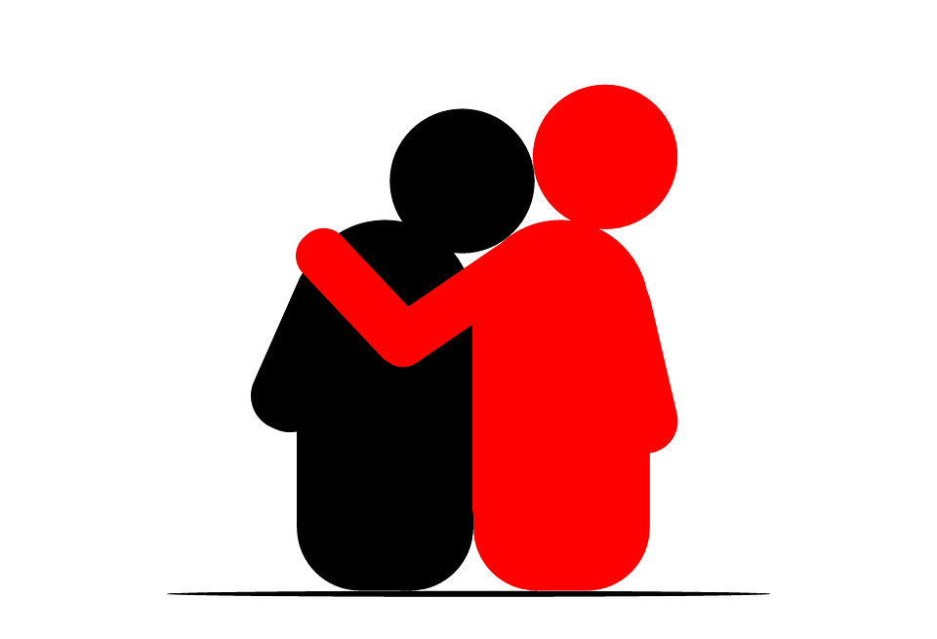
Empathy
Peanut Butter and Cupcake by Terry Border
Try a Little Kindness by Henry Cole
One Smile by Cindy McKinley
Nugget & Darling by Barbara Joosse
Stand In My Shoes by Bob Sornson
The Invisible Boy by Trudy Ludwig

Slide 37
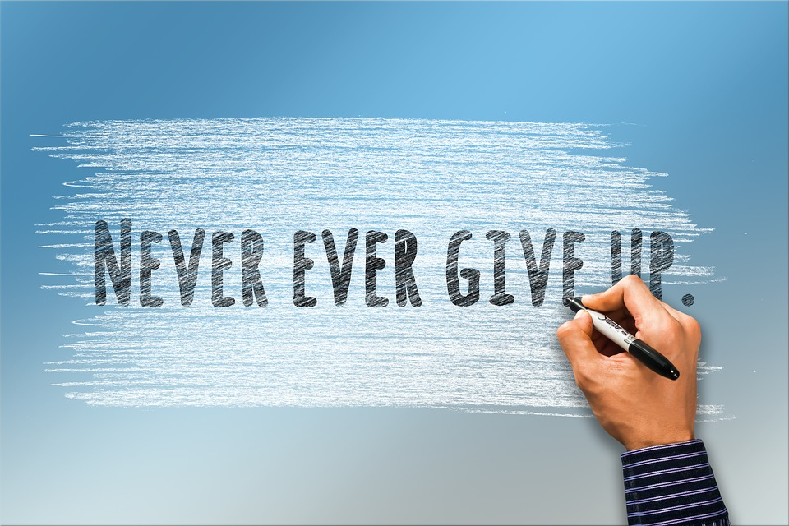
Perseverance
The Water Princess by Susan Verde
Leo The Late Bloomer by Robert Kraus
Tortoise and the Hare by Jerry Pinkney
Shhh! By Jeanne Willis and Tony Ross
Giraffes Can’t Dance by Giles Andreae

Slide 38
Honesty
Too Many Tamales by Gary Soto/Ed Martinez
Becoming Vanessa by Vanessa Brantley-Newton
The Secret Olivia Told Me by N. Joy
The Boy Who Cried Wolf by B.G. Hennessy
Alma and How She Got Her Name by Juana Martinez-Neal

Slide 39
Cooperation
Teamwork Isn’t my Thing and I Don’t Like To Share by Julia Cook
One by Kathryn Otoshi
Frankie by Mary Sullivan
Noisy Night by Josh Solis
Swimmy by Leo Lionni

Slide 40
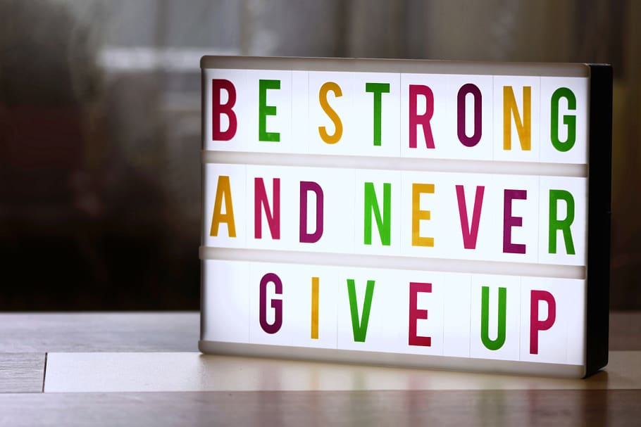
Courage
Don’t Worry Bear by Greg Foley
Be Brave Little One by Marianne Richmond
Scaredy Squirrel by Melanie Watt
Courage by Bernard Waber
Some Things Are Scary by Flomma Pevvy Heide

Slide 41
Creativity
The Dot by Peter H. Reynolds
Beautiful Oops by Barney Saltzberg
Because by Mo Williams
Happy Dreamer by Peter H. Reynolds
When Pencil Met Eraser by Karen Kilpatrick

Slide 42
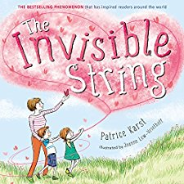
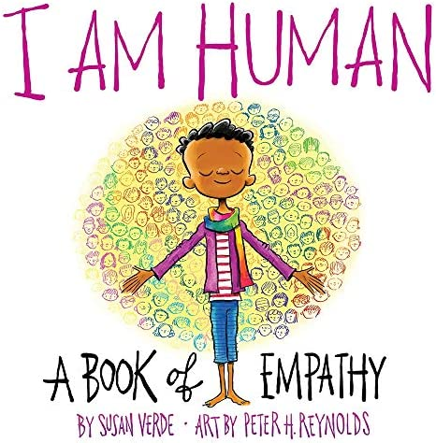
Allison’s Top 5
The Book With No Pictures
B.J. Novak
The Invisible String
Patrice Karst
I Am Human
Susan Verde
Pete the Cat: I love my White Shoes
Eric Litwin
The Power of One
Trudy Ludwig

Slide 43
Anita’s Top 5
Peanut Butter and Cupcake
Terry Border
The Dot
Peter H. Reynolds
Chrysanthemum
Kevin Henkes
Lilly’s Purple Plastic Purse
Kevin Henkes
The Invisible String
Patrice Karst

Slide 44
Mindfulness
I Am Peace
Susan Verde
Art by Peter H. Reynolds
2. Moody Cow Meditates
3. Breathing Makes It Better

Slide 45
Anxiety and Worry
Worry Says What
Wilma and the Worry Machine
Way Past Worried

Slide 46
Books and Technology
Libbib
Excellent site/app to categorize your personal libraries
https://www.libib.com/library/add-item
Novel Effects
App to add some fun to your read aloud experience
YouTube
Tons of recorded read alouds

Slide 47
We want to hear from you
What are some of your favorite books to use with students?

Slide 48
Giveaways!

Slide 49
Contact us/social media
Anita
Email: atownsley@s-tama.k12.ia.us
Phone: 641-484-3999 Extension 1114
Allison
Email: grahama@newton.k12.ia.us
TikTok: allisongraham08
Instagram: allisonmgraham
Twitter: @allisongraham83
Facebook: Emerson Hough School Counseling

