Slide 1
Growing Your K-5 Future Ready Culture
ISCA 2019
Amy Anderson (she/her/hers)
Southeast Polk PK-12 At-Risk Coordinator
amy.anderson@southeastpolk.org
https://tinyurl.com/ISCA-K-5CCR

Slide 2
Presentation & Resource Folder at
https://tinyurl.com/ISCA-K-5CCR

Slide 3
Introduction
My Background
Counselor for 10 years at middle school & K-5 level
Current role: PK-12 At-Risk Coordinator
Why I’m Here
Iowa CCR Academy Courses through Iowa College Aid
Mentorship from Dave Ford & Sue Schirmer
Amazing K-5 Counseling PLC at Southeast Polk
Summer curriculum work identifying priority standards and objectives
Supportive administration

Slide 4
Learning Outcomes
Participants will understand three of NOSCA’s Eight Components of College and Career Readiness Counseling and how they relate to the K-5 setting
College Aspirations
College and Career Exploration and Selection Process
College and Career Assessments
Participants will demonstrate understanding by setting one goal for the school year related to the three components.
Handout

Slide 5
Agenda
Gain awareness of three of the “Eight Components”
Learn how one elementary school implemented a Future Ready curriculum and programs
Review a pre-/post-assessment tool
Review outcome data from a curriculum unit and 5th grade small group intervention
Set a goal for the school year related to one of the eight components

Slide 6
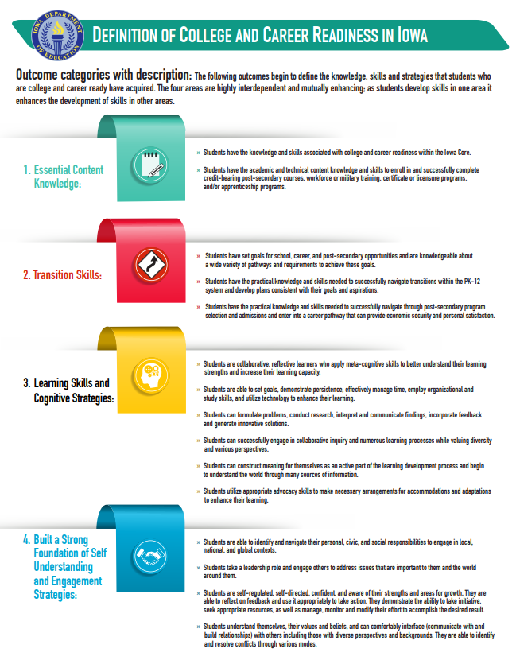
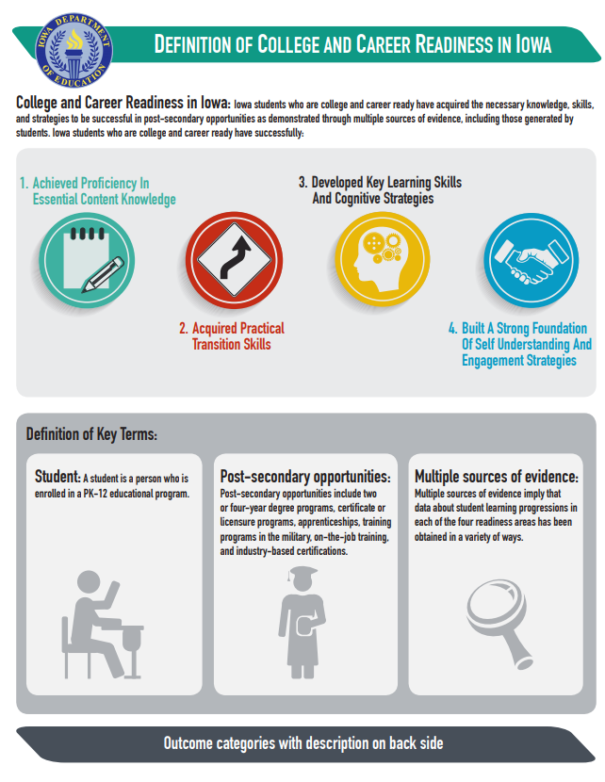
Iowa CCR Definition
Notes:
https://educateiowa.gov/sites/files/ed/documents/Definition%20of%20College%20and%20Career%20Readiness%20Flyer.pdf . Definition looks at individual student level. This presentation is more about school-wide culture

Slide 7
Data-Based Decision Making & Equity
Iowa CCR Academy Course
Data scavenger hunt
Articles on equity, focusing on subgroups
Program gap analysis
Ask your secondary counselors
Iowa Postsecondary Readiness Reports

Slide 8
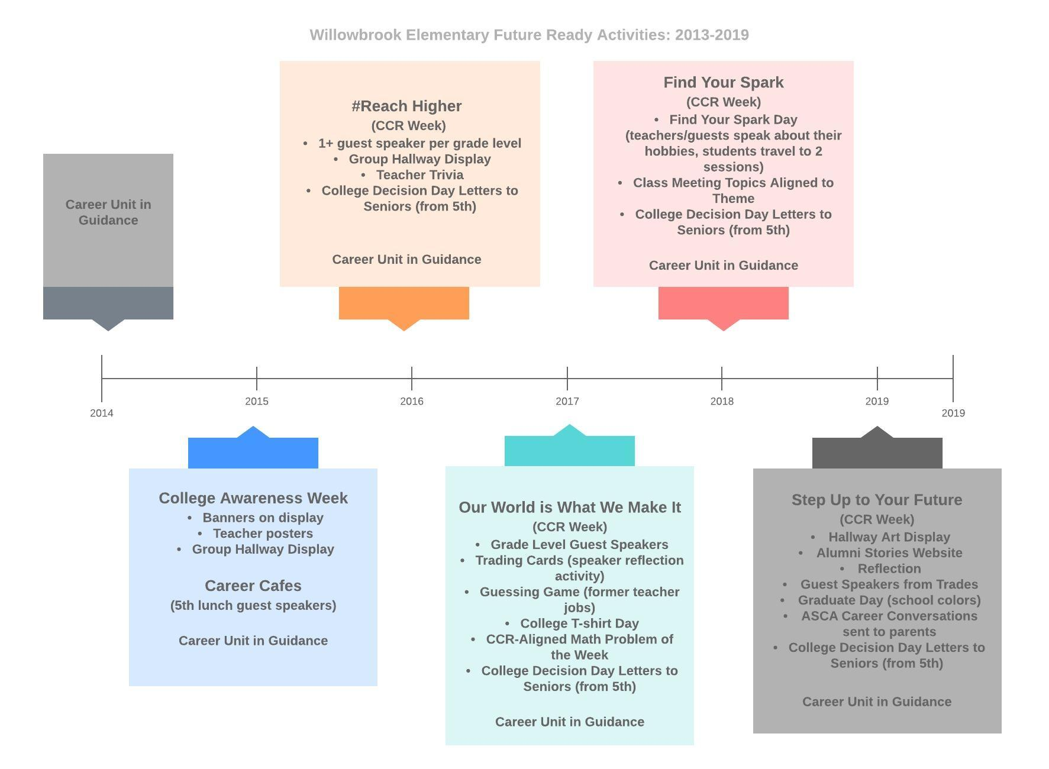
Notes:
This diagram shows how we built the CCR programming at Willowbrook Elementary over the course of 6 years. *Start small. Use data. Form a committee if you can. Align work K-5 and K-12 if you can.

Slide 9
NOSCA’s Eight Components of College and Career Readiness Counseling
Six of the eight components are relevant for elementary
We are focusing on three today. Skim them, and write your current practices for each on your handout.
1. College Aspirations
2. College and Career Exploration and Selection Process
3. College and Career Assessments

Slide 10
Share out
Turn and talk to a neighbor about your current practices
Capture new ideas on your handout

Slide 11
College Aspirations
Notes:
Includes all of your work related to early identification and intervention around grades, attendance, behavior. More specifically, it also includes building a college-going culture-- discussing it, making it VISIBLE in building. More info on that here: https://secure-media.collegeboard.org/digitalServices/pdf/highered/college-ed-create-college-going-culture.pdf

Slide 12
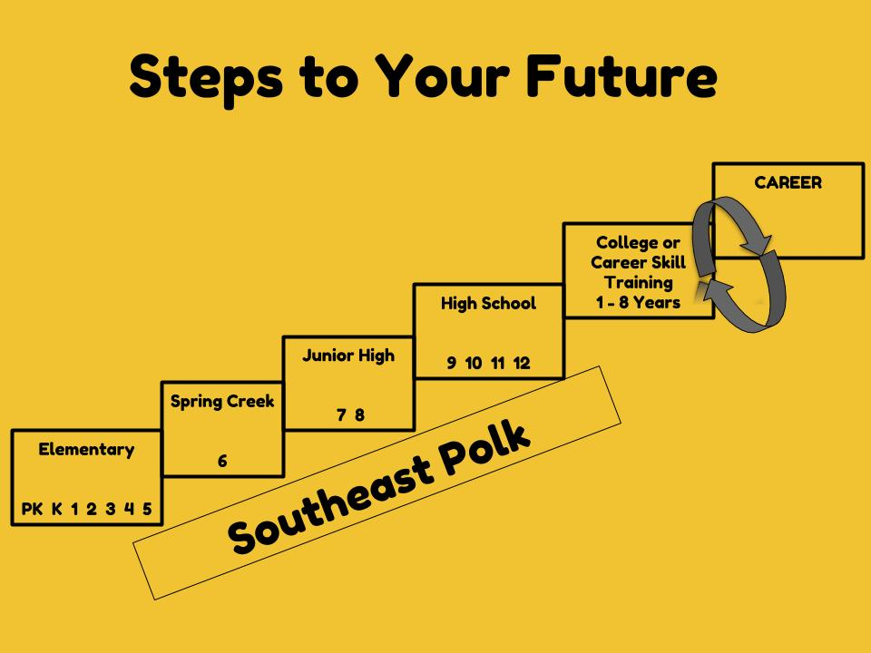
Curriculum (College Aspirations)
All grades
Pathway from elementary to high school and beyond
Counselor Presentation
Grade 4
Academic vocabulary: college, apprenticeship
Virtual college tours + scavenger hunt
Fantasy College Project
Notes:
All students learn about the pathway from elementary to high school and beyond. Fourth grade curriculum has an additional focus on postsecondary opportunities

Slide 13
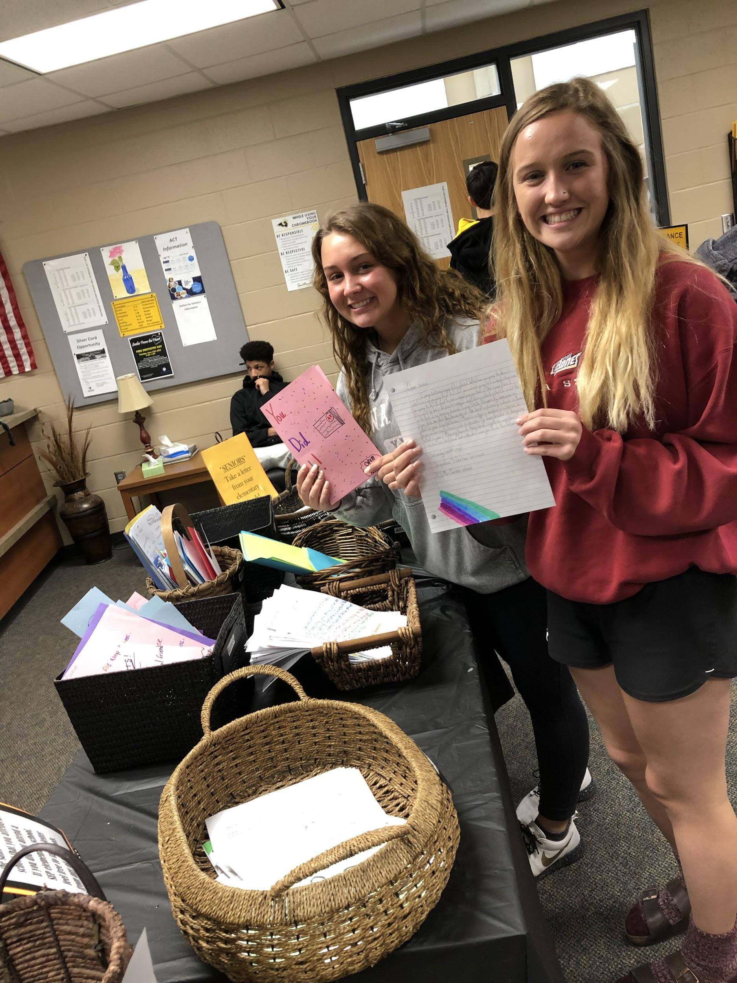
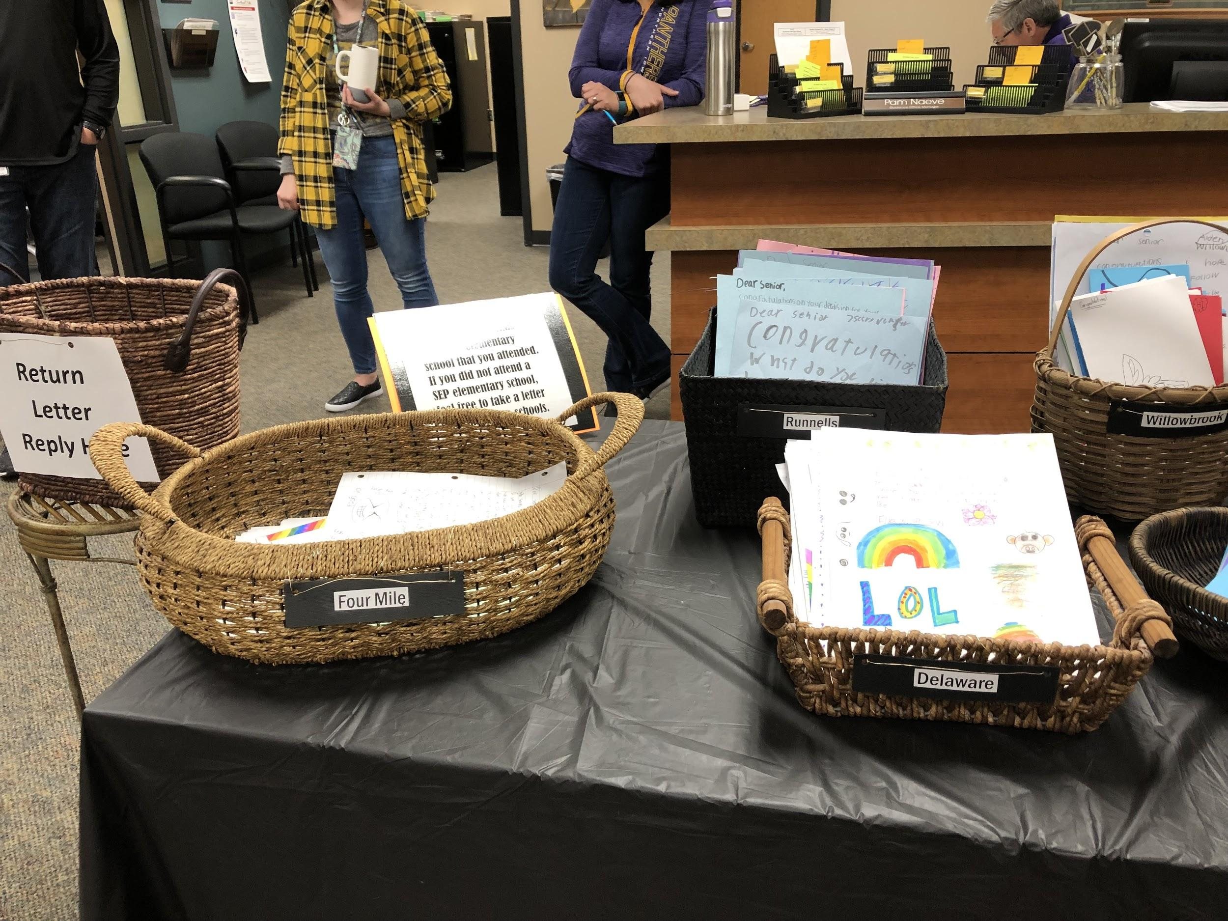
Decision Day (5th Grade Letters to Seniors)
Notes:
All SEP elementary buildings work with the high school to create letters from 5th grade students congratulating seniors who stop in the Counseling Office on Decision Day on their big transition. High School students select a letter from the elementary they attended.

Slide 14
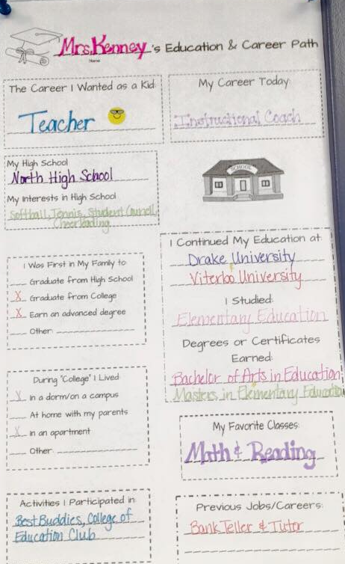
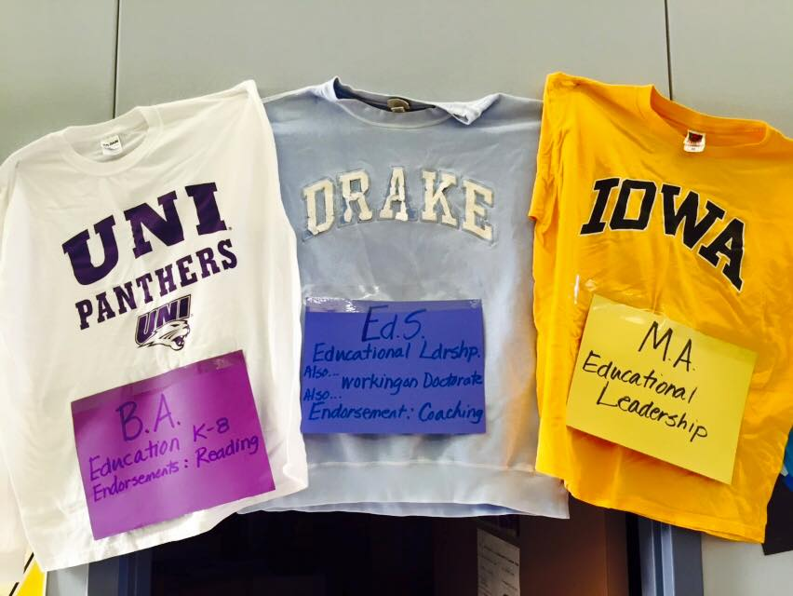
College-Going Culture - Make it visible!
Poster template
Notes:
Making college-going culture visible

Slide 15
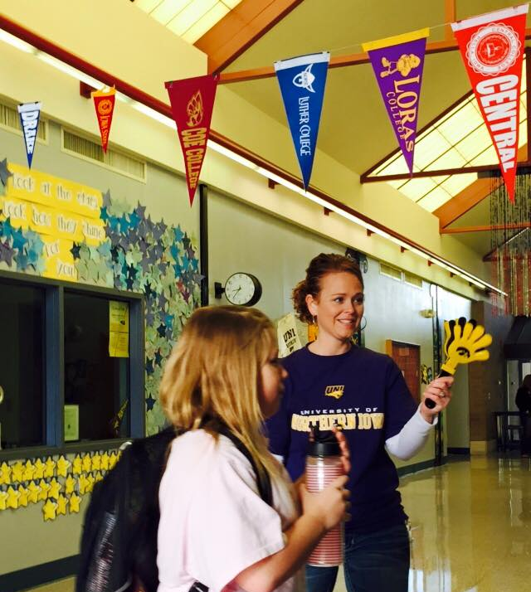
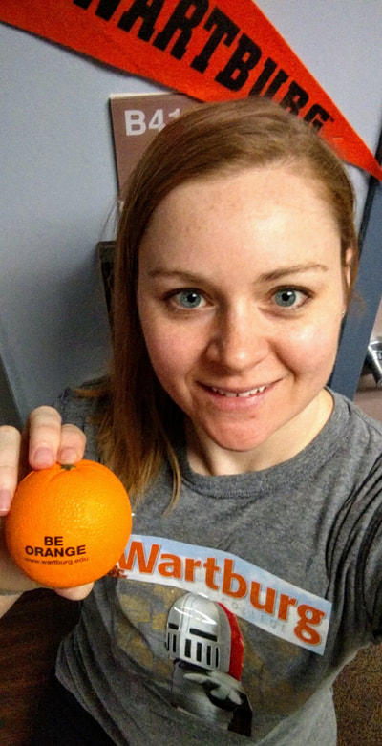
College-Going Culture - Make it visible!

Slide 16
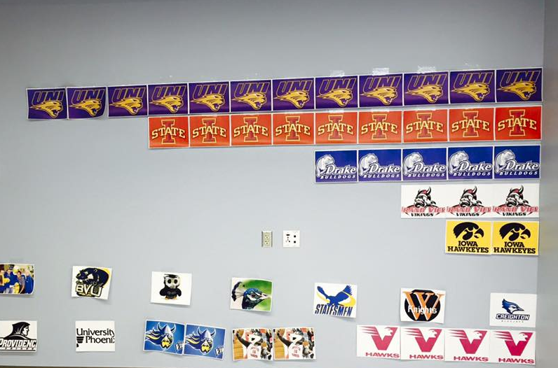
Teacher College Bar Graph

Slide 17
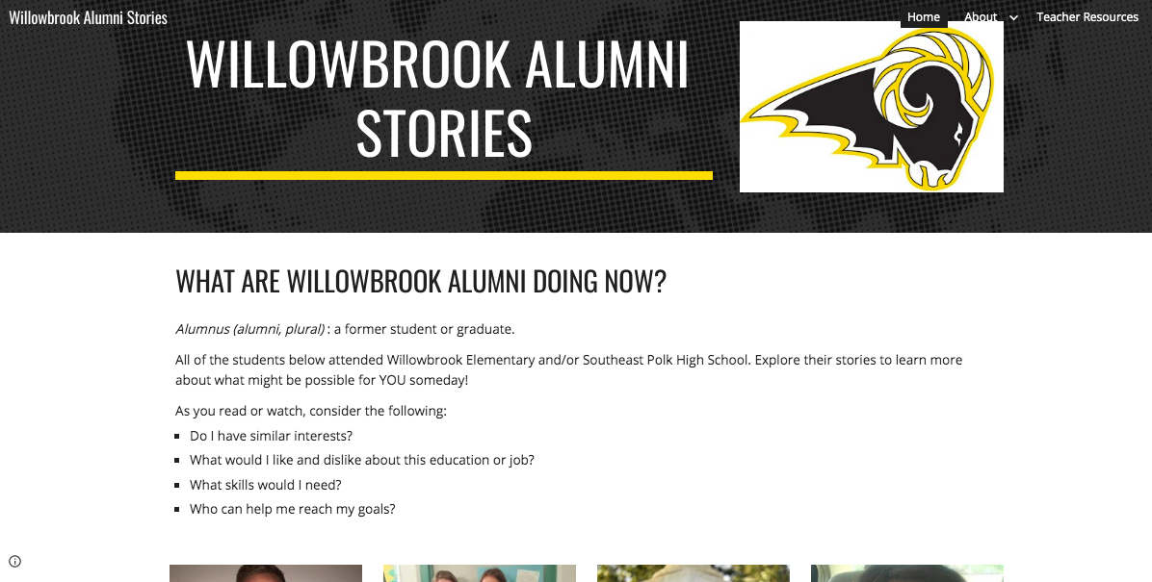
Alumni Stories Website
Notes:
We were logistically unable to coordinate a graduate walk (which I learned about at ISCA last year!), so we did this instead. A 5th grade teacher helped me create it and many teachers reached out to former students.

Slide 18
College & Career Exploration

Slide 19
Curriculum Framework (K-5)
Career Paths
-simplified version of clusters
-borrowed from DMPS model
-Presentation used grades 2-4
Notes:
The Venn Diagram comes from the concept of Ikigai, a Japanese concept that means “a reason for being.” I learned about this simplified model as an AmeriCorps volunteer for a summer camp with The Power of Hope in Seattle, Washington. When I share this with students, I use myself to model examples of why all 3 are needed for the best fit career. (i.e. - good at napping and interested in it but no one will pay me for it; good at math and many jobs use math, but I don’t enjoy it; counseling - all three)
At SEP, we also use the DMPS model of Career Paths. We have discussed if we need to switch to career clusters, since we use Career Cruising 8-12. However, the simplified version has worked well for us so far.

Slide 20
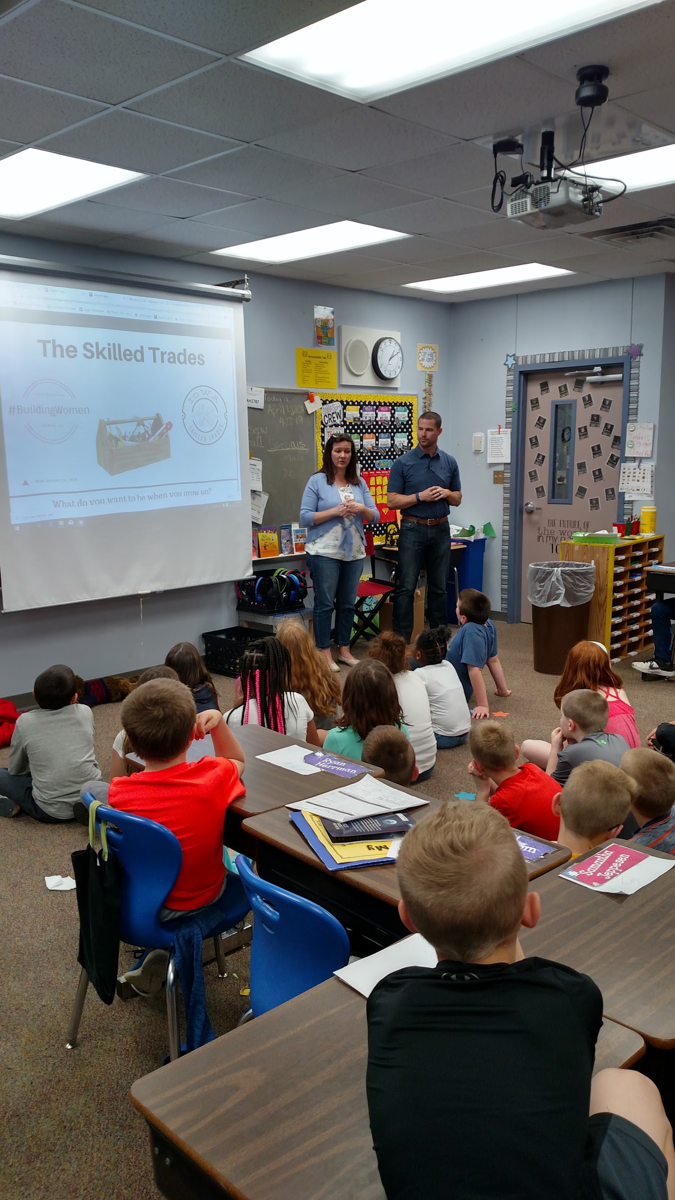
Career Speakers
Year 1- none
Year 2- Career Cafe (5th only, 6 career speakers- 1 per path)
Year 3 & 4 - Each grade level invited speakers
Year 5 - Guest speakers on hobbies
Year 6 - Alumni website + speakers on trades

Slide 21
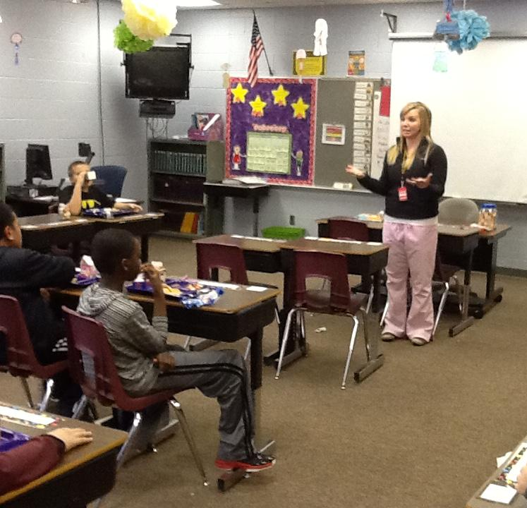
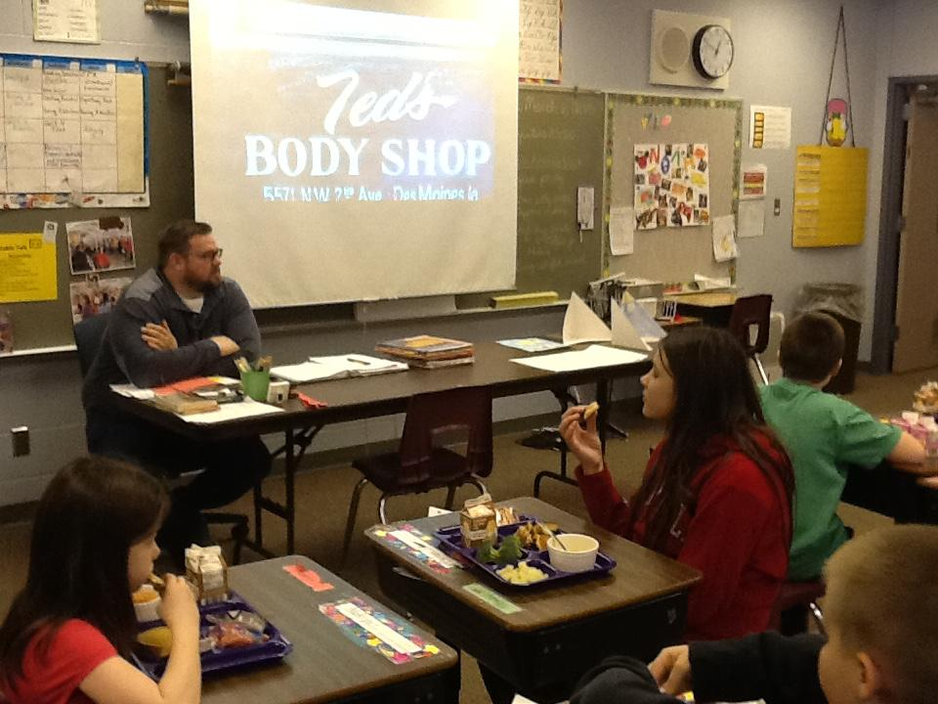
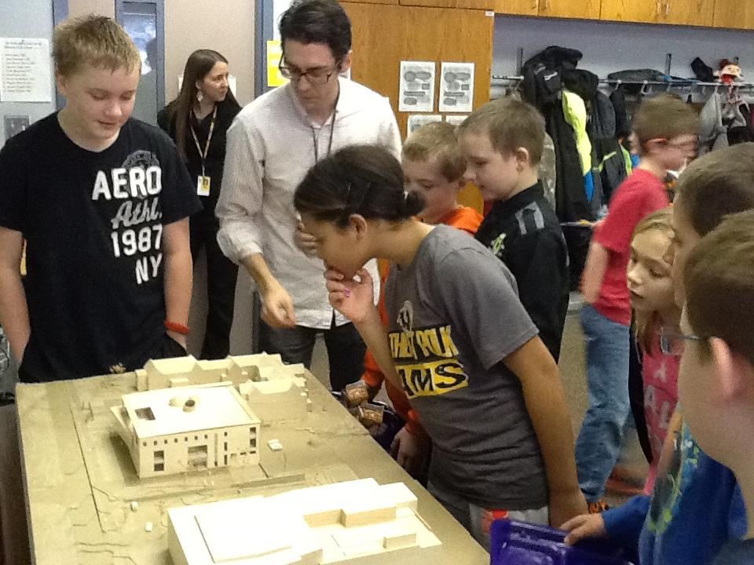
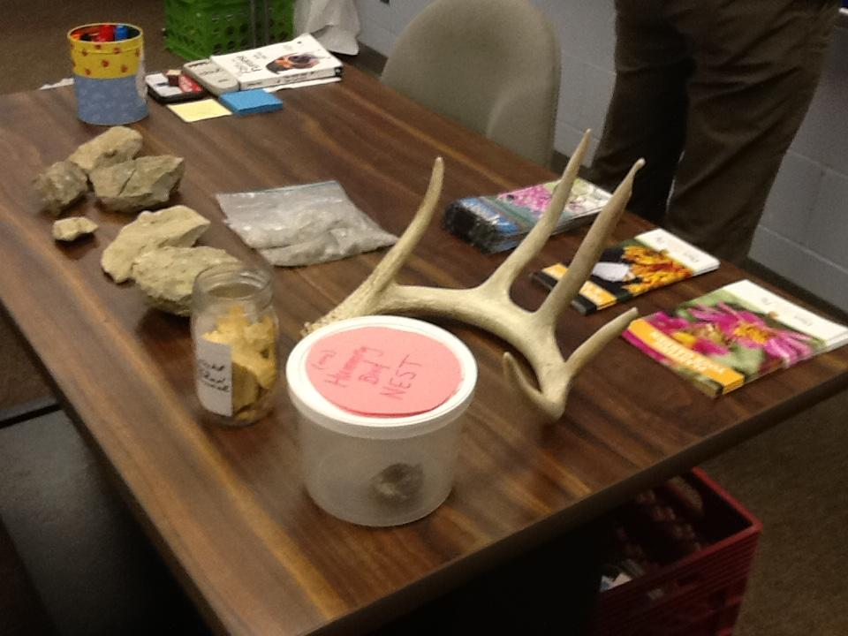
Career Cafe (5th)
5th grade students selected their top 2 career paths and were invited to lunch with a guest speaker from that path.
Notes:
This was a year 1 activity. Allowed me to start small.

Slide 22
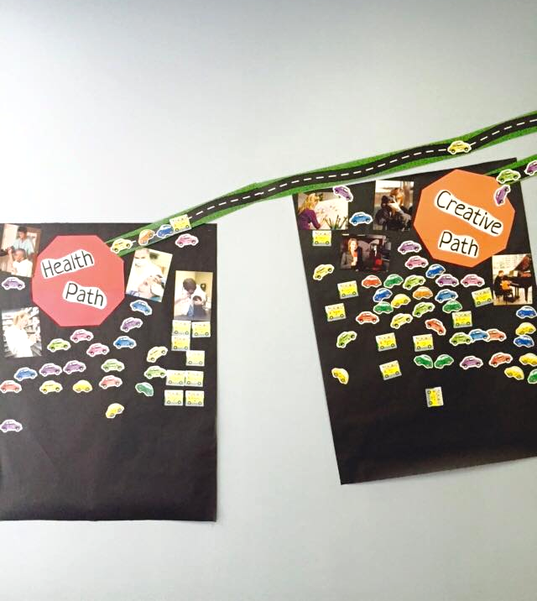
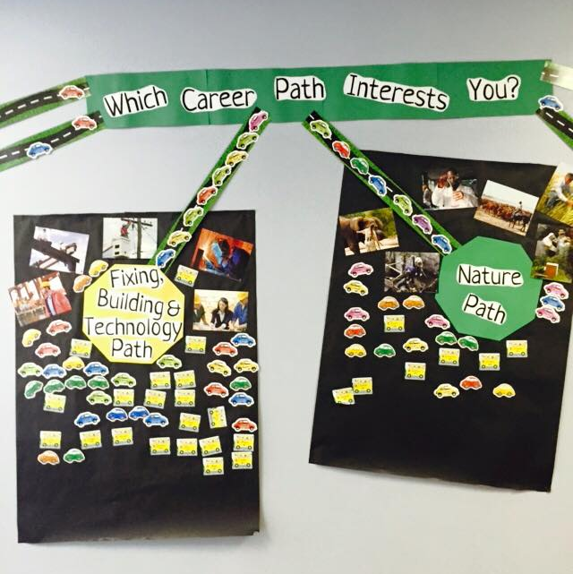
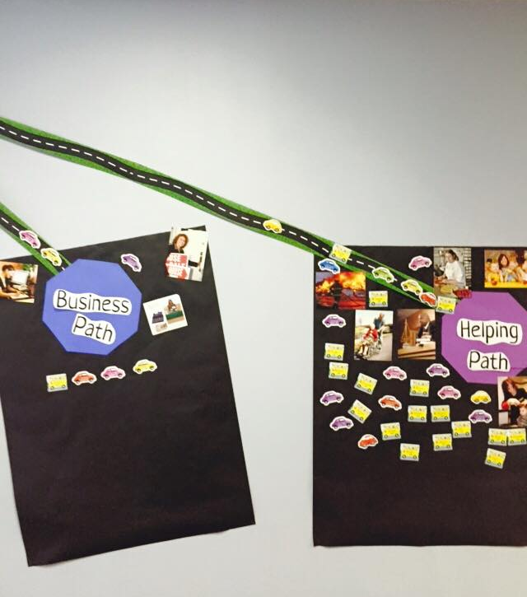
Notes:
We did a lot of visual displays at Willowbrook that students had an interactive part in. This made their interests and preferences visible to everyone. Many students stopped to look for their own name and that of friends and siblings.

Slide 23
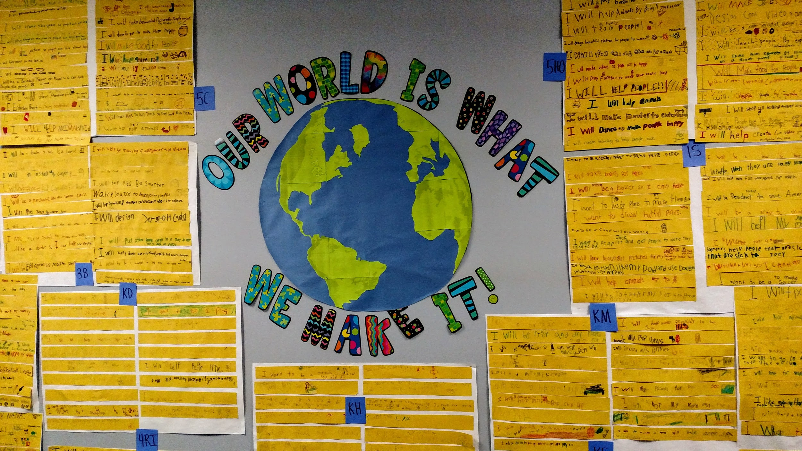
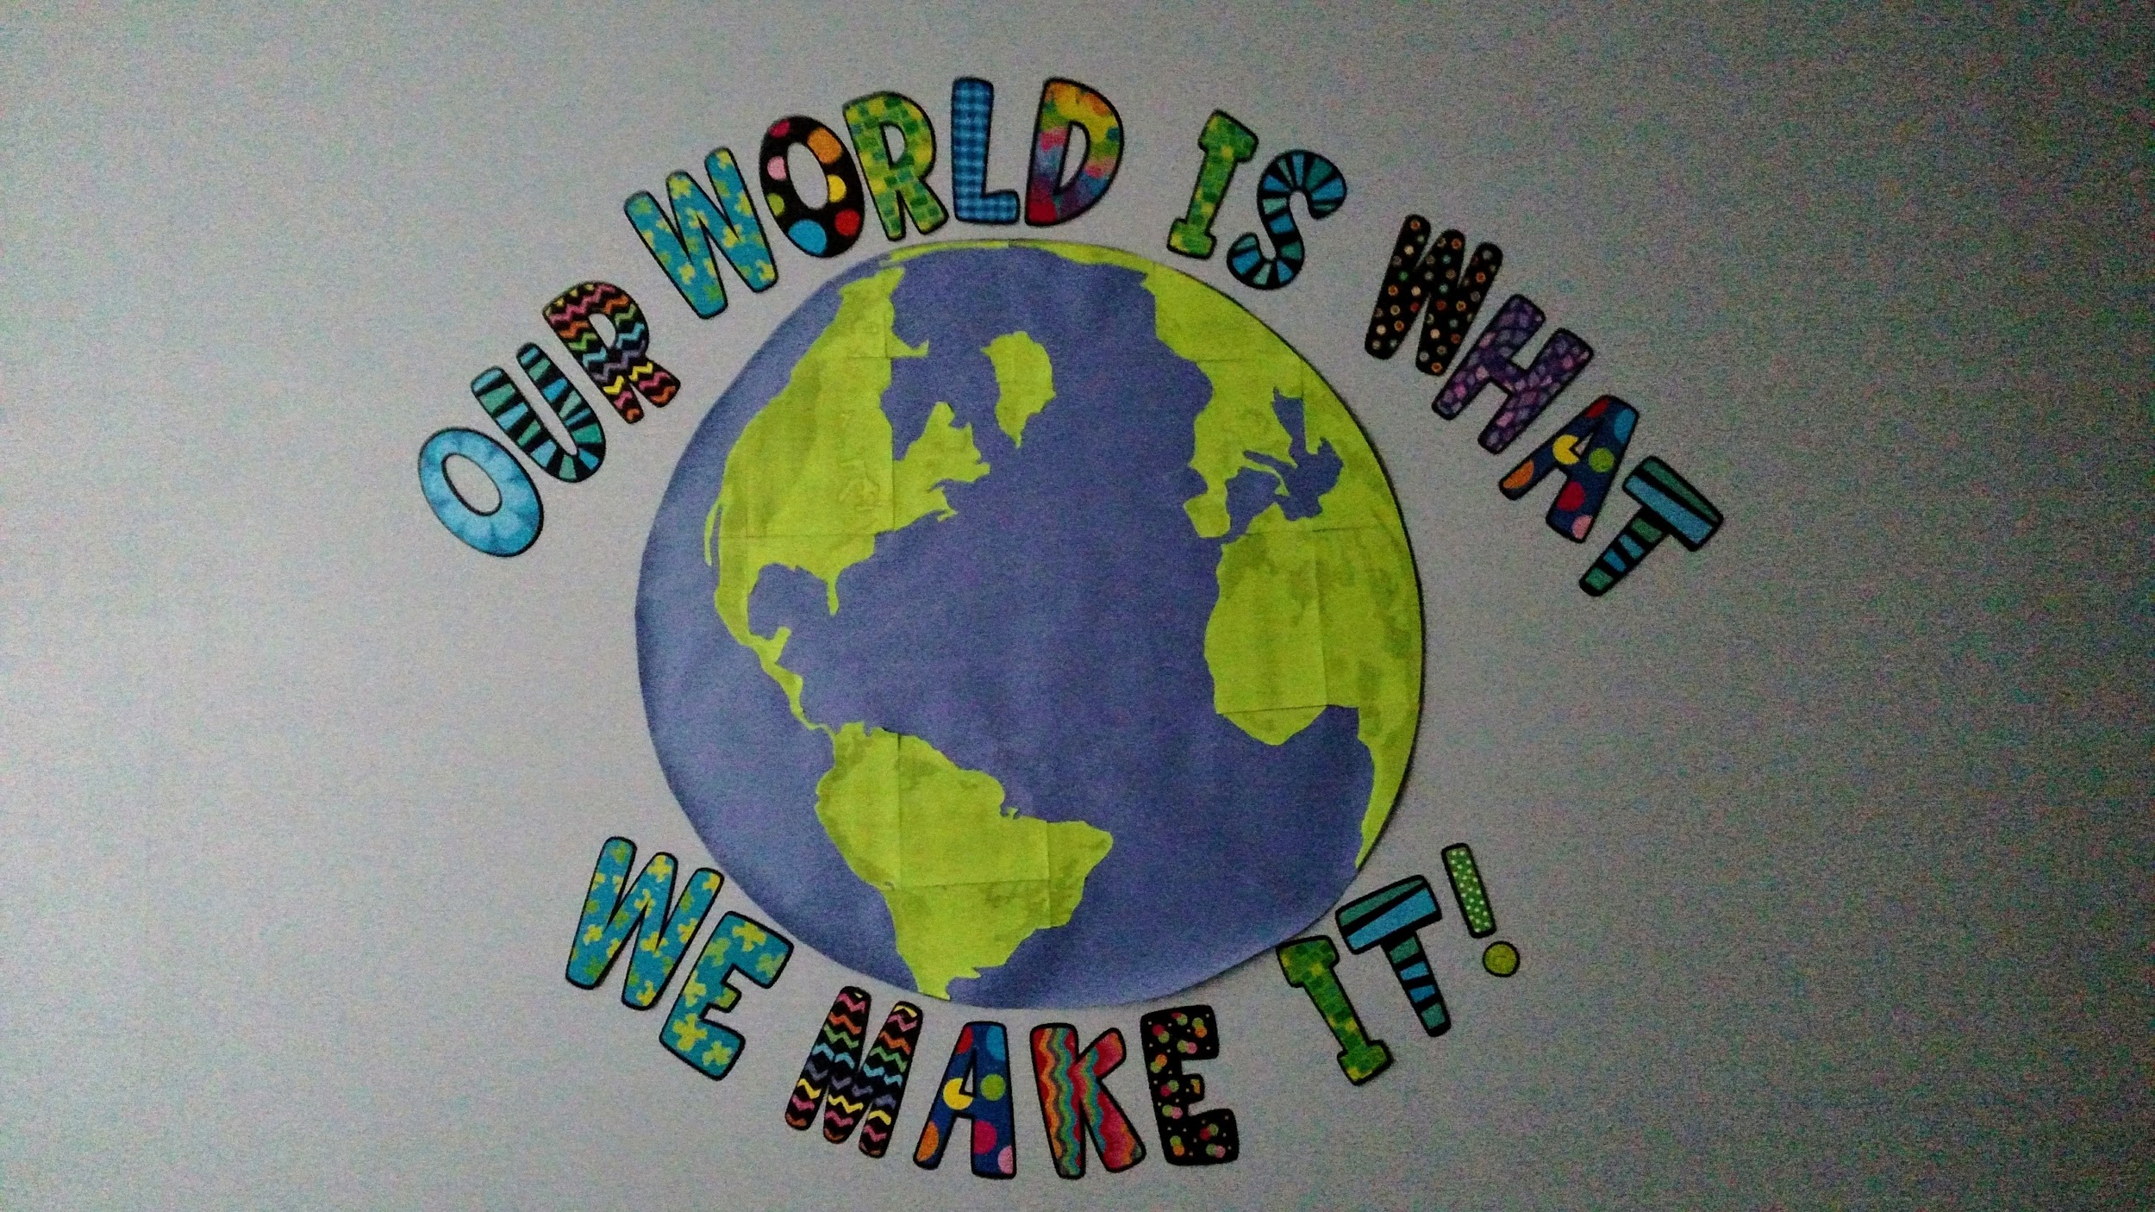
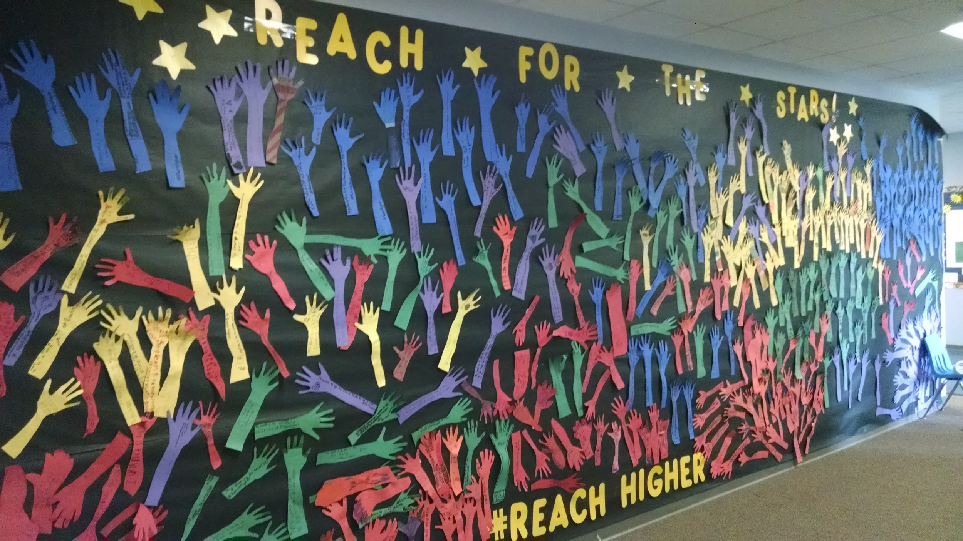
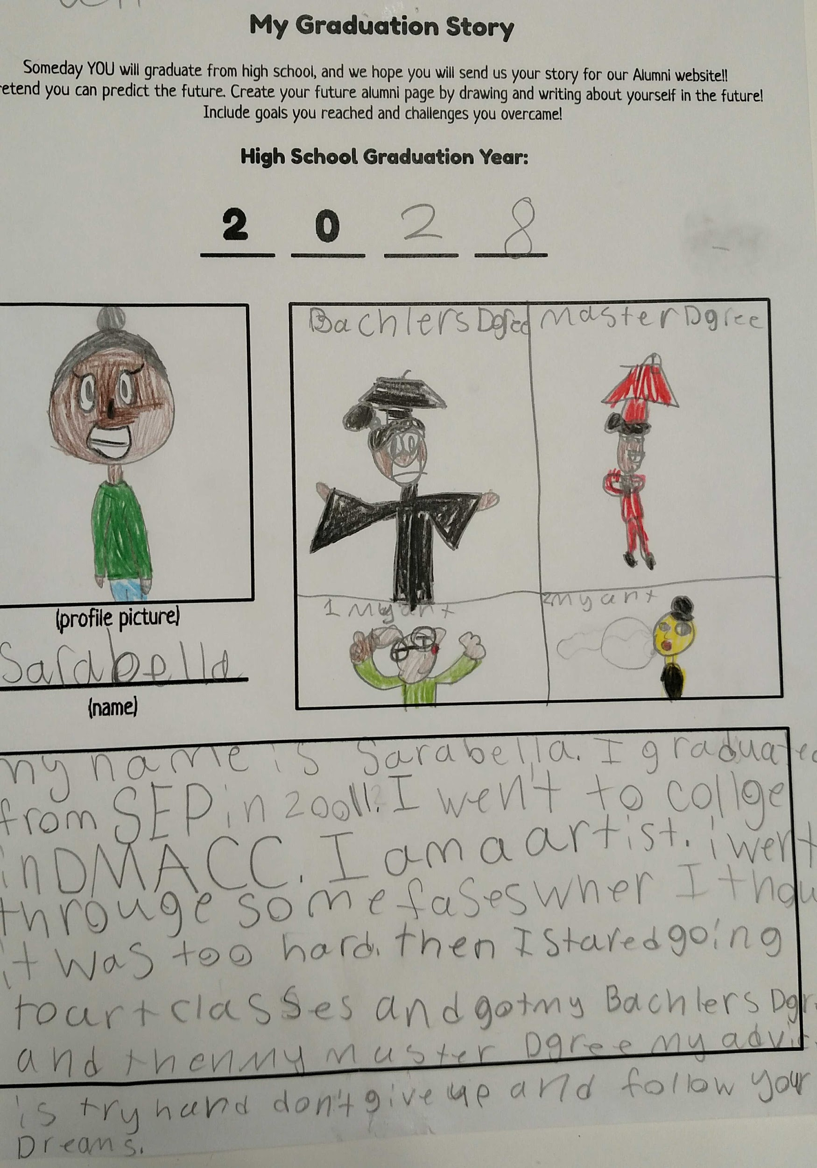
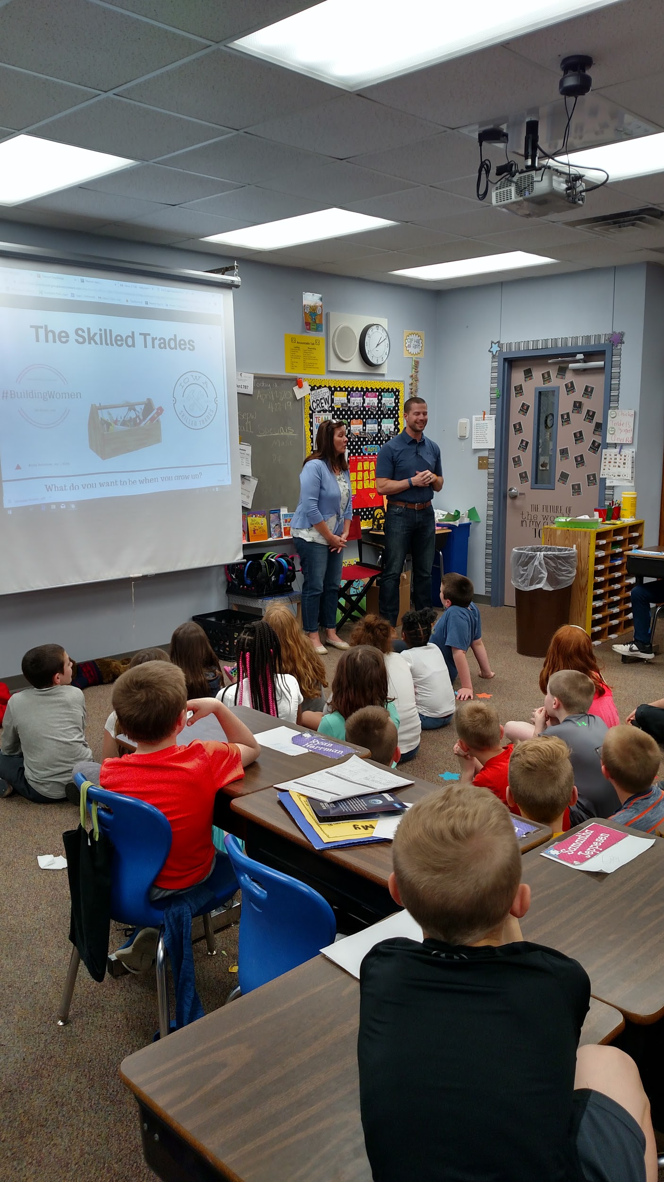
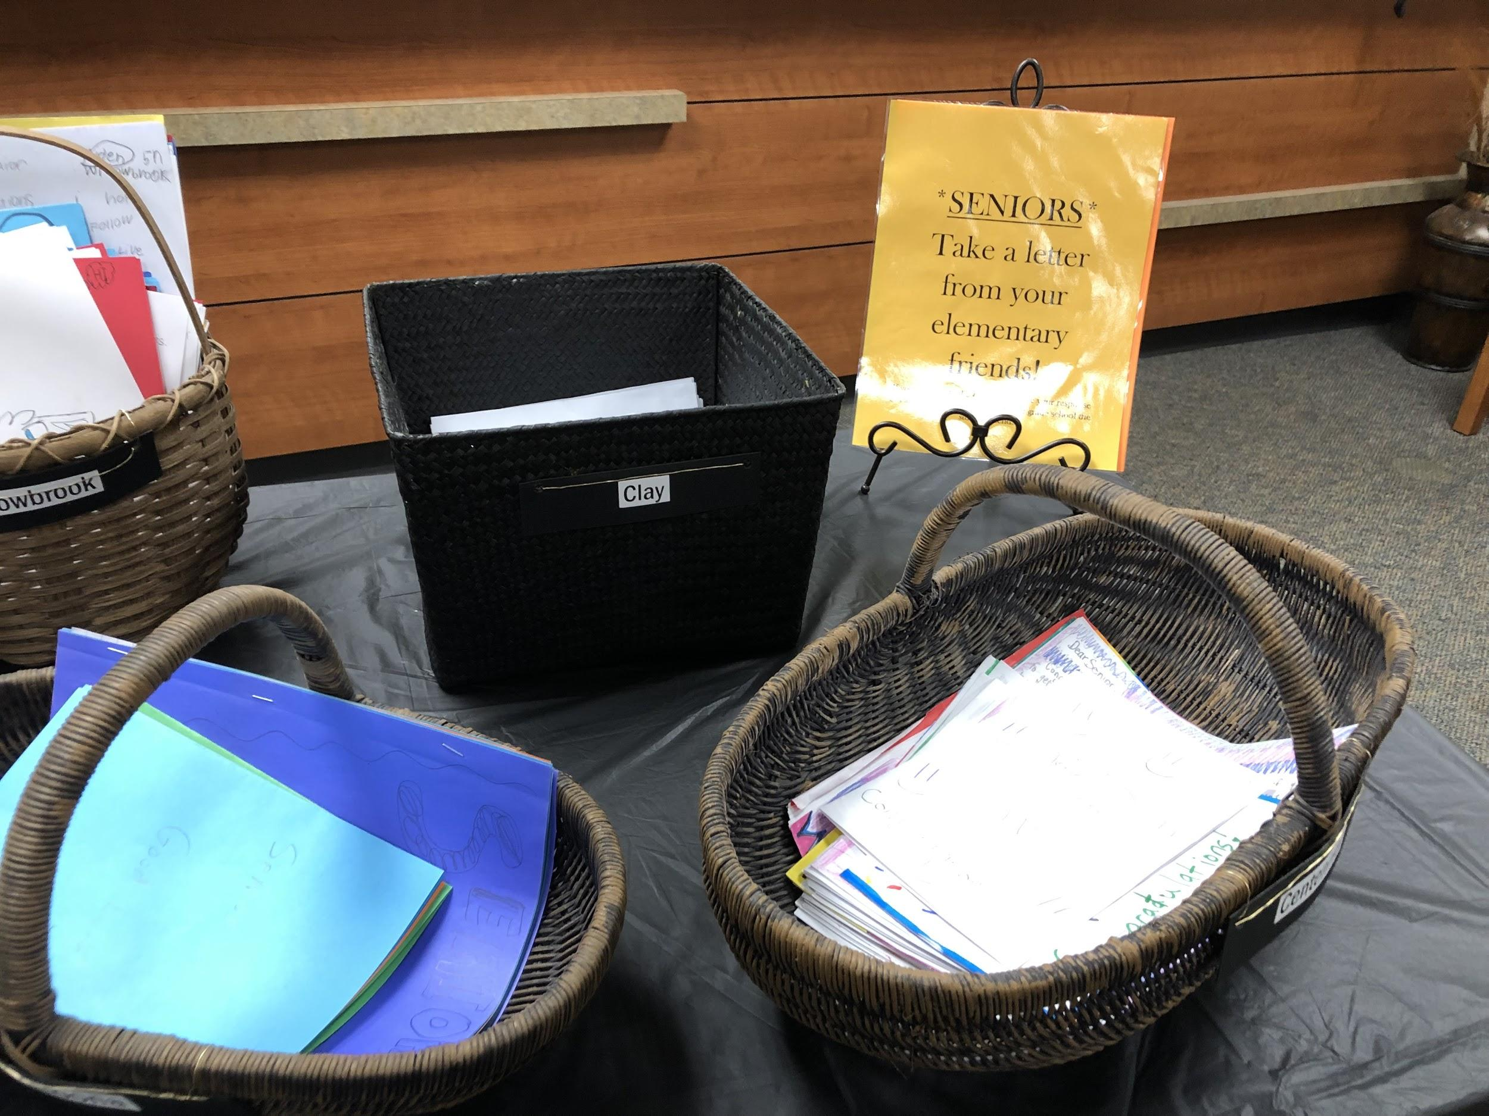
Notes:
Each year we selected a new theme for the week and display

Slide 24
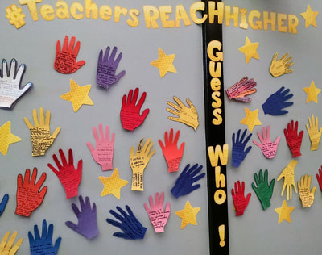
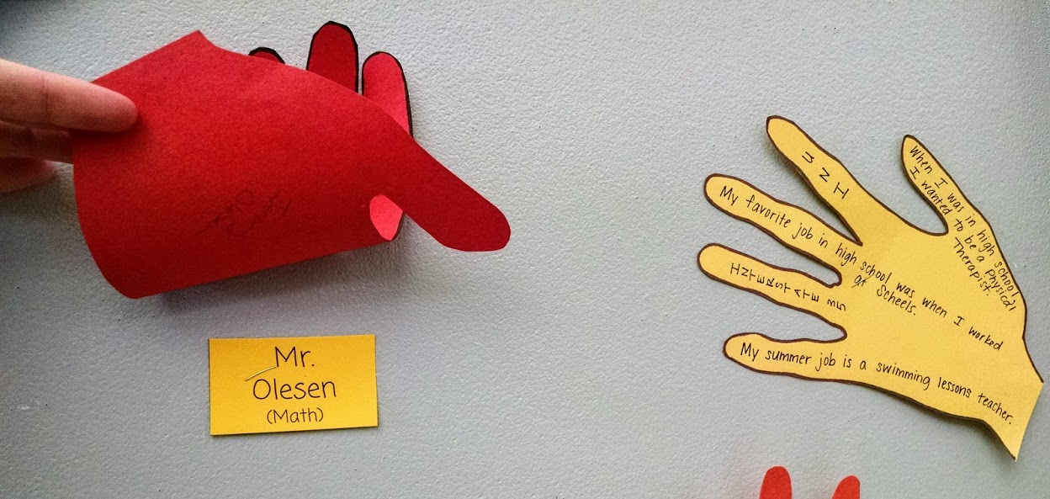
Notes:
Teachers wrote some facts about themselves related to their education, career, and previous jobs

Slide 25
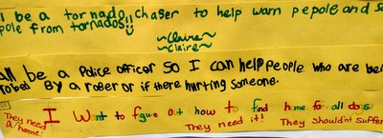
Notes:
This year our theme and activities centered around the idea that one purpose of work is that it allows us to impact the world in some way. Students were asked to write a sentence that described how they wanted to help the world. Their answers were very thoughtful, and even the youngest learners were able to participate.

Slide 26
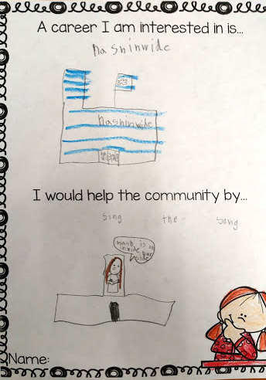
Notes:
Again, the idea that our work impacts our community. This kindergartener is starting to make connections but maybe doesn’t quite understand Nationwide yet. :)

Slide 27
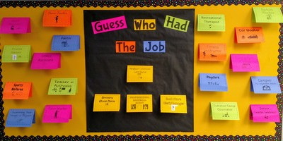
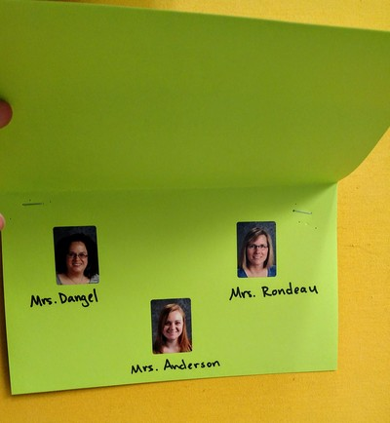
Notes:
Teacher submitted previous jobs they had held before being a teacher. These were grouped into a guess who activities and placed in the lunch hall where students stand for awhile waiting to be dismissed.

Slide 28
Notes:
Find Your Spark week (see resources in folder) was the result of my observation that many students did not know the definition of a hobby and could not name one even when it was defined. We spent the week focusing on hobbies and interests and had a day when students attended 2 sessions from teachers or guest speakers about hobbies they enjoyed outside of work. Examples were camping, baking, and sports. We had some high school students come to a station to discuss extracurricular opportunities in HS.

Slide 29
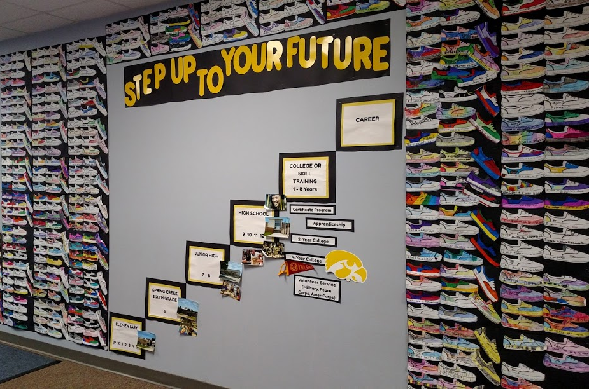
Notes:
Step Up to Your Future Week was last year. It was the result of my attendance at ISCA and action planning from Dave Ford’s session, along with the goals I set after looking at our district data in the CCR Academy courses. I wanted to focus on postsecondary education and further explain college, apprenticeships, and other options.

Slide 30
Step Up to Your Future
Alumni Stories website (embedded resources for exploration & family conversations)
Notes:
I showed this before but wanted to highlight that we included a part on the website that teachers could use in a class meeting to encourage reflection on what they saw on the website.

Slide 31
College & Career Assessments

Slide 32
College & Career Assessments
K
Interests Lesson; Community Helper Picture Puzzles; Interest Inventory
1st
Career Treasure Hunt
2nd
Paws in Jobland; Exploration Worksheet
3rd & 4th
Virginia Career View ; Career One Stop Videos; 3rd Grade Exploration Worksheet; 4th Grade Exploration Survey
5th
What Would I Be Good At? Exploring Careers (Sunburst video available on Learn360) Holland Quick Assessment; O*Net; Careers in the Military; Government & Military Videos; Skilled Trades Careers

Slide 33
Outcomes of 5th Grade CCR Unit

Slide 34
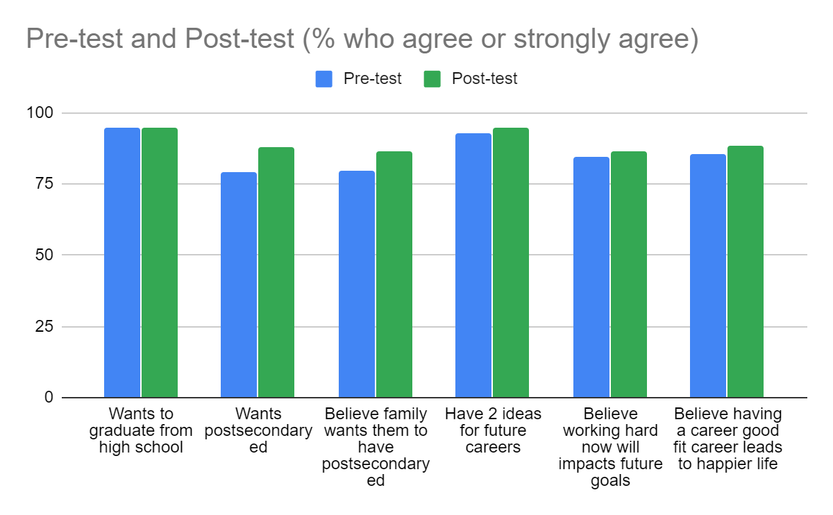
Outcomes
5th Grade CCR Unit
Pre-/Post-Assessment
adapted from ASCA article: Operation Occupation
12 students showed growth in their desire for postsecondary ed. They went from neutral/no desire to agree/strongly agree!

Slide 35
Small Group CCR Intervention

Slide 36
Small Group CCR Intervention
5th grade students selected based on:
Data from whole class pre-test
Measures of engagement (behavior, attendance)
Subgroup status
4 students
1 white, 2 Hispanic/Latino, 1 Black/African American
English Learners - 3
IEP - 1

Slide 37
Small Group Plans
Activities based on Possible Selves Theory
Research on Possible Selves
Small Group Plans
Define possible selves (both hoped for, and feared)
Choose pictures of adults in various domains (work, family, lifestyle)
Categorize pictures by hoped for and feared
Draw personal timeline into future
Map of next year/strategies/helpers

Slide 38
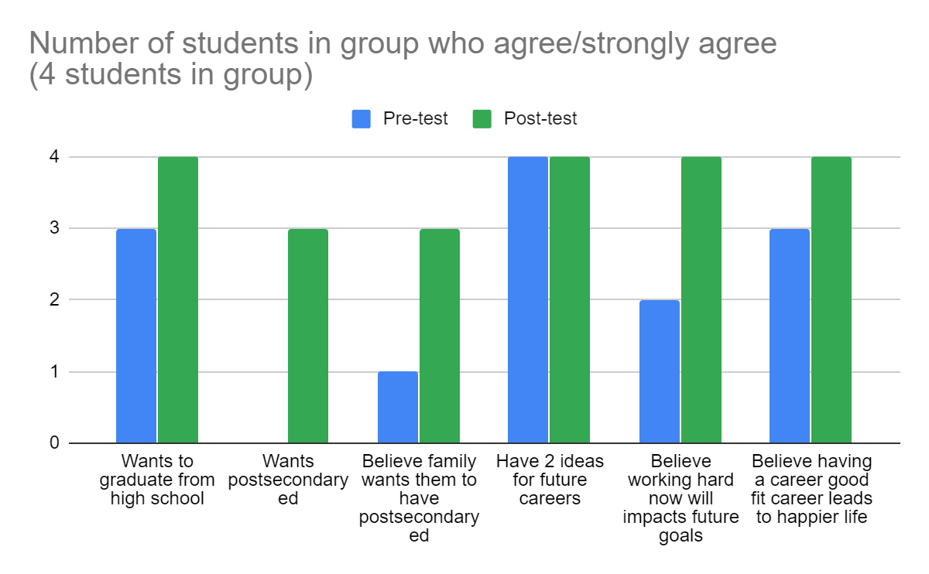
Outcomes of Small Group CCR Intervention
Outcome Data:
Attendance - no impact
Behavior - no impact
Grades -
2 students improved by one letter grade in two core classes from 2nd to 3rd trimester

Slide 39
Future Directions
Integration of SEL/CCR Competencies in core content areas
Social Skill of the Month (Tie into future career)
Student Leadership Groups (talk to ISCA President-Elect-Elect Natalie Wilson for more info!!)
Apply for a position within the school
Meet in small groups to complete work on behalf of the school
Parent Engagement
ASCA Career Conversations
Family Nights
529 Plan Information
Visiting a college campus or workplace
Creating partnerships for local colleges/trade schools, etc. to “adopt” a grade level for a year

Slide 40
Connecting to your work
Set a goal for your building or department for this school year
List the first step you will take.
Possible first steps:
Look at data to determine areas of need in district
Connect with secondary counselors about needs.
Create a CCR Week Planning committee
Take a CCR Academy course!

Slide 41
Thanks!
Any questions?
Find me at amy.anderson@southeastpolk.org
Presentation & Resources at https://tinyurl.com/ISCA-K-5CCR

Slide 42
Credits
Special thanks to all the people who made and released these awesome resources for free:
Presentation template by SlidesCarnival
Photographs by Unsplash
Backgrounds by Pixeden

