Slide 1
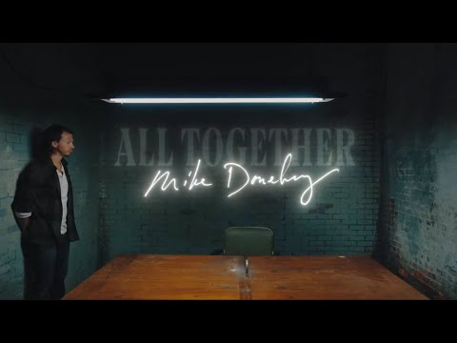
ISCA 2022
Maybe We Don’t Have to Have it All Together
11-8-22

Slide 2
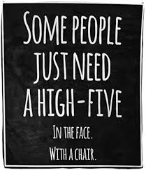
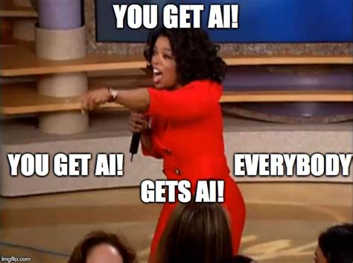
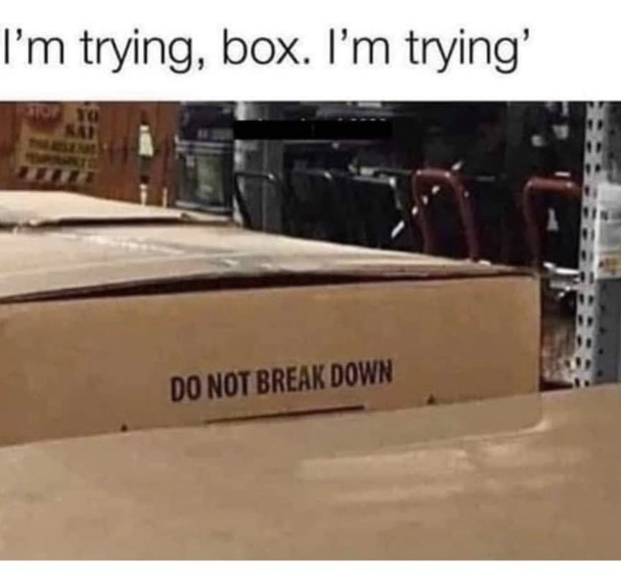
Check in:
3
1
5
2
4

Slide 3
Purpose & Goals:
This session will focus on practices to build connections between adults in order to maintain regulation, emotional safety, and relationships between staff.
Goals:
Reflect on our own understanding of vulnerability
Discuss the importance of connection for regulation
Practice and reflect on ways to proactively build connection

Slide 4
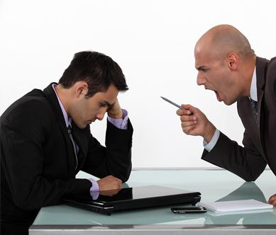
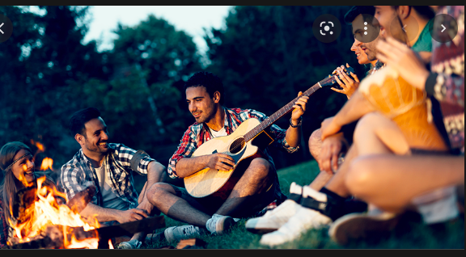
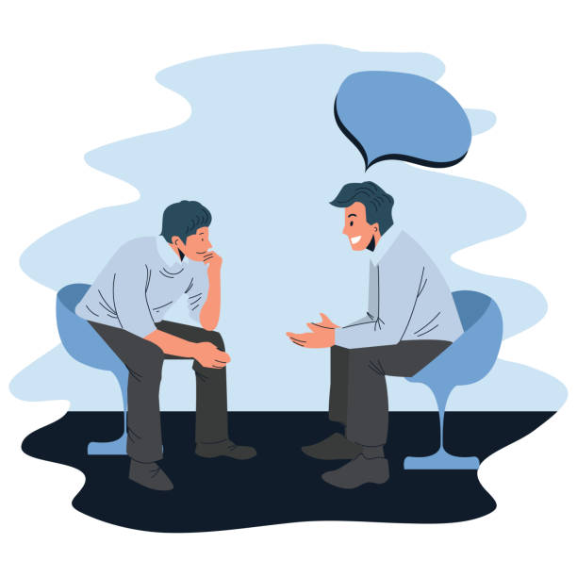
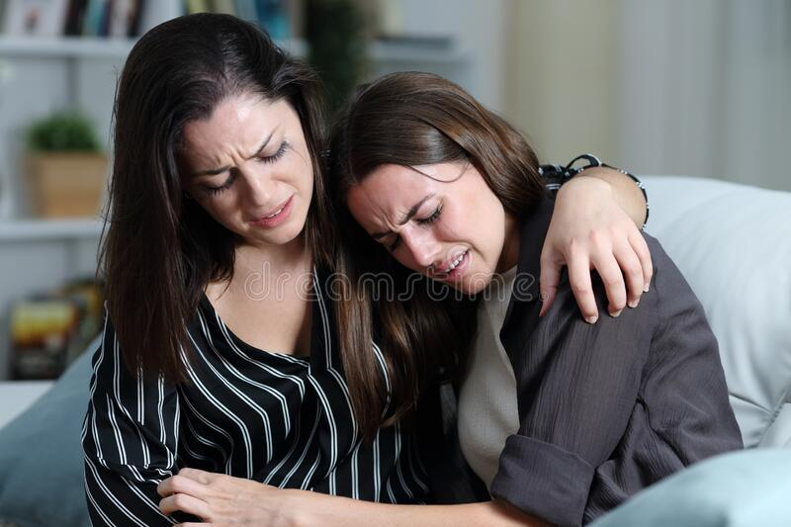
What does “vulnerability” look like?
Notes:
What picture most represents what you think of when I say “vulnerability”?
To you?
To district leadership?
To staff?

Slide 5
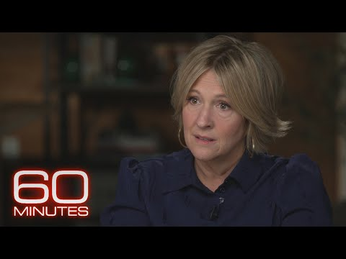
Notes:
Does this definition align with perceptions in your district?

Slide 6
Why is vulnerability hard in education?
What message are we sending to staff and students when we give off the idea that we have it all together?
Notes:
Why is vulnerability so hard in education? (discussion)
Is there an unwritten expectation that we “have it all together”??

Slide 7
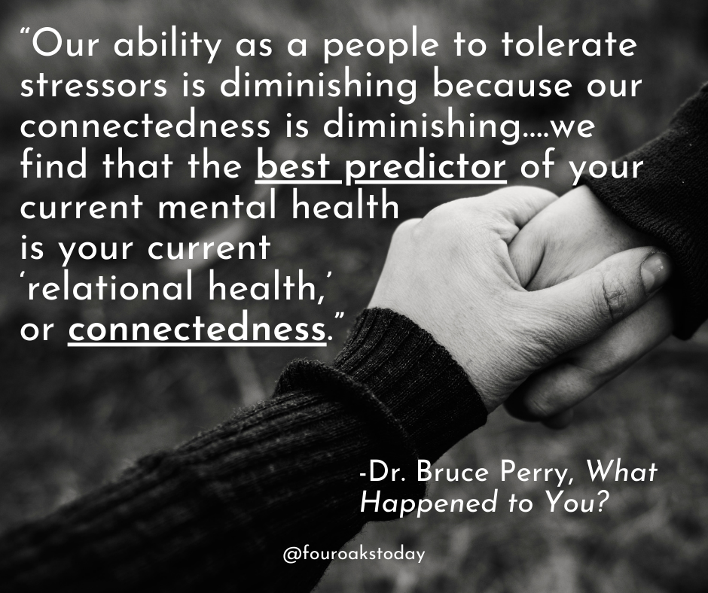
Why keep trying?
Notes:
Vulnerability over and over leads to connections & recognition of shared experiences.
Bruce Perry on connectedness being a better indicator well-being than past trauma or adversity
Page 108: “Connectedness has the power to counterbalance adversity.”
Talk about how this has changed from 50-70 years ago when huge extended families provided connectedness all the time.

Slide 8
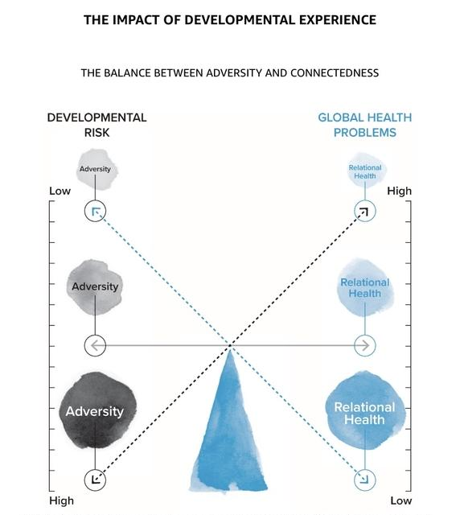
Perry, Dr. Bruce and Oprah Winfrey. What Happened to You?: Conversations on Trauma, Resilience, and Healing. New York, Flatiron Books, 2021, 110.
Notes:
It takes a second to think thru this one.--View it as a scale with weights on it
With high connectedness and low adversity during development (blue line), the balance of developmental risk is tipped in direction of low global health problems (lower risk for mental, social, and physical health problems).
In contrast, high adversity and minimal connectedness (black line) increases developmental risk and probably of significant problems in overall health.

Slide 9
Practical Strategies for
Increasing Vulnerability
PIES
Mood Meter
Scale of 1-5
High/Low; Rose/Bud/Thorn

Slide 10
Practical Strategies for
Increasing Connectedness
Circle questions to build commonalities and compassion
60-Second Shout Out
2 Notes of gratitude or acknowledgement
Deep listening stems

Slide 11
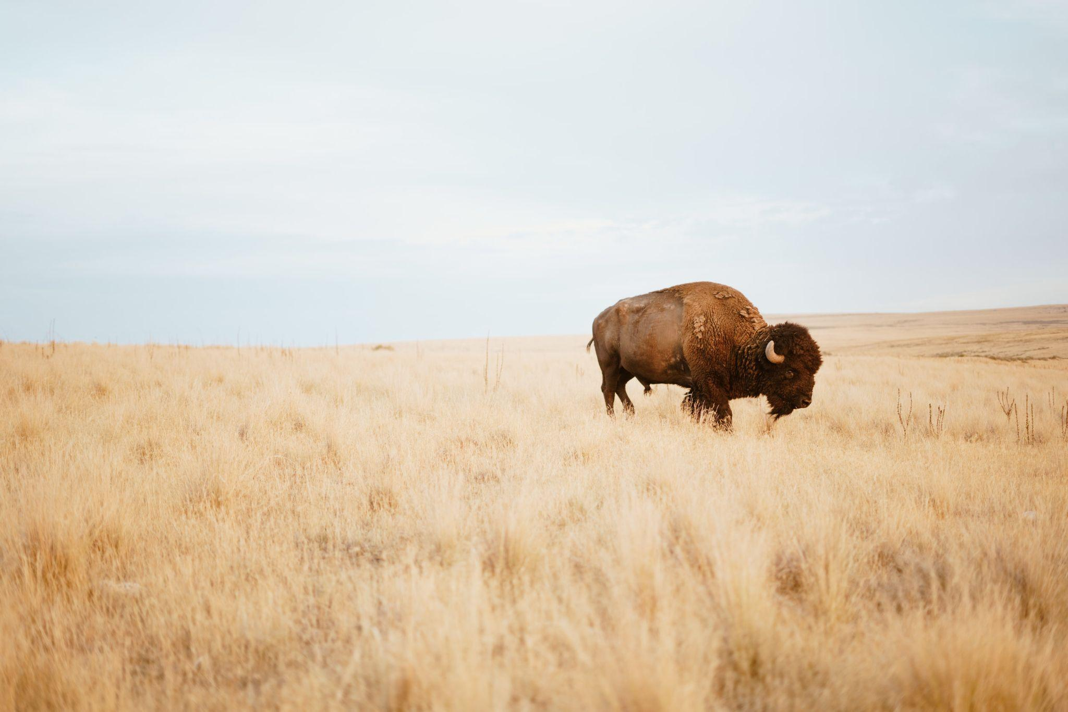
Be the Buffalo.
Notes:
Article read out loud

Slide 12
Reflection:
“Feeling it” doesn’t always feel good.
What do I need to “be the buffalo” about vulnerability this week?

Slide 13
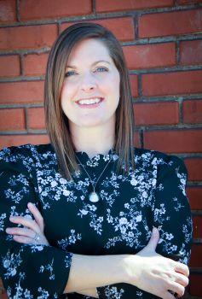
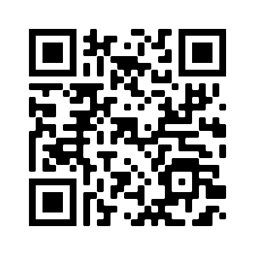
Thank you!
Megan Isenberg
misenberg@fouroaks.org

