Slide 1
Updated ASCA Ethical Standards
Dr. Haley Wikoff - ASCA Ethics Committee Co-Chair
Dr. Erin Lane – ISCA Counselor Educator VP, ISCA Ethics Committee Chair
Notes:
Introduce US
Who is in the room? Level? Years as a counselor?

Slide 2
Overview of Session
Process of Changing Ethical Standards
Overview of Major Changes to the Standards
Impact of Changes for your School Counseling Program
Processing your Ethical Challenges

Slide 3
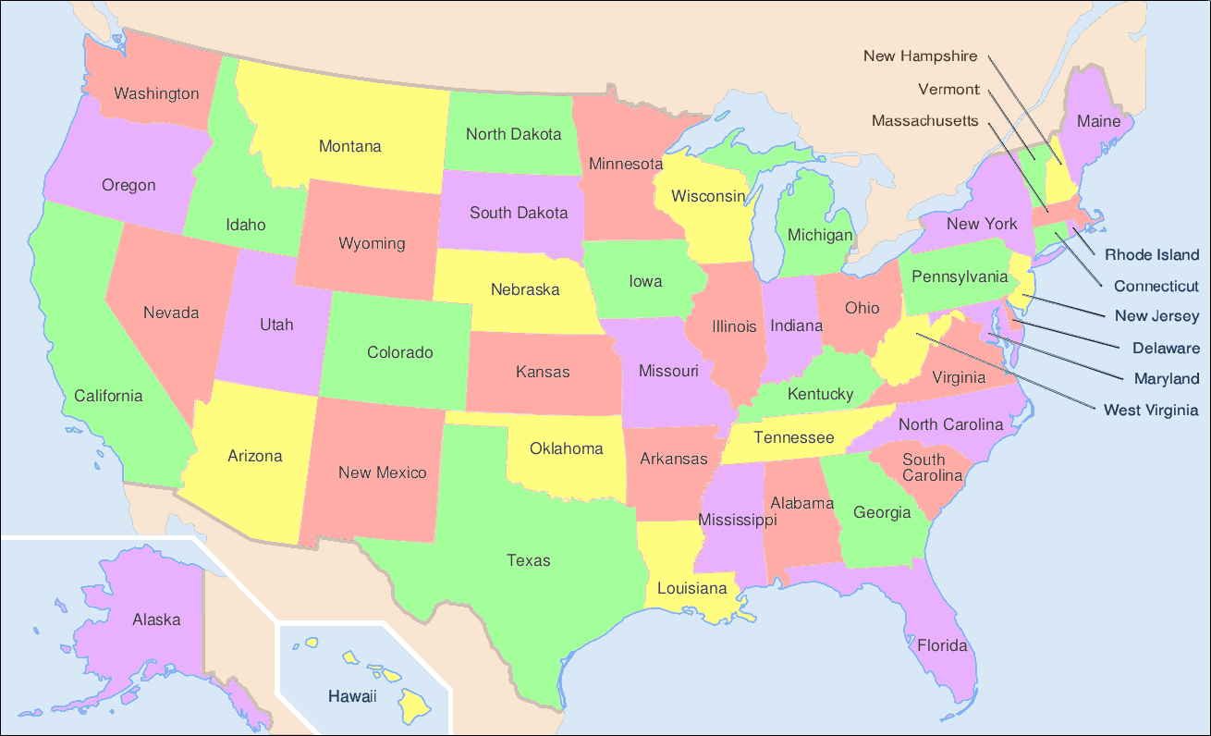
THE PROCESS
All 50 states and Guam identified a state liaison (September 2021)
States worked together in groups, led by a captain (a member of the ethics committee)
Between October - January, states worked on their assigned section, and met regularly with other states and their captain to process and discuss
In January, all the recommended changes were sent to the Ethics Committee and ASCA Staff (all the changes were collapsed into one document)
Notes:
Erin

Slide 4
THE PROCESS, CONT…
The Ethics Committee met 2-4 times a week for 4 weeks, until February 10, 2022
smoothed transitions,
reduced redundancy,
met with DEI and Position Statement Committees
DEI and Position Statement Committees added additional changes
Public comment for a month
Committee met and incorporated public comment
Notes:
Haley

Slide 5
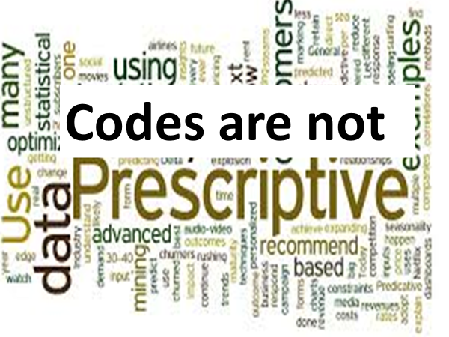
Notes:
Haley

Slide 6
General Overview
34 new standards added
Two standards eliminated
Organized for better flow
Action oriented
Alignment with ASCA National Model
Intentionality behind Inclusive language
Comparison document – ASCA Ethical Responsibilities

Slide 7
Updated Terminology
Anti-Racist
Bias Incident
Culturally Sustaining School Counseling
Equity
Oppression
Racial Bias
Racism
Systemic Change

Slide 8
PREAMBLE AND PURPOSE
Preamble changes
New wording
School counselors have unique qualifications and skills to implement a comprehensive school counseling program that addresses pre-K-12 students’ academic, career and social/emotional development needs.
Language updates
A physically and emotionally safe, inclusive, healthy school environment…
Equitable access to:
school counseling program that promotes academic, career, and social/emotional development
school counselors that support students from all backgrounds…
Notes:
Erin

Slide 9
SECTION A - OVERVIEW
Greater emphasis on equity, creating and sustaining safe and inclusive environments where all students can thrive
Awareness of personal biases and appropriate training relevant to providing culturally sustaining practice
Language changes: Intention to increase person-first language and decrease deficit language
Lessons from COVID (A.2.p, A.15.a, A.15.i, A.16.g)
Former A.5 Dual Relationships and Managing Boundaries section and A.11 Bullying, Harassment, and Child Abuse section have had an overhaul
Notes:
Haley

Slide 10
SECTION A - CONTINUED
A.5 - Sustaining Healthy Relationships and Managing Boundaries
updated language throughout
four new standards (a, b, g, j)
acknowledges that some relationships extend beyond the school day/building (a and b)
conflict of interest through self-promotion (j)
A.7 Group Work
three new standards (a, b, g)
culturally sustaining group counseling services
equitable access to participation/remove obstacles
topic selection
A.8 Student Peer-Support Program
three new standards (a, d, e)
equitable access and representation
share goals with stakeholders
Notes:
Haley

Slide 11
A.9 SERIOUS AND FORESEEABLE HARM TO SELF & OTHERS
IMPORTANT NEW LANGUAGE
b. recognize the level of suicide risk (e.g., low, medium, high) is difficult to accurately quantify. If required to use a risk assessment, it must be completed with the realization that it is an information-gathering tool and only one element in the risk-assessment process. When reporting risk-assessment results to parents/guardians, school counselors do not negate the risk of students’ potential harm to self even if the assessment reveals a low risk, as students may minimize risk to avoid further scrutiny and/or parental/guardian notification. The purpose of reporting any risk-assessment results to parents/guardians is to underscore the need for parents/guardians to act, not to report a judgment of risk.
Notes:
Wendy

Slide 12
SECTION A - CONTINUED
A.9.d - Provide culturally responsive mental health resources to parents/guardians (new).
A. 10 - Marginalized Populations (new section title)
two new standards (g, h)
establish safe, equitable, affirming school environment
systemic change
equitable access and inclusion
A. 11 - Bullying, Harassment, Discrimination, Bias & Hate Incidents (new section title)
six new standards (a,b,c, e, f, h)
recognize can be rooted in race, gender, sexual orientation, and ethnicity
policies centered in safety, belonging, and justice
accessible and effective reporting tools
prevention and response
Notes:
Jaimie

Slide 13
SECTION A - CONTINUED
A.12 - Child Abuse is its own section now
A.15- Technical and Digital Citizenship
three new standards (g, h, i)
moved advocate for equitable access to technology for all students to the top
challenges with confidentiality, the importance of boundaries, safeguarding sensitive information, advocate against alert tools that require 24 hr monitoring
A.16 - Virtual/Distance School Counseling
one new standard to address the challenge of assisting students considering suicide in a virtual setting
Notes:
Jaimie

Slide 14
SECTION B - RESPONSIBILITIES TO PARENTS/GUARDIANS, SCHOOL AND SELF
B.1. Responsibilities to Parents/Guardians
Language updated - inclusive and culturally responsive
two new standards added (e, f): PPRA and parent contributions
B.2. Responsibilities to the School and B.3 Responsibilities to Self
Language updated
Notes:
Wendy

Slide 15
SECTION C - SCHOOL COUNSELOR DIRECTORS/ADMINISTRATORS/SUPERVISORS
Updated language
b - using an allocation procedure that is nondiscriminatory, equitable, informed by comprehensive data, and consistently applied
e - related to the school counseling profession or equitable outcomes for students
New
g - using and/or advocating for a performance appraisal instrument that aligns with the ASCA School Counselor Professional Standards & Competencies that assesses school counselors’ knowledge, skills, and attitudes.
h - understanding the ASCA Ethical Standards for School Counselors, the ASCA National Model, and the ASCA School Counselor Professional Standards & Competencies
i - Providing staff with opportunities and support to develop knowledge and understanding of historic and systemic oppression, social justice and cultural models (e.g., multicultural counseling, anti-racism, culturally sustaining practices) to further develop skills for systemic change and equitable outcomes for all students.
j - collaborating and consulting with school counseling graduate programs to support appropriate site placement for supervisees and ensure high-quality training that is essential for school counselor preparation.
Notes:
Jaimie

Slide 16
SECTION D - SCHOOL COUNSELING PRACTICUM/INTERNSHIP SITE SUPERVISORS
Updated language
“practicum/internship site supervisors”
d - Engage in culturally affirming supervision, maintain cultural competence and consider cultural and historic factors and power dynamics that may have an impact on the supervisory relationship.
i - added “use data when available”
l - Help supervisees select appropriate professional development based on identified needs
m - (was n) - added “consult with school administrators”
New standard
n - Recognize and acknowledge the specific roles of school counselor educators, site supervisors and the practicum/ internship student. Supervisors ensure that supervisees are able to participate in a variety of academic, college/career and social/emotional activities through individual, group and classroom interventions.
Notes:
Haley

Slide 17
MAINTENANCE OF STANDARDS
Minor tweaks to language
i.e., rather than “when doubt exists,” the wording is “in the absence of a settled opinion or conviction…”
More explicit information on who to contact at the state association level
ethics committee or leadership
Notes:
Wendy

Slide 18
ETHICAL DECISION MAKING
Updated this section - included language and reference to several models
b - (new step) - identify potential cultural, religious, and worldview factors and power dynamics that are present within a potential ethical dilemma.
d - (moved up & expanded) - consult with appropriate professionals (e.g., supervisors, other student service professionals, school counseling peers, cultural experts).
g - highlights and defines the ethical principles of: beneficence, autonomy, nonmaleficence, justice, fidelity (previously loyalty), & veracity (added)
j - (expanded) Implement the course of action and analyze the outcome.
k - (new) Identify any inconsistencies in school/district policy for potential revision
Notes:
Haley

Slide 19
Suicide Risk Assessments
Section A.9 – Serious and Foreseeable Harm to Self & Others
b. Recognize the level of suicide risk (e.g., low, medium, high) is difficult to accurately quantify. If required to use a risk assessment, it must be completed with the realization that it is an information-gathering tool and only one element in the risk-assessment process. When reporting risk-assessment results to parents/guardians, school counselors do not negate the risk of harm to self even if the assessment reveals a low risk, as students may minimize risk to avoid further scrutiny and/or parental/guardian notification.
The purpose of reporting any risk-assessment results to parents/guardians is to underscore the need for parents/guardians to act, not to report a judgment of risk.
d. Provide culturally responsive mental health resources to parents/guardians

Slide 20
Student Safety
A.11 Bullying, Harassment, Discrimination, Bias & Hate Incidents (new section title)
6 New standards in this section (a, b, c, e, f)
a. Recognize that bullying, discrimination, bias, and hate incidents rooted in race, gender, sexual orientation and ethnicity are violations of federal law and many state and local laws and district policies
e. Recognize that bias incidents are not only potentially traumatizing for students but can lead to significant damage and disruption of the school environment. Facilitate and monitor schoolwide prevention of bullying, harassment, discrimination, hate and bias through active practices that support a positive school climate, culture and belonging.

Slide 21
Technology
A.15 Technical and Digital Citizenship
g. understand challenges with confidentiality when using email and establish protocols and boundaries for responding to emails.
i. Advocate against alert tools or apps requiring constant monitoring by school personnel. These tools are not aligned with the nature and function of school counseling.
A.16 Virtual/Distance School Counseling
g. recognize the challenges in virtual/distance/hybrid settings of assisting students considering suicide, including but not limited to identifying their physical location, keeping them engaged on the call or device, contact their parents/guardians and getting help to their location.

Slide 22
Using the 2022 ASCA Ethical Standards as an Advocacy Tool
Advocacy
For you and your program
To build collaborative relationships with parents/guardians

Slide 23
For You and Your Program
Familiarize yourself with all the changes
On-going professional development
Collaboration with administration
To highlight program needs
To enhance program functioning
As a communication tool

Slide 24
Building Relationships with Parents/Guardians
B.1.a – recognize, honor, and respect the importance of parents/guardians when providing services to students in a school setting and collaborate with students’ parents/guardians as appropriate.
Share our ethical responsibilities with them, and that we recognize parents are a “guiding voice in their child’s life (A.2.g) – balance that with our primary responsibility to students.
Educate on a comprehensive school counseling program
Role/function
Resource/support for both students and parents/guardians

Slide 25
Questions? Situations?

Slide 26
Resources
Webinars
ASCA Ethical Standards Update
Suicidal Risk Assessments & Information Gathering
ASCA Ethical Responsibilities
ASCA Ethical Standards for School Counselors (2022)

Slide 27
Thank you!!! Haley Wikoff (hd-wikoff@wiu.edu) Erin Lane (erin-lane@uiowa.edu)

