Slide 1
The School Counselor’s Role in Supporting Mental Health of Teachers/Staff Without Toxic Positivity on a $0 Budget
tinyurl.com/iscatoxic

Slide 2
Hello!
tinyurl.com/iscatoxic
Dr. Amy DeGroot-Hammer
Dr. Jenna Hardersen
Dr. Kris Meyer
Buena Vista University: Professional School Counseling Program
Notes:
Intro - All

Slide 3
Notes:
Jenna

Slide 5
What is Toxic Positivity?
tinyurl.com/iscatoxic
Prioritizing happiness over all else and ignoring negative emotions.
Suppressing, minimizing, invalidating negative emotions
Winners
vs
Losers
Notes:
Kris

Slide 6
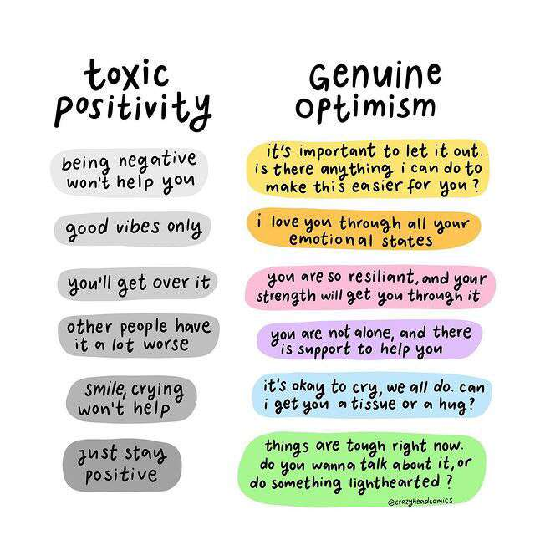
Notes:
Jenna

Slide 7
Notes:
Amy

Slide 8
Working with Admin
Must start at the top
Often they cause toxic (+) by insisting on (+) because fear disgruntled staff, losing staff, angry constituents
Often use denial of (-) as a coping mechanism
PSC may have to lead, teach, help heal admin:
To accept and listen to all staff
To be transparent and open
To help them transform their own fears and pain
Or encourage them to get outside counseling
Notes:
Kris

Slide 9
Conversation Starters with Admin
1. “I try to be a neutral player in the school so I can learn what is important to communicate between admin and the staff. In regards to…. I thought you would want to know…
2. I was listening to staff the other day and wondered if it might be more helpful to you if you presented the idea of like this…instead of… I think they would hear your words better coming from that direction.
3. Do you think it might be possible to….? I am just giving it to you to think about. Maybe we can talk about it later after you have time to think more about it.
4. When we had our meeting, I know you wanted to let the staff know that…. But I think what they heard or interpreted instead was…. If I know them like I do, they might respond or engage if you led them by saying… Just letting you know.
Notes:
Kris

Slide 10
Be open to the “Squeaky Wheel”
Ignoring or dismissing, will miss out on a relationship
Will miss out on opportunities to learn
Will develop silos and resistance to anything from admin or PSC
If listen, can develop trust
Notes:
Amy

Slide 11
Conversation Starters with a Squeaky Wheel
1. When they come to you with “advice” in the form of an underlying complaint, take it for face value and assume good intent.
2. Treating the squeaky wheel with respect and truly listening is a gift they will not always expect.
3. Open yourself, be vulnerable to learn by using statements such as:
a. Hmmm, I never thought of it that way.
b. How did you think of that? That is something I never would have thought of.
c. That might be a good idea. Can I think about it a bit and let’s talk again…[set date!].
4. You can also drop in and chat in their classroom, identifying strengths they have in their work.
Notes:
Kris

Slide 12
More Squeaky Wheel starters…
Ask about their life!
a. How did they come to this career?
b. Were there other educators in their family?
c. Who was a role model for them?
6. Ask them for advice such as:
a. If there was one thing you would want our admin to know, what would it be?
b. If you were the counselor, how would you handle this?
c. If you were the principal, what would you do? Or do differently?
7. Be willing to listen and vulnerable to learn from them!
Notes:
Kris

Slide 13
Reframing
"Choose not to be harmed—and you won't feel harmed. Don't feel harmed—and you haven't been." Marcus Aurelius
Notes:
Jenna
No one can harm you. Whatever other people do and say is on them. Whatever your reaction is to what other people do and say—that’s on you.
No one can make you angry, only you have that power. Someone can certainly say something offensive or stupid or mean, but no one can make you upset—that’s a choice.
We control the story we choose to tell ourselves about the harm caused us.

Slide 14
5 Radical Minutes
Think about your role as a school counselor, what does toxic positivity look like in your world
1 minute each, then 1 minute together:
Reframe or change the script
Notes:
Jenna

Slide 15
Notes:
Jenna

Slide 16
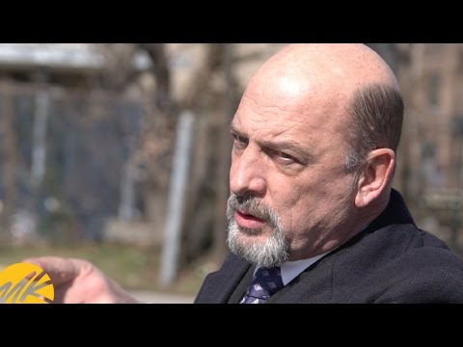
Notes:
Kris

Slide 17
Systemic Change
Tell your story
Start Local
School board
Take care of people
Build positive workplace
State/Federal Level
Legislature
How to write to/contact yours
ISEA Resources
Notes:
Amy

Slide 18
How to help struggling staff
Insurance/EAP program
You are sometimes the free counselor - they can leave it with you
Community resources
Break for student/teacher
Take class for 5 minutes
Basic health
Eating/drinking habits, exercise, home life
Help them reflect
Paint the picture
Paper/pen therapy prompts
Teach to reframe
Notes:
Jenna

Slide 19
Pen/Paper Prompts
Write about:
Your joy or lack of joy
Your ability to focus
The Squeaky Wheels you are dealing with in your staff
Frustrations with your admin
Often share in an email with a counseling friend and hold for 24 hrs and then revisit to see if your feelings have changed or have gathered more info. (The Ladder of Inference - Amy)
Gratitude list (to reframe)
Notes:
All

Slide 20
Notes:
Kris

Slide 21
Notes:
Kris

Slide 22
Any Questions?
Dr. Meyer’s Podcast - https://livelifeinspiredviewsforeveryday.buzzsprout.com
Contact us:
Dr. Amy DeGroot-Hammer - degroothammer@bvu.edu
Dr. Kris Meyer - meyer@bvu.edu
Dr. Jenna Hardersen - hardersen@bvu.edu
tinyurl.com/iscatoxic
Notes:
Jenna

Slide 23
Resources
https://u.osu.edu/studentwellnesscenter/2021/03/28/toxic-positivity-the-darker-side-of-the-rainbow/
Coutu, D. L. (2002). How resilience works. Harvard Business Review.
Duffy, M.W. and Fosslien, L. (2022). Managers, what are you doing about change exhaustion? Harvard Business Review.
Imber, A. (2022). Where your work meets your life. Harvard Business Review.
Korpar, L. (2022). What is toxic positivity. LinkedIn News.
https://www.amazon.com/Toxic-Positivity-Keeping-World-Obsessed/dp/0593418271

