Slide 1
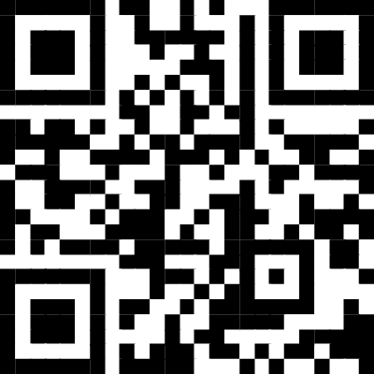
Strengthen Your Program Through Data
tinyurl.com/iscadata22

Slide 2
Sheryl Bass
College/Career Transition Counselor
Linn-Mar High School
Kirkwood Community College
School Counselor for 10 Years
University of Iowa Alum
Contact – Sheryl.bass@linnmar.k12.ia.us

Slide 3
Making Data Work
4th Edition

Slide 4
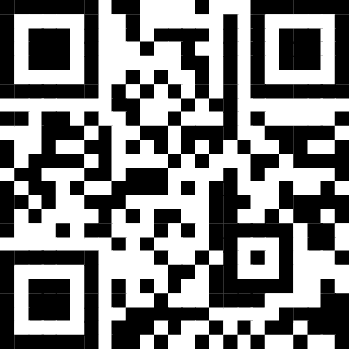
Self-Assessment
My School Counseling Program Practices
From Making DATA Work Fourth Edition
https://tinyurl.com/sc22assess

Slide 5
Self-Assessment
Count your total points to determine your level of practice
Add up points based on groups
T = Use of Time
D = Use of Data
S = Delivery of Services
I = School Counselor Identity

Slide 6
Answer each question with a 1 to 5 response
(1= Strongly disagree/Never to 5=Strongly Agree/Always)
1 | I collect and examine school data to identify program goals and monitor student progress. | 5
2 | I identify ASCA Mindsets & Behaviors for the core curriculum, small group and closing the gap activities I provide. | 3
3 | The needs of my students determine how I plan my day. | 2
4 | I consider the school improvement plan when developing my program goals. | 4
5 | I maintain a weekly and annual calendar that I share with faculty and staff. | 2
6 | I collect data about my program SMART goals. | 5
7 | I provide direct and indirect services to my students 80% of the time or more. | 4
8 | I create high quality perception data assessment surveys driven by ASCA Mindsets & Behaviors to measure change in student attitudes, knowledge and/or skills. | 4
9 | I know the difference among process, perception and outcome data. | 5
10 | I am able to meet the challenges I face at my school. | 5
11 | I share the results of data I collect with stakeholders (i.e., administrators, teachers, parents, students). | 5
12 | I have conducted an ASCA Use of Time assessment in the last two years. | 1
13 | I conduct short term individual counseling and crisis counseling as needed. | 5
14 | I have identified 2-3 SMART program goals this school year. | 5
15 | I conduct or plan to conduct small group counseling this school year. | 2
16 | I provide developmentally appropriate career and college access core curriculum activities each school year. | 5
17 | I am a leader at my school. | 5
18 | I feel energized by my work as a school counselor. | 4
19 | I have evidence that my school counseling program is creating change for my students. | 5
20 | I collaborate with my school administrator to align my school counseling role with the ASCA National Model. | 3
21 | I have a signed annual agreement that outlines my duties and responsibilities. | 2
22 | I have a core curriculum, small group and closing-the-gap action plan that identifies the lessons I provide. | 3
23 | I work closely with teachers and believe that I have their trust. | 5
24 | I/we hold School Counseling Advisory Council meetings twice a year. | 3
25 | My program is RAMP or, I am/we are considering applying for RAMP. | 1
TOTAL |  | 93

Slide 7
The Observer
Description
Does not maintain a regular schedule – is available to help out when needed
Primarily does individual student counseling
Works in isolation
Does not know how to implement a school counseling program
Does not engage in leadership teams/committees
Does not align activities to school improvement goals and has no impact on student achievement

Slide 8
The Seeker
Description
Work reactively – have little control over schedule, calendar, and duties
Overwhelmed by demands of the job, blame students and administration for inability to plan or be proactive
Does not have the skills to effectively advocate using data
Not participating in leadership teams
Activities not aligned with school improvement goals
Does not know what impact the program has on student achievement

Slide 9
The Navigator
Description
Has a sense of responsibility for providing support in all 3 domains
Tries to be proactive, but still often providing responsive services in addition to scheduled activities
Likely provides services aligned with the National Model, but doesn’t have data
Serves on site-based committees
Activities not aligned with school improvement goals
Has some impact on student outcomes

Slide 10
The Change Agent
Description
Understand the ASCA National model and rates the program highly on self-assessments
Uses the Annual Administrative conference template to meet with administrator
Is proactive, but can be driven by what has worked in the past and can be resistant to change
Has control over schedule and interventions and publishes calendar
Does not consistently use data to influence the program, relies on what has previously worked
Aligns the program with the school improvement goals and works to increase student achievement

Slide 11
The Leader
Description
Align school counseling program with school vision and mission
Publish annual and share weekly calendar
Use evidenced-based interventions that address needs from data
Continually assess and improve interventions and share results with stakeholders
Seen as leaders of the school leadership team
Measure impact on students
Regularly look at data to establish student outcome goals
Use student needs to determine use of time and analyze use-of-time

Slide 12
ASCA Model Resources
Phased Implementation Plan
Templates
MApp (ASCA App) - https://mapp.ramp4.org/login

Slide 13
Use of Time
Where to Start
Begin tracking use-of-time
Make a draft annual calendar
Share your weekly calendar with your administrators and staff
3 | The needs of my students determine how I plan my day.
5 | I maintain a weekly and annual calendar that I share with faculty and staff.
7 | I provide direct and indirect services to my students 80% of the time or more.
12 | I have conducted an ASCA Use of Time assessment in the last two years.
21 | I have a signed annual agreement that outlines my duties and responsibilities.

Slide 14
Share Your Time Data
Month | Delivering |  | Program Planning and School Support (Defining, Managing, Assessing, Fair-Share Responsibilities)
 | Direct Student Services Activities (Include dates of school counseling initiatives or events, classroom and group activities, career or college nights, schoolwide academic support events, etc.) | Indirect Student Services Activities (Significant collaborations, leadership and advocacy activities)
Ongoing Services | Individual Appointments with Target Pop | Collaborate with MEDCO, Workplace Learning Connection, & Kirkwood Services | Email Campaign - Regular CCC Updates to Seniors and Juniors Promote SP3 Enrollment Texting from Iowa College Aid
August | Job Shadow and Internship Promotion Survey Seniors |  | Kirkwood Enrollment
September | Session on Choosing a College Job Shadow Applications Due College Application Session | Parent Session - College Applications | Job Shadow Approval
October | College Application Campaign College Application Drop-Ins Financial Aid Info FAFSA Applications Start Oct 1 FAFSA Completion Event College Visits (Seniors) Kirkwood Iowa Iowa State UNI Concurrent Enrollment Registration | Parent Session - FAFSA Completion Sessions | Advertise Concurrent Enrollment Options
November | Internship Prep ACT Prep FAFSA Completion Event Career Assessment Lesson - November 30 | Parent Session - Scholarship Sessions Remind students of college/state deadlines for applications and Fin Aid! | National Scholarship Month National Career Development Month National Apprenticeship Week Nov 14-20, 2022
December | Career Information Sessions Apprenticeship Information | Remind students of college/state deadlines for applications and Fin Aid! | Advertise Academy Options for 2022
January | Academy Sign-Up Promotion & Workshops Academy individual appointments Junior Scheduling Meetings Junior College Planning Session |  | College & Career Readiness Month
 | Goal | Actual | Actual | Goal
School Counseling Core Curriculum | 15.0% | 10.8% | 78.3% | 80.0%
Individual Student Planning | 25.0% | 26.8%
Responsive Services | 25.0% | 10.4%
referrals, consultation, collaboration | 15.0% | 30.2%
Program Planning and School Support | 20.0% | 12.8% | 16.5% | 20.0%
Fair Share Responsibility |  | 3.7%
Non Counselor Duties |  | 9.8% | 9.8%
Published Calendar
https://sites.google.com/a/linnmar.k12.ia.us/linn-mar-high-school-counseling/career

Slide 15
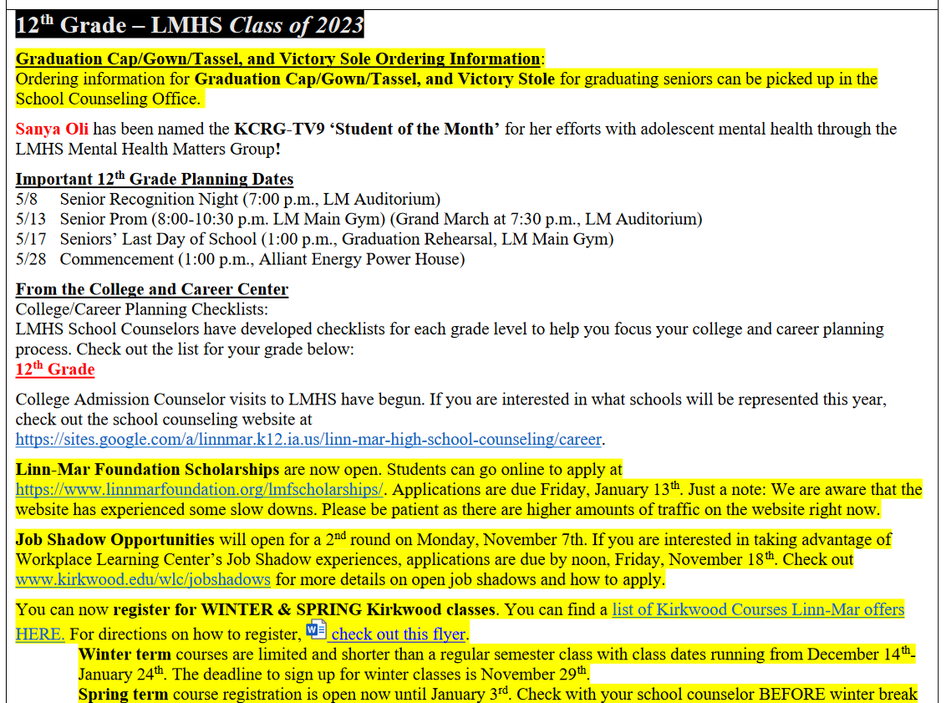

Slide 16
Delivery of Services
Create Classroom & Group Mindsets and Behaviors Action Plan
Create Closing-the-Gap Action Plan
Create lesson plan
Collect Data on at least 1 classroom lesson
Create Classroom and Group or Closing-the-Gap Results Report
2 | I identify ASCA Mindsets & Behaviors for the core curriculum, small group and closing the gap activities I provide.
7 | I provide direct and indirect services to my students 80% of the time or more.
13 | I conduct short term individual counseling and crisis counseling as needed.
15 | I conduct or plan to conduct small group counseling this school year.
16 | I provide developmentally appropriate career and college access core curriculum activities each school year.
22 | I have a core curriculum, small group and closing-the-gap action plan that identifies the lessons I provide.

Slide 18
School Counselor Identity
Complete annual administrative conference
Create an Advisory Council – share your PowerPoints and Slides
Share your action plans
Align your mission and vision to the district & school mission & vision
17 | I am a leader at my school
18 | I feel energized by my work as a school counselor
19 | I have evidence that my school counseling program is creating change for my students.
20 | I collaborate with my school administrator to align my school counseling role with the ASCA National Model
22 | I have a core curriculum, small group and closing-the-gap action plan that identifies the lessons I provide.
23 | I work closely with teachers and believe that I have their trust
24 | I/we hold School Counseling Advisory Council meetings twice a year
25 | My program is RAMP or I am/we are considering applying for ramp

Slide 19
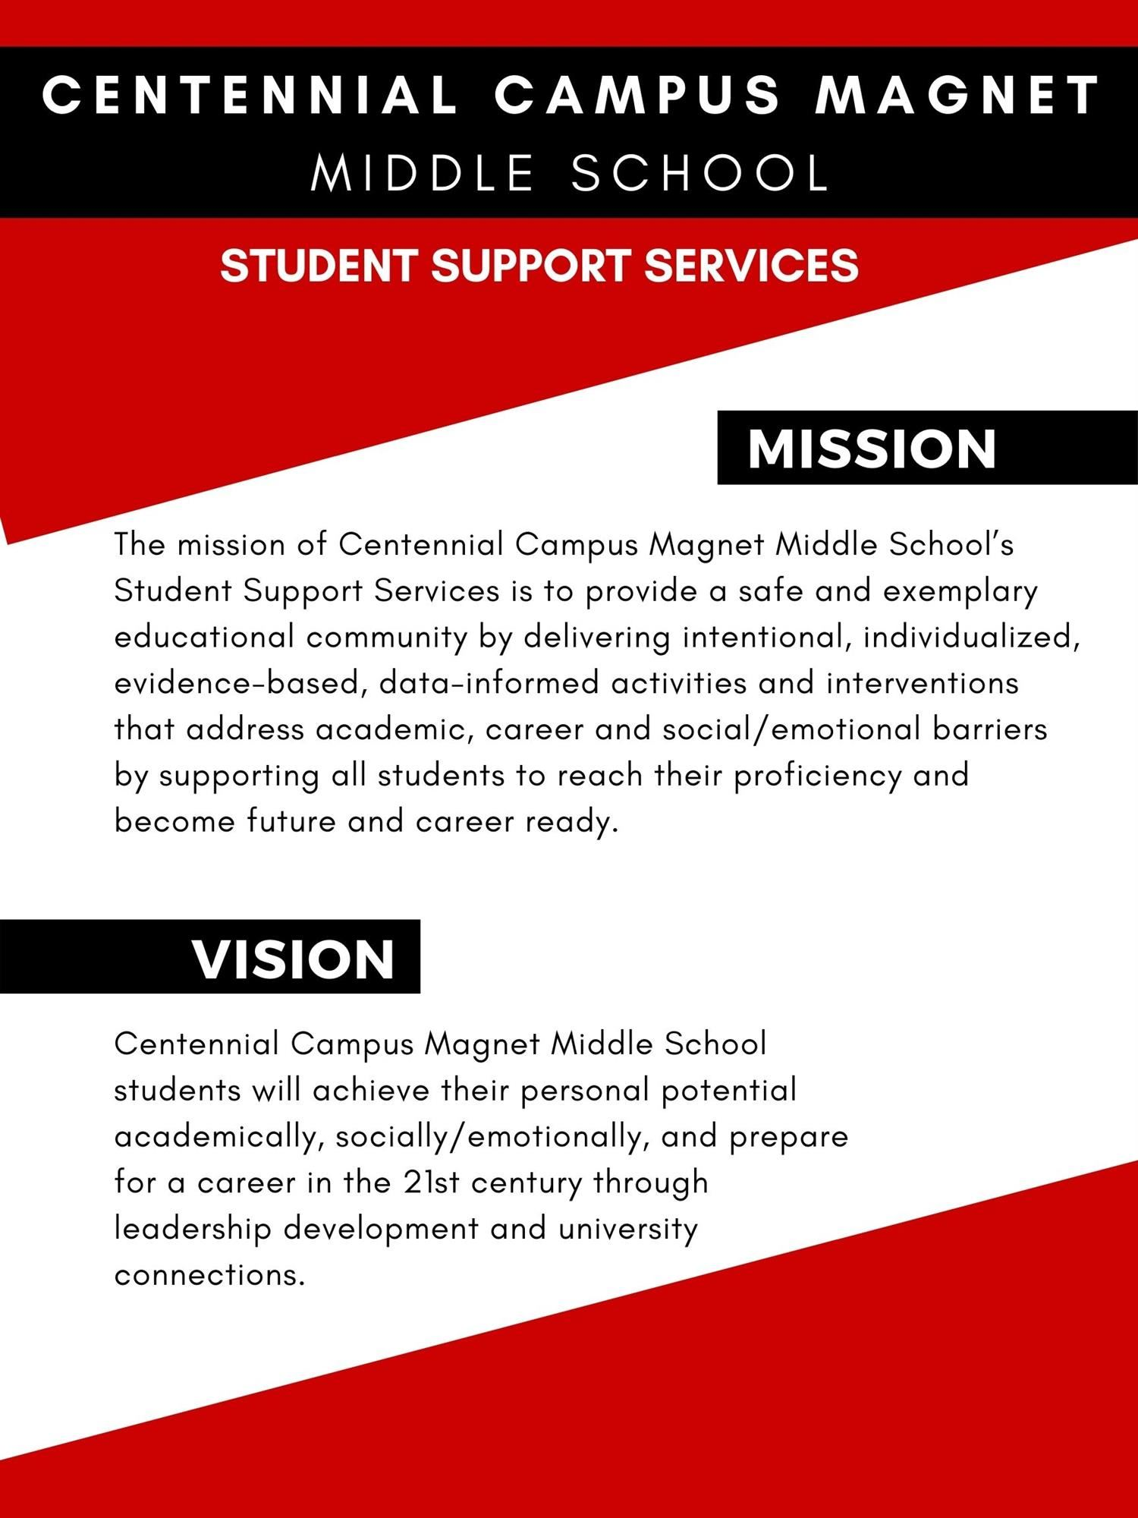
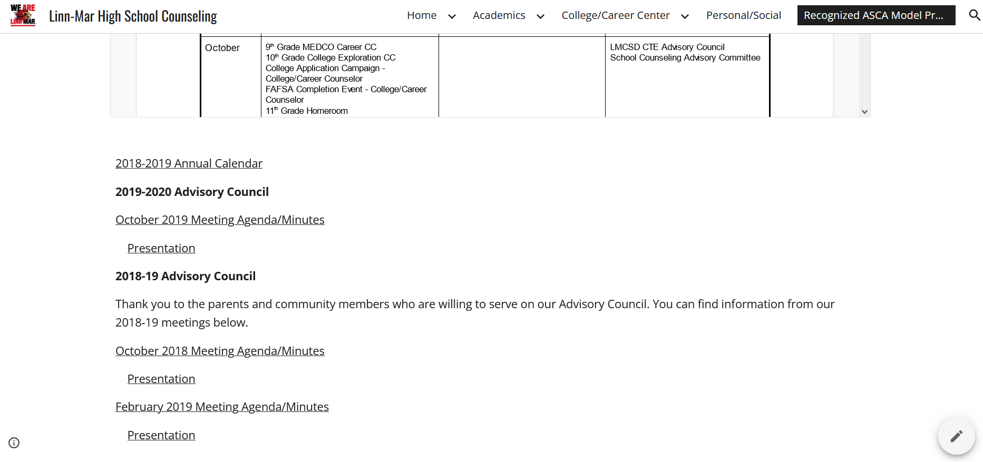
Example of Mission & Vision
Linn-Mar High School Counseling Website
Administrative Conference

Slide 20
Use of Data
Where to Start
Complete the School Data Summary
Complete Needs Assessments for staff, students, and parents
Create 1 student outcome goal
1 | I collect and examine school data to identify program goals and monitor student progress.
4 | I consider the school improvement plan when developing my program goals.
6 | I collect data about my program SMART goals.
8 | I create high quality perception data assessment surveys driven by ASCA Mindsets & Behaviors to measure change in student attitudes, knowledge and/or skills.
9 | I know the difference among process, perception and outcome data.
11 | I share the results of data I collect with stakeholders (i.e., administrators, teachers, parents, students).
14 | I have identified 2-3 SMART program goals this school year.

Slide 21
Data Summary

Slide 22
Student Outcome Goal Plan

Slide 23
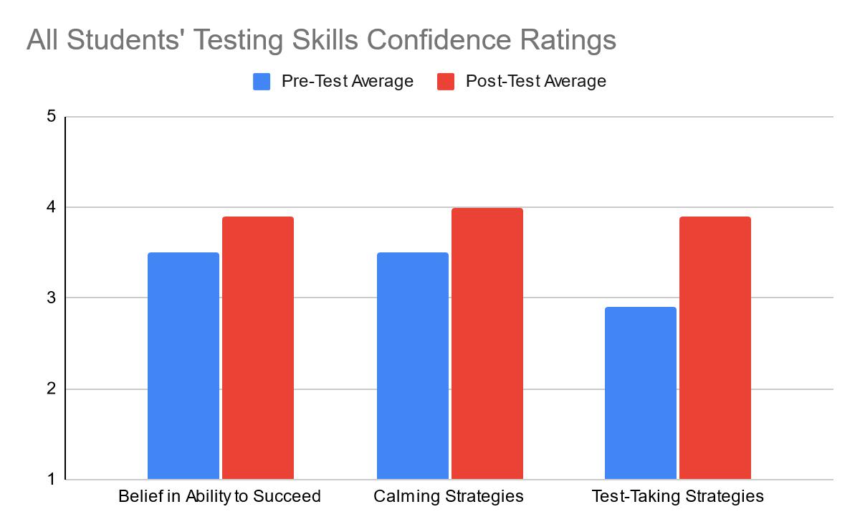
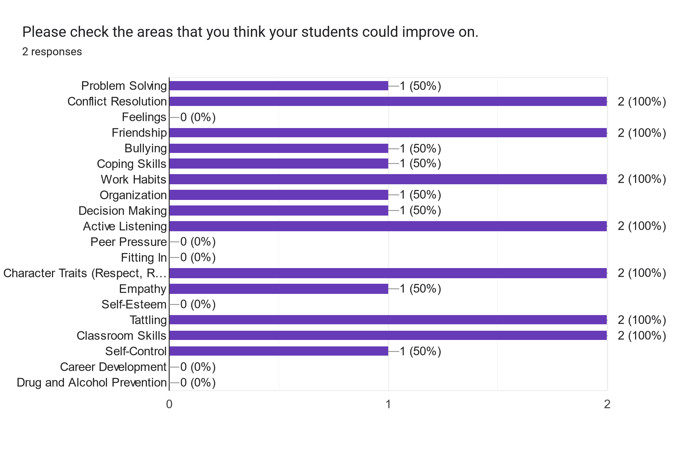
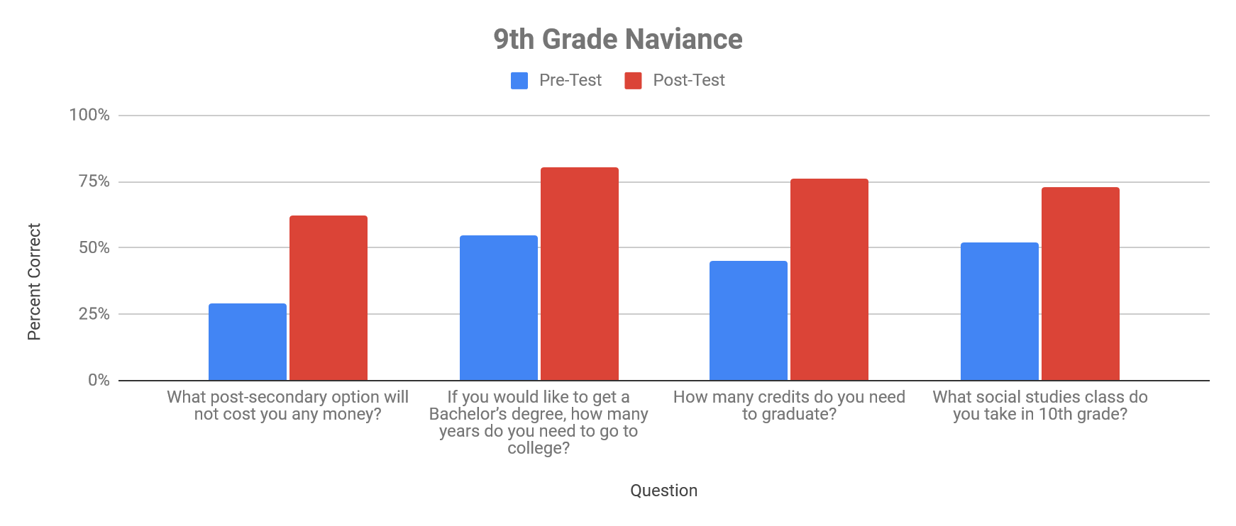
Supplemental Data
Needs Assessments
Staff Needs Assessment
High School Student Needs Assessment
3-6 Elementary Student Needs Assessment
K-2 Elementary Student Needs Assessment
Mindsets & Behavior Data
Pre-Post Tests
Likert Scale Options

Slide 24
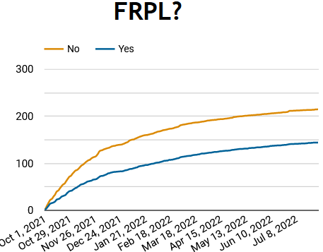
Design | Annual Student Outcome Goal: By May 31,2022, FRL students who have indicated they are planning to attend postsecondary education or training will increase the percentage of FAFSA applications completed by 10% from 77% in 2022 to 87% in 2023.
Ask | Data Collection: Monitor FAFSA completion using Iowa College Aid FAFSA report. Monitor Verification status using Iowa College Aid FAFSA report. Use BOY survey to track students considering education and training after high school. Determine student interest via individual meetings with seniors.
Track | Identify FRL students considering postsecondary training/education. Track using fafsa.iowa.gov 2022 FRL FAFSA Completion
Announce | Recommendations: Provide FAFSA filing assistance throughout the day, in the evenings and on weekends. Refer families to ICAN when needed FRL Families may need individual outreach and assistance to file Students need more information earlier about the FAFSA/paying for college
DATA Template

Slide 25
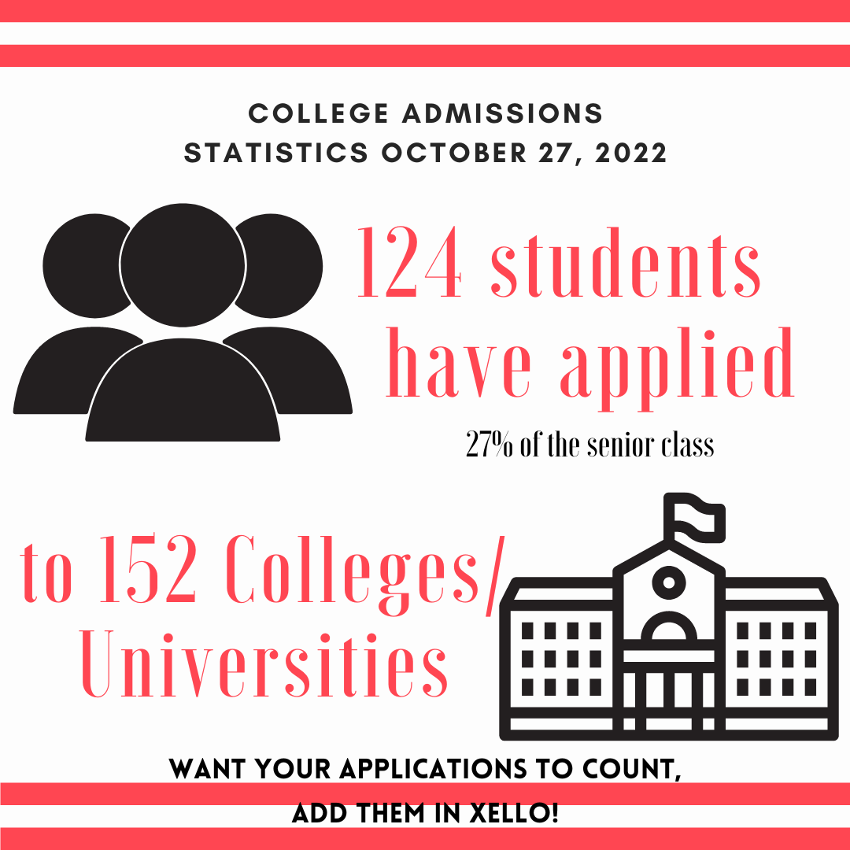
Share Data Throughout the Year

Slide 26
End of Year Data
The Use of Data in School Counseling by Trish Hatch & Julie Hartline
Appendix
Flashlight Presentation
Flashlight 1-pager – Make a Copy to Edit

Slide 27
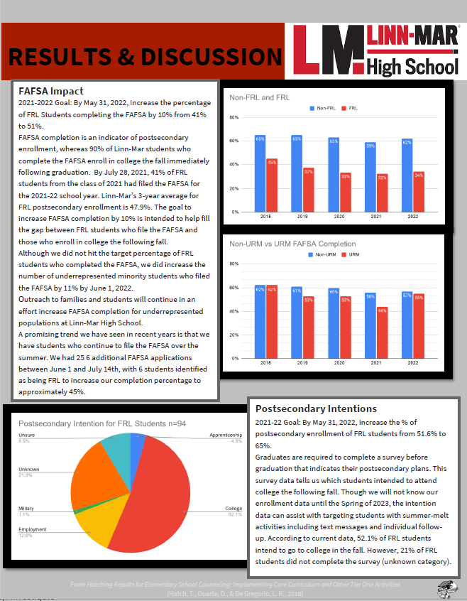

Slide 28
Design Resources
Canva
Visme
Piktochart
Smore
Notes:
When conducting research, it is easy to go to one source: Wikipedia. However, you need to include a variety of sources in your research. Consider the following sources:
Who can I interview to get more information on the topic?
Is the topic current and will it be relevant to my audience?
What articles, blogs, and magazines may have something related to my topic?
Is there a YouTube video on the topic? If so, what is it about?
What images can I find related to the topic?

