Slide 1

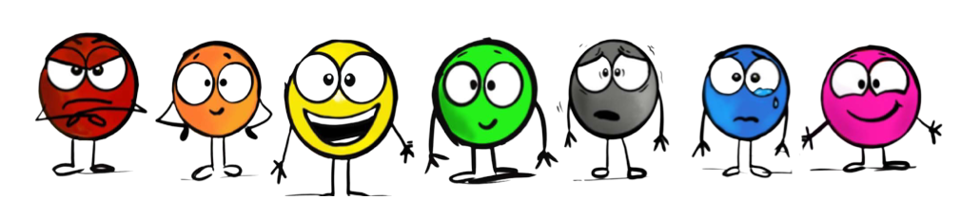
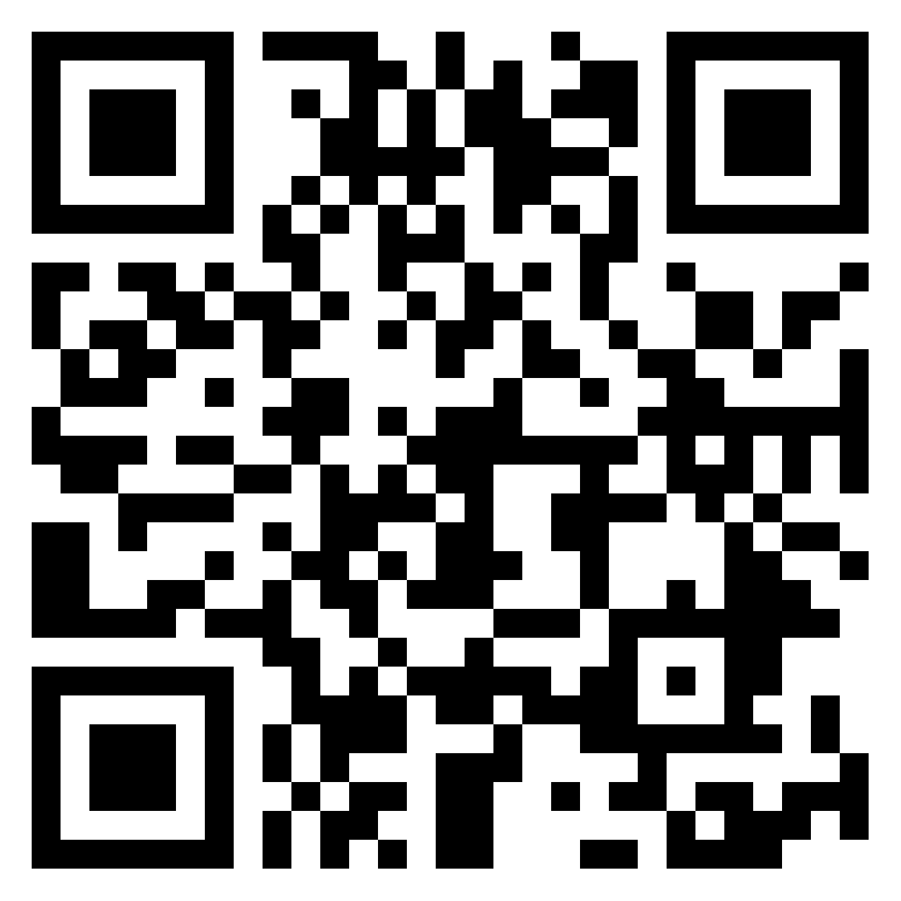
Bibliotherapy through “SPOTS”
Sheila Kinyon-Johnson
&
Janet McDaniel
Muscatine Community School District

Slide 2


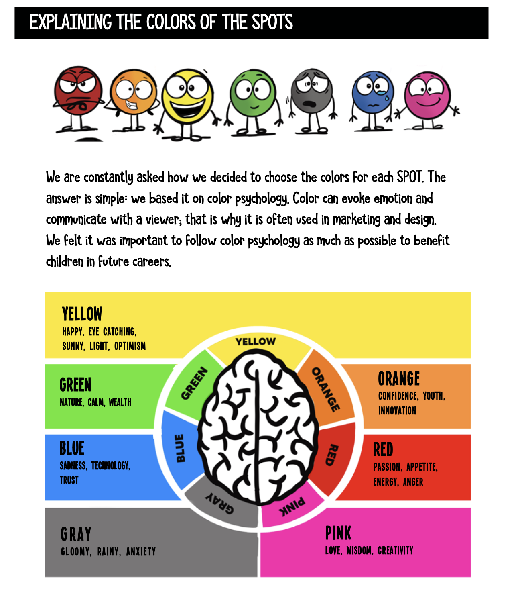



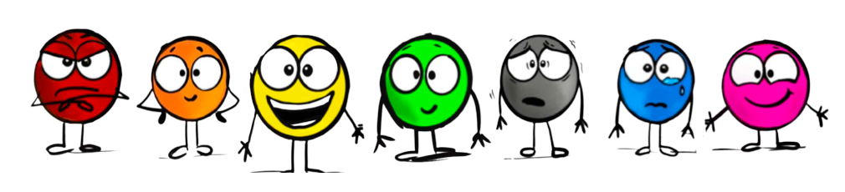


Slide 3
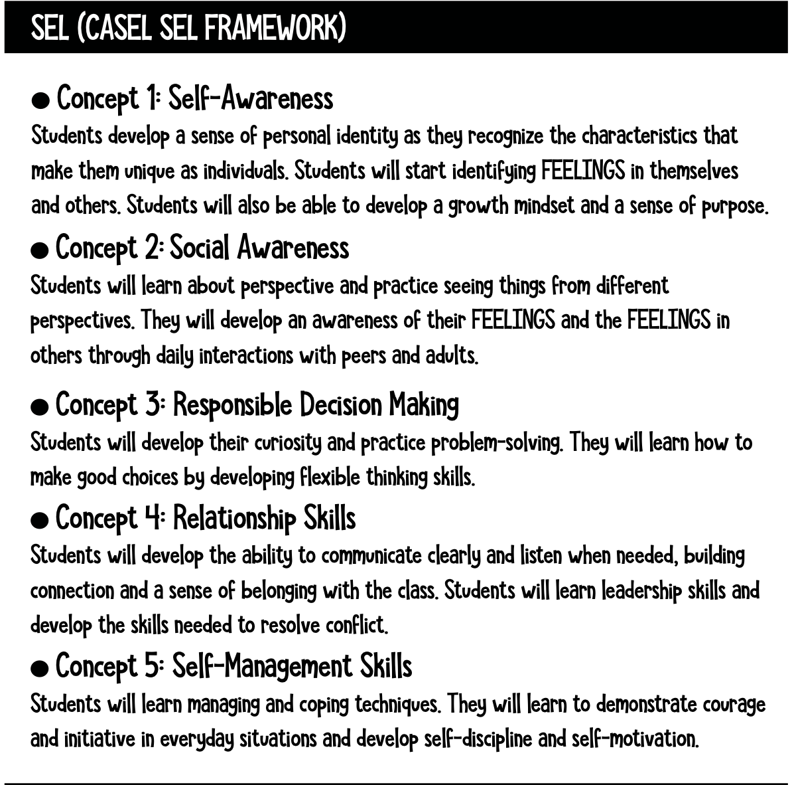
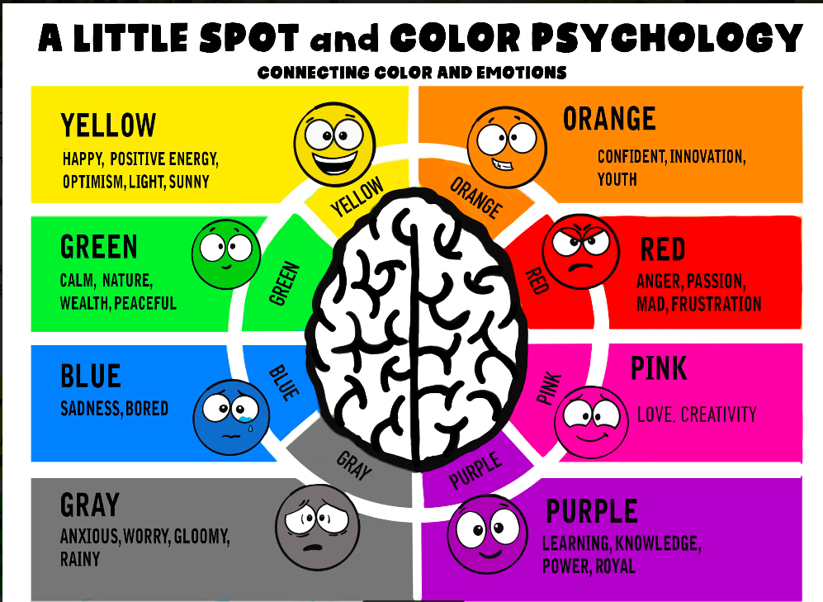

Slide 5

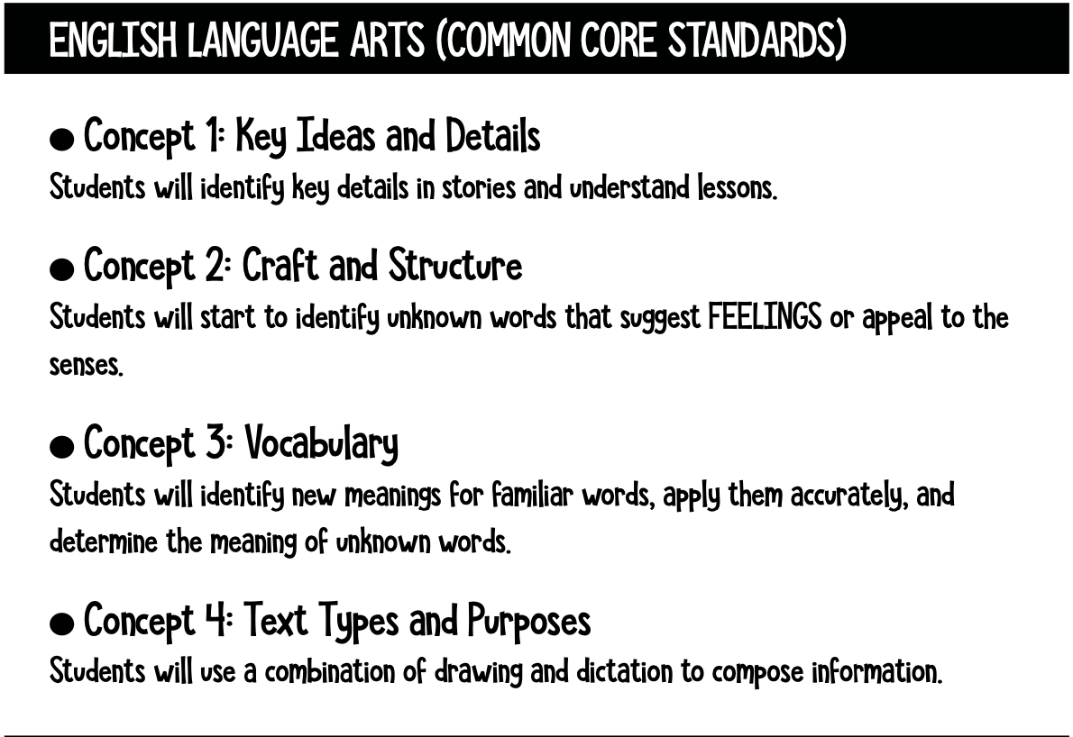

Slide 7
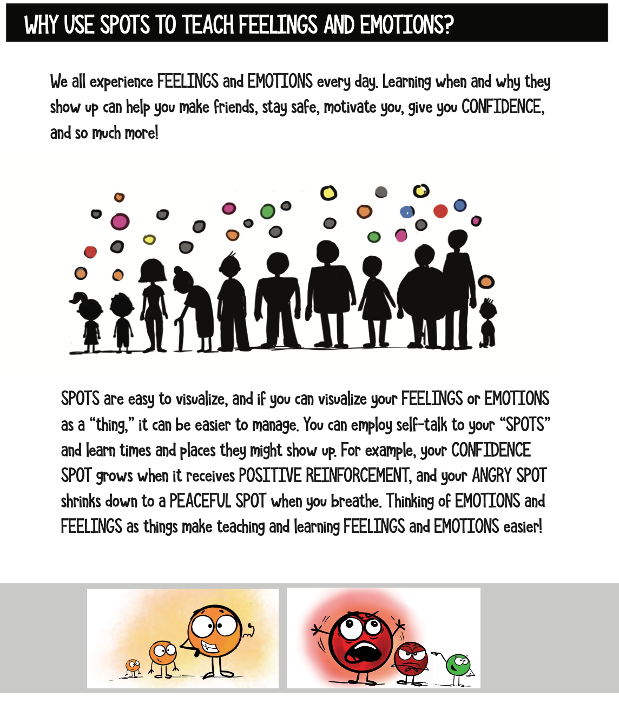
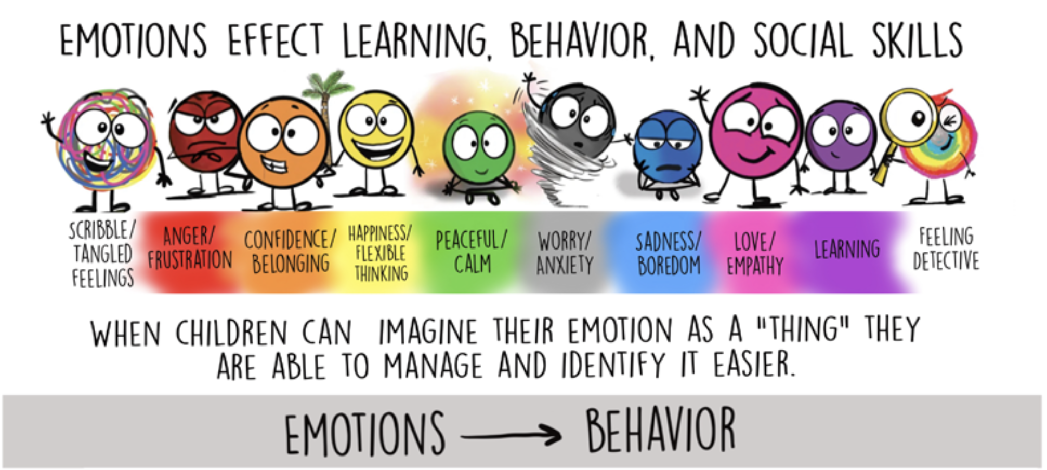

Slide 8
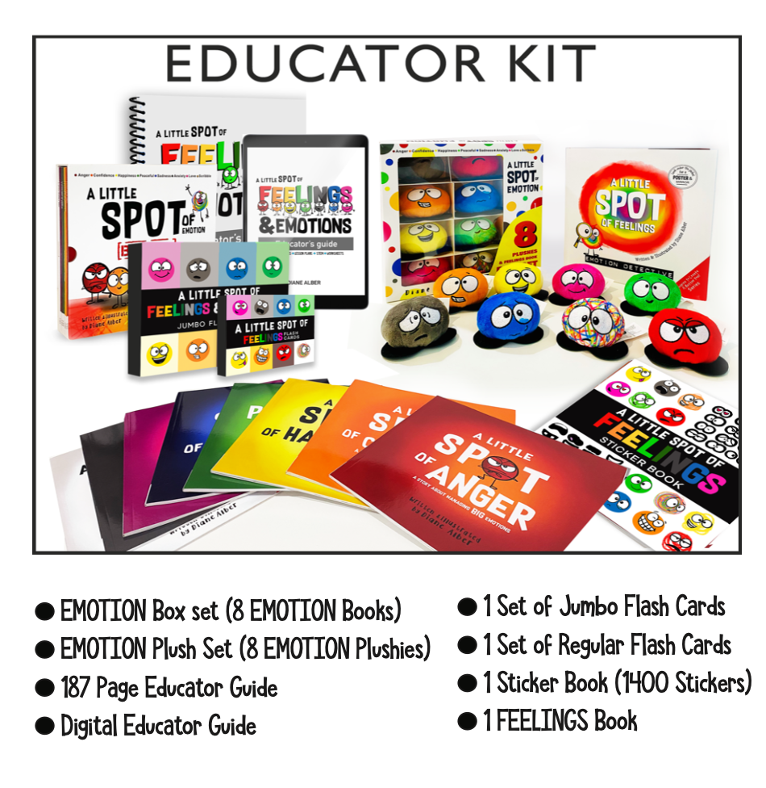

Slide 9
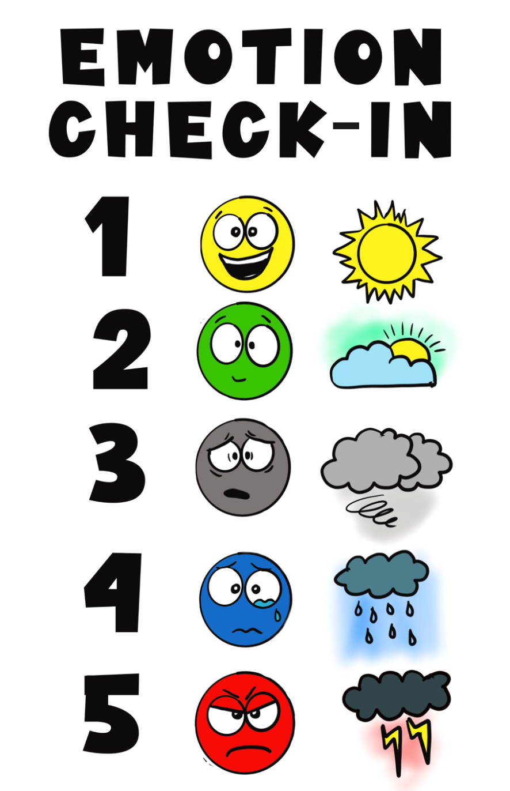
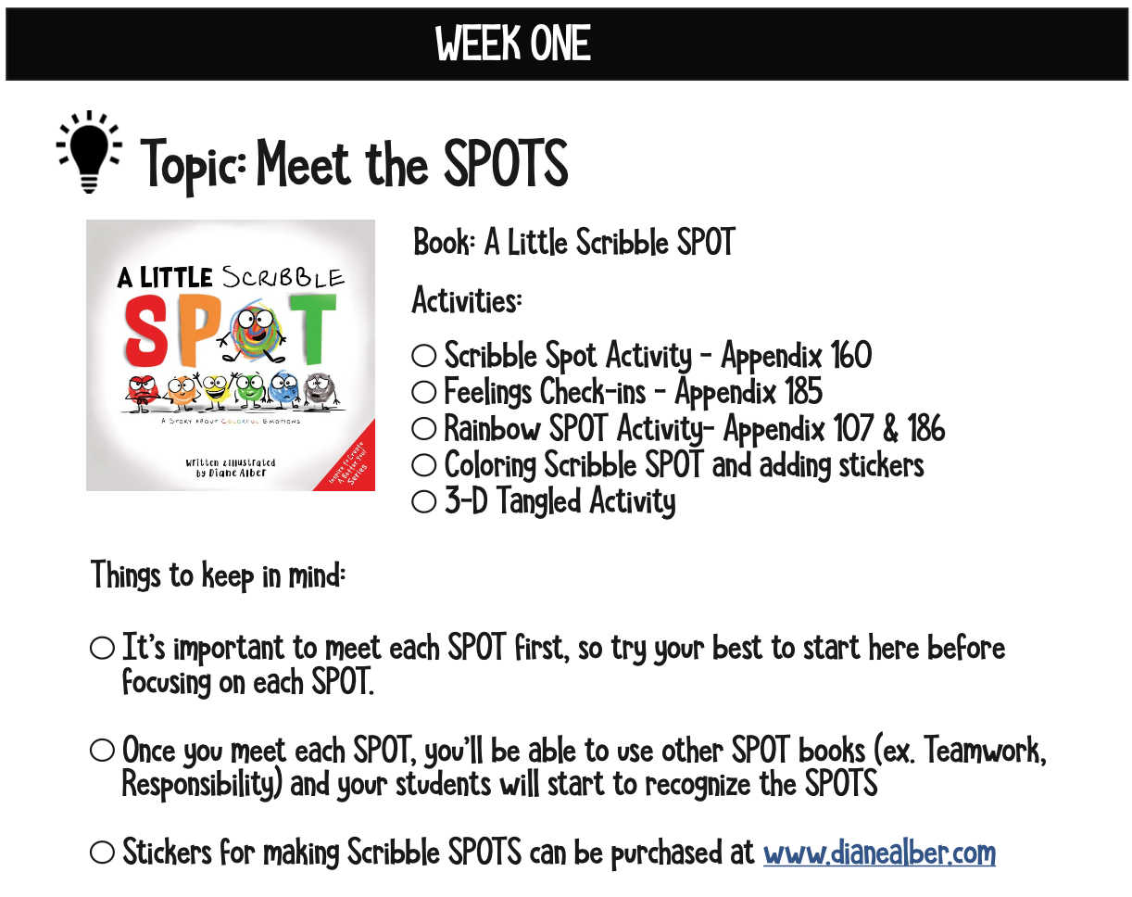
WEEK ONE

Slide 10
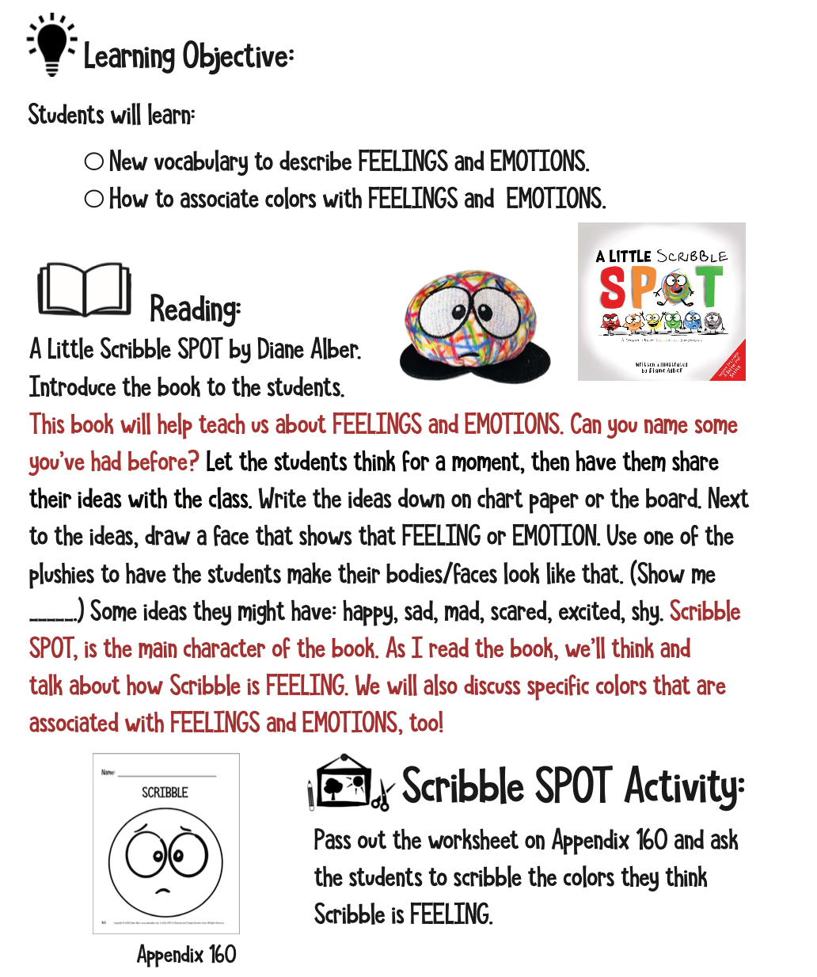
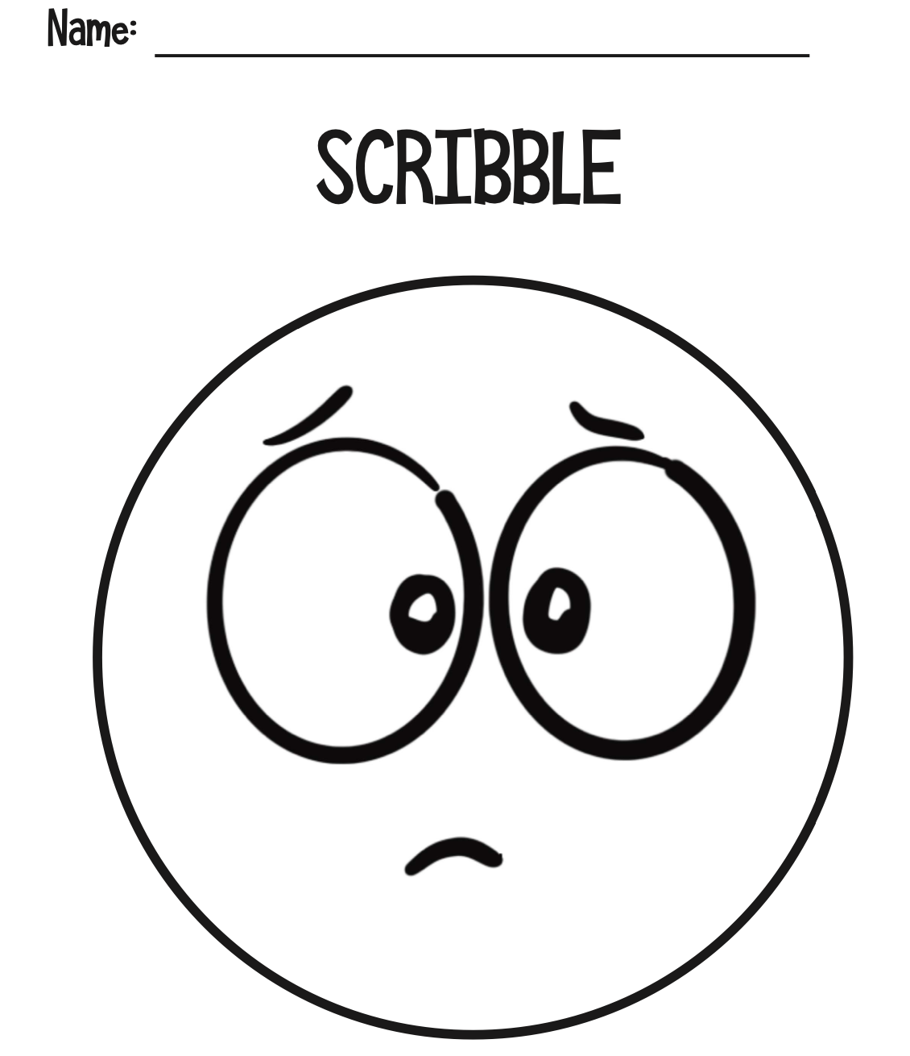
WEEK ONE

Slide 11
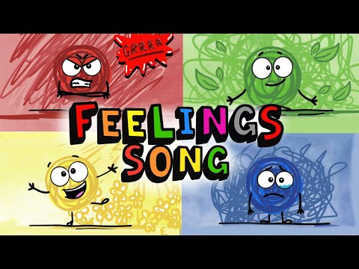
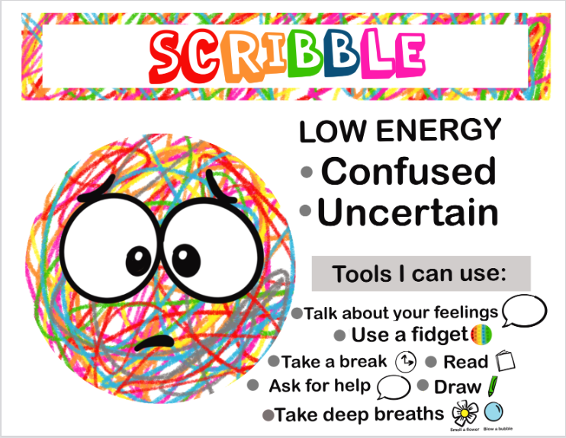
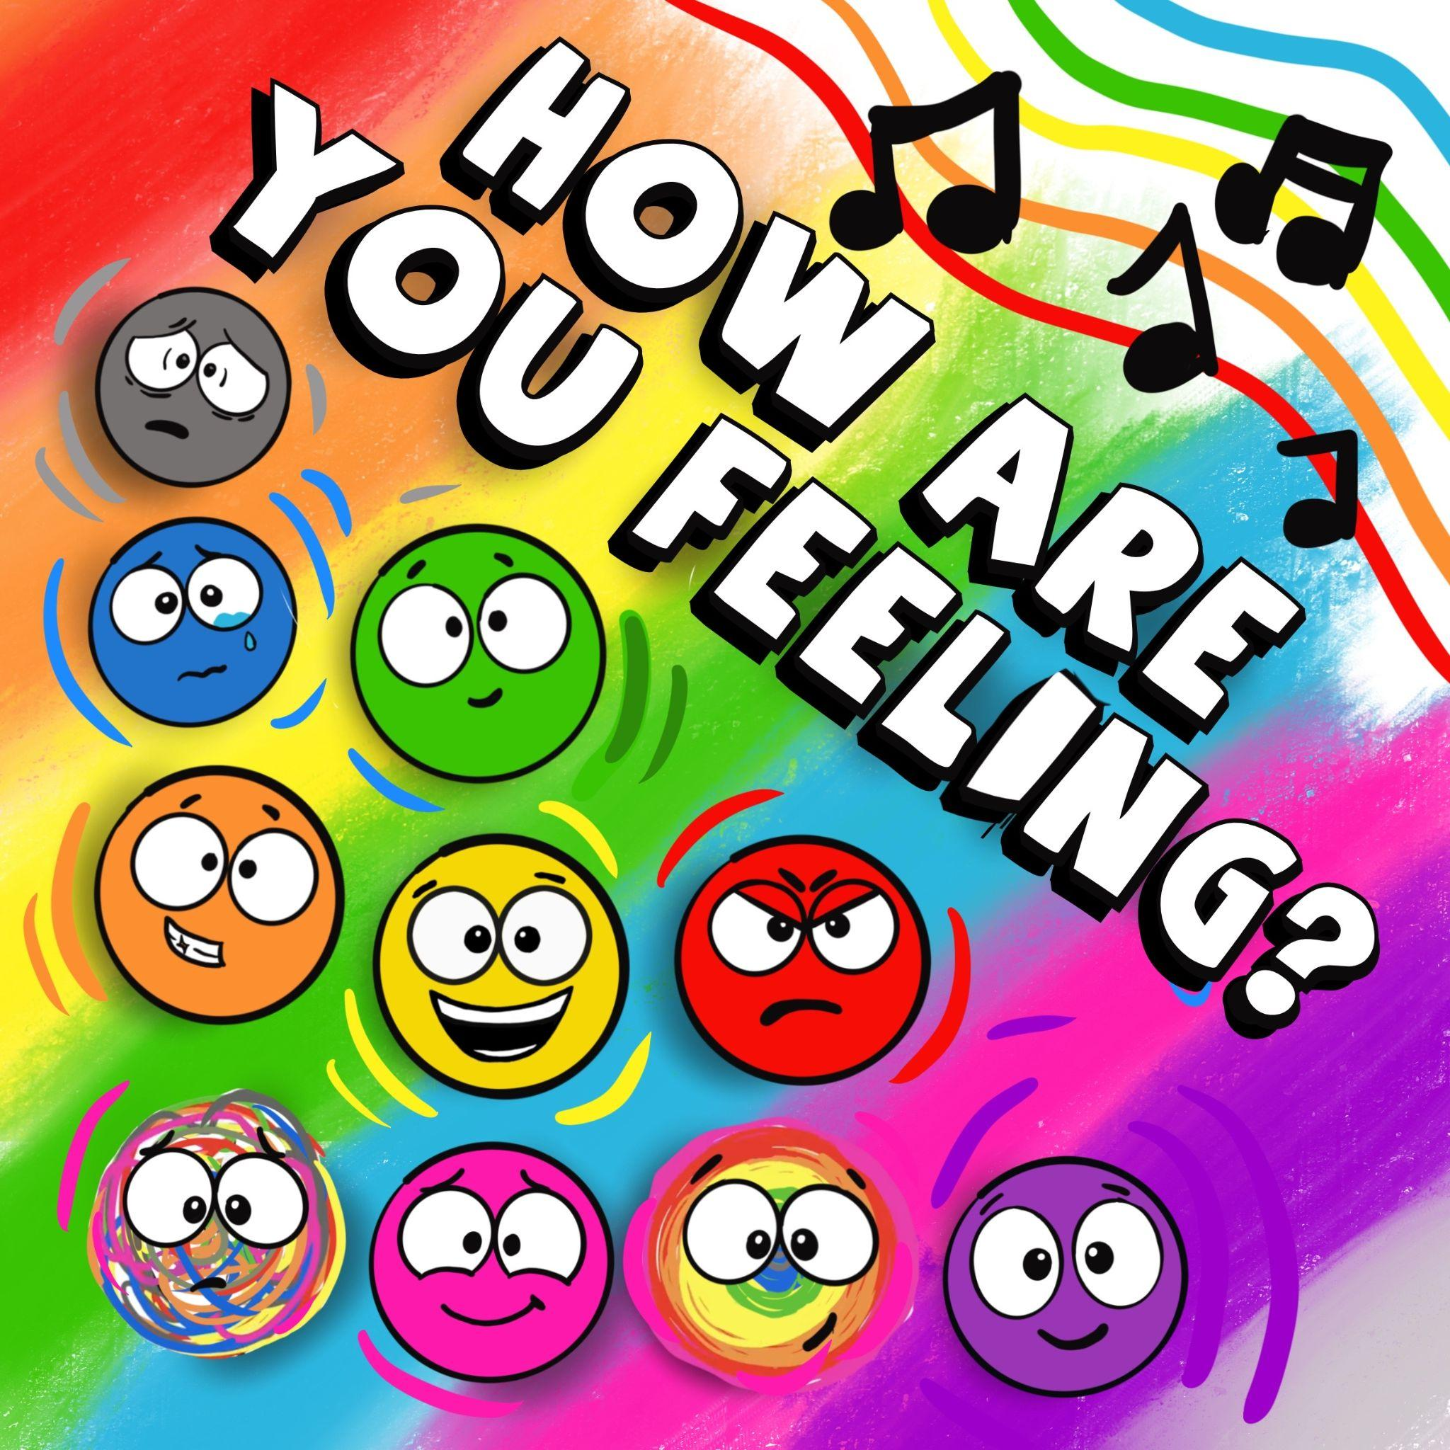

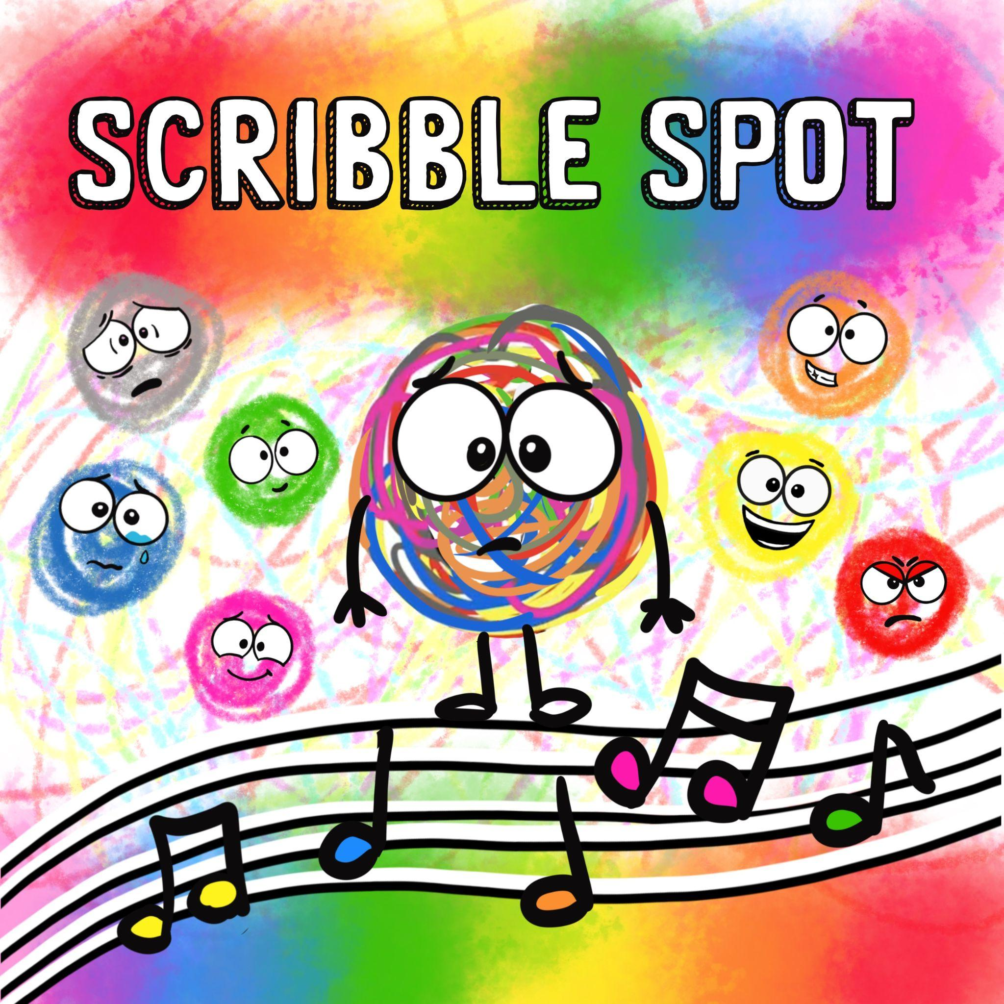
How are you feeling song
Scribble SPOT Song
All songs available on spotify, apple music, itunes and amazon music
Notes:
You can read the book, “A Little Scribble SPOT” https://www.dianealber.com/products/a-little-scribble-spot-a-story-about-colorful-emotions
Full Activities in the Feeling and Emotions Educator Guide https://www.dianealber.com/products/a-little-spot-of-feelings-emotions-educator-guide-digital-format-only
There are over 18 songs on Spotify, Apple Music, and Amazon Music as well https://www.dianealber.com/pages/music

Slide 12
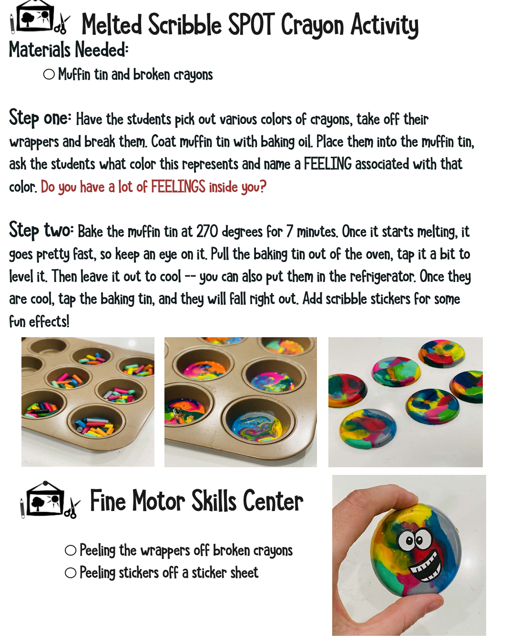
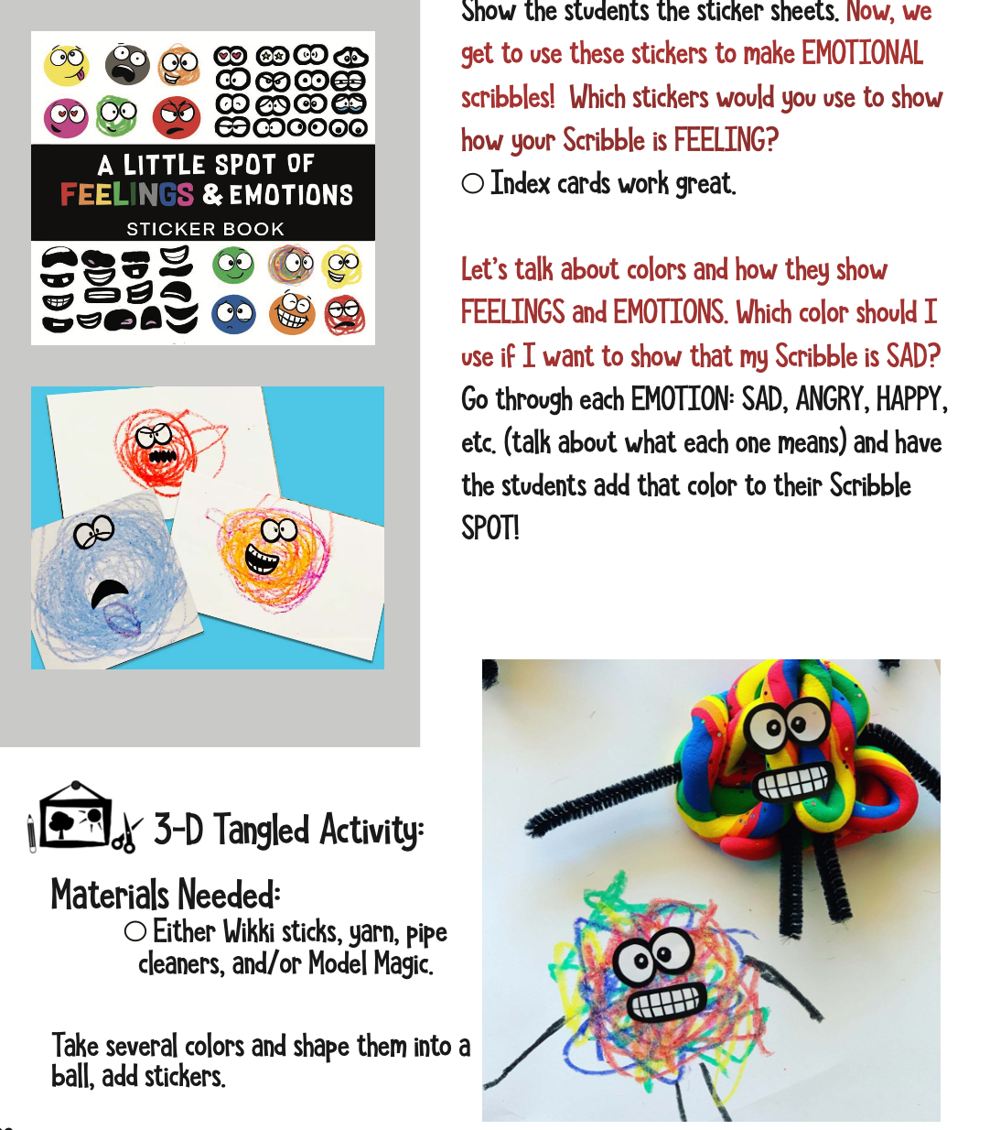
WEEK ONE

Slide 13
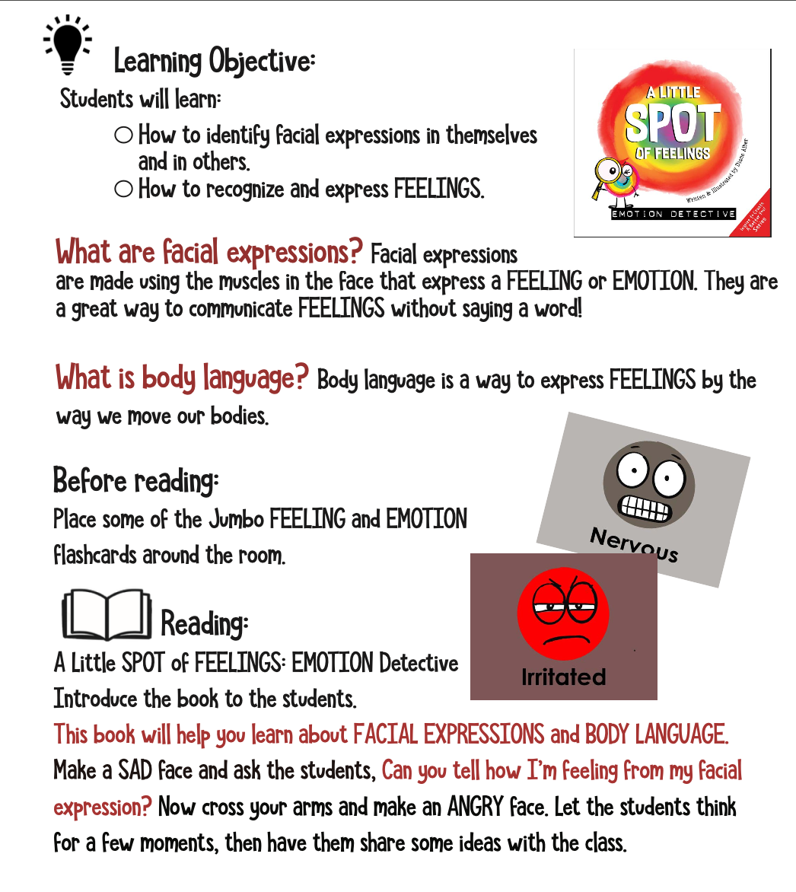
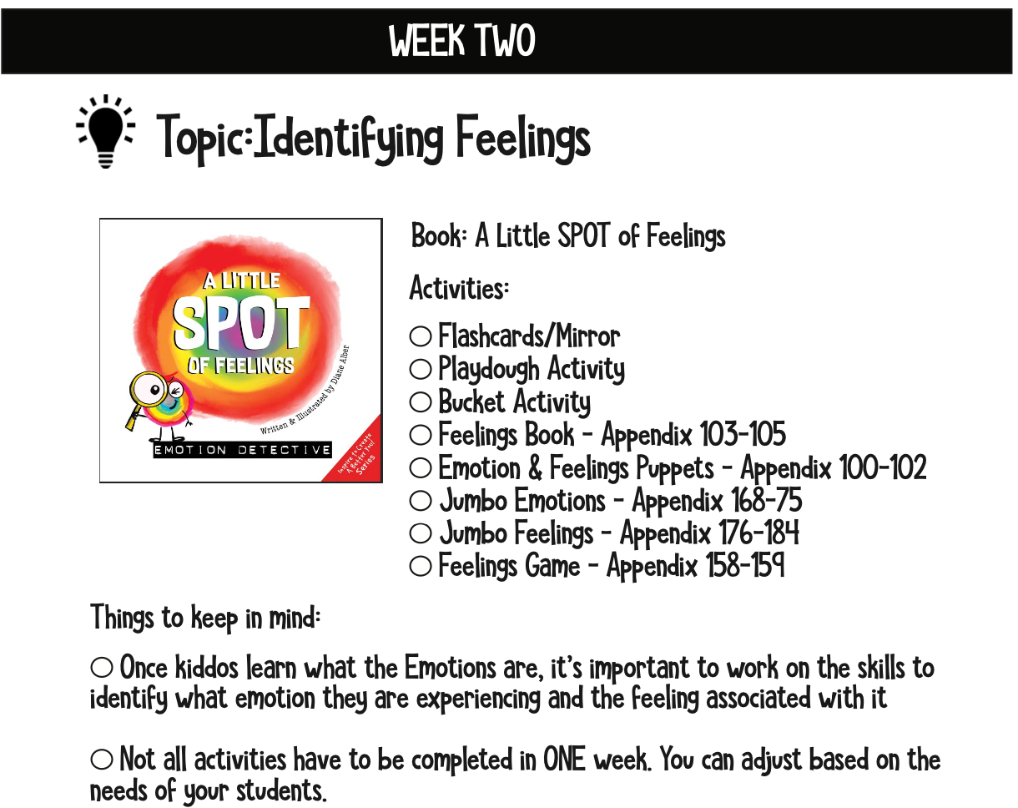
WEEK TWO

Slide 14
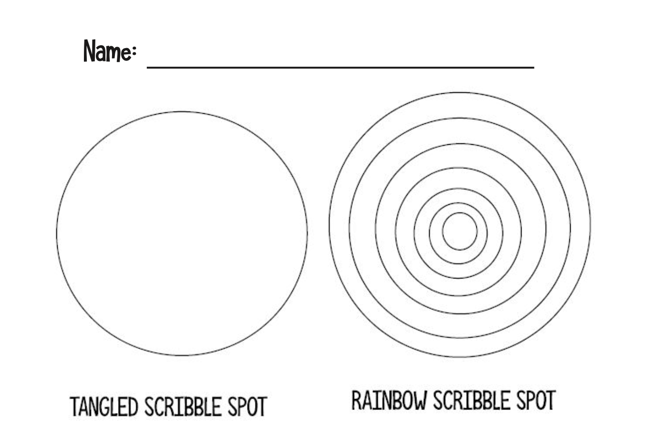
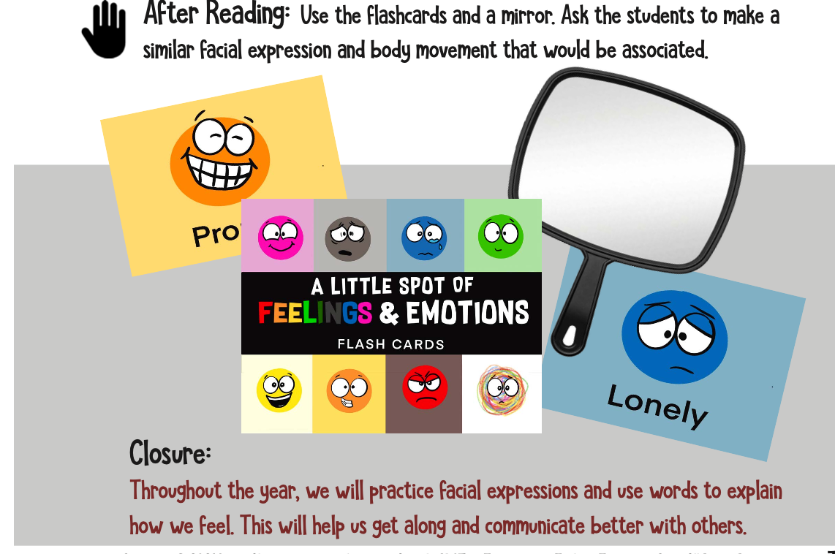
WEEK TWO

Slide 15
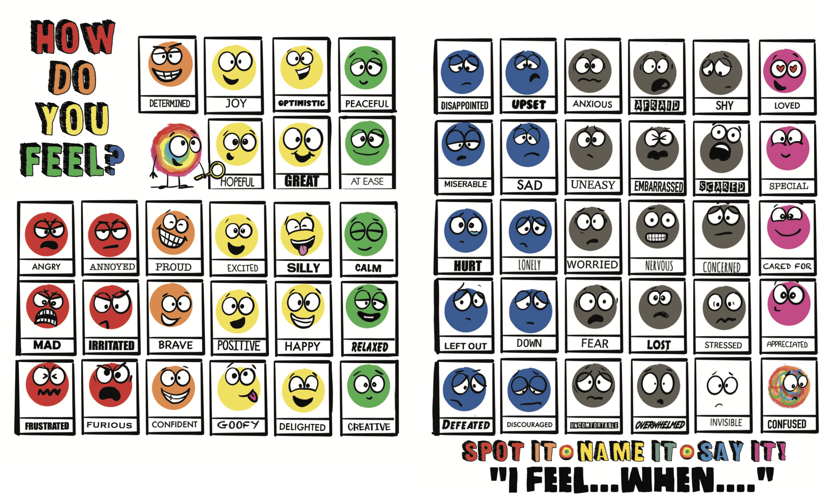
WEEK TWO

Slide 16

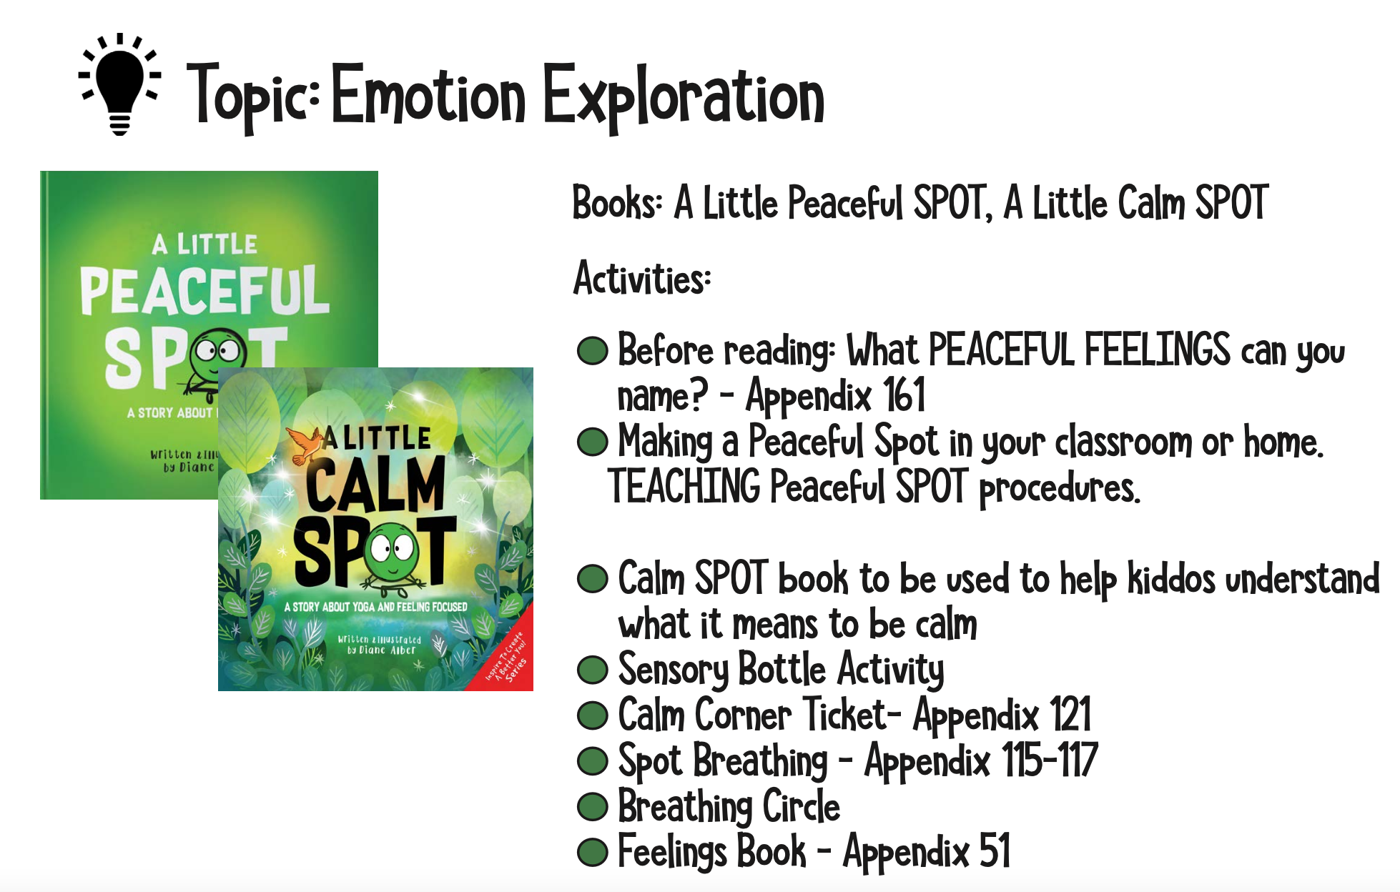
WEEK THREE

Slide 17
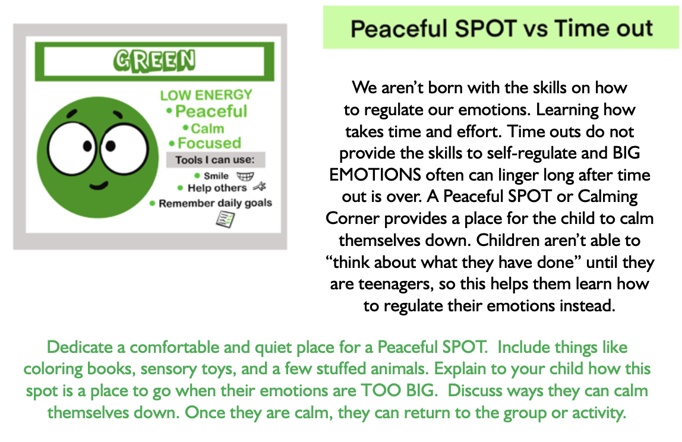
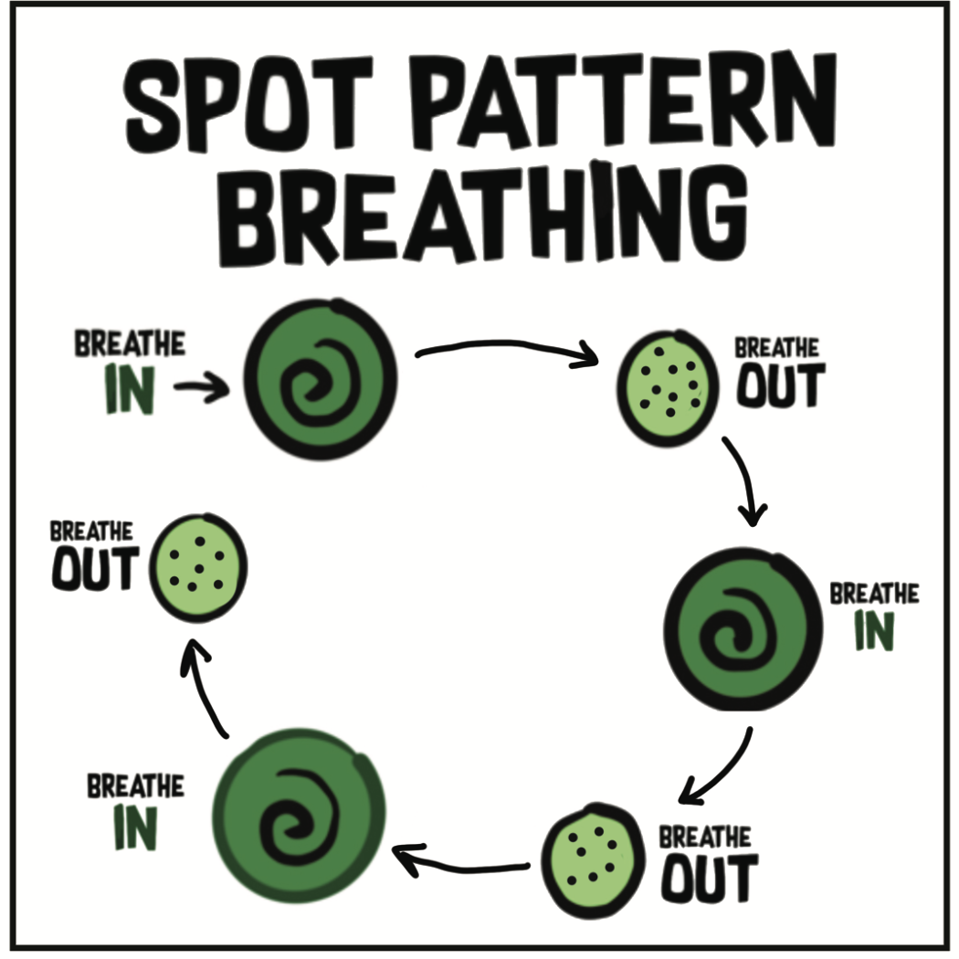
WEEK THREE

Slide 18
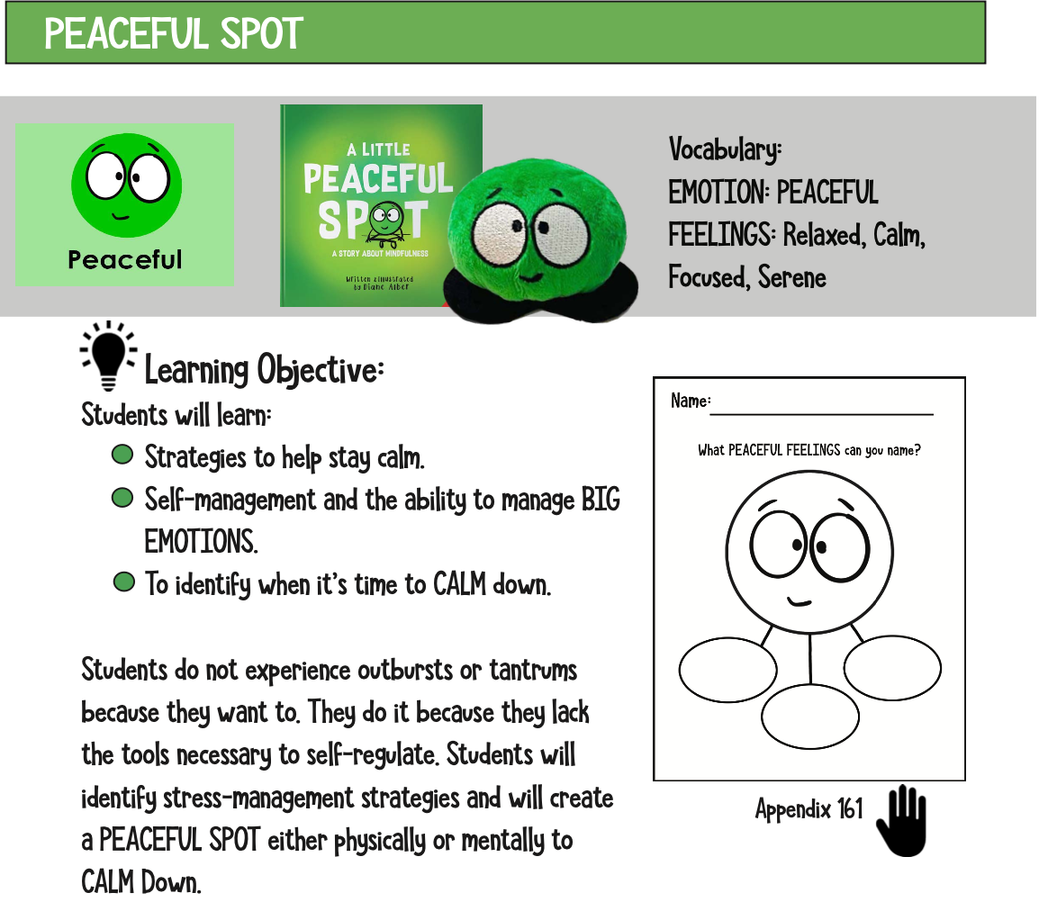
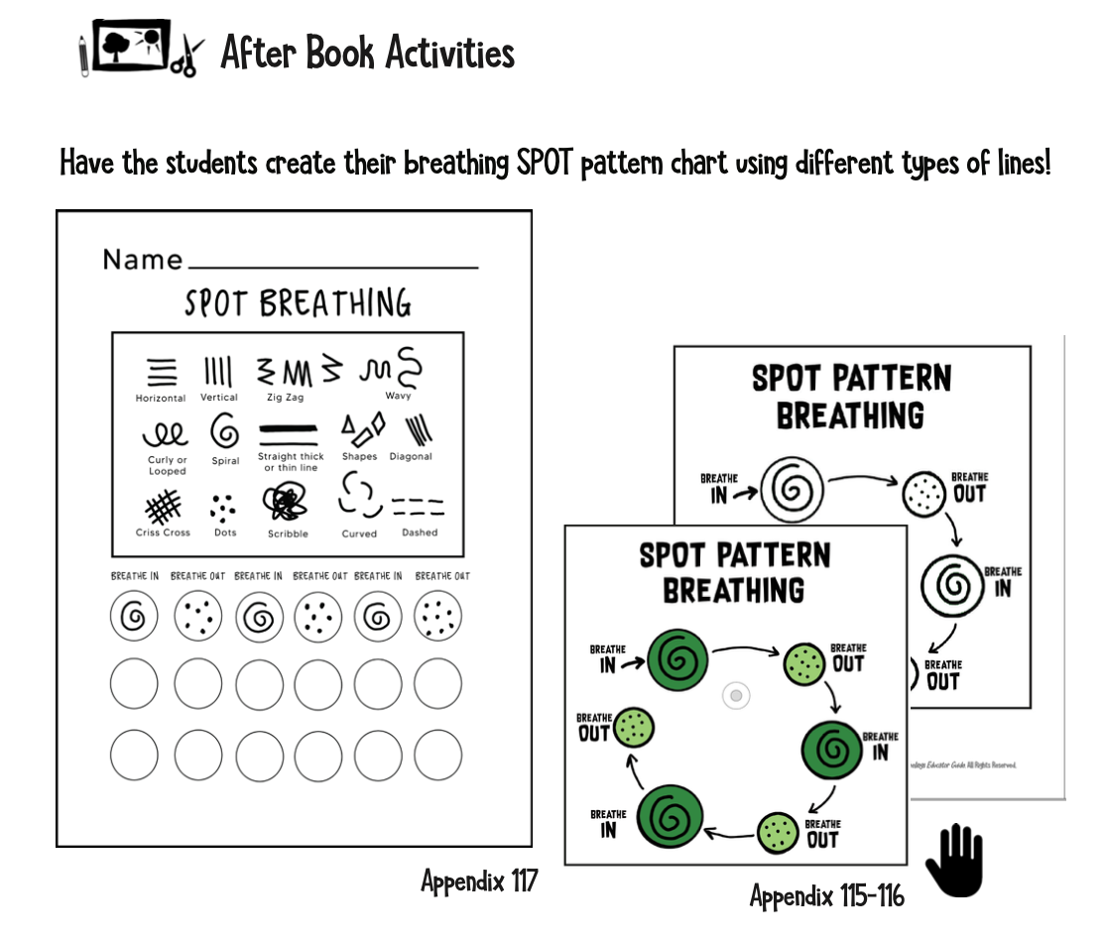
WEEK THREE

Slide 19
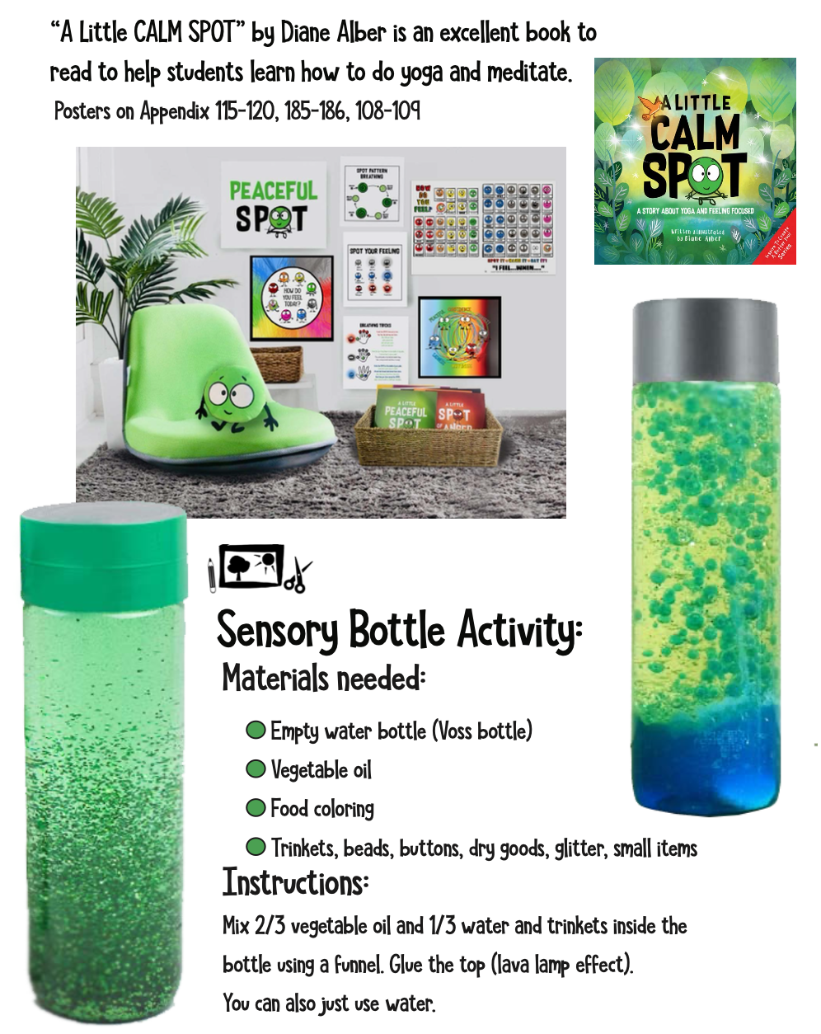
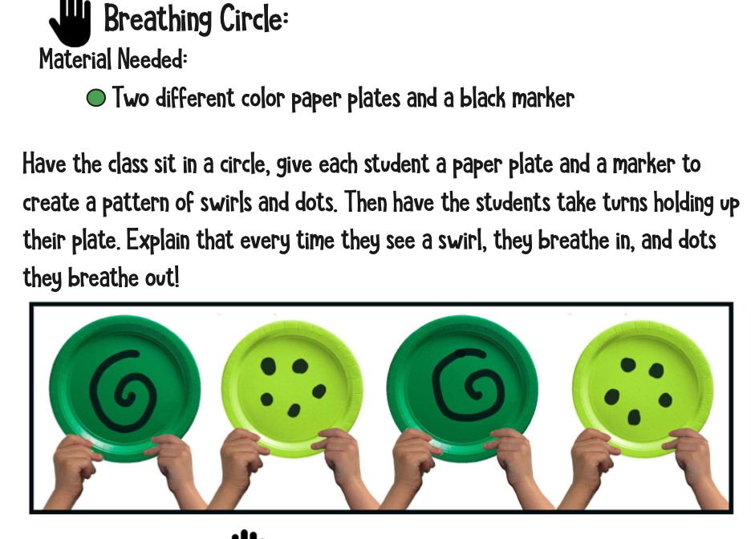
WEEK THREE

Slide 20
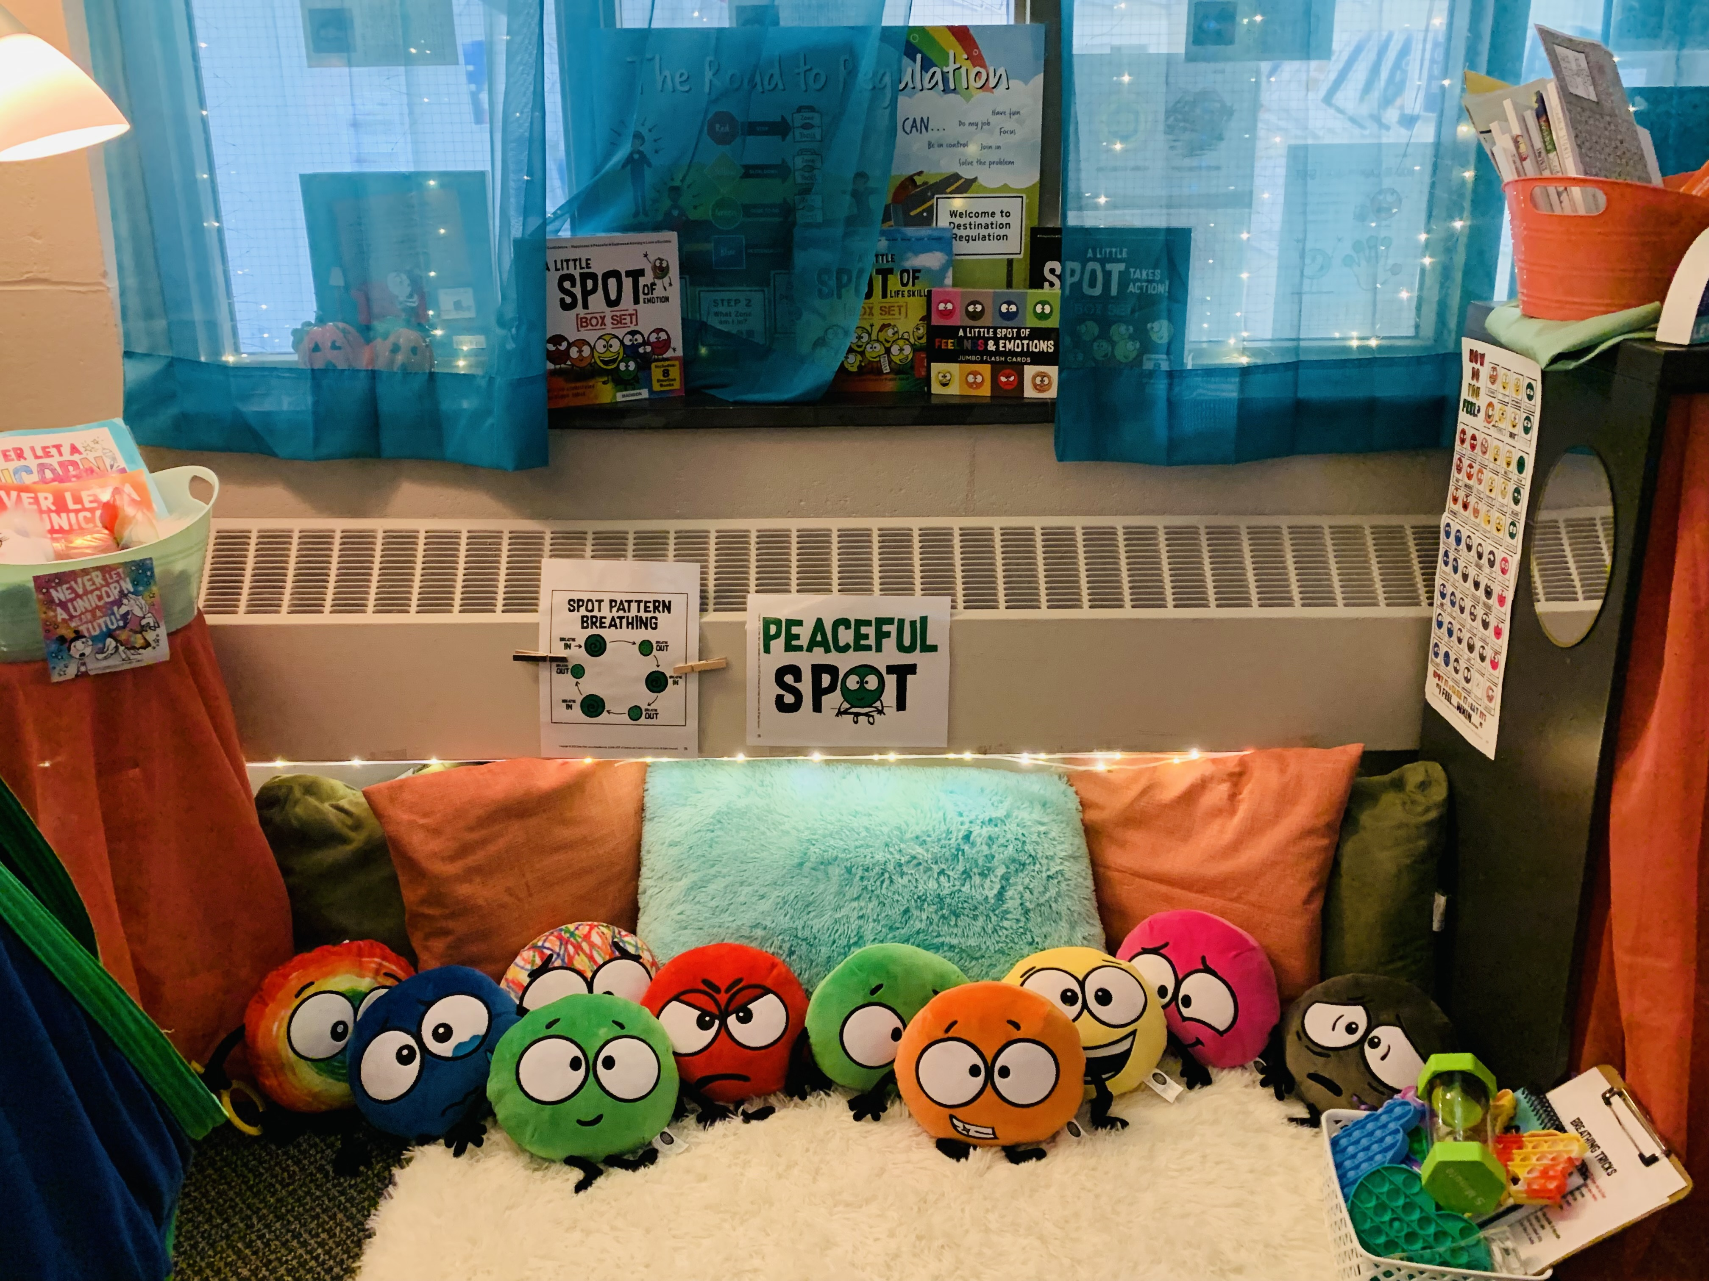
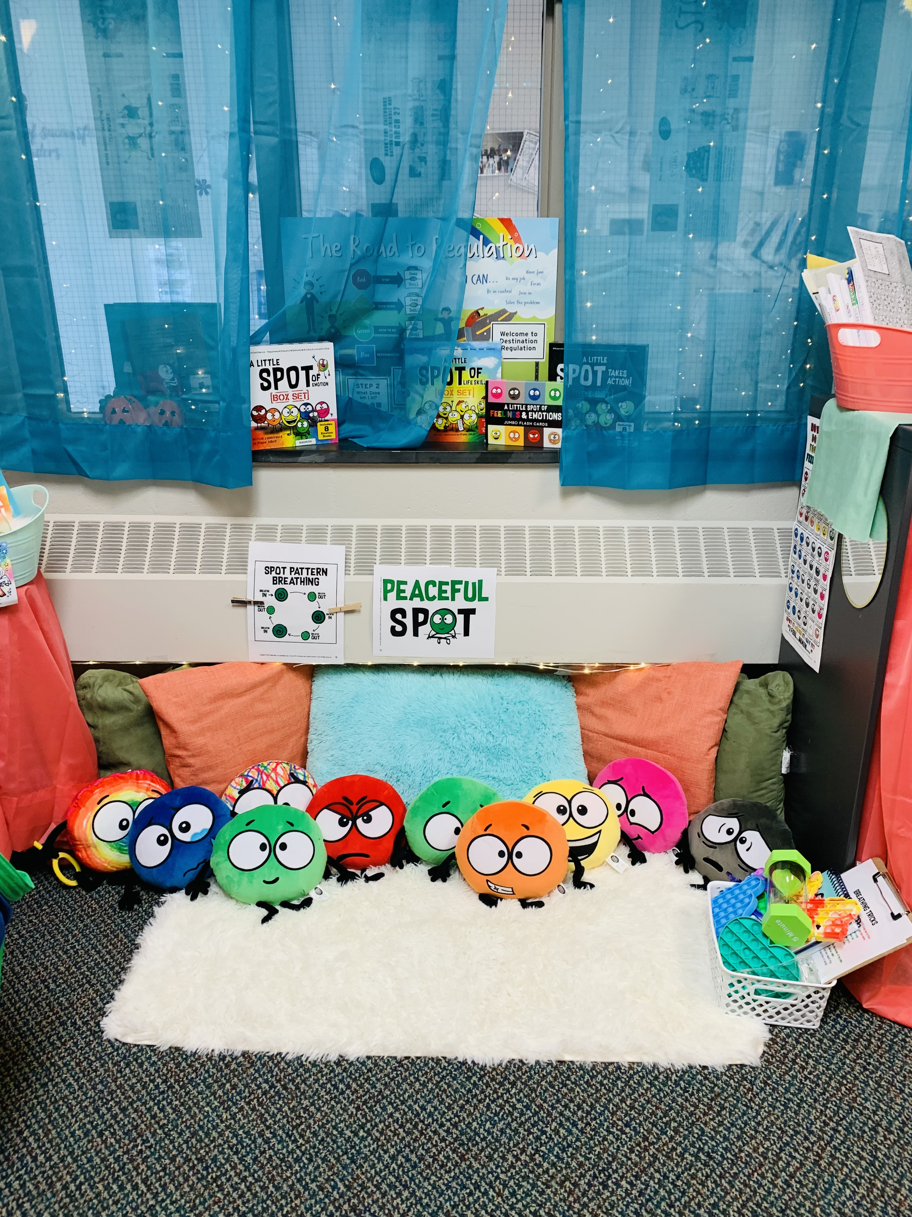
WEEK THREE

Slide 21
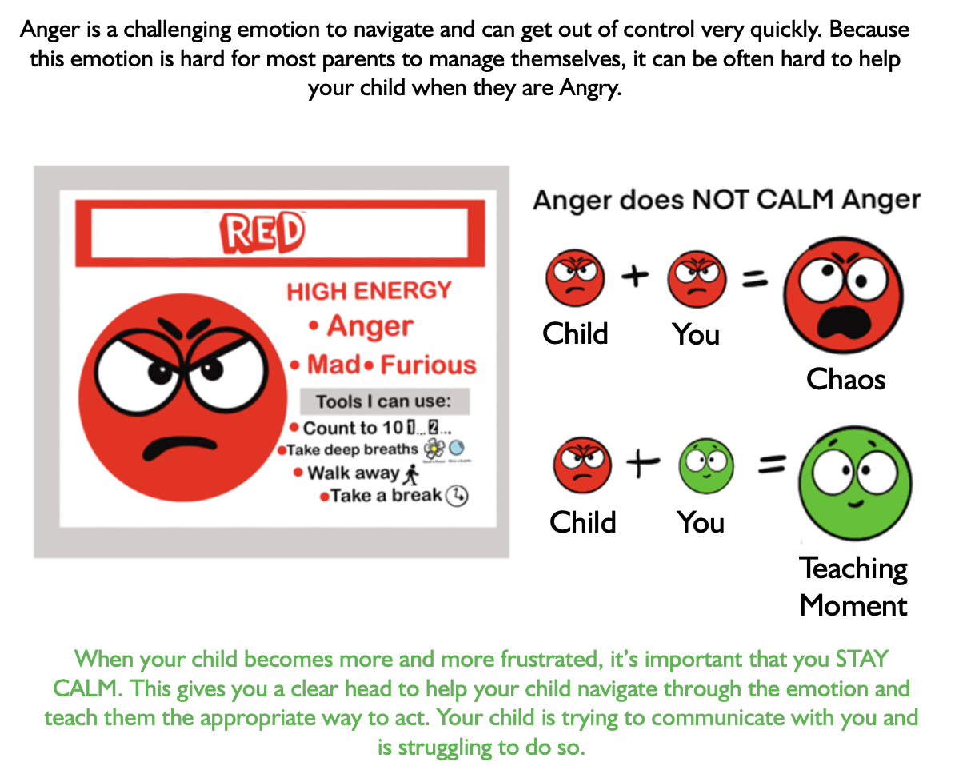
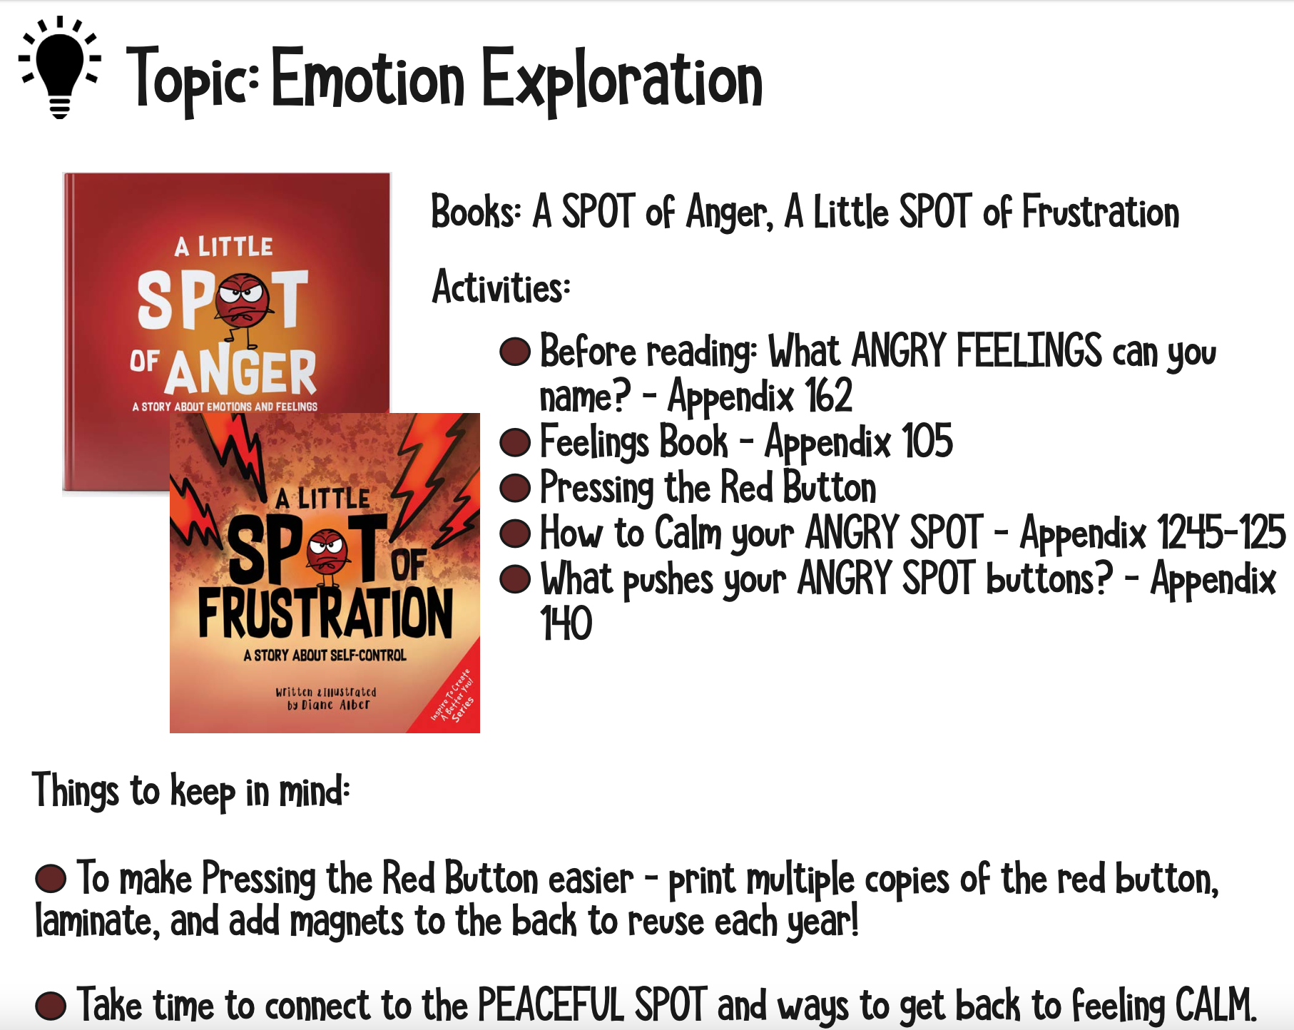
WEEK FOUR

Slide 22
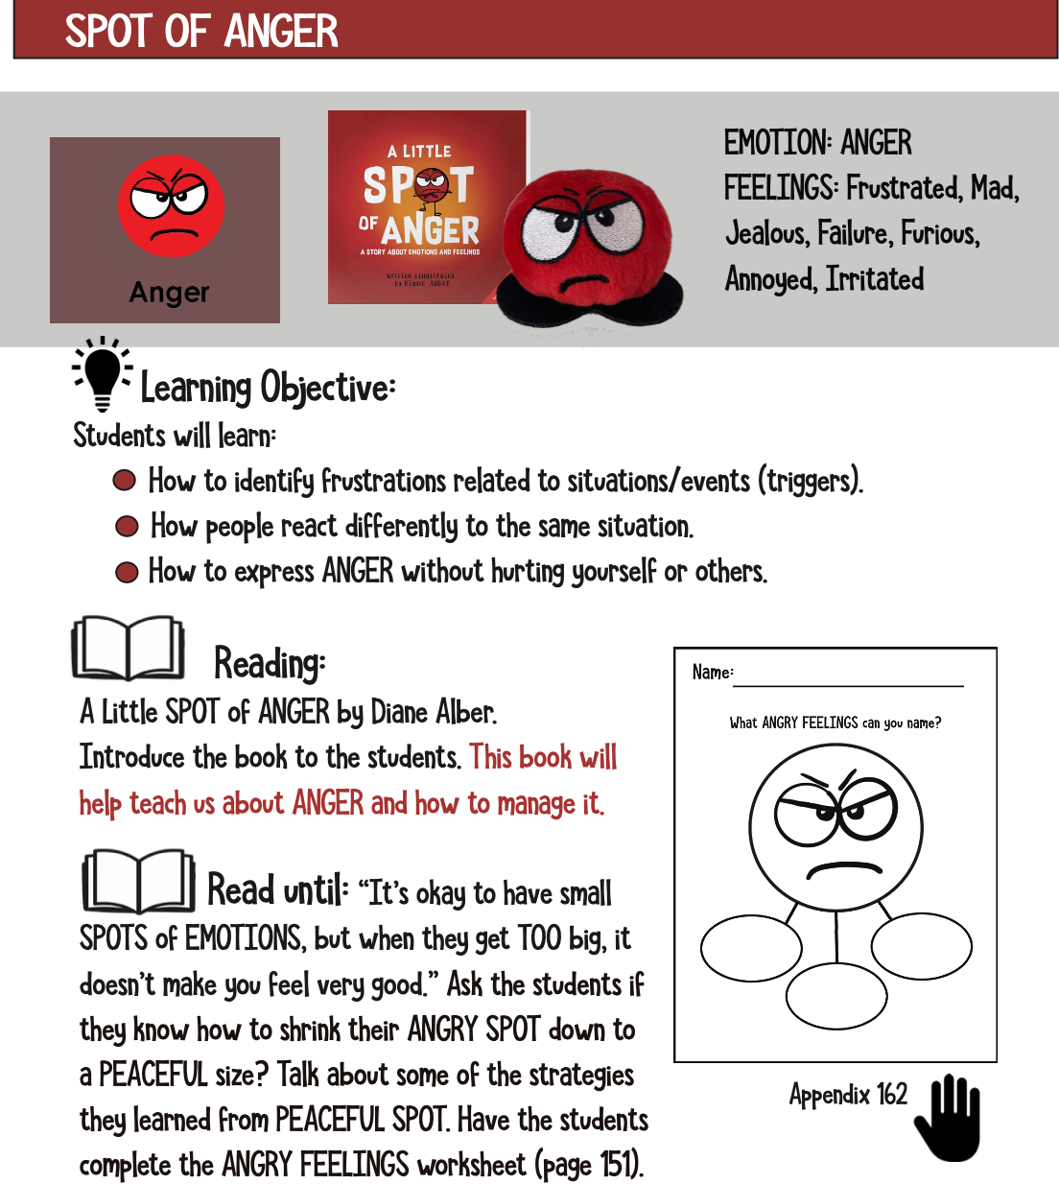
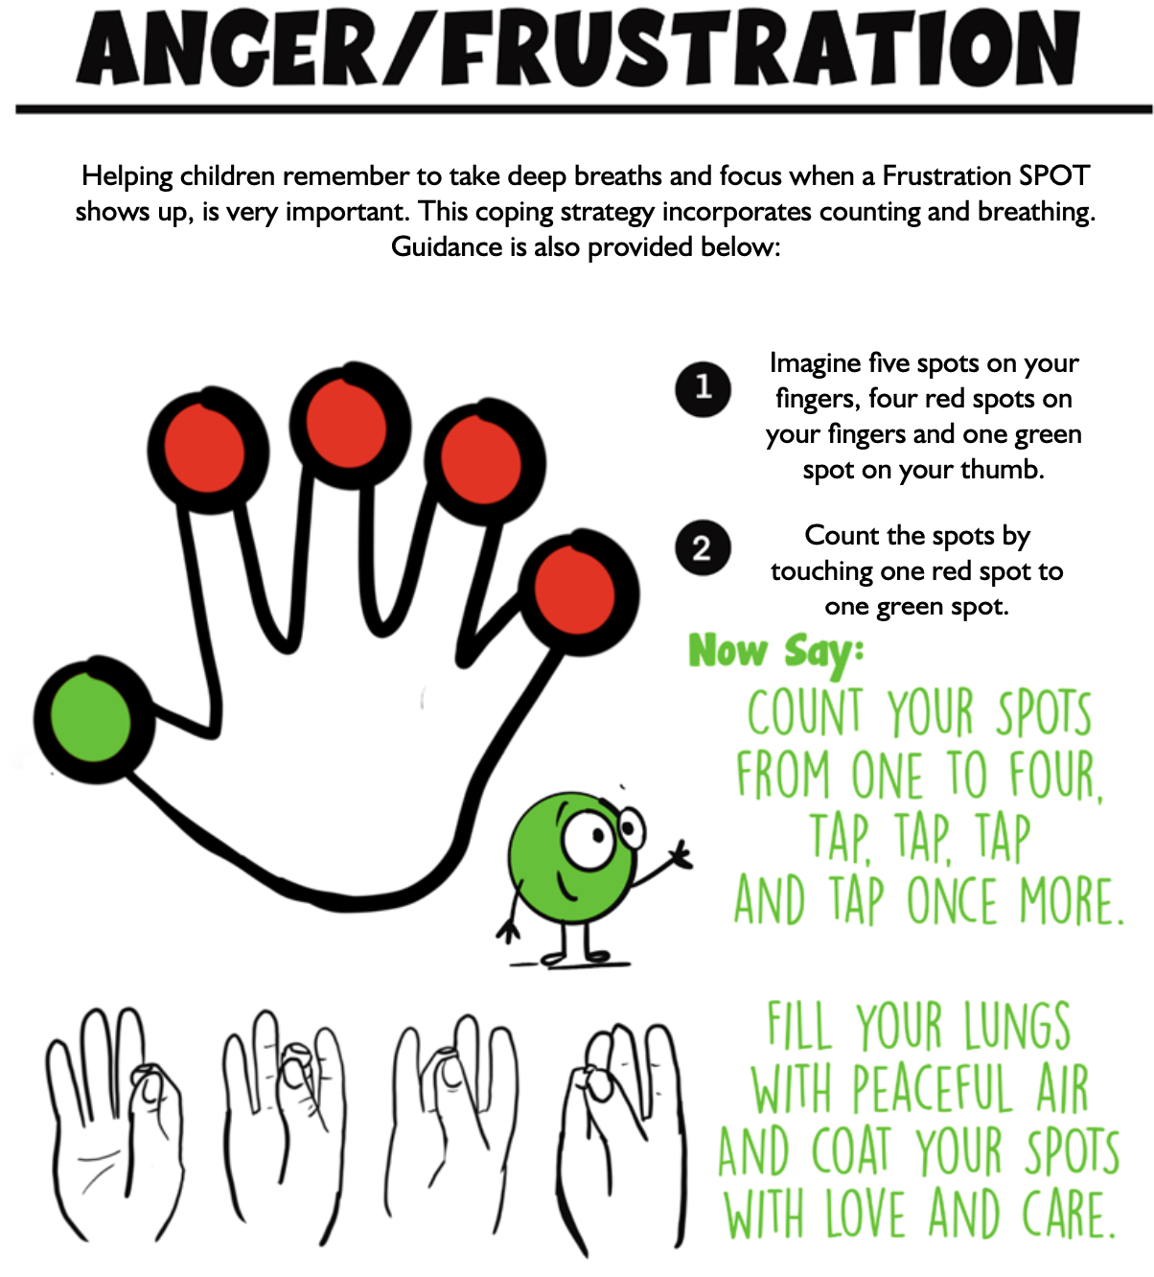
WEEK FOUR

Slide 23
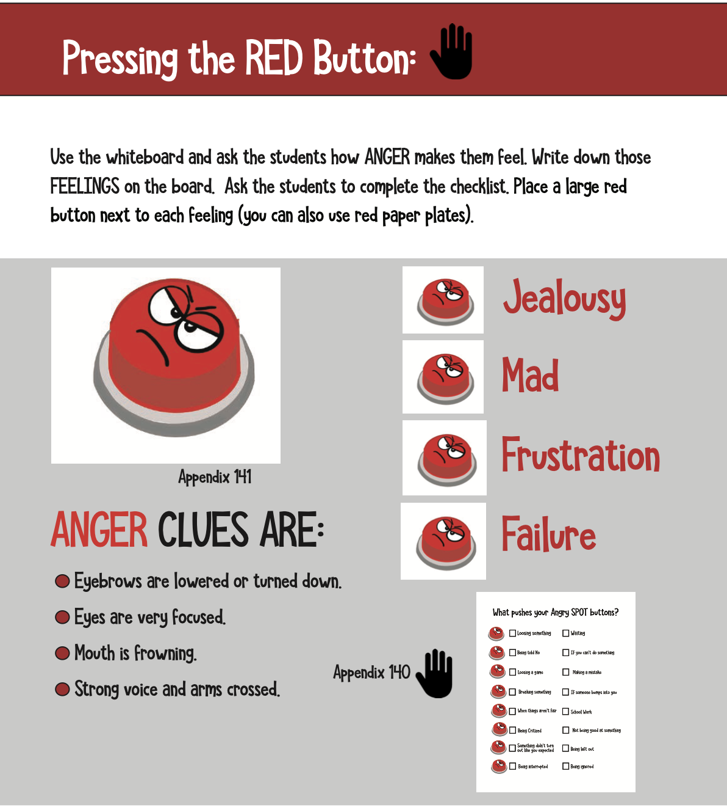
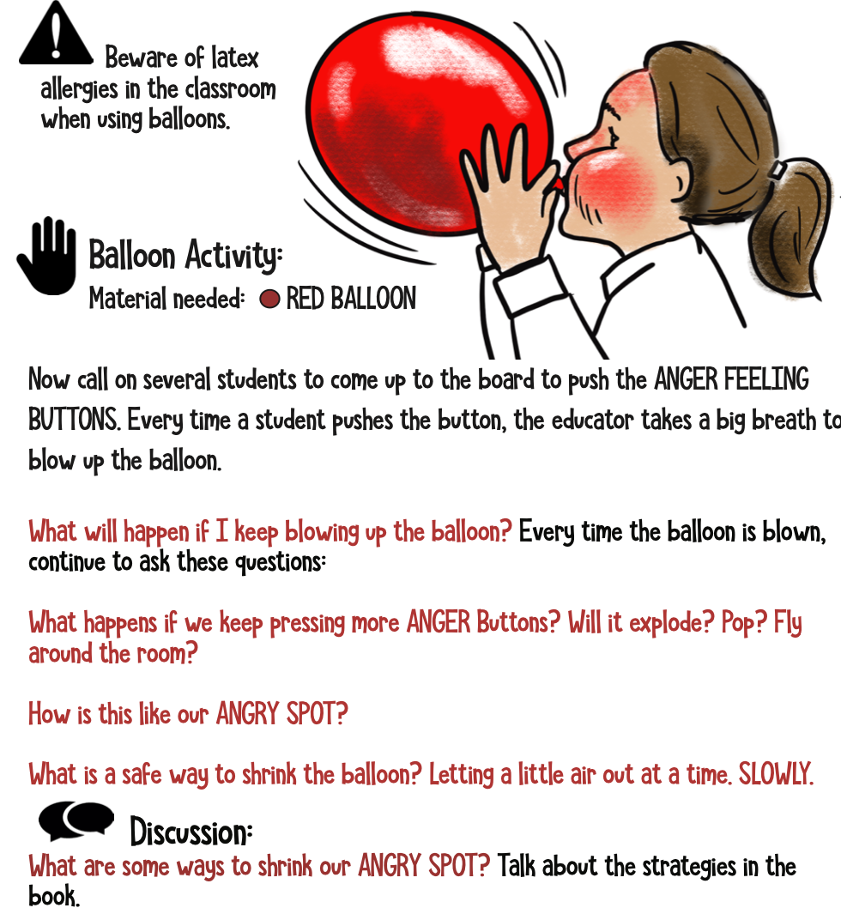
WEEK FOUR

Slide 24
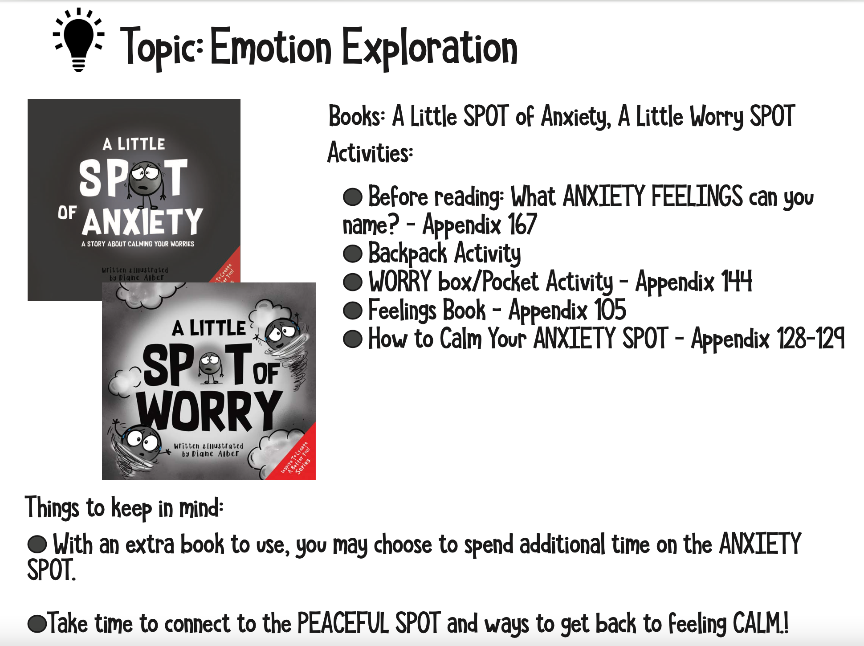
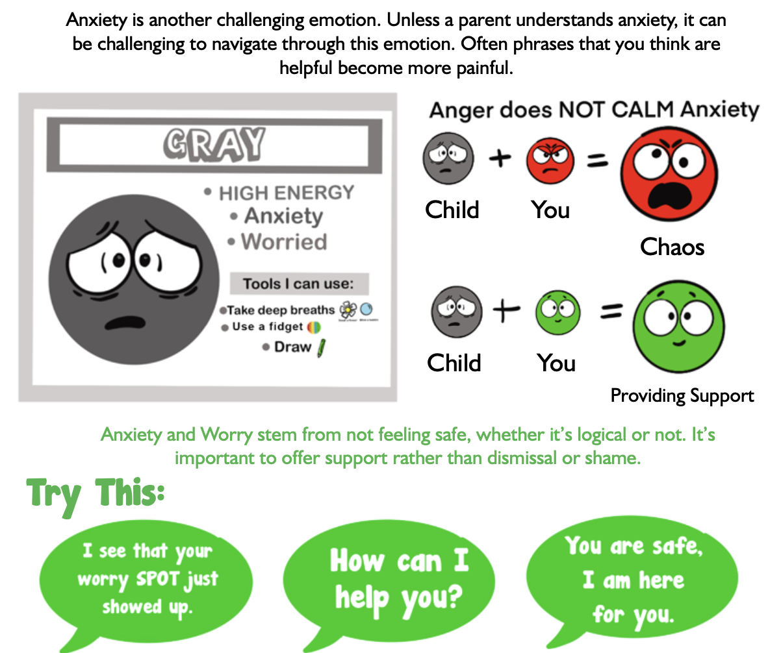
WEEK FIVE

Slide 25
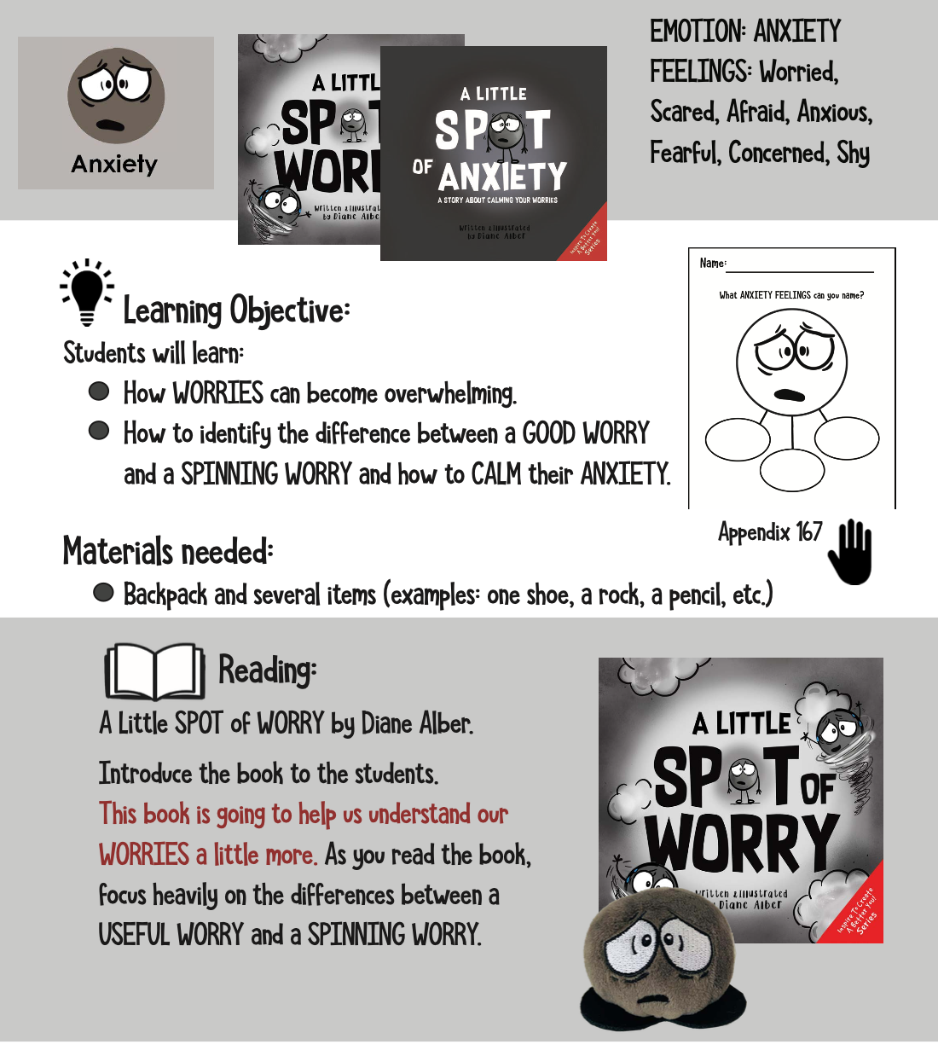
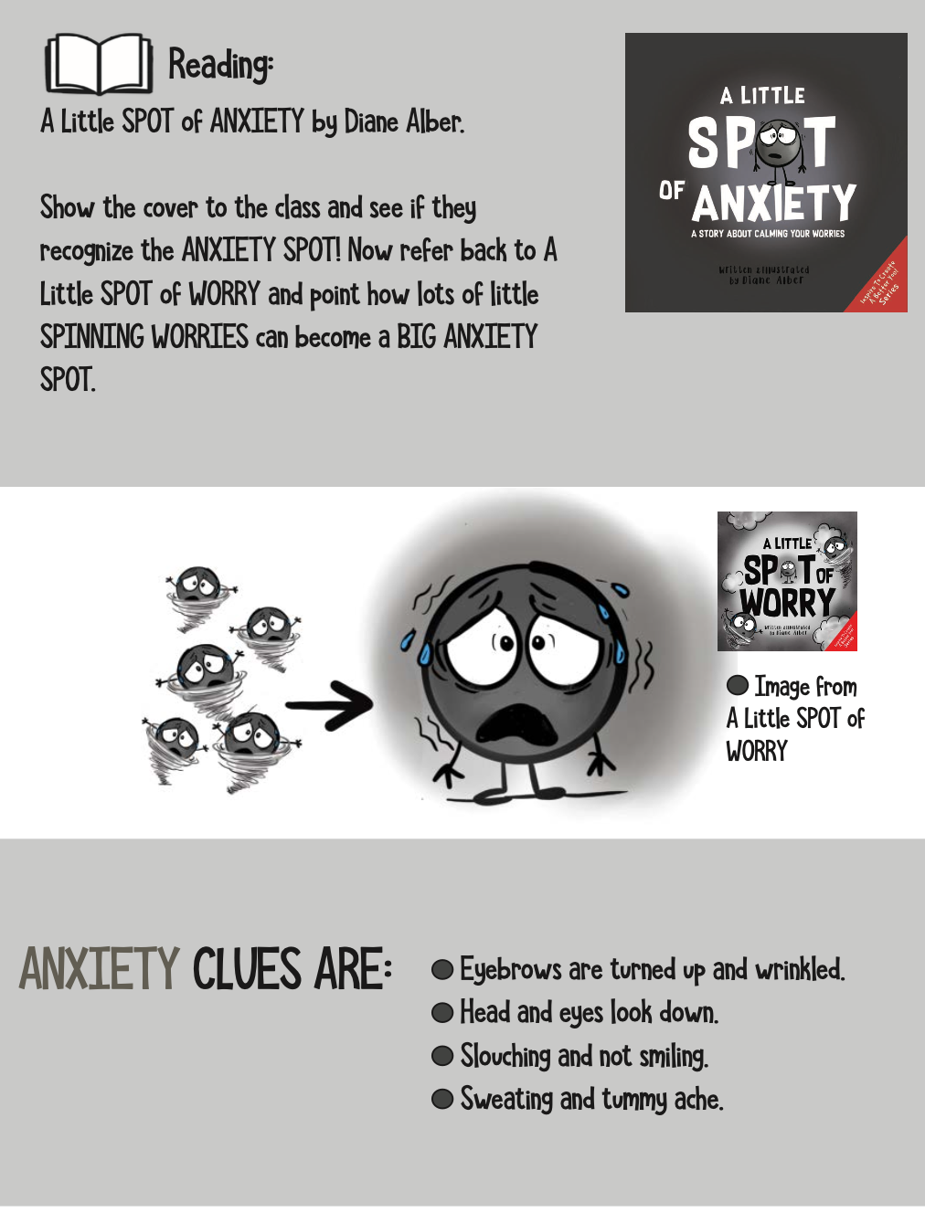
WEEK FIVE

Slide 26
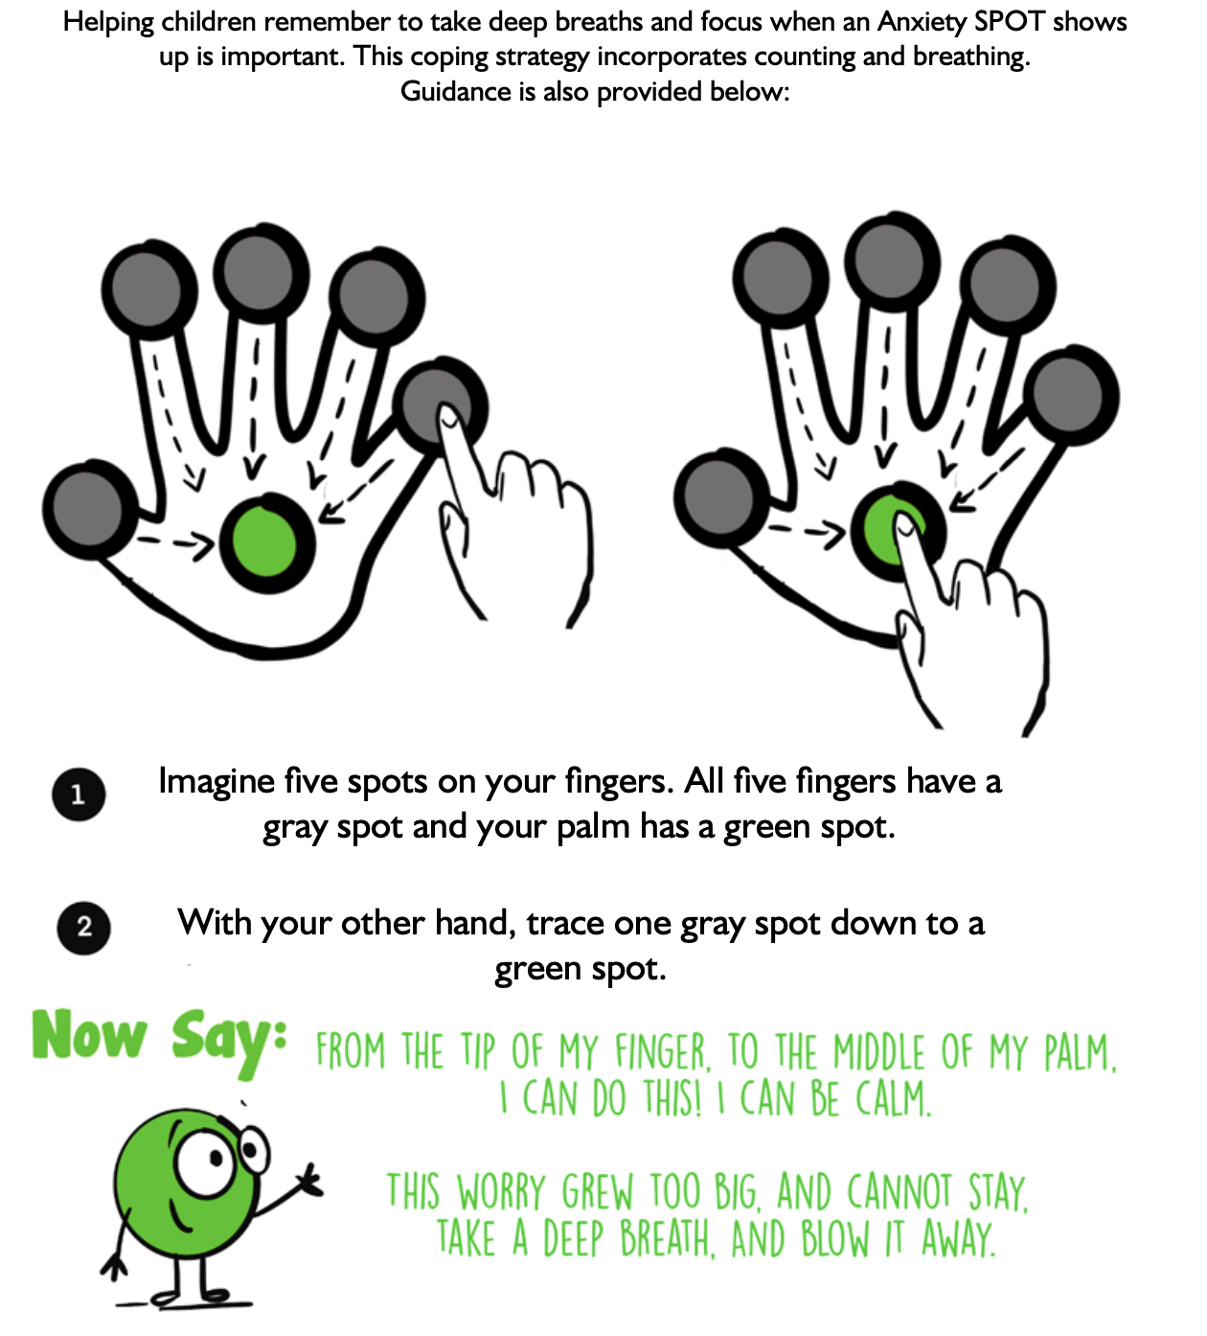
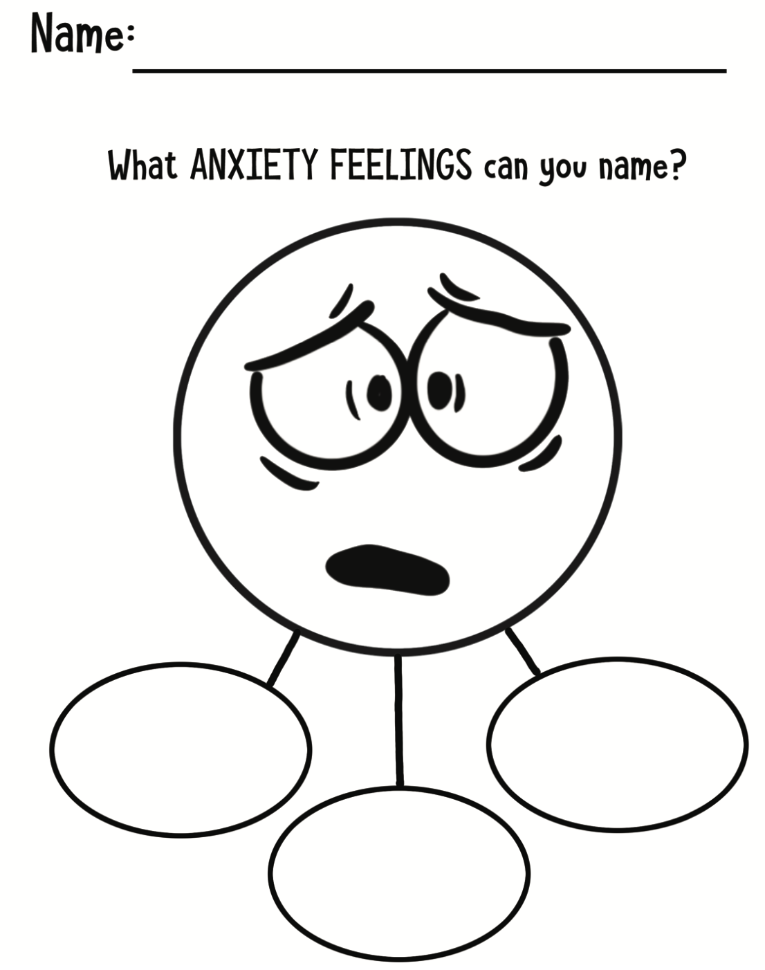
WEEK FIVE

Slide 27
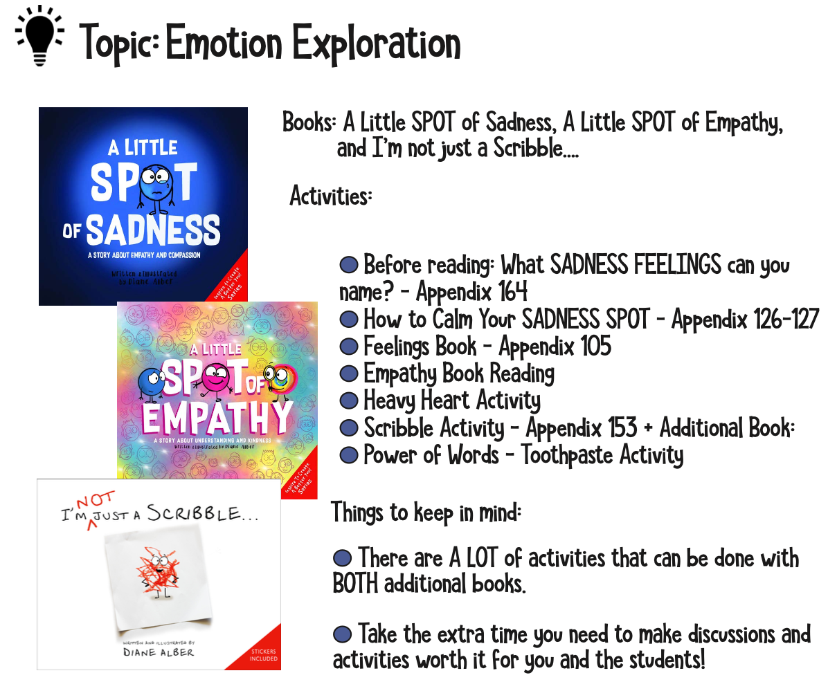
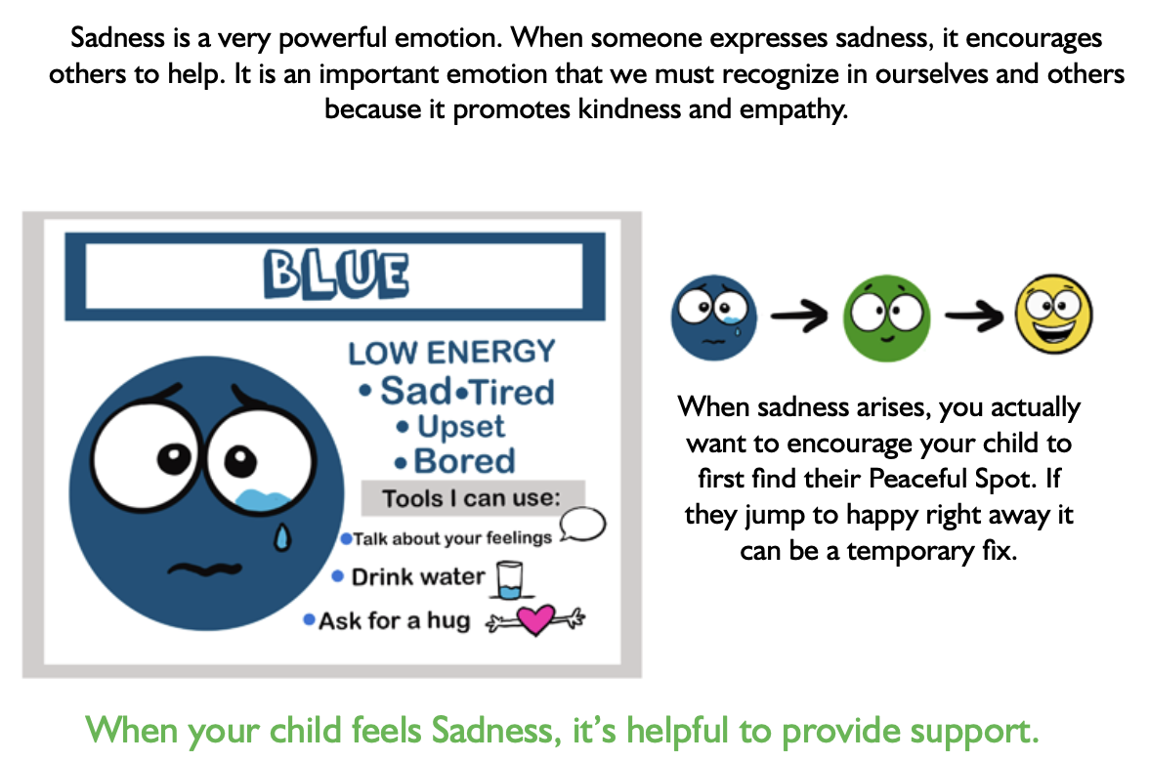
WEEK SIX

Slide 28
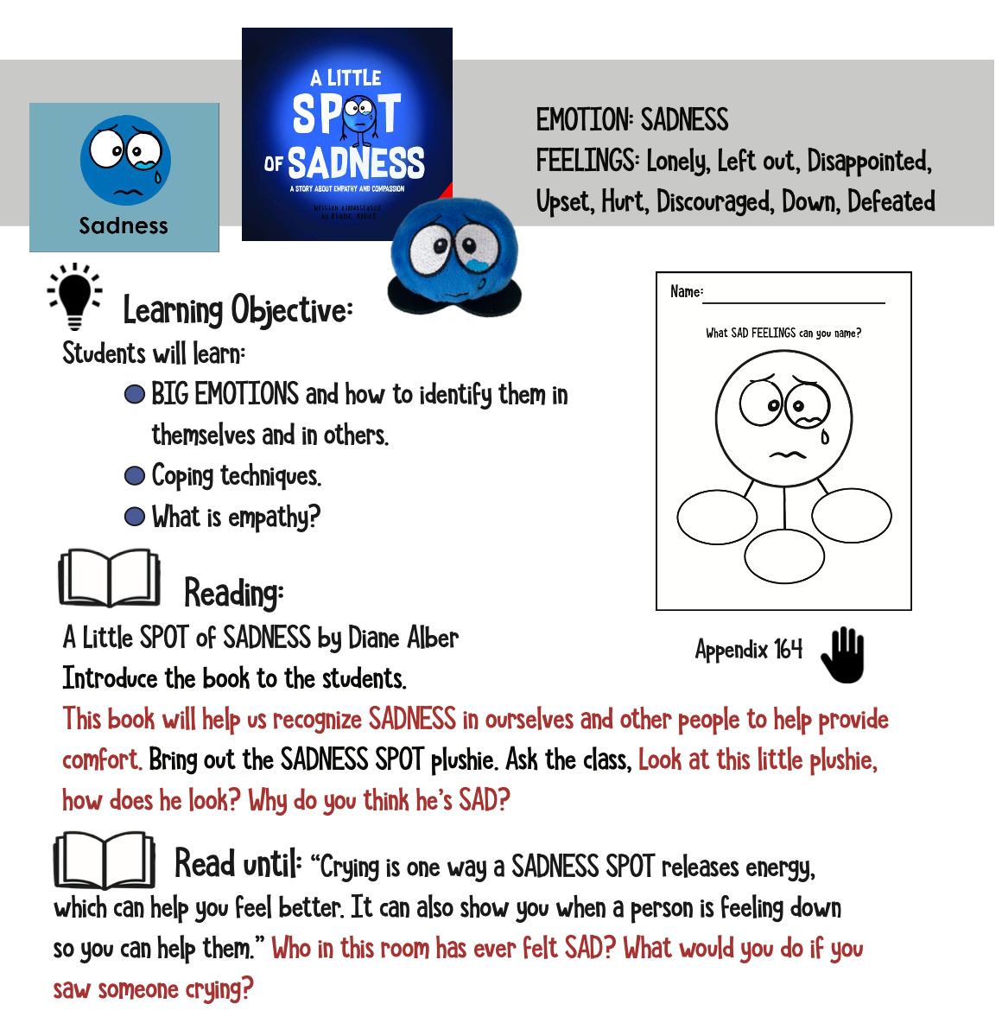
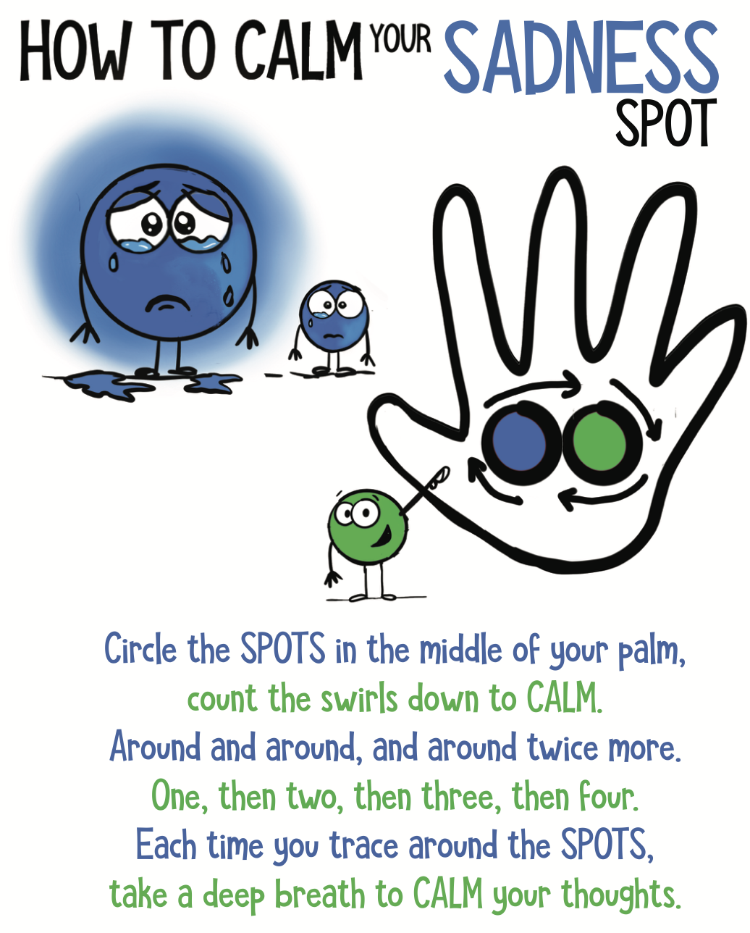
WEEK SIX

Slide 30


WEEK SEVEN & EIGHT

Slide 31


WEEK SEVEN & EIGHT

Slide 32


WEEK SEVEN & EIGHT

Slide 33


WEEK SEVEN & EIGHT

Slide 34


WEEK NINE

Slide 35


WEEK NINE

Slide 36


WEEK NINE

Slide 37


WEEK NINE

Slide 38


WEEK TEN

Slide 39


WEEK TEN

Slide 40


WEEK TEN

Slide 41


WEEK TEN

Slide 42

LEARNING SPOT

Slide 43


WEEK 11 +

Slide 45


Slide 46



Slide 47







SONGS

