Slide 1
Advocating Your Role
How to Present to and Work with your School Board Members

Slide 2
Presenters
Lauren Cerqueira - ISCA Advocacy Chair
School Counselor - Iowa City Community Schools
Melissa Murphy - ISCA Past President
School Counselor - Springville Community Schools
Brittania Morey - ISCA Ex-Officio Board Member
Vice President Marketing & Communications - ICAN
President - Linn-Mar Community School District Board of Education

Slide 3
What is advocacy?
Advocate: to support or argue for (a cause, policy, etc.), to plead in favor of (www.merriam-webster.com)
Recommending to the hospitality committee chair that the lounge needs a Sodastream, not a fifth Mr. Coffee
Laying out the case to the curriculum director that the school should purchase a particular SEL curriculum
Telling your principal why the posters that provide resources for students who have been sexually assaulted should not be taken down from middle school hallways
Sharing with board members about your comprehensive school counseling program
Notes:
Melissa & Lauren

Slide 4
What is advocacy?
Counselors can be most effective when colleagues understand role, goals, purpose of School Counselors
School Counselor training and capabilities
Role of School Counselor
School Counselor and Student Mental Health Position Statement
Faculty/Staff – Understand role and work in daily work - strategize together
Administration – Can align responsibilibities to job assignments
Board – Understand that there are resources within the district (What/expectations, but not how)
Notes:
Melissa & Lauren

Slide 5
The Role of Board Members in District Decisions
Governance versus day-to-day operational decisions
School board sets priorities for direction of the district
Administration determines how those priorities are met
Board can set goals and priorities with counselor capabilities in mind
This is where advocacy can be impactful
Helping board members understand impact potential can influence goals for priorities.
Ie: tier 2 & 3 community support versus in-house support
Notes:
The role of the board can be confusing. Many think the board has the last say on every decision in the district. The reality is the board sets direction and policy, but it is the district administration and building administration that oversees the day-to-day operations of the district and makes the majority of district decisions. The board has input and provides oversight, but the board does not determine day-to-day decisions. Examples - the board generally has no say over student events like homecoming, graduation or conferences.
An example of policy vs operations - the board may set a priority of increased professional development but will not select the actual PD given to staff. The board may set a goal of increased focus on mental health in the district, the administration will then select options and bring recommendations to the board, or provide updates on how their decisions are meeting the board’s goal.

Slide 6
Sample Goals and Priorities
Does your board have goals & priorities?
IASB Standards
Does your board have goals & priorities?
Linn-Mar utilizes IASB Standards
Goals & Values
Standard 2: Student Learning
Review district current and potential support structures, analyzing needs and effectiveness (2.2-9)
Engage in board learning and district leadership discussions surrounding academic targets for student learning goals and strategies (2.1 - 3&4)
Notes:
The Linn-Mar board recently adopted the Iowa Association of School Boards standards of operations and conducted a self-assessment to determine goals and priorities for the next two years.

Slide 7
Why talk to board members?
Board members represent the community–they are voted into office to establish the policies administrators, faculty and staff, and students have to follow
Allocate resources
Make hard decisions about budgets
May have an antiquated view of school counseling (Guidance Counselor)
Average age of a board member: 59
May have no knowledge of educational systems beyond own experiences in school
First ASCA National Model: 2003
May believe sole focus is scheduling and career advisement
May not understand Social-Emotional Learning place and purpose
Notes:
First bullet - Britt
Second bullet - Melissa

Slide 8
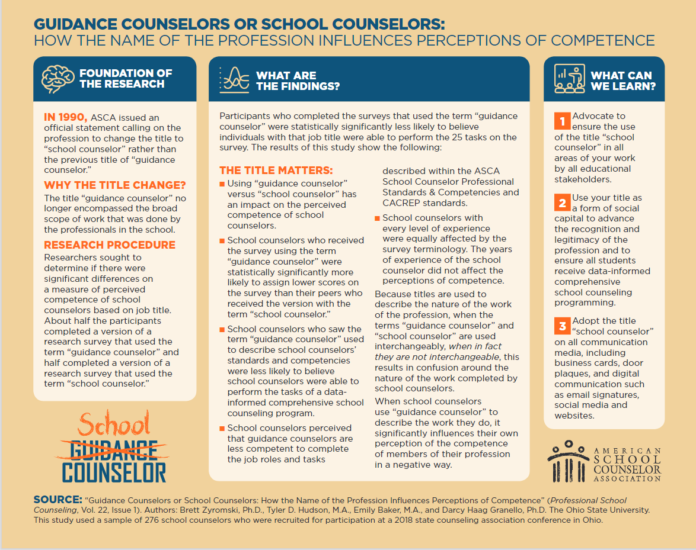
Notes:
Melissa

Slide 9
What should board members know - State Requirements
Iowa Code requires all schools to have a licensed school counselor
Training and Credentials
A K-12 Articulated, Sequential School Counseling Program
School Counselors are part of District ICAP team
ICAP - Individual Career and Academic Plan for students beginning in grade 8
Ratio Recommendations and Reasonings
ASCA National Recommendation - 250:1
Iowa Recommendation - Working towards 350:1
Notes:
Lauren

Slide 10
Notes:
Lauren begins
When giving information do your best to talk about trends
Cost Effectiveness of School Counselors Implementing ANM (Carrell & Hoekstra, 2011)
• School counselors cause economically & statistically significant increase in achievement (especially boys) and reduce misbehavior of boys (20%) and girls (29%)
• A marginal counselor is three times as effective in raising achievement as a marginal teacher hired to reduce class size
• Hiring one additional school counselor is equivalent to raising the quality of every teacher in the school
Melissa supports

Slide 11
What should board members know
Your Role
Counseling duties - What can they do, what can we do?
Program goals–look to beliefs, mission, vision
What are counselors doing, how is time protected?
Classroom time–move away from “guidance time”
Data–ratios
Define caseload, not just the students you see 1:1 or small group)
Steps to reaching ratio goals
Notes:
Melissa

Slide 12
What should board members know - Your Role
Professional Standards, Ethics, and Evaluation Methods
ASCA Professional Standards
State of Iowa Evaluation Process
Code requires teacher evaluation
School Counselor Evaluation Supplement
Aligned with professional standards
Notes:
Lauren Ethical standards were just revised summer 2022 Direct to Erin’s session - last session on Tuesday

Slide 13
Recommended Model of Direct/Indirect Services - 80/20
80% Direct and Indirect Services
20% Program Planning and School Support
Ways to Measure and Evaluation
Use of time (link)
Create summary sheet to give board members
Effectiveness of school counselors
Research in Padlet
Notes:
RAMP templates/Use of time
Cost Effectiveness of School Counselors Implementing ANM (Carrell & Hoekstra, 2011)
• School counselors cause economically & statistically significant increase in achievement (especially boys) and reduce misbehavior of boys (20%) and girls (29%)
• A marginal counselor is three times as effective in raising achievement as a marginal teacher hired to reduce class size
• Hiring one additional school counselor is equivalent to raising the quality of every teacher in the school

Slide 14
What should board members know - Your Role
Appropriate and Inappropriate Activities for School Counselors
Advocate for appropriate activities
Talk about inefficiencies of inappropriate Activities
Come with solutions/new ideas
Notes:
Melissa/Lauren

Slide 15
Appropriate and Inappropriate Activities
Advisement and appraisal for academic planning
Providing counselling to students with disciplinary and/or attendance concerns
Providing short-term individual and small-group counselling services to students
Consulting with teachers
Analysing disaggregated schoolwide and school counselling program data
Building the Master Schedule
Performing disciplinary actions or assigning consequences
Providing long-term counselling in schools to address psychological disorders
Supervising classrooms or common areas
Serving as a data entry clerk
Notes:
Britt - explain board presentation experience

Slide 16
Engage Your Board - Foundational Topics to Share
What kind of board do you have?
Digital or paper
What is the best way to share information
What should you share?
Goals of program
Areas of expertise or training
Areas of most need for students - needs being addressed or not addressed
Notes:
Britt

Slide 17
Summary of Success
Summary sheet of success,
Goals, strategies, and outcomes
Hatching Results template
Consider including: ratio data, interventions, classroom lessons/topics covered, referrals, seen, how long does it take you to see referred students, goals section, % of time at various tiers, what community resources are available
Notes:
Sheet shared with Linn-Mar board during presentation

Slide 19
Conversations with Board Members
Types
Board presentations
Presentation during a board meeting to full board about your program
Group presentations
Invite a non-quorum number of board members to visit (3 of 7 or 2 of 5)
One on One Conversations
Chat with a single board member in person/email
Why are you having the conversation?
Board interest
Counselor concerns
Notes:
Britt - review ways to engage with board

Slide 20
Engage Your Board - Meeting Presentations
Make presentation interactive
Show, don’t tell, about school counseling
Community Circles
Introduce and Discuss
Examples - MTMDSS, Appropriate/Inappropriate Duties
Notes:
Britt - How to present to your board - what is the board looking for

Slide 21
Community Circles
Ancestry
Heritage
Home
Notes:
Example of opening - don’t tell what community circles are, engage them in the process

Slide 22
Notes:
Britt - During our board presentation our presenter shared this overview video from Trish Hatch that easily and clearly explains MTMDSS. This video is linked in the padlet.

Slide 23
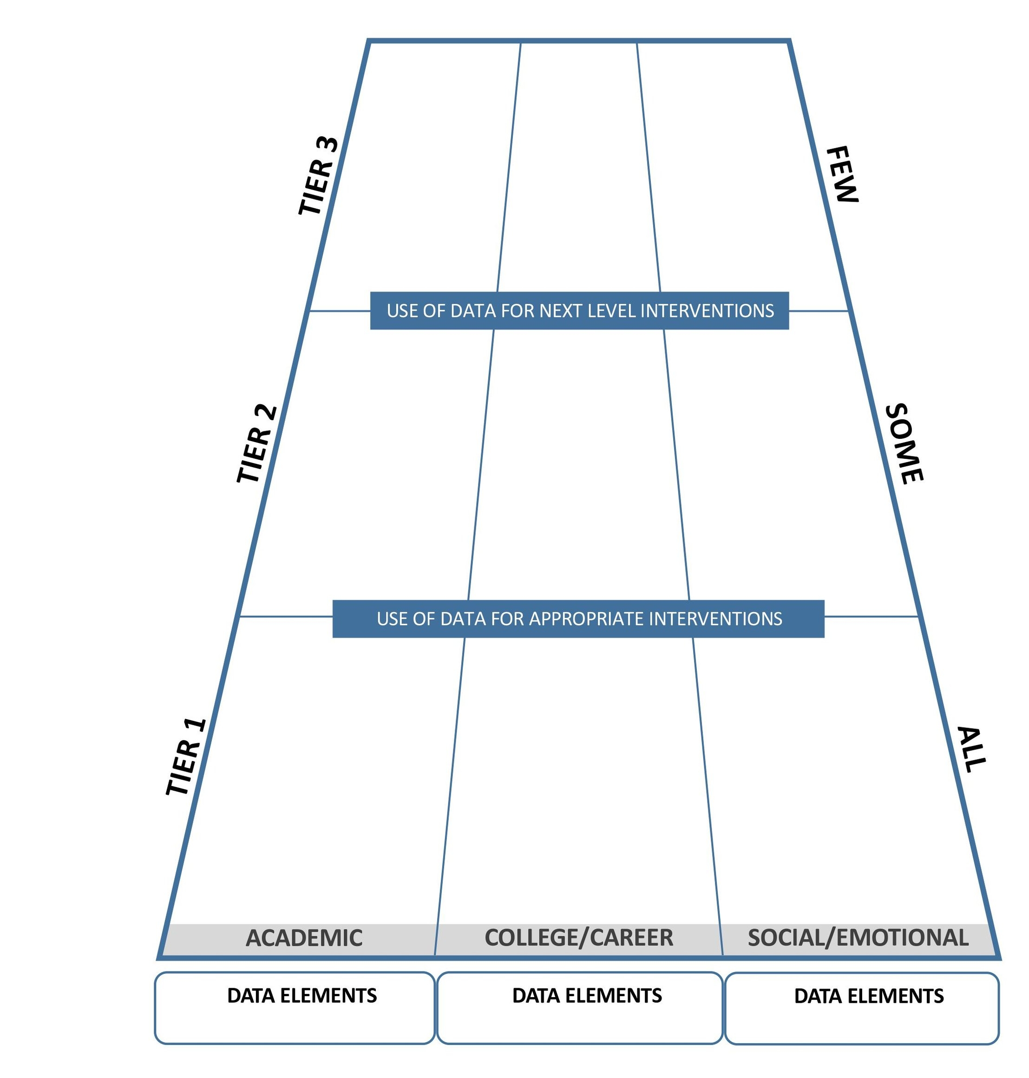
MTMDSS Visualization
1:1 Counseling – Academic Anxiety
Referral to Trio
Mercy
Referrals to Iowa College Aid
1:1 Counseling
Referrals to Post-Secondary Support Programs
Crisis Response
504 Facilitation
Check In Check Out
SAIG – Classroom Survival
Apprenticeship Programs
Small Group Counseling
College Visits
Behavioral Response
MTSS Consultation/ Collaboration
Highlight the different content areas and tiers of support
Use as an activity for board members to become engaged participants in the discussion
College and Career Planning
Classroom Guidance
D/F Monitoring
PBIS Expectations
PBIS Expectations
Medco Tour
Community Circle
ISASP Organization
Classroom lessons on careers
Notes:
Britt - After viewing the video and reviewing the different tiers and content areas we participated in a discussion activity. After defining then the activity for the board was to hear options and the board shouted out where it should be placed. Created great dialogue and effectively illustrated the different tenants of school counseling and what activities in those areas at each tier looked like.

Slide 24
Engage Your Board - Small Groups/School Visits
Board visits are an opportunity to showcase students and elements of your program
Invite to observe small groups (where appropriate)
Talk about counseling process with individual students
Show resources available to you and students
Day in the Life - preview a normal day’s activities and schedule
Notes:
Britt - talk about what board visits are and how to showcase to boards in a short time

Slide 25
Mock Conversation with a Board Member
Questions a board member might ask
How do you spend your day?
How do you define your position versus how your position is defined by the district?
What are the greatest areas of need for our students? Are you equipped to address those needs?
What supports do you need to meet the needs of our students?
In your presentation you outlined the goals of the program – use of time, direct and indirect duties, how close would you say your day-to-day role reflects the goals of the program as you’ve described them?
What can the board do to better support your work and thus meet the needs of students?
What’s working and what isn’t?
Notes:
Mock one for audience and then engage attendees to share ideas - How would you answer these questions?

Slide 26
Mock Conversation with a Board Member
Questions a counselor might ask of a board member
Can I tell you about how my work aligns with board goals?
I know the board has been discussing mental health, can I talk to you about how school counselors in the district can help?
I’m concerned about how my position is being utilized. According to professional standards…and I’m supervising classes for planning time.
Can I talk to you about professional development days for counselors? Our district PD rarely includes something specific to my role. I’d really love to attend or take part in…
Notes:
Ask Britt same mock questions and then open for attendee questions and discuss

Slide 27
Visit the Hill
Thursday, February 23, 2023
Morning program of topics of importance to Iowa’s high school and college students, school counselors, and those in admissions and financial aid
Lunch
Share your views with legislators
Notes:
This is a placeholder–details remain to be seen

Slide 28
Take Away Resources
Padlet link - https://padlet.com/cerqueiralauren/x4g02ygh0tcg3t26
Title Matters
Counselor Ratios
Impact Sheet Template

Slide 29
Contact Information
Lauren Cerqueira - ISCA Advocacy Chair
School Counselor - Iowa City Schools
Cerqueira.Lauren@iowacityschools.org
Melissa Murphy - ISCA Past President
School Counselor - Springville Community Schools
mmurphy@springville.k12.ia.us
Brittania Morey - ISCA Ex-Officio Board Member
Vice President Marketing & Communications - ICAN
President - Linn-Mar Community School District
brittania.morey@linnmar.k12.ia.us or bmorey@icansucceed.org

