Slide 1
SEL Support: Creating a calming-Support Room in your building
A helpful guide to improving student attendance, behavior, mental health and student academic outcomes
Mr. Michael Allen

Slide 3
Why Don’t they JUST come to school???
Physical Health Issues
Mental Health Issues (Child or family member)
Hunger, unstable housing or transportation
Bullying
Fear of violence
Social anxiety
Trauma, violence, significant stress in their homes or communities

Slide 4
Impact of chronic absenteeism
Chronically absent students are at a greater academic risk for missing early learning milestones
Failing Courses
Not graduating on time
Chronic absent students are more likely to experience poor outcomes later in life, from poverty and diminished health to increased involvement in the criminal justice system (75% of state inmates in jail failed to complete high school)
Top Reason local jail prisoners dropped out of high school is:
Loss of interest or behavioral or academic problems – more than a third and twice as many as the general population
Less proficient in Math and Reading
Increases student likelihood of dropping out of school
Chronic absence in later grades was found to be a better predicator of whether students will drop out of school before graduation than test scores
Increase in Mental Health Issues (Anxiety/Depression)
On average, a college graduate is likely to live about 9 years longer than someone who has not completed high school

Slide 5
Purpose
Calming-Support Room was intentionally designed for students who struggle with high anxiety/depression/mental health diagnosis’, to de-stress in a supportive, non-judgmental atmosphere, where they can learn coping mechanisms and decompress.

Slide 6
Purpose-Continued
Students will check in and check out of the Calming-Support Room and utilize Calming-Support Room as a tool to support their needs
Students will learn and utilize various coping strategies (fidgets, coloring, music, games, relaxation techniques, etc.)
Decompress
De-stress
To get students to comfort zone, that allows them to go back to class, re-focused and ready to learn or in some cases complete their work in this room
Incentivize Student’s to attend school
Provides a level of comfort to Parents and/or Guardians.

Slide 7
What student population benefits?
Students who struggle with emotional self-regulation
Students with high anxiety/depression/suicide ideation
Students who struggle with attendance
Students who have a mental health diagnosis
Students who struggle with connectivity

Slide 8
Calming-Support Room
Originated on October 15th, 2021
50 Students utilized room (October 15, 2021-May 6th, 2022)
140 total Student check-in’s to Calming-Support Room
Student Mental Health Level upon entry: 4.2 out of 10
Student Mental Health Level upon exit: 6.5 out of 10

Slide 9
What will you see in this room
Fidgets
Coloring books
IPad for calming games and videos
Student Chromebook to complete work
Students will be allowed to listen to music on iPad or Chromebook (cell-phones will not be permitted in this room)
Tv/video games
Lower lighting (lamps)-to help create calming atmosphere

Slide 10
What will you see in this room
The Anxiety Book Curriculum
Zones of Regulation Curriculum
Calming Poster (New this year)
Sketch Books

Slide 11
Implications
Improved Attendance
Improved social-emotional well-being
Improved connectivity to school
Improved academics
Improved skills on how to self-regulate
Improved Student relationships with Students and Parents

Slide 12
What is the process for going to this room?
Admin/Counselors/Social Workers/Teachers-can identify students who may benefit (these students would be our most extensive cases) (Tier 2/3)
Students would be assigned a pass to come or can request a pass (in some cases a student may need to report before first period)

Slide 13
How will it be staffed or monitored?
Self-Sufficient room with counselors and/or social workers who will first go over the process of the room with the student and help administer interventions with the goal of students becoming self-sufficient to be in the room by themselves and to utilize coping strategies (If applicable). The goal is for students to be in the Calming-Support room for no more than 15 minutes (In most cases). In some cases, students will complete work in the Calming Support Room (on a case-by-case basis, depending on the level of support needed)

Slide 14
What this room is not?
This is not a get-out-of-class free card
Students must be identified and recommended by admin, counselor/social worker/teacher, or parent.
This is not therapy (Unless staffed-where available)

Slide 15
Calming-Support Room Expectations Example

Slide 16
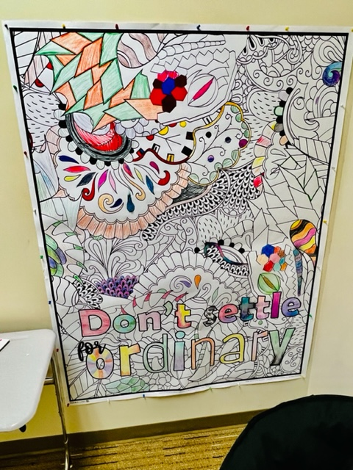
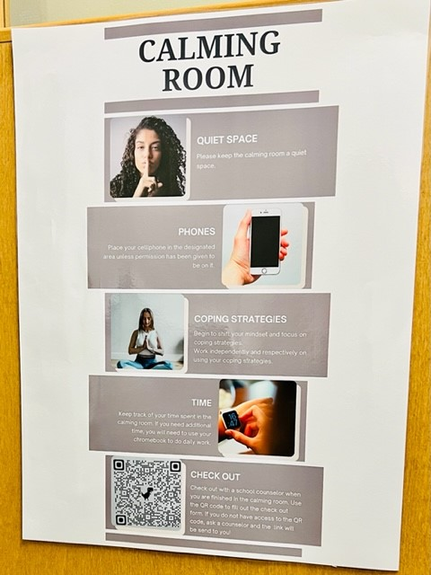
What it Might look like

Slide 17
When and where
Designated area within the building
In close proximity to Counseling Office or Social worker’s office (If applicable)
Utilized throughout the day (depending on staffing)
An area easily assessable to students

Slide 18
Getting buy-in from your administration
Show me the data. (Attendance, Referrals, Grades, behavior referrals)
Chronic Absent students (<10% absent from school)
Number of students with mental health diagnoses and/or seeing therapist that is adversely impacting their attendance, grades, and behavior in your building
Better grades, higher attendance, and fewer behavior referrals, make them look good☺ But more importantly, it creates an environment in which more students feel connected and safe

Slide 19
Evidenced Based Data

Slide 20
Evidenced Based Data

Slide 21
Evidenced Based Data

Slide 22
Evidenced Based Data

Slide 23
Evidenced Based Data

Slide 24
Evidenced Based Data

Slide 25
What Stands out?
97% of students’ primary reason for utilizing the room was due to Anxiety
47% of students chose due to Depression and Just needing a break from class
62% of students may not have attended school if the calming room was not available
A combined 90% of students stated they either “maybe” could focus better in class or did focus better in class after checking out of the Calming-Support Room
Close to 70% stated their anxiety level decreased after checking out of the Calming-Support Room
81% of students stated that there was a time in which they stayed at school because they could go to the Calming-Support Room

Slide 26
Describe the Calming/Support Room in one word!
peaceful
helpful
Calming
nice
tranquil
Quiet
Useful.
non-distracting
relaxing
pleasant
safe
Peace of mind
helpful
relieving
Kind

Slide 27
What’s Next
Delving Deeper into the data for students utilizing the Calming-Support Room
Academic, Behavior, and Attendance data
Advocating for this room to be staffed(social worker, therapist, part-time counselor)
Advocating for the Calming-Support Room to be a part of the MTSS process for students (Tier 2, Tier 3)
Creating additional Pre and Post Assessments for students to complete
Putting a Calming-Support Room in more schools!

Slide 28
Mr. Michael Allen Professional School Counselor
Ankeny Community School District
Southview Middle School
(515) 965-9635 extension: 55698
Michael.allen@ankenyschools.org

Slide 29
References
The Relationship Between School Attendance and Health: https://files.eric.ed.gov/fulltext/ED592870.pdf
Inmate Education Levels: https://federalcriminaldefenseattorney.com/inmate-education-levels/
How Chronic Absenteeism Affects Student Achievement: https://blog.edmentum.com/how-chronic-absenteeism-affects-student-achievement
Chronic Absenteeism in The Nation’s Schools: https://www2.ed.gov/datastory/chronicabsenteeism.html#four
The Anxiety workbook for teens: https://www.theministryofparenting.com/wp-content/uploads/2018/05/Anxiety-help-book-for-Teens.pdf

