Slide 1
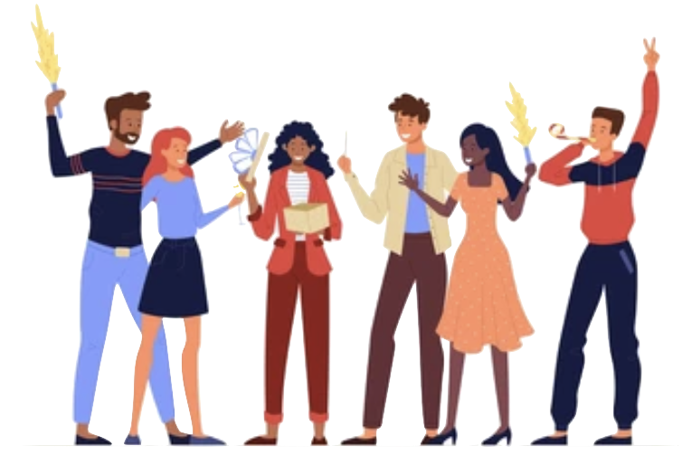
Building Relationships Through Story Circles.
Jewell Jones

Slide 2
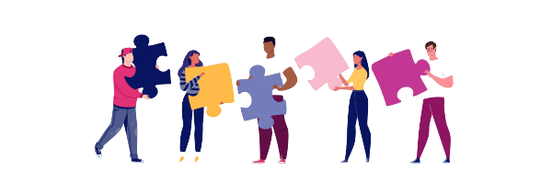
Building Connections
At a time where many things can divide us, we have to make a conscious effort to connect.
Two types of people - Socially Energised & Those Energized from Solitude
Both still need connection to balance wellness
Impact of covid on student behavior and engagement
Benefits:
Lowering anxiety and depression
Regulating emotions
Decreasing feelings of loneliness

Slide 3
Story Circle
A group of individuals gathering for the shared purpose of telling and listening to stories.
It takes courage and vulnerability to share our stories
Listening deeply to one another creates connection

Slide 4
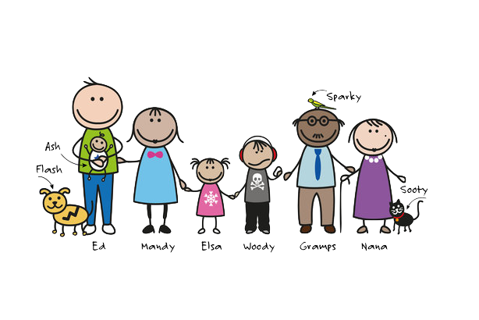
Informal Story Circles
Many of us have our earliest experience making connections through the stories told by family members.
These stories can provide us with our history and cultural background
Help to shape our perceptions, learning patterns, and the way we engage in the world

Slide 5
Circle Experience
Formally introduced through Imagine America Gather to Grow: A project designed to put together storytelling circles
Encouraging community members to grow together while sharing experiences
Artistic interpretations of story circles can connect the community

Slide 6
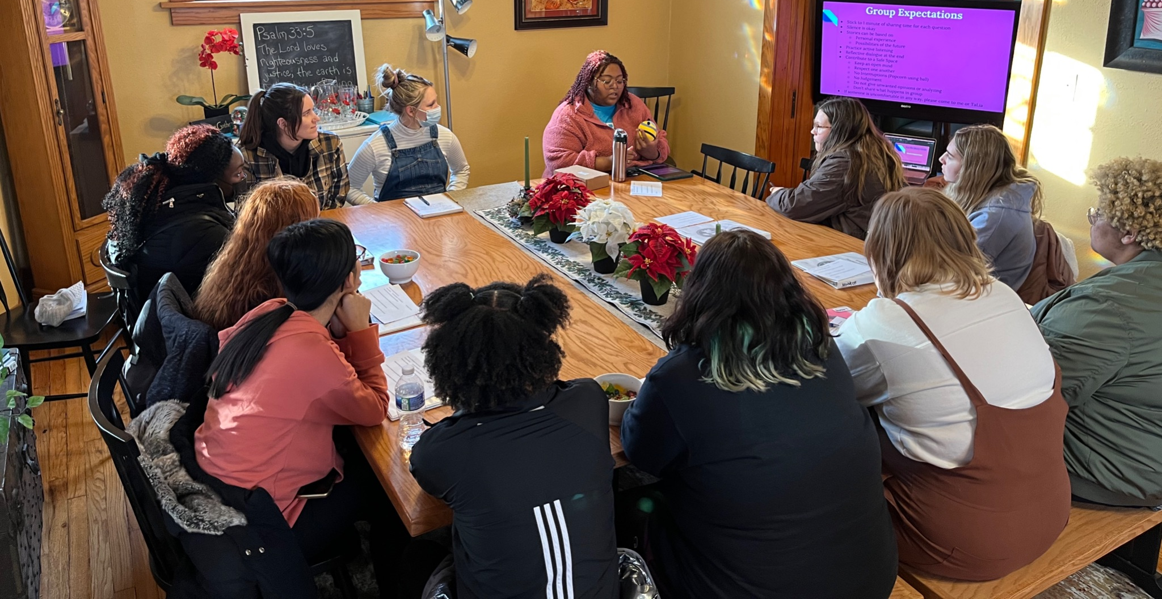
Using Story Circles
Space where students can express themselves freely
Flexibility to focus on lived experiences and hopes of the future.
Keep the Nature of the circle: to refrain from interruption or judgement
Based on a chosen theme (best in collaboration with students)
Facilitator provides prompts based on the theme that builds gradually
Students respond to their own interpretation of the prompts
Lead by example, participate by answering to prompts

Slide 7
Circle Expectations (Example)
Stick to 1 - 2 minute of sharing time for each question
Silence is okay
Practice active listening
Reflective dialogue at the end
Stories are based on authentic, personal, real experience / Hopes
Contribute to a Safe Space
Keep an open mind
Respect one another
No Interruptions or Judgement
Stories don’t need fixing
Don’t share what happens in group
If someone is uncomfortable in any way or would like to talk individually, please come to me after.

Slide 8
Implementation
Ideal for small groups 5 - 7 students
Full Sessions between 30 - 40 min (varies # of students & prompts)
Use pre surveys to determine a theme & post surveys to determine future interest
Develop 2-3 prompts based on the theme
1st prompt: Introduction to topic
2nd prompt: Moment of awareness/ something that stands out/fired up
3rd prompt: Hope for the future
To process in closing ask what they have learned about themselves and others

Slide 9
Outcomes
Self awareness- Exploring & Identifying Emotions
Social awareness - Appreciating diversity and respect for others
Relationship skills- Social engagement
Receiving validation can help increase self efficacy
Relieving stress with social support can allow focus on academics
The Funds of Knowledge students share can help Counselors understand student’s perspectives and how to meet their needs.

Slide 10
Alternatives
Groups work great for specific populations:
Those from different backgrounds needing to make connections
Students needing specific socio-emotional interventions ie self-esteem, bullying
Students of a minority group who need to connect with students with similar life experience
Introduce different forms of expression with circles
Coloring or puzzles while sharing stories works good w/ middle school
Many themes work best paired with educational portions
For time, try one prompt per session before or after an intervention.

Slide 11
Moment of Connection (Example Prompts)
Share a story about a time you recognized that your differences were your strength or weakness.
Share a story about a moment or experience that fundamentally impacted the way you look at the world.

Slide 12
"Friendship is based on the oldest
and most intrinsic human
awareness that there is more to life
than just ourselves."
-Christopher Hansard

Slide 13
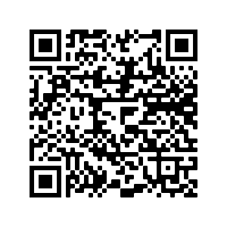
Resources
Gather to Grow-UNI
Example of a Full Story Circle: Women Empowerment
Why Social Interaction is Important For Young Children
Let’s Talk: Discussing Race, Racism , and Other Difficult topics
How to Use Funds of Knowledge in Your Classroom
Social Interaction in Schools: How It Works
Presenter’s Contact
Jewell Jones
Email: jwlljone@uni.edu

