Slide 1
EQ for You!
Social-Emotional Self-Care

Slide 2
Welcome!
Today’s Goals
About Me
What is EQ/KCG?
Why is it Important?
KCG breakdown

Slide 3
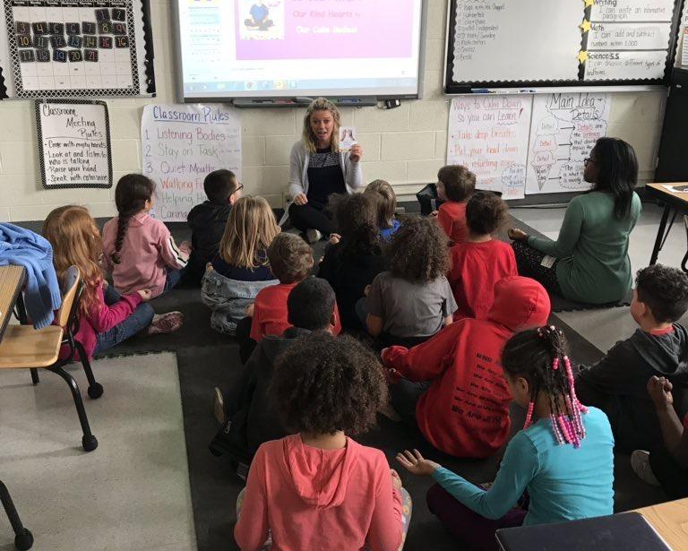


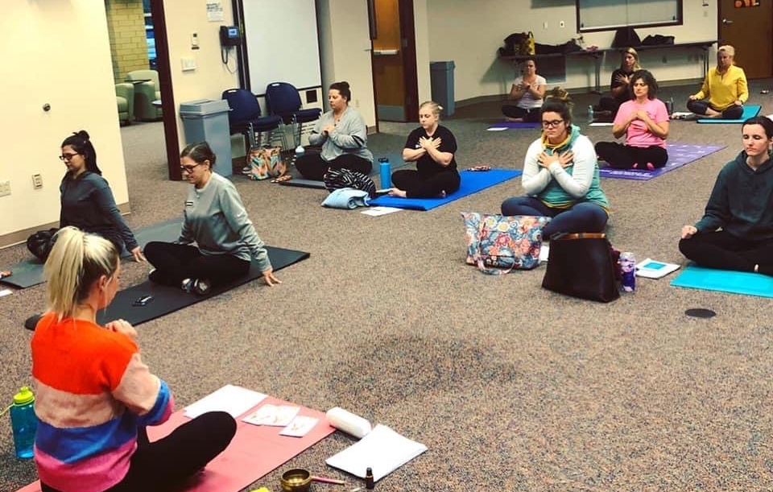
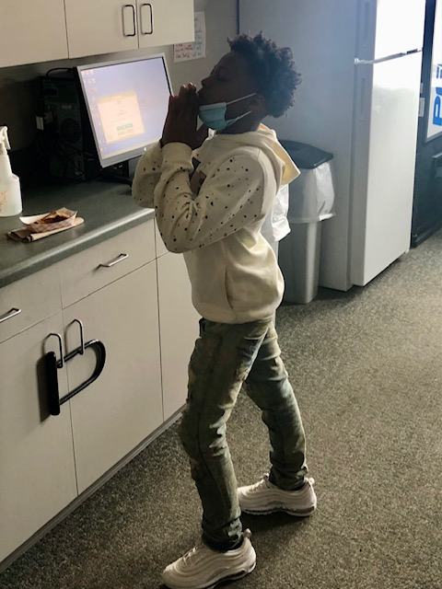

About me

Slide 4
Challenge to Change, Inc.
Mission: Through evidence-based yoga and mindfulness programming, Challenge to Change, Inc. provides preventative social and emotional skills benefiting the mind, body, and emotional state to people of all ages. We are committed to empowering learners to utilize mindful resources in order to navigate the world around them.
Yoga in the Schools
Trauma-Informed Yoga
  Homeless Youth Shelters
  Juvenile Detention Centers
  Trainings
KCG: EQ for YOU!
Continuing Education Courses
for Teachers
  Yoga for Teachers, Mindful Games,
Social-Emotional Learning
Studio Programming
  Camps, Classes, Workshops
  Online C2C Hub
Training Programs
  95 Hour Youth Yoga Teacher Training
  200 Hour Yoga Teacher Training
  300 Hour Yoga Teacher Training
Medical Mindfulness Department
  Holistic Healing for Medical Providers and Patients
Notes:
Quick Growth= we had to find ways to prioritize our values within a rapidly changing environment

Slide 5
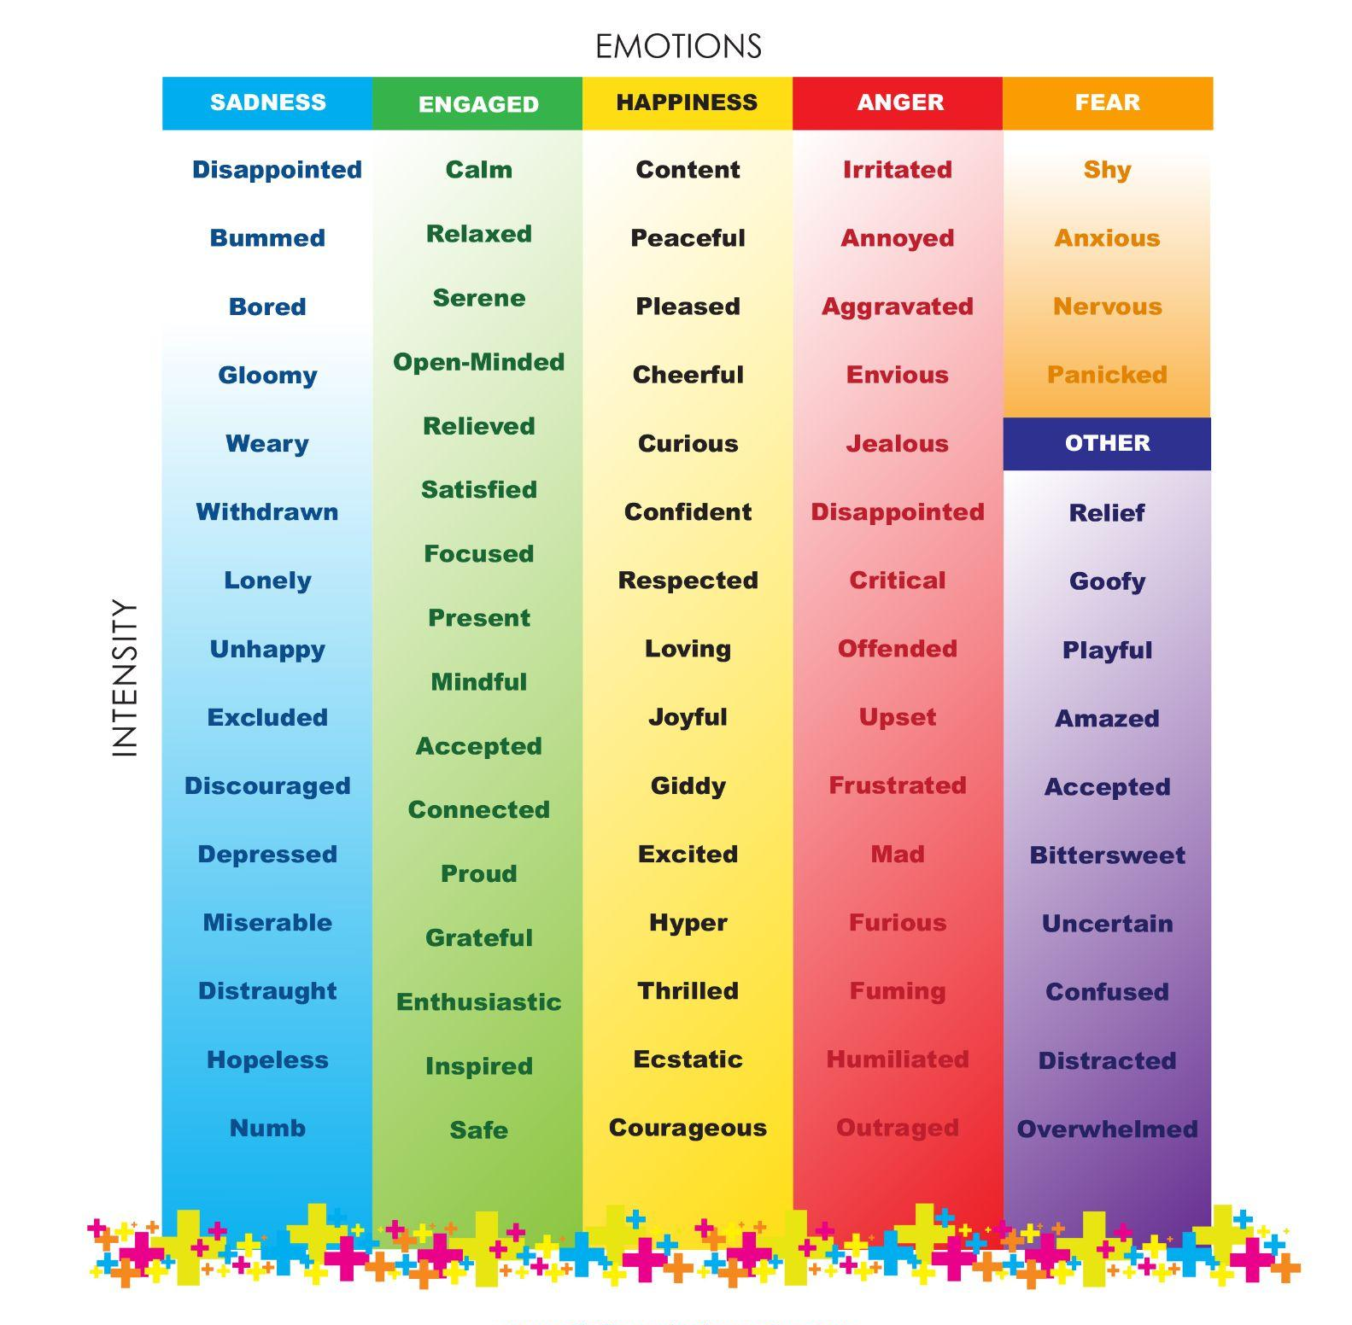

Slide 6
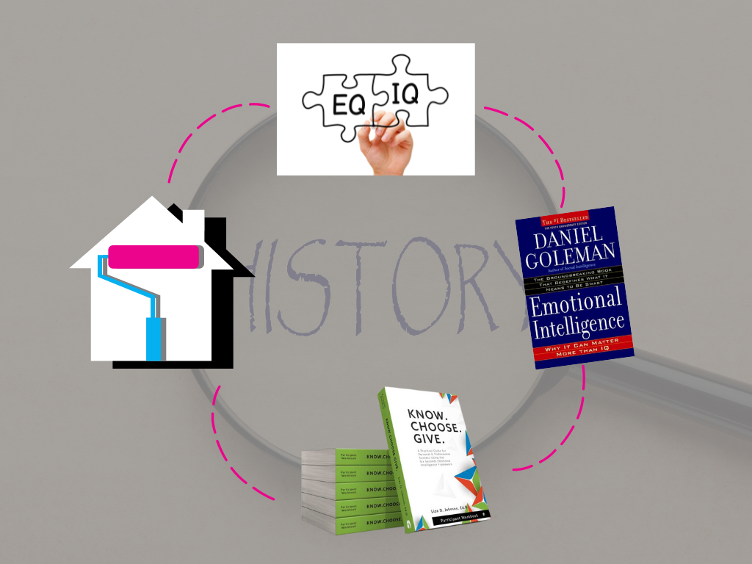
Video

Slide 7
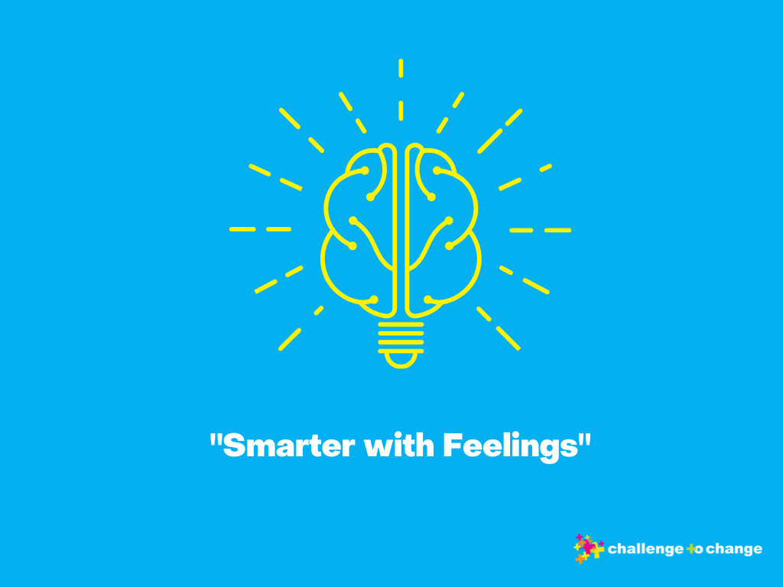

Slide 8
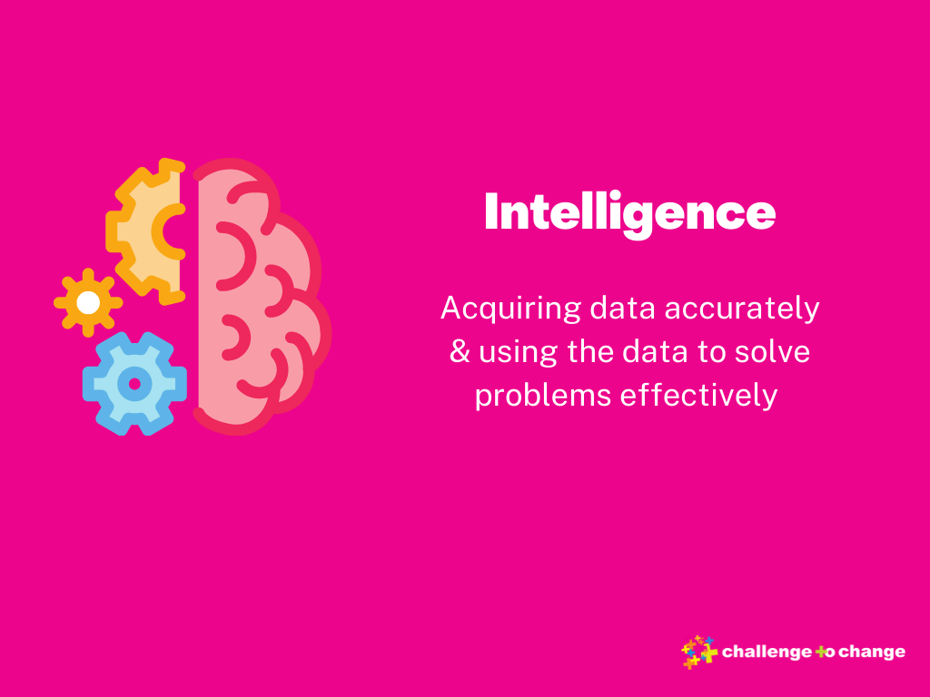

Slide 9
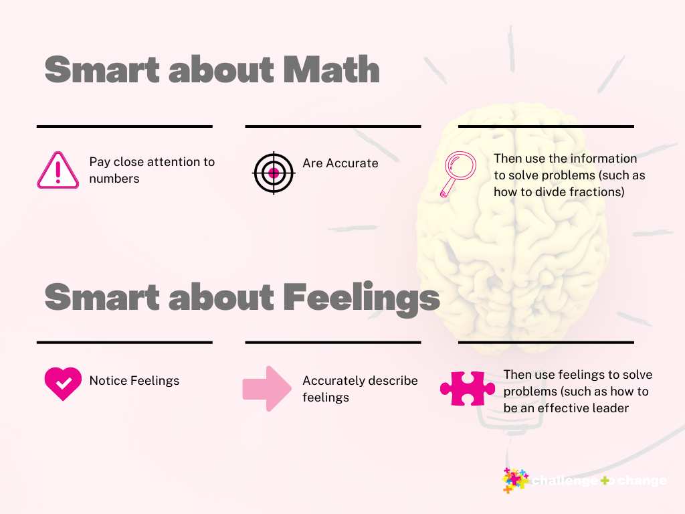

Slide 10
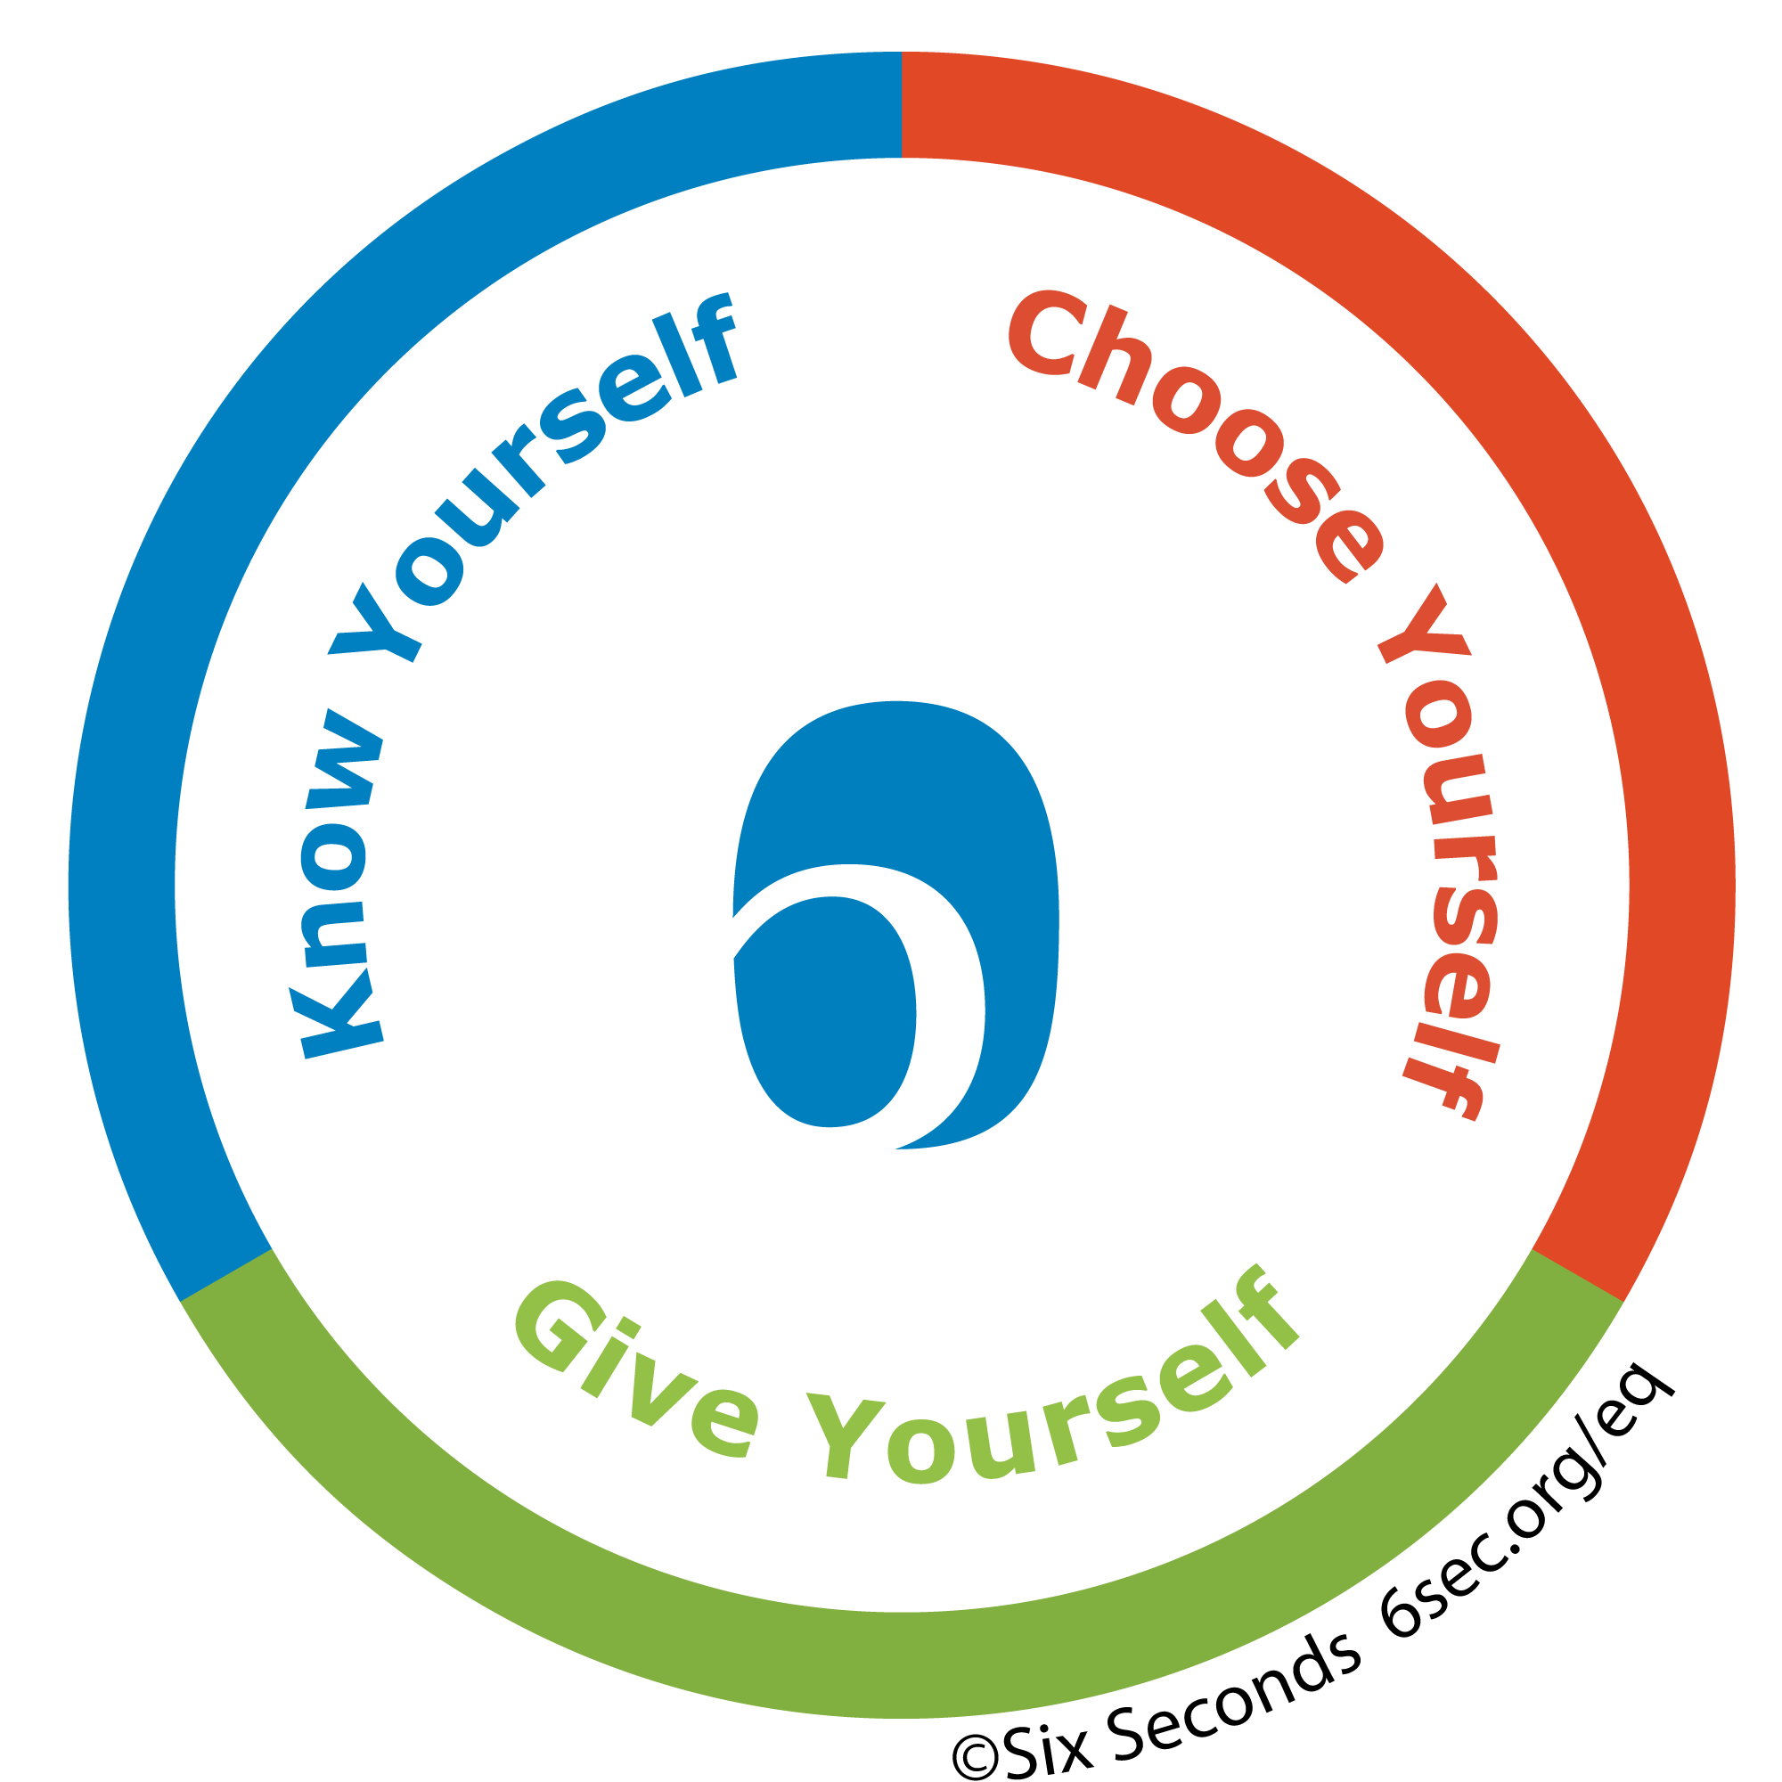
Emotional Intelligence (EQ) Facts + Why
EQ accounts for 58% of performance efficiency in all types of jobs.
A strong link has been found between academic achievement and many dimensions of EQ.
The World Economic Forum has identified EQ as one of the top 10 skills needed to thrive in 2020.
Key to having a successful relationship with yourself and others.
Numerous studies have linked emotional intelligence to critical life success factors such as:
  Better Effectiveness
  Relationships
  Wellbeing
  Quality of Life

Slide 11
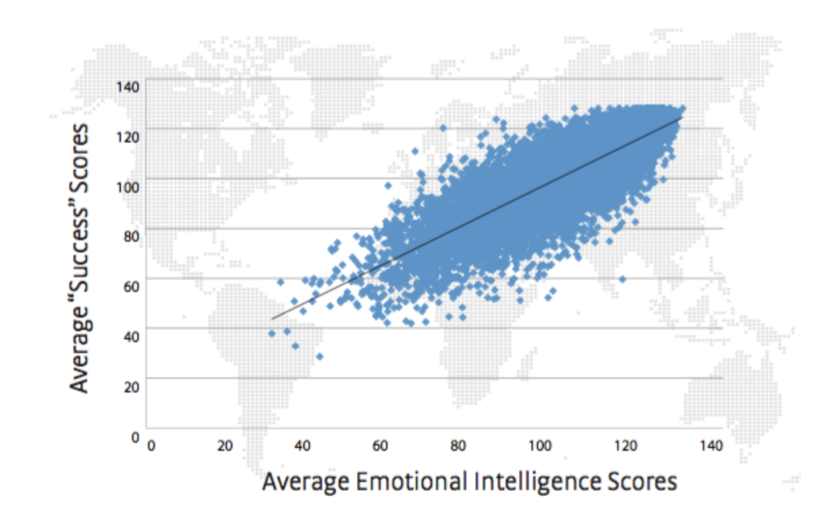
EQ in Education
Strong, positive relationship between emotional intelligence test scores and success scores.
  Graph: variables move together, up to the right
  Developing the learnable skills of EQ, statistically, a sound way to improve scores on success
    Safe environment
    Emotions acknowledged and under control
    Improved Attitudes and behaviors
    Better Academic Performance
    Less Negative Behaviors
    Reduced Emotional Stress

Slide 12
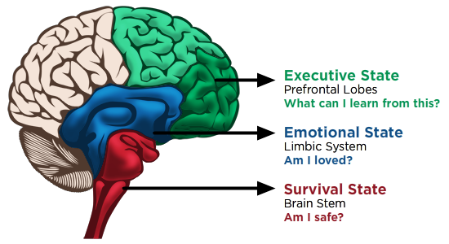
EQ: Brain Health & in the Workplace
Information is passed through each level of the brain before higher order thinking can take place *Emotions are 8 times more powerful than logic. WOW that actually comes from neuroscience.
Travis Bradberry. All our 5 senses have to come through our spinal cord which then goes through the limbic system then to the prefrontal cortex, which is our logic. So emotional Intelligence is using both brains and balancing them. Using both the emotional and the logic when making decisions.
  Financially the bottom line is increasing
  Career advancement
  Better employee engagement
  Reduce turnover
EQ skills are one key resource to support brain health. They have been found to improve well-being and brain health
  Finding and following purpose
  Exercising optimism
  Recognizing & naming emotions
  Practicing empathy
  Cultivating strong relationships
Graphic Credit: https://nebraskadeved.org

Slide 13
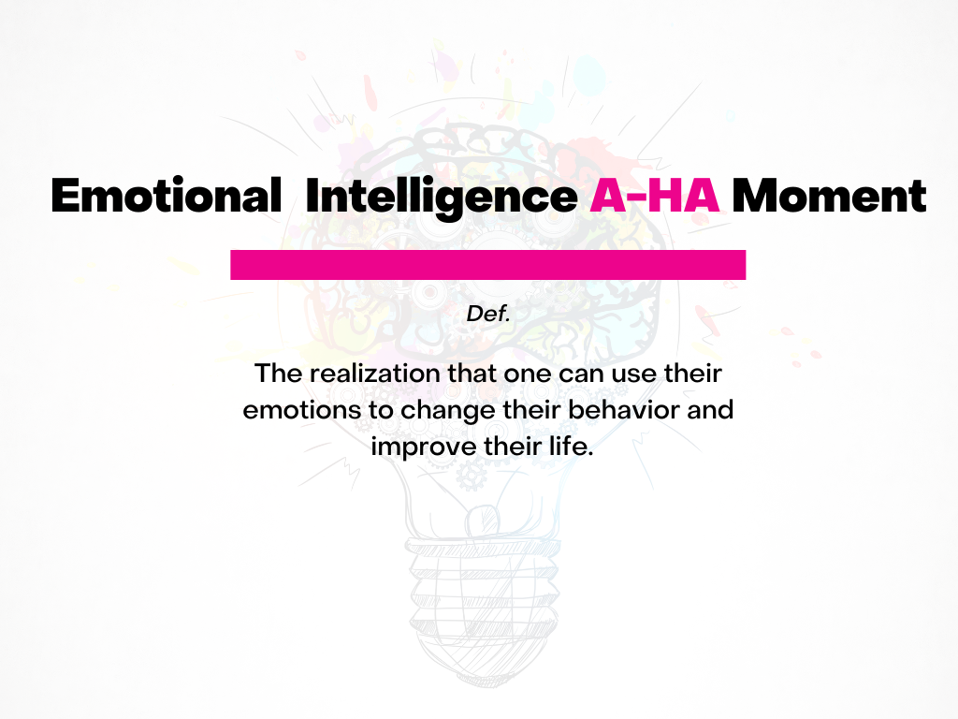
How can EQ enhance your personal life?
How can EQ enhance your work life?
How can EQ enhance your school environment?

Slide 14
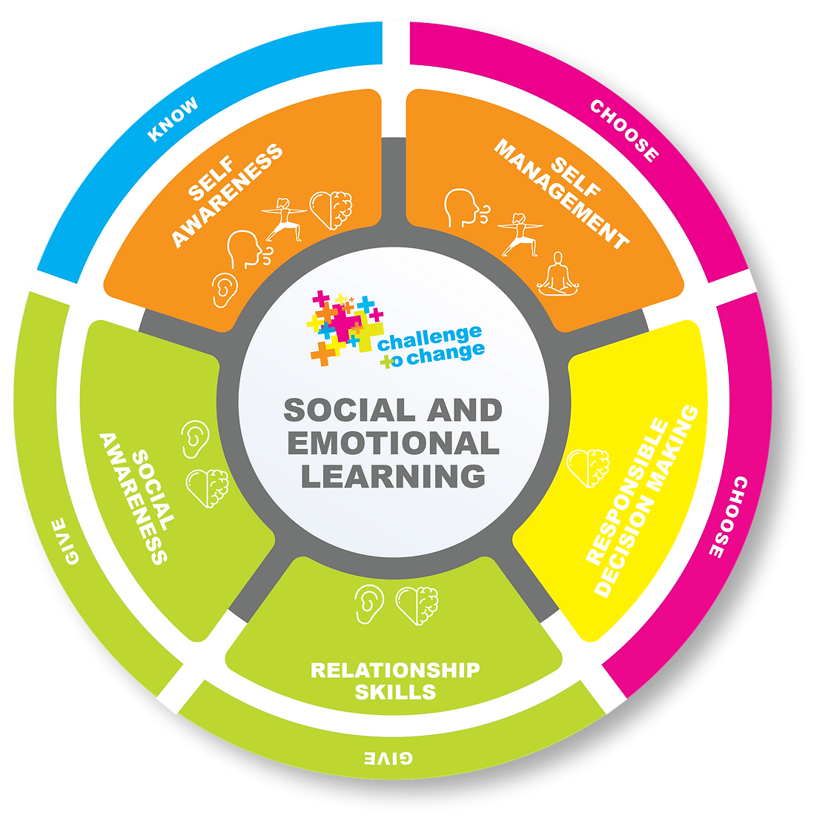

Know, Choose, Give
What am I feeling?
What are my options?
What do I truly want?

Slide 15
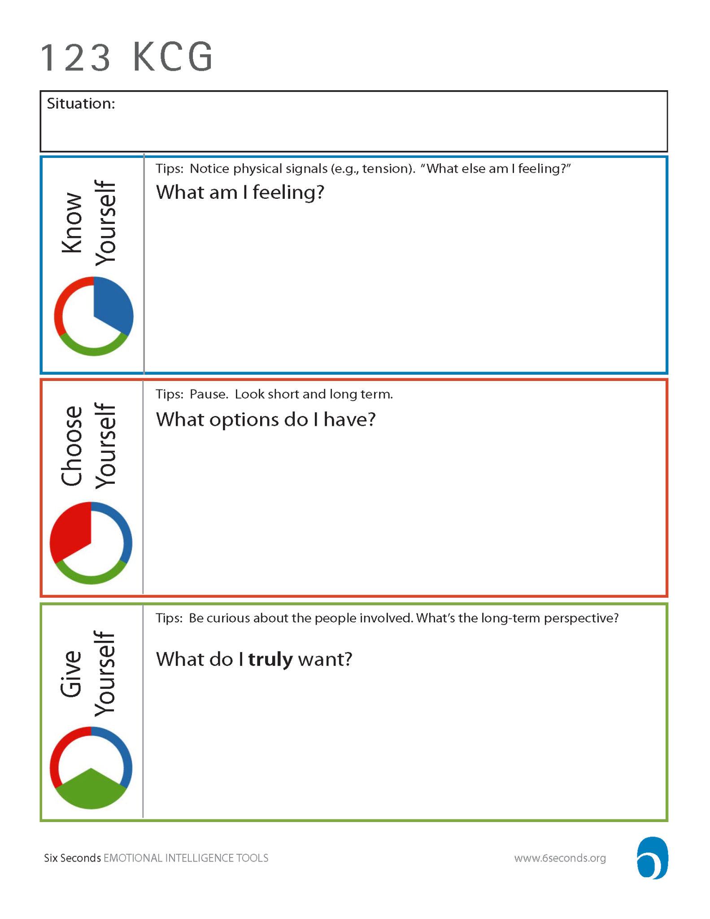
*Example
Ex. My Husband is mowing, trimming and laying mulch all the while the house needs decorated for Eloise’s 1st birthday party.

Slide 16
Know
The ability to clearly see what you feel and do.
Awareness of thoughts & feelings
“What am I feeling?”

Slide 17
*Example
Ex. My Husband is mowing, trimming and laying mulch all the while the house needs decorated for Eloise’s 1st birthday party.
Ex. Irritated, Annoyed, Stressed, Critical, Overwhelmed

Slide 18
Emotional Identification
How we feel on the inside can have a major impact on how we behave on the outside.
Emotions are reactions we have to the world around us.
Each emotion sends us a signal that tells us what seems to be happening in the world.
Emotions are data.
Emotions are a psycho-physical event, working automatically and chemically to affect our body and mind.
Emotions are contagious.
Emotions are absorbed and cycled out of the body in about 6 seconds.
How would understanding and managing YOUR emotions in healthy ways impact your relationships, teaching, leadership and school community?

Slide 19
Check-In
Increased emotional vocabulary= greater self-awareness.
Accurately describing our emotions equips us to better navigate them.
Communicate more effectively with others.
We learn to recognize emotions in ourselves and in others through check-in.
Opportunity to develop strategies to navigate emotions.
Check-in provides a “language” for our feelings.
Facilitated Check-In’s:
  Allow individuals to practice self-awareness by identifying and naming emotions in a supported environment.
  Allow facilitators/peers to understand where others are, encouraging social-awareness/relationship building.

Slide 20
Check-In Tools: Emotions Chart

Slide 21
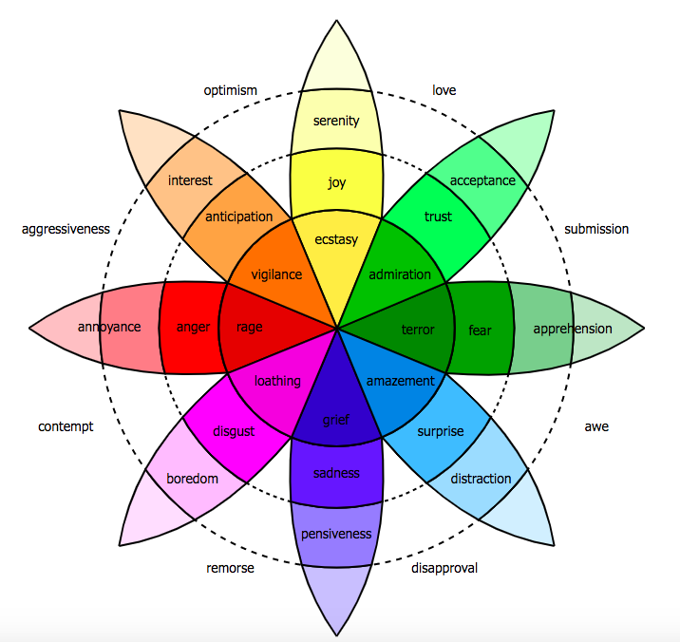
Check-In Tools: Plutchik’s Wheel

Slide 22
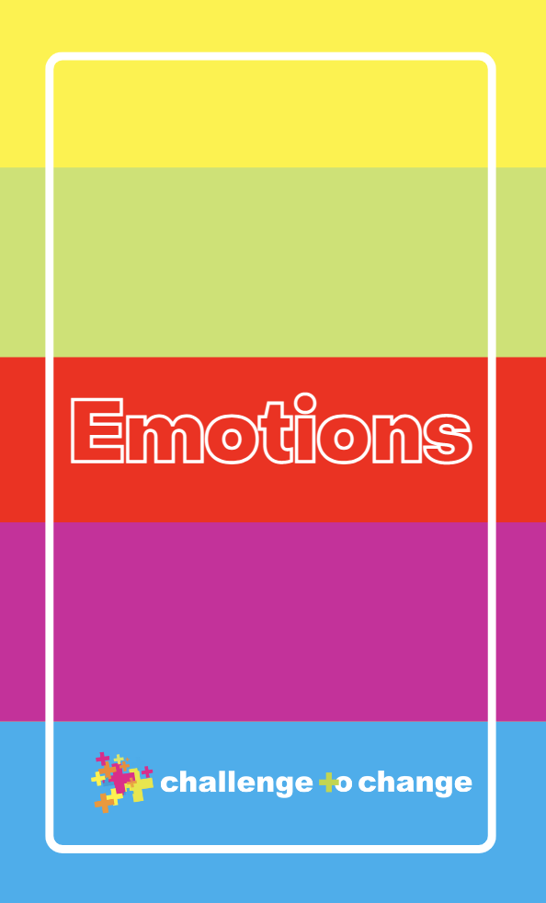
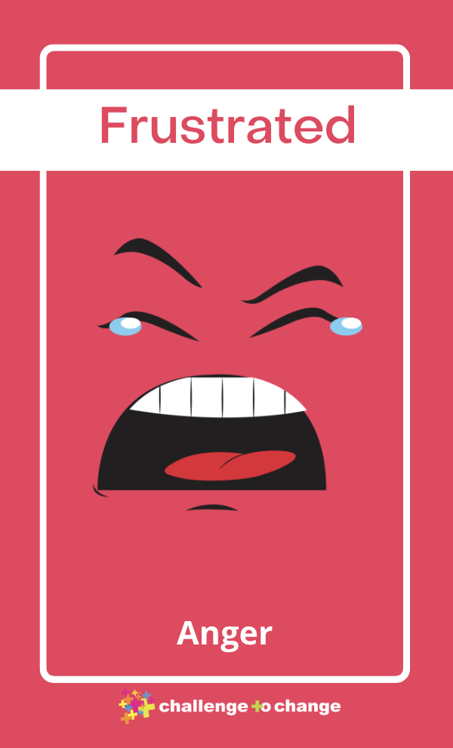
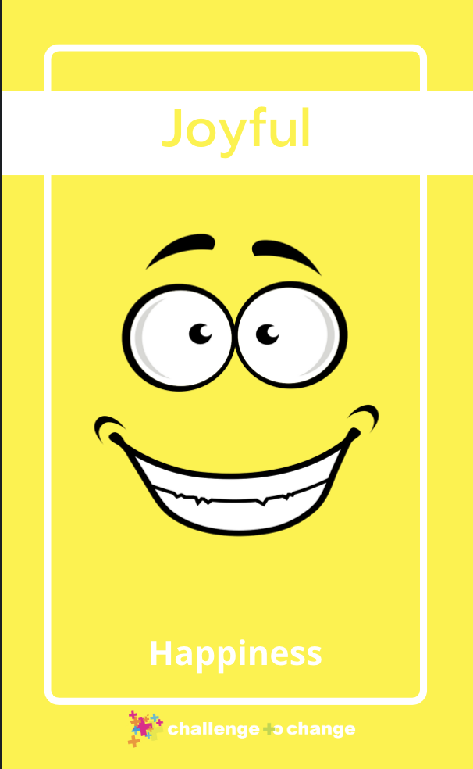
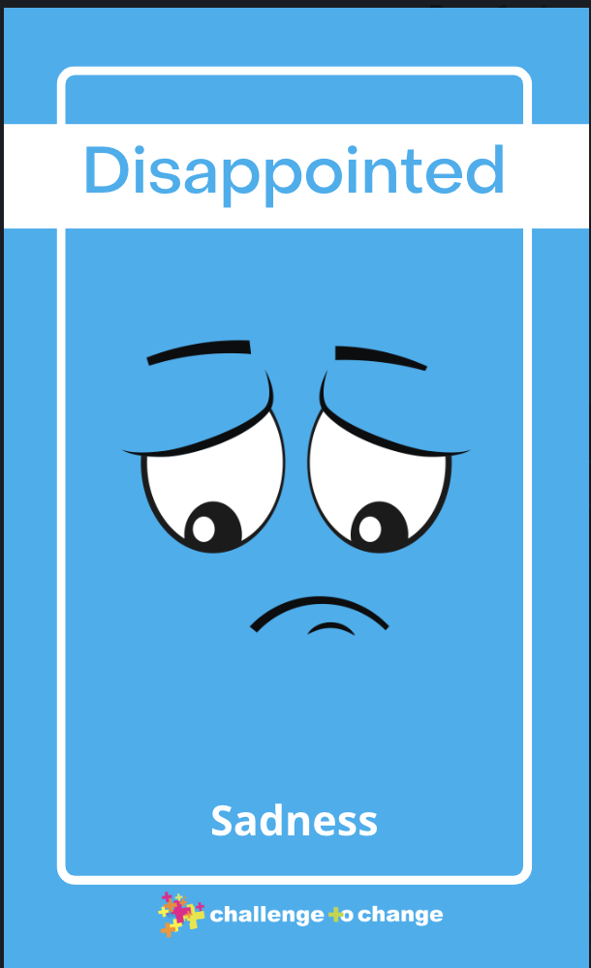
Check-In Tools: Emotions Cards

Slide 23
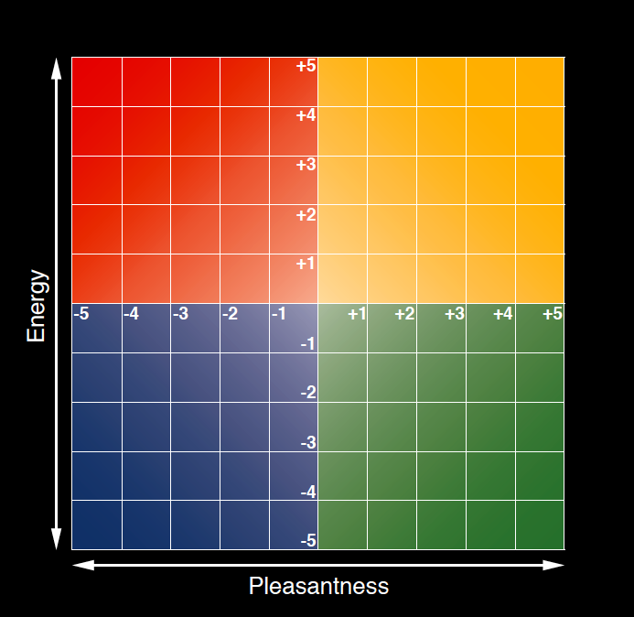
Check-In Tools: Mood Meter

Slide 24
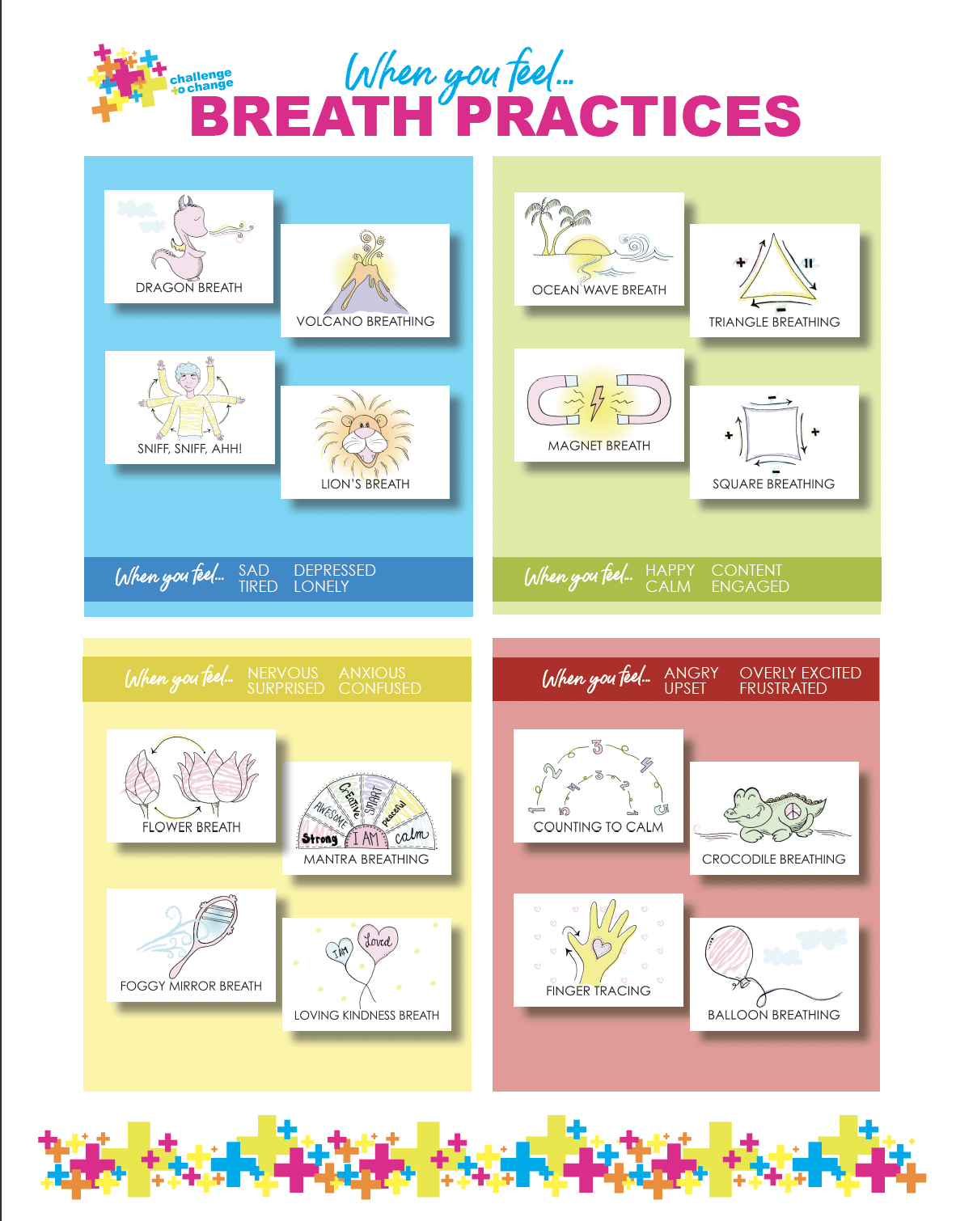
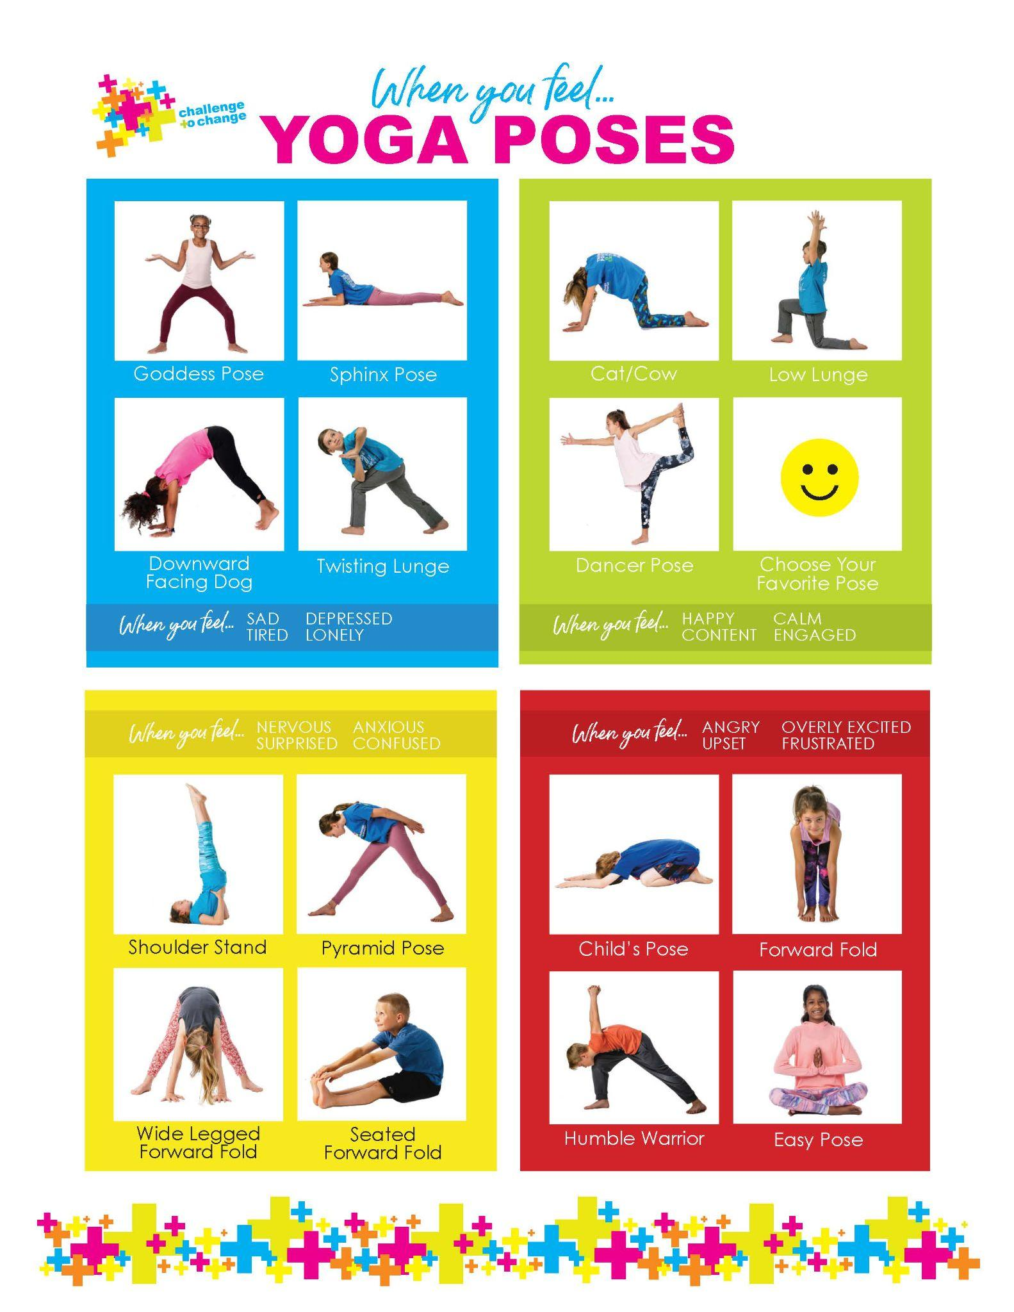

Check-In Tools: When I’m Feeling, Mudras

Slide 25
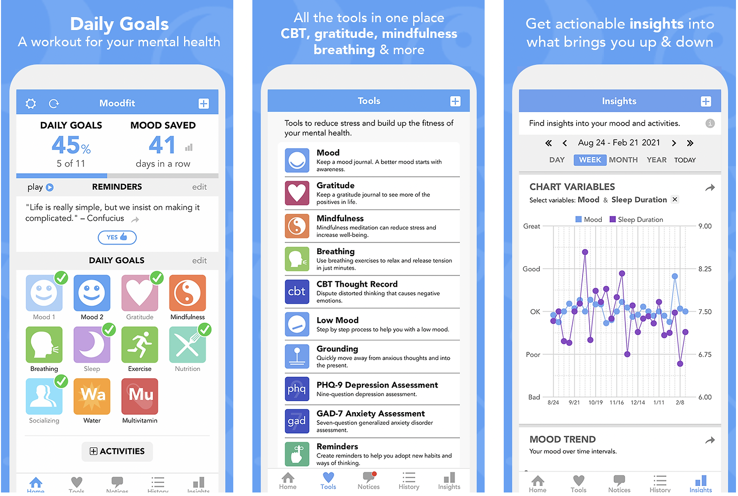
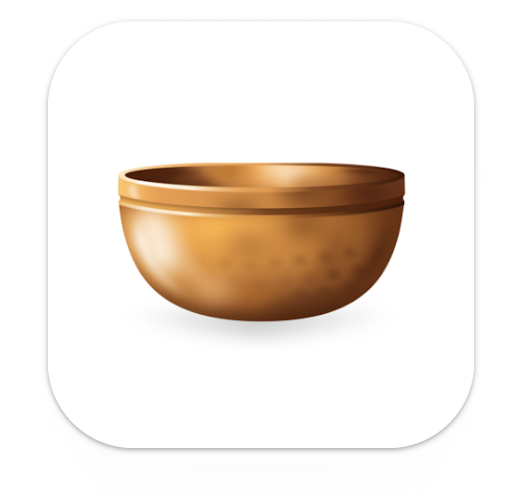
Check-In Tools: Apps
Insight Timer
Mood Fit

Slide 26
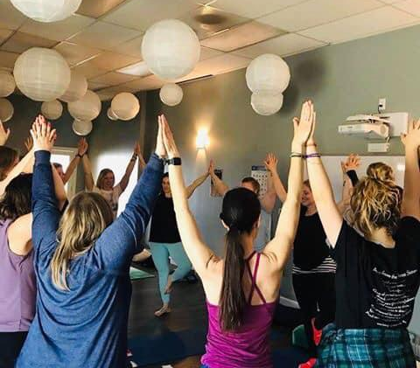
When/How to Use Check-In
Self-Check-In
  Throughout Day
  Journaling
Morning Meetings
1 on 1’s/Meetings
Conversation with friend, family member, colleague
Behavioral interventions/referrals
How can you incorporate check-in’s into your personal life? The educational setting?

Slide 27
Choose
The ability to PAUSE and take a deep breath in order to evaluate your options.
Proactive vs. reactive
“What choices do I have?”

Slide 28
*Example
Ex. My Husband is mowing, trimming and laying mulch all the while the house needs decorated for Eloise’s 1st birthday party.
Ex. Irritated, Annoyed, Stressed, Critical, Overwhelmed
Ex. 1) Go out to him right away and confront him about what he is doing is not helpful to me and talk about how I AM FEELING.
2) Pause and practice a mindfulness technique like gratitude. Give myself time to cool down before talking to him.

Slide 29

Emotion Regulation
Wet Cement
What is it?
  Regulating our own and others’ emotions.
  Applying EQ skills in order to increase, maintain, or decrease the intensity, duration, and/or quality of an emotion.

Slide 30
Emotion Regulation
Why is it important?
  Opens the door for intentional behavior and mitigates emotional reactivity.
  We choose the content, nature, and intensity of our emotions.
  Emotion regulation skills help us to improve our long-term wellbeing and enhance our relationships.
3 Types:
  Self-Regulation
  Co-Regulation
  Interpersonal Regulation

Slide 31
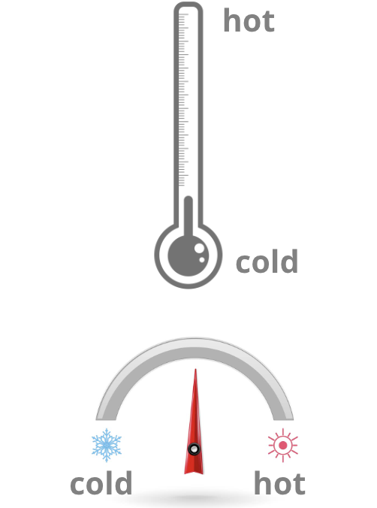
Thermometer vs. Thermostat
Thermometer: reacts to the temperature of the environment.
  Allow external factors to control their emotions.
Thermostat: regulates the temperature of the environment.
  Determine what their emotions are going to be.
  We can navigate, channel and transform those emotions to purposely act and connect with others.
Are you typically a thermometer or thermostat within your household or school environment?
What might you be able to do to be more of a thermostat within those settings?
Why is it important for you to be a thermostat in your home or school?

Slide 32

PAUSE
How might regulating your emotions help you as a leader/partner/mother/ father/friend?

Slide 33
Give
The ability to understand what’s really important to you.
Reacting in a way that will benefit all
“What do I really want?”

Slide 34
*Example
Ex. My Husband is mowing, trimming and laying mulch all the while the house needs decorated for Eloise’s 1st birthday party.
Ex. Irritated, Annoyed, Stressed, Critical, Overwhelmed
Ex. 1) Go out to him right away and confront him about what he is doing is not helpful to me and talk about how I AM FEELING.
2) Pause and practice a mindfulness technique like gratitude. Give myself time to cool down before talking to him.
Ex. 1) Raising happy, healthy, safe and loving children with my partner.
2) Create a welcoming and loving environment for myself, family and friends
3) Nurture and provide empathy in my relationship with that person

Slide 35
Empathy
Brené Brown on Empathy (3 min.)
What is it?
  Empathy is a deep understanding of and feeling of association with someone else’s experience.
  Daniel Goleman: “In today’s psychology, the word “empathy” is used in three distinct senses: knowing another person’s feeling, feeling what the person feels, and responding compassionately to another’s distress. In short, I notice you, I feel with you, so I act to help you.
  Not about “fixing,” but helping others to feel noticed, cared for, and understood

Slide 36
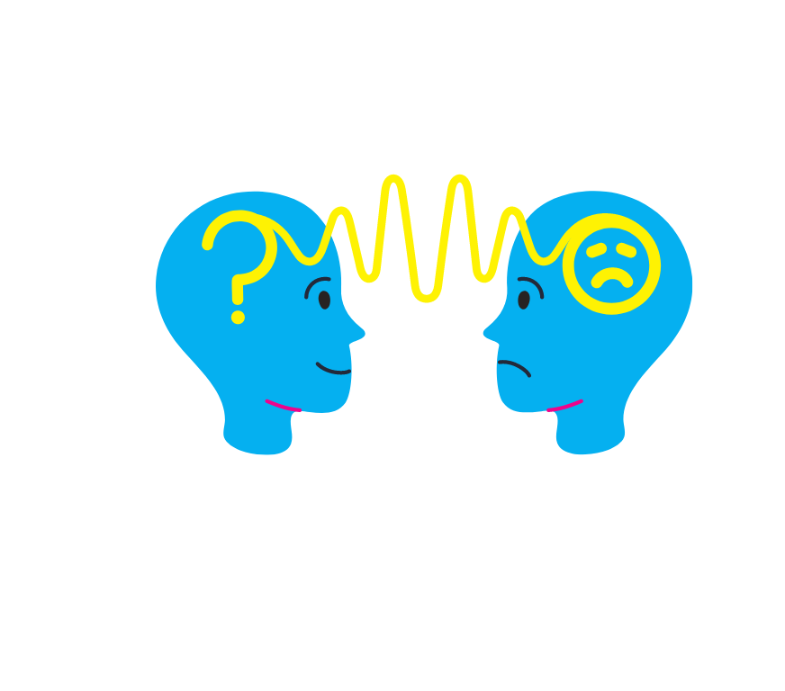
Empathy
Why is it important?
  Wired to feel empathy for one another.
  When we practice that capacity, we create deeper, more meaningful relationships.
Back to the “palladium rule”
Proactively develop and strengthen through intentional practice. Empathy allows us to relate to others’ feelings and see the world through their eyes. Benefit from their experience and mistakes, even if we have not faced those ourselves.
6 Seconds definition of “Raising Empathy” includes empathy towards oneself and others. Fostering deeper self-empathy for healthier and more productive outcomes.
What might empathy look like with your family? Colleagues? Students?
How do you demonstrate empathy and why is it important?

Slide 37
Reflective Listening
Listening without reacting, interrupting, or coming up with a response, no matter what is said.
Positive Body Language:
  Leaning in
  Making appropriate eye contact
  Using relaxed and open facial expressions
  Keeping an open body position (arms unfolded)
Example Statements:
  It sounds like you feel ___ because ___?
  That must have felt ___. It sounds like…
  Tell me more.
  I don’t quite understand what you are saying. Can you repeat that? Help me understand that.
  Are you saying that (state your understanding of what the speaker is saying)
  Mm, uh-huh, go on.
How might you practice this in your workplace or relationships? How does it show up?
If this is something you don’t practice, how can you start? If this is something you do practice, are you willing to practice new ways of listening?

Slide 38
*Example
*Example
Ex. My Husband is mowing, trimming and laying mulch all the while the house needs decorated for Eloise’s 1st birthday party.
Ex. Irritated, Annoyed, Stressed, Critical, Overwhelmed
Ex. Irritated, Annoyed, Stressed, Critical, Overwhelmed
Ex. 1) Go out to him right away and confront him about what he is doing is not helpful to me and talk about how I AM FEELING.
2) Pause and practice a mindfulness technique like gratitude. Give myself time to cool down before talking to him.
Ex. 1) Raising happy, healthy, safe and loving children with my partner.
2) Create a welcoming and loving environment for myself, family and friends
3) Nurture and provide empathy in my relationship with that person

Slide 39
Action Plan
Set one goal for how you may be able to implement something that you learned here within your home and/or work life.
How can you hold yourself accountable?
Share action plan with a neighbor.

Slide 40


Q & A
Thank You!
Jordan Turner, BA Education, E-RYT 200, RCYT
Yoga in the Schools Director
Email: jordan@challengetochangeinc.com
Facebook: https://www.facebook.com/challengetochangeyoga
Instagram: @challengetochangeinc

